Slide 1

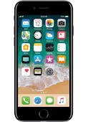





Pivotal Cloud Foundry
Cloud Native App
Beacon
request
customer
Spring Boot
favorites
promotions
favorites
Favorites, promotions
Pivotal Cloud Cache
Favorites, promotions
Beacon
request
Greenplum MPP
SFDC
Spring Cloud Stream
favorites
promotions

