Slide 1
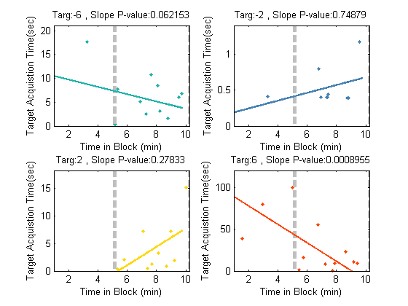
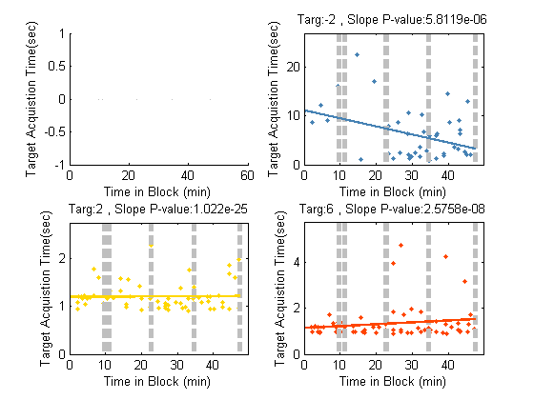
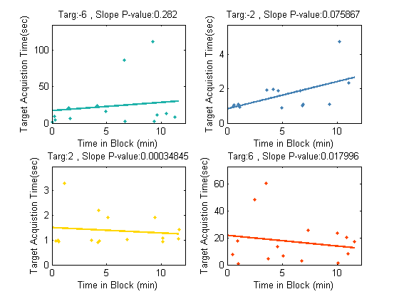
Patient 1, Late Learning (gh)
Starr Lab Collaboration: BMI Learning with Activa PC + S
Beta band used as input signal in one-dimensional neurofeedback task
3 Patients perform a single 1-2 hr session each
Decoders initially fit, fixed over session
Each patient shows performance benefit for at least 1 target that is difficult in the beginning and becomes easier (red arrows, note y axis)
Future task: Remove central targets (that subject gets by chance)
Patient 3, Late Learning (defijk)
Patient 2, Late Learning (i)
Target 6
Target 2
Target -2
Target -6

Slide 2
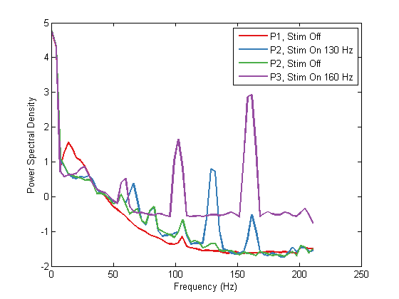
At-home BMI training:
Currently considering patients 1 and 3
Patient 1 shows strongest beta band peak (red)
Patient 3 shows considerably higher noise in signal (purple) making it possible that difficulty in improved performance is due to noise contamination of beta signal
IRB for at-home BMI was approved and a follow up FDA letter was sent to inform them of the new protocol (early Sept)
No changes needed to actual Starr lab FDA submission
Power Spectral Density of Patients 1-3
In-clinic neural control signals used were all beta band
frequency range but processing was different for different
patients:
Patient 1: Stim off, stream time-domain signal, calculate
beta power with MT method
Patient 2: Stim on, stream frequency-domain signal centered at beta frequencies
Patient 3: Stim on, stream time-domain signal, calculate beta power with pwelch method and use Kalman filter for cursor control instead of deterministic linear weighting
Conclusion for long term (at-home) training: Kalman filter on pwelch of time-domain signal works best with stim off (if comfortable for patient)

