Slide 1
At-Home Neurofeedback 05/17 – 06/08

Slide 2
Dates of Neurofeedback Sessions:
Sunday | Monday | Tuesday | Wednesday | Thursday | Friday | Saturday
 |  | T, 5/17 | W, 5/18 | R, 5/19 | F, 5/20
 | M, 5/23 | T, 5/24
 | M, 5/30
 |  |  | W, 6/8
Recording Details:
E10 – E11
BW: 2.5
Center Frequency: 12.5 Hz
Gain: 4000
Stim ON
Tasks:
Motor task: Movement from one target to another target after a tone
Neurofeedback only
Neurofeedback plus movement task: NF to top or bottom target, then 3x taps between targets

Slide 3
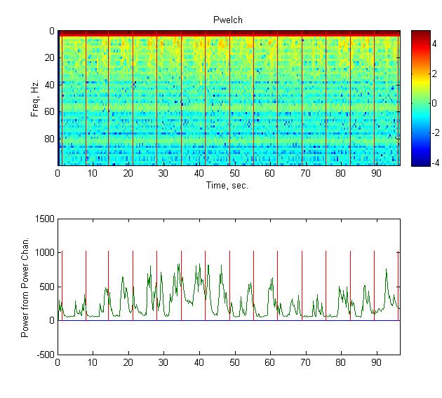
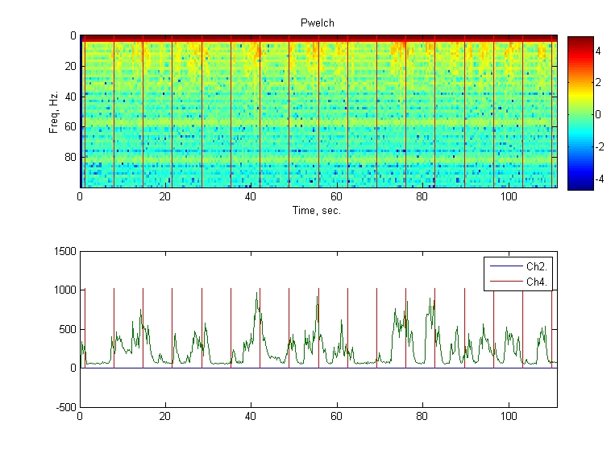
Ipsi Finger Movement Contra Finger Movement
Red is when tone is played, Green is power channel over M1, Spectrogram computed w/ pwelch

Slide 4
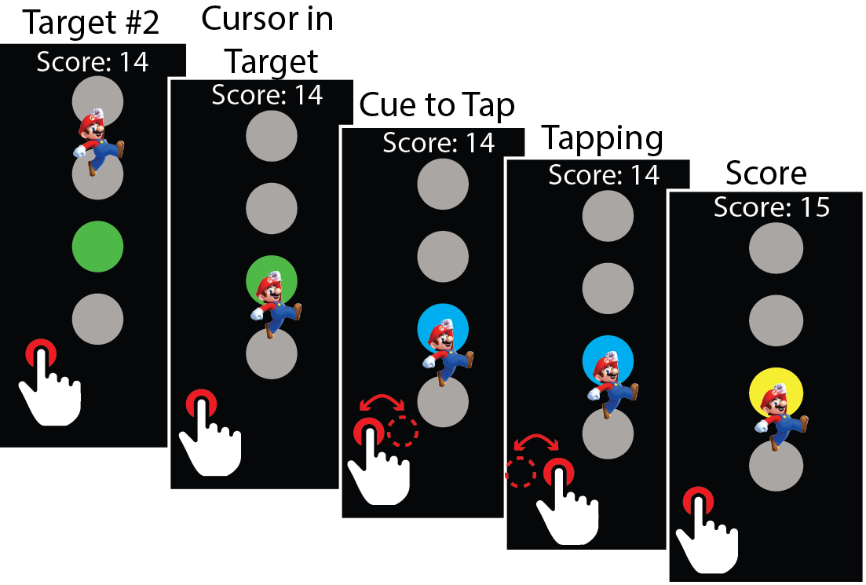
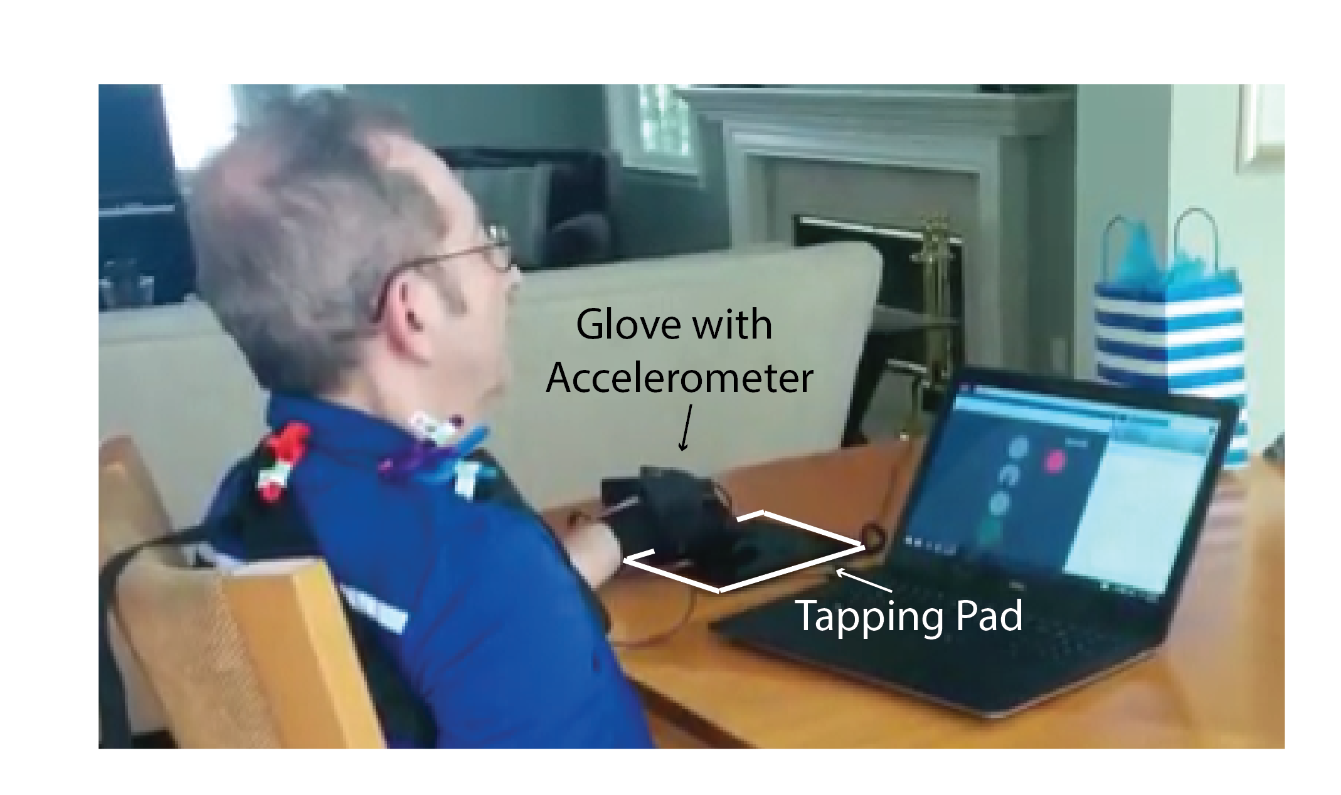
Neurofeedback w/ Tapping Task:
Fixed decoder: Beta power mean = 375, std = 75 (from Power channel)
Decoding:
Z-score current estimate of power (w/ mean and std)
Transform zscore to the y-axis of the screen (-8, 8)
Constant positional assist of 15%
NF Targets
Only TOP and BOTTOM target
Tapping:
Wearing glove w/ accelerometer
Must tap between targets 3 x to complete the trial (cap touch sensors detect when target has been selected)

Slide 5
Questions:
1. Does he learn?
Over days?
Within session?
2. What’s the effect of the week-long break in practice ?
3. Discernable effect of neurofeedback on following movement?
4. Mean beta trends with medication time or time of day?
5. How reliable is the setup?
Dropped packets throughout session?
6. Future Improvements

Slide 6
Presentation Notes
1. Colormap
TOP target is Yellow
BOTTOM target is Teal
2. ‘Consecutive’ Learning Data from Highlighted Days:
3. Neurofeedback = NF
S | M | T | W | R | F | S
 |  | T, 5/17 | W, 5/18 | R, 5/19 | F, 5/20
 | M, 5/23 | T, 5/24
 | M, 5/30
 |  |  | W, 6/8

Slide 7
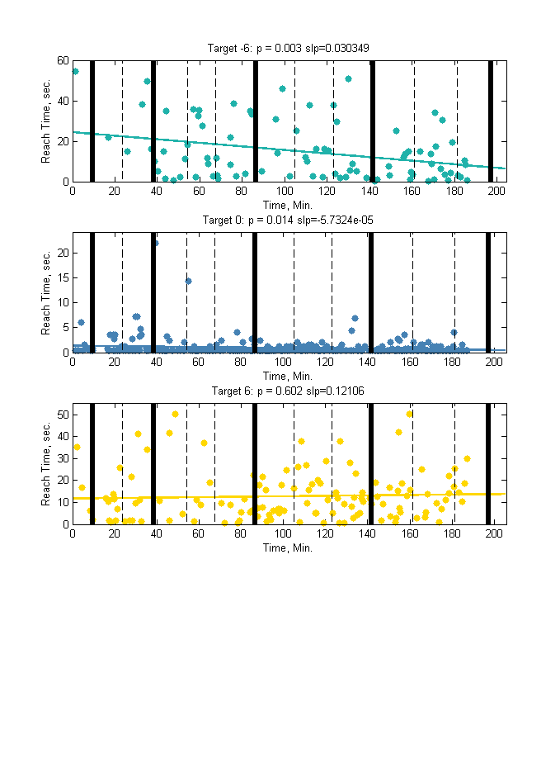
NF Learning Over Consecutive days

Slide 8
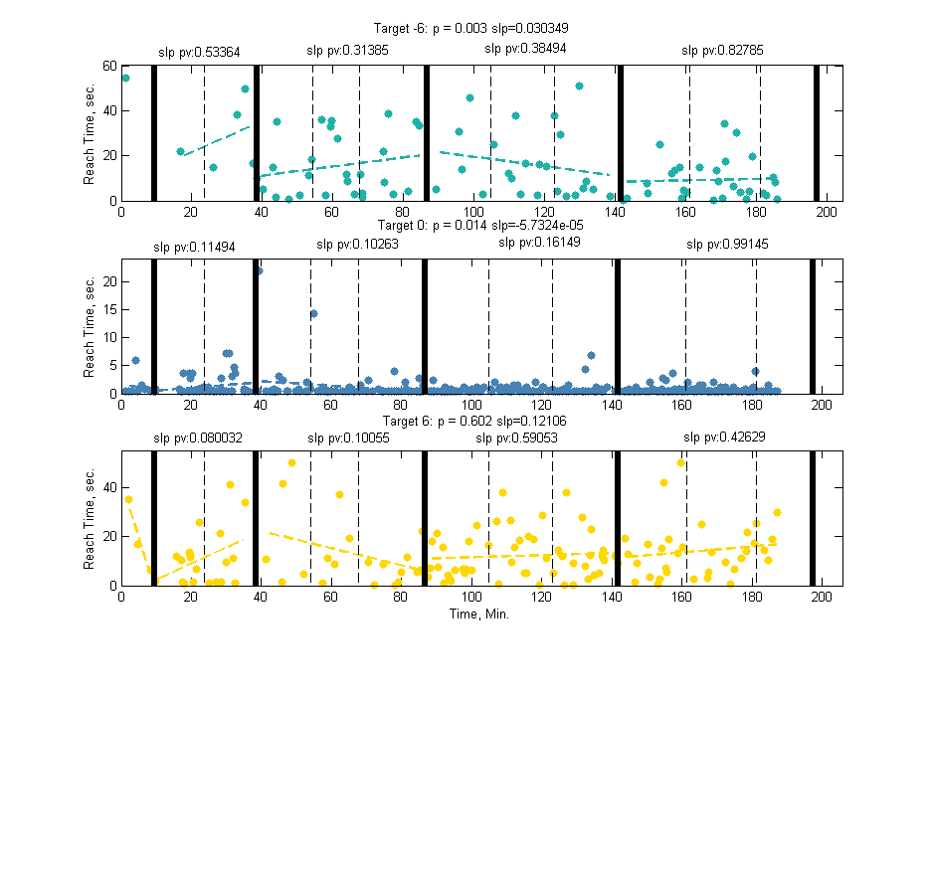
NF Learning Within Consecutive days

Slide 9
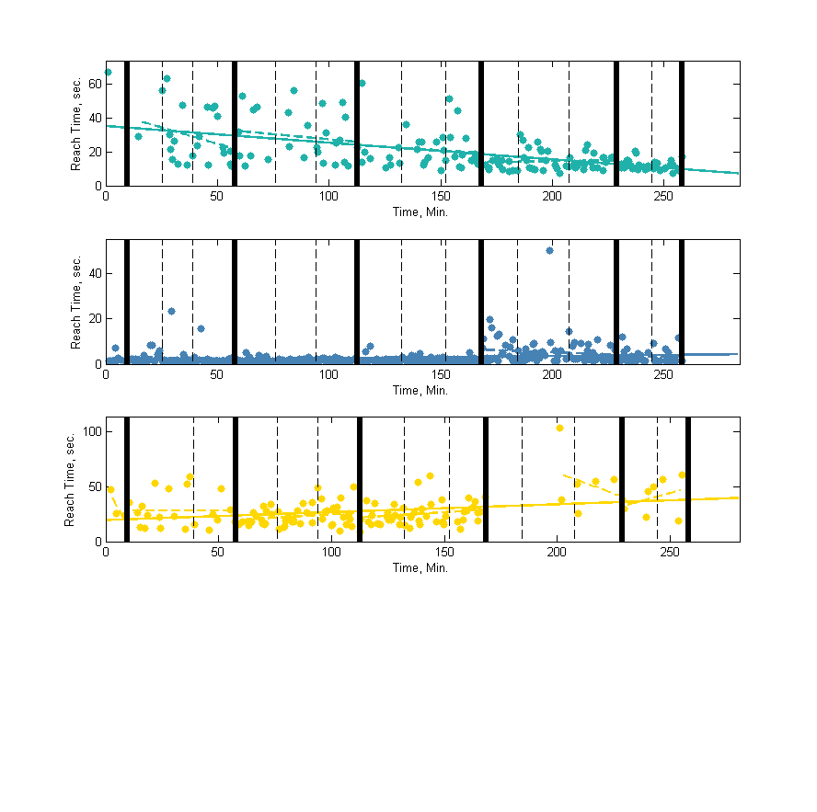
Adding Days with 1 week break: - Top Target is harder after 1 week break - Even middle target becomes harder
Weekend
1 week
1 week

Slide 10
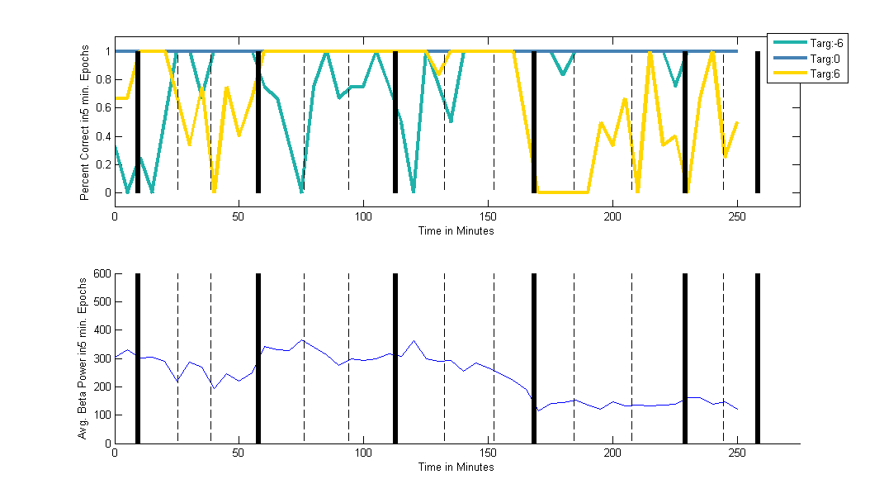
Is the 1 week break really a result of (un)learning, or can it be explained by a shift in baseline beta?
Percent Correct (% of Targets Achieved / Total Targets presented in 5 min window)
1 week
1 week
Slight increase in
Baseline beta
Reduction in
Baseline beta

Slide 11
Questions:
1. Does he learn?
Over days?
Within session?
2. What’s the effect of the week-long break in practice ?
3. Discernable effect of neurofeedback on following movement?
4. Mean beta trends with medication time or time of day?
5. How reliable is the setup?
Dropped packets throughout session?
6. Future Improvements

Slide 12
Questions:
1. Does he learn?
Over days?
Within session?
2. What’s the effect of the week-long break in practice ?
3. Discernable effect of neurofeedback on following movement?
4. Mean beta trends with medication time or time of day?
5. How reliable is the setup?
Dropped packets throughout session?
6. Future Improvements

Slide 13
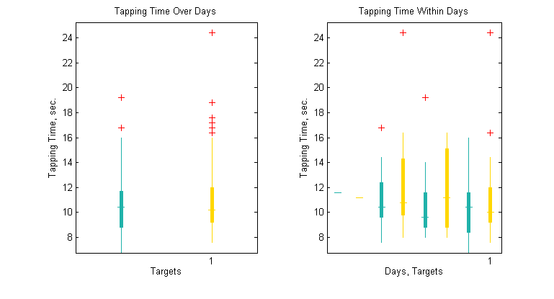
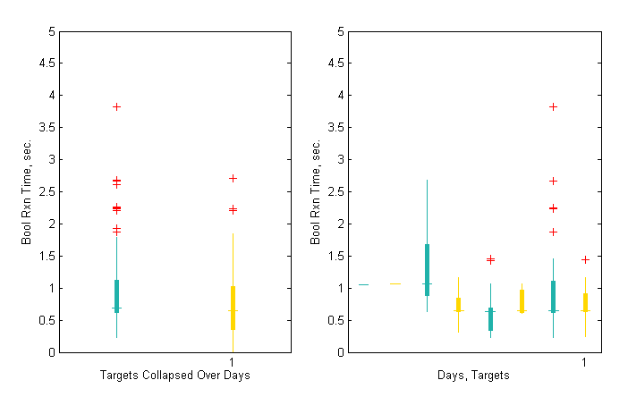
Kinematics from Tapping:
Total Tapping Time:
Reaction Time (Time to start first tap):

Slide 14
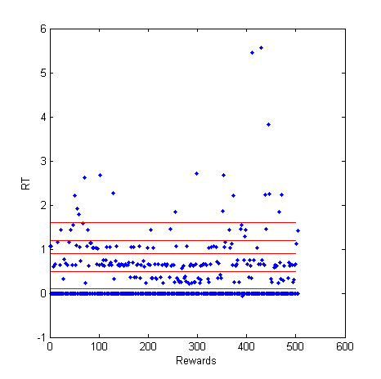
Reaction Time from Touch Sensor is Best modeled as discrete groups:
RT From Task | Number of Trials | Percent low | P (not from fair coin), Binomial Test
1.2 – 1.6 sec | 14 | 57% low | P = 0.791
0.9 – 1.2 sec | 33 | 45% low | P = 0.728
0.5 – 0.9 sec | 89 | 41% low | P = 0.1374
0.1 – 0.5 sec | 48 | 29% low | P = 0.0055
HIGH targets appear to be faster

Slide 15
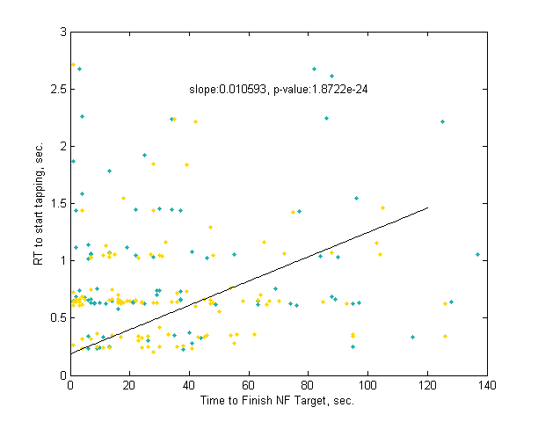
Difficulty of Beta Task explains differences in Reaction Time?
Indeed, harder NF targets (evidenced by longer time to finish NF target, axis) are associated with a longer RT (slope of linear regression sig. > 0)
4 Consecutive Days had harder low beta target (see slide 10) possibly explaining the faster RTs for higher target

Slide 16
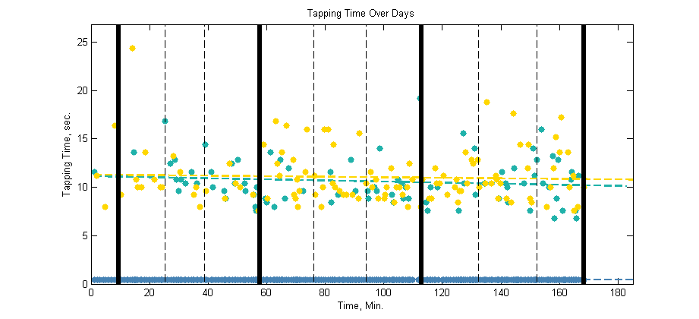
Is there a trend in tapping times ? If so, we could potentially exclude early data when he is less proficient at tapping

Slide 17
Questions:
1. Does he learn?
Over days?
Within session?
2. What’s the effect of the week-long break in practice ?
3. Discernable effect of neurofeedback on following movement?
4. Mean beta trends with medication time or time of day?
5. How reliable is the setup?
Dropped packets throughout session?
6. Future Improvements

Slide 18
Questions:
1. Does he learn?
Over days?
Within session?
2. What’s the effect of the week-long break in practice ?
3. Discernable effect of neurofeedback on following movement?
4. Mean beta trends with medication time or time of day?
5. How reliable is the setup?
Dropped packets throughout session?
6. Future Improvements

Slide 19
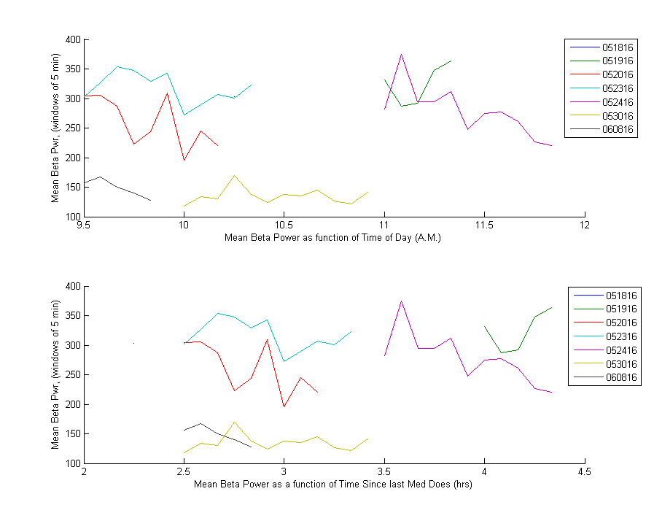
Beta power as function of:
Time of Day
Time Since last Med Dose

Slide 20
Questions:
1. Does he learn?
Over days?
Within session?
2. What’s the effect of the week-long break in practice ?
3. Discernable effect of neurofeedback on following movement?
4. Mean beta trends with medication time or time of day?
5. How reliable is the setup?
Dropped packets throughout session?
6. Future Improvements

Slide 21
Questions:
1. Does he learn?
Over days?
Within session?
2. What’s the effect of the week-long break in practice ?
3. Discernable effect of neurofeedback on following movement?
4. Mean beta trends with medication time or time of day?
5. How reliable is the setup?
Dropped packets throughout session?
6. Future Improvements

Slide 22
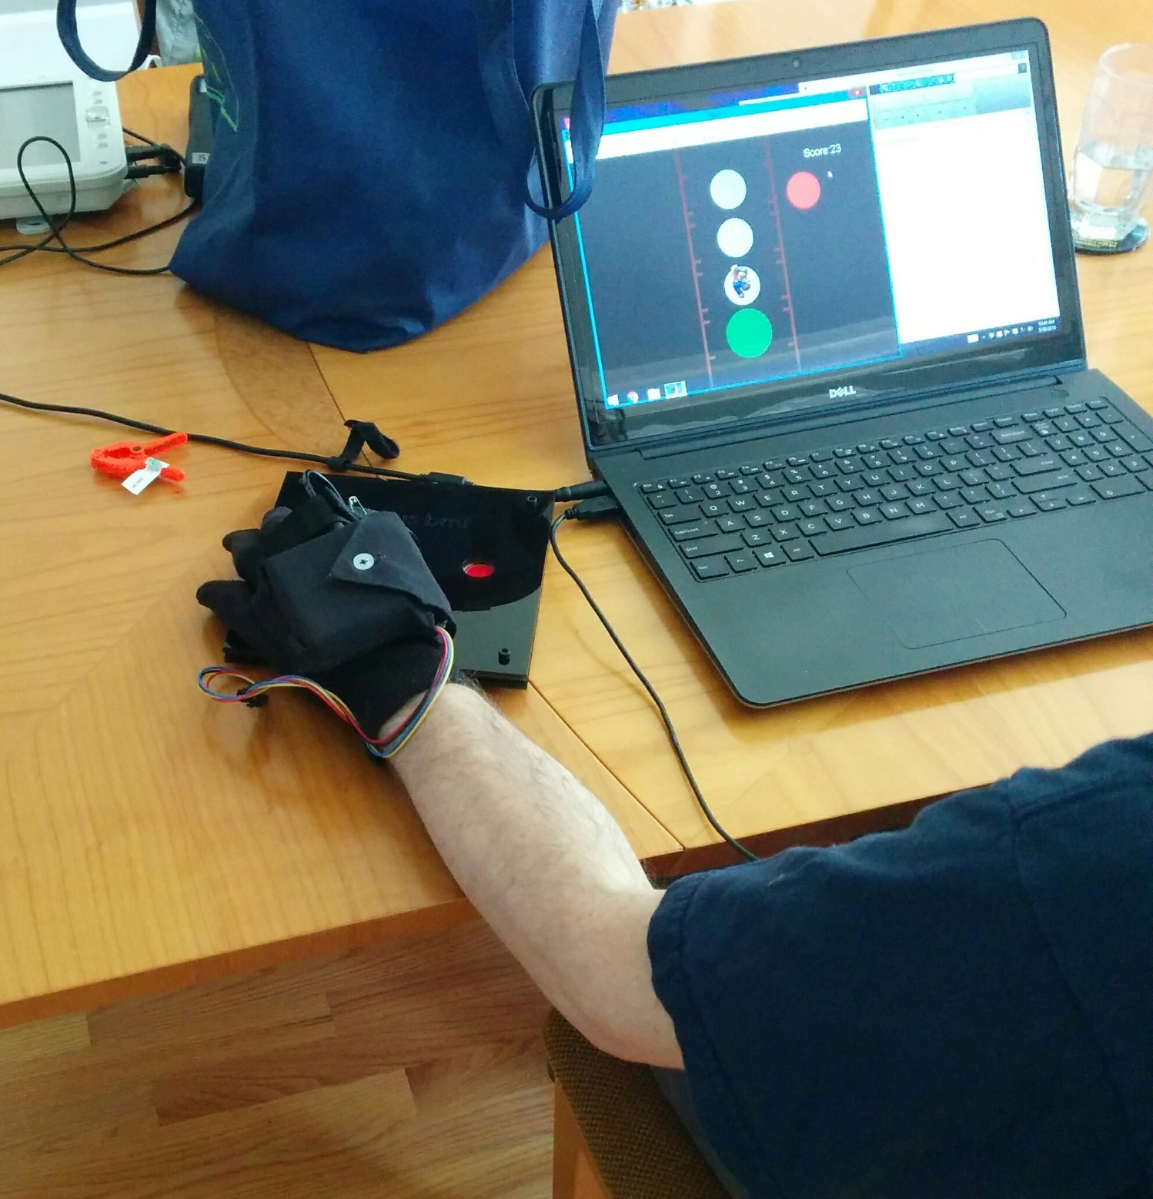
Future Improvements to System:
Engineering
Place Arduino on board instead of glove (heavy)
Add a way to secure tapping pad to table
Don’t use BT w/ Matlab (slow), just use serial connection for faster Fs and better power supply (USB port instead of batteries)
Better sleeve for holding Nexus – Velcro sleeve instead of strap + clamps
File writing mid-task (hdf files) instead of saving at end (and graceful failures) for data loss minimization
Push buttons on board instead of touch sensors (make easier to push buttons)

Slide 23
Future Improvements to System:
Patient Directions
No movement
Consistent strategy
Experiment Design
Stream STN beta power channel (no additional battery drain)
Reset decoder according to baseline @ beginning of each day
Auto-adjust assist level (when getting better, make task harder slowly) ?

Slide 24
Example Patient Strategies: Videos
1) Moving
2) ‘Piano playing’
3) ~Sleeping
4) Focusing
https://berkeley.app.box.com/files/0/f/8011975297/1/f_67419777141
https://berkeley.app.box.com/files/0/f/8011975297/1/f_66396078701

Slide 25
Conclusions
Possible learning
Variable beta levels day-to-day that require daily recalibration
Many engineering fixes to the current system for heavier use
Better patient instructions are needed

