Slide 1
At Home BMI Summary
Preeya Khanna

Slide 2
Overview:
10 Days:
Thurs-Fri (2)
Mon – Fri (5)
Mon – Wed (3)
Different times of day
Daily metrics:
A) Movement related desynchronization
B) M1/STN Beta
C) Left hand accelerometer sensors / pulse sensor
D) Right hand IMU
E) Mood assessments before/after training

Slide 3
Task:
Get Cursor
to Center:
Cursor
in Center:
Get Cursor
to Periph:
Cursor
in Periph:
Begin Finger-
tapping
Get Cursor
to Center:
TAP!
Tap for
6 seconds
Details:
Periph target timeout = 60 seconds
Reward sound after tapping

Slide 4
Decoder:
Calibrated from instructed delay task:
Calculate M1 mean/spread
Decoder is position decoder w/ smoothing (2 timesteps)
Occasionally add assist if performance is poor

Slide 5
Time to Top and Bottom Targets:

Slide 6
Beta Modulation to Top / Bottom Targets:

Slide 7
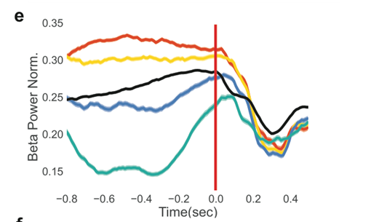
Beta Modulation to Top / Bottom Targets:

Slide 8
How Different is Beta during Low / High Target?
M1 Beta Power Distributions for
High vs. Low Beta Target

Slide 9
What About STN: Unlocks M1?
Background:
M1 leads STN in Beta oscillations
Apparent paradox: Levodopa therapy reduces beta power in STN but does not change power in M1
dopamine suppresses transmission of hyper-synchronous cortical events to the STN–globus pallidus network
Beta frequencies: M1 movement related beta is usually higher than levodopa-related beta reduction
Variable STN beta power reflects a cortico-thalamo-basal ganglia system that is less hyper synchronized
Weak correlation with M1 beta desynchronization
Notes:
5 min blocks
Cortical beta drives subcortical beta – resulting in hyper synchronization between these two.
Complicated – motor beta related to movement is in upper beta whereas levodopa reduces LOW beta in STN
Levodopa has not been conclusively shown to reduce cortico-STN coherence in the upper b frequency band
STN gamma LEADS motor cortex gamma (unlike beta)
Drop in STN beta correlates w/ RTs – STN beta must be desynchronized
Paradox: How can cortical beta stay the same but STN beta increase so much if Ctx drives STN?
Striatum does it (bc no dopa)
Plasticity changes => oscillatory amplification
STN/GPe interactions promote more beta
Imbalance in hyperdirect and direct pathway

Slide 10
Tapping Metrics?
Metric | High vs. Low Target
Movement Onset Time | Low target faster MOT
Spectral Peak Power | Low target more power
Spectral Peak | Low target faster
RMS Angle | Low target higher
RMS Angular Velocity | Low target higher
# Discrete Taps | More for lower target
TODO:
Assess LH movement w/ tapping
Split by Open vs. closed first

Slide 11
Other Metrics
Before NF
After NF
Mood (self-reported)
TODO:
HR

