Slide 1
Gamma & P.A.C Measurements with Nexus-E: A study in compression and stim effects

Slide 2
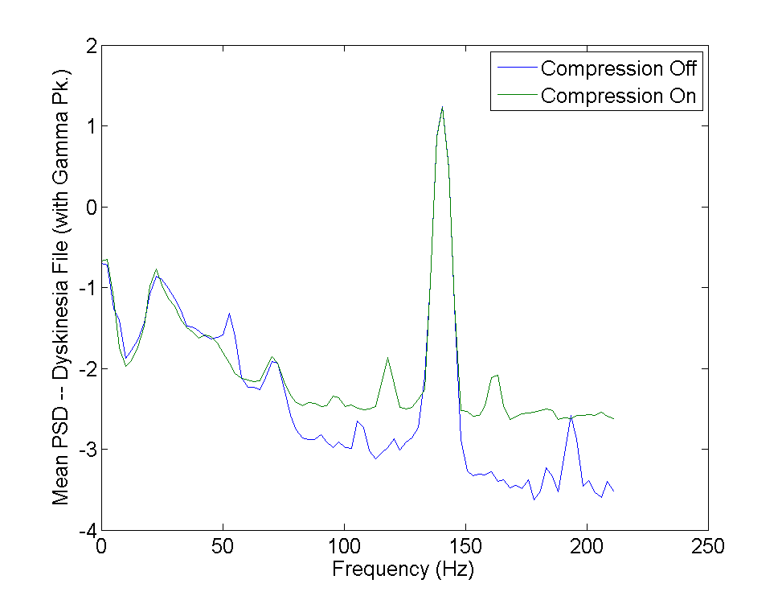
Mean PSD during Dyskinetic Part of File
Presence of peak at 70 Hz
Stim On (4V, 140 Hz)
Testing streaming with compression off and compression on

Slide 3
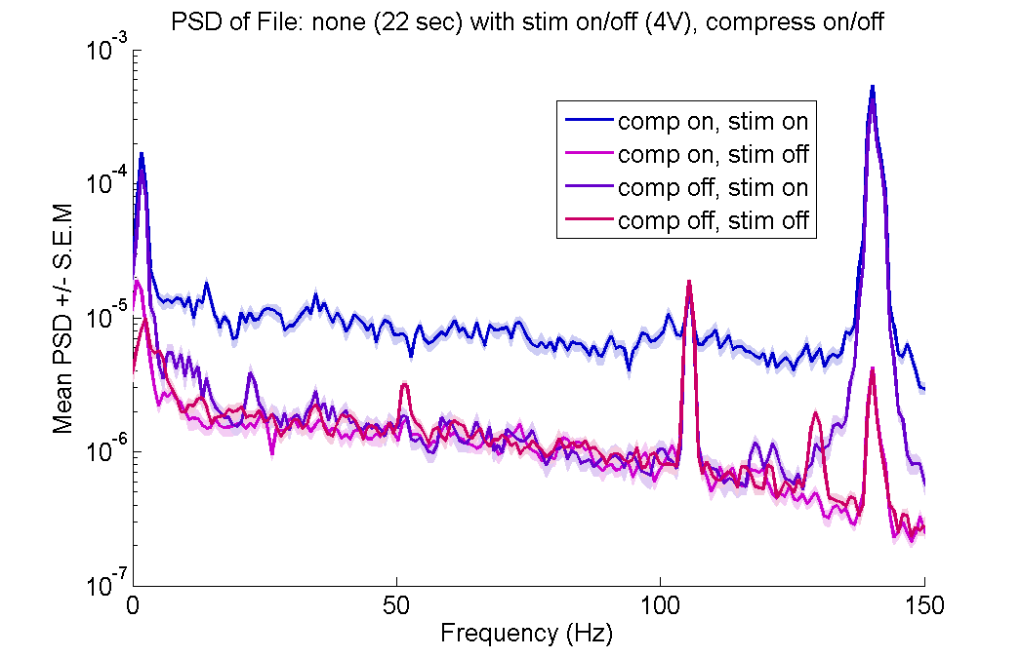
Baseline PSD without Pxx channels on (streaming from time domain data): No File playing in Saline Tank

Slide 4
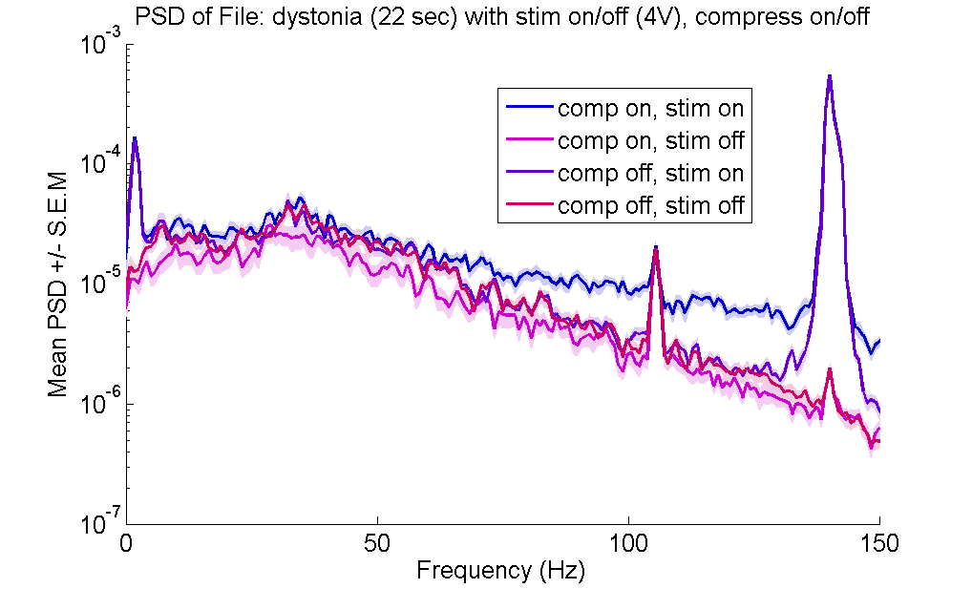
PSD without Pxx channels on (streaming from time domain data): Non-dyskinesia File (no 70 Hz)

Slide 5
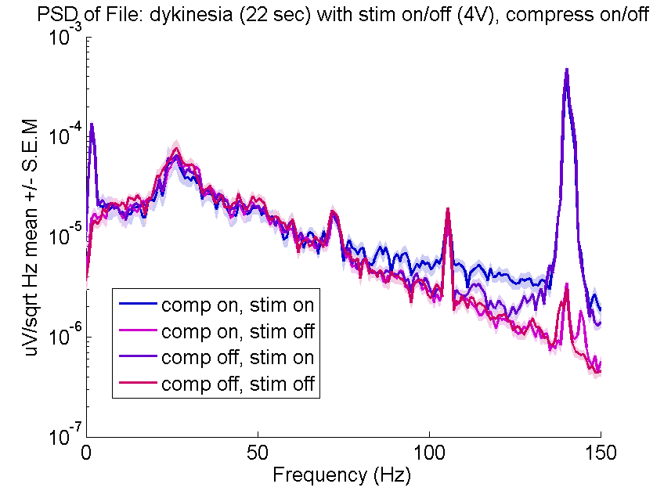
PSD without Pxx channels on (streaming from time domain data): Dyskinesia File (70 Hz)

Slide 6
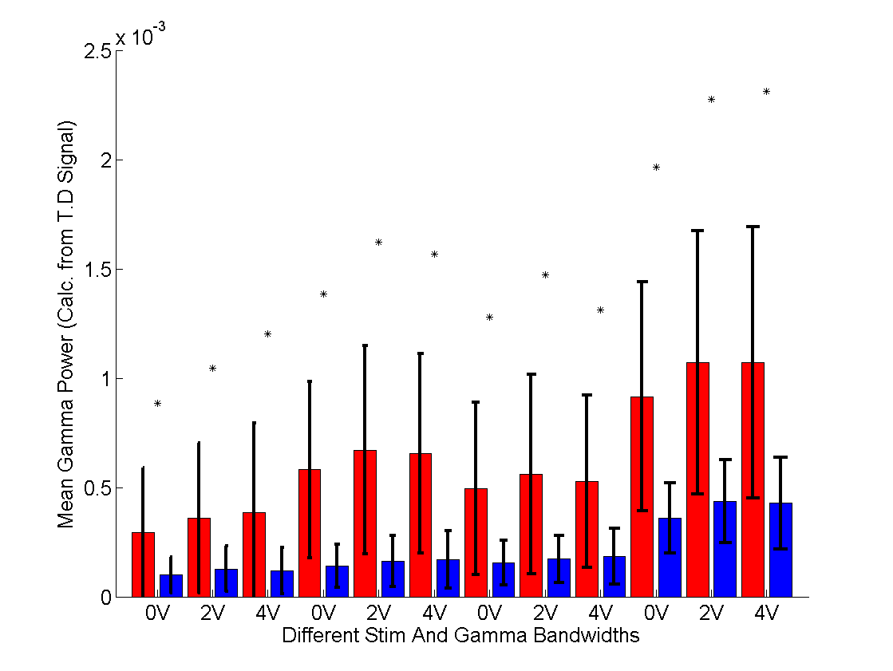
Trying different Gamma Configurations
75 +/- 8 Hz
Sense differences between dyskinesia file (red) and non-dyskinesia file (blue)
Different configurations of power channels
Optimize Sensing Channel CF / BW
72.5 +/- 2.5 Hz
75 +/- 2.5 Hz
70 +/- 2.5 Hz

Slide 7
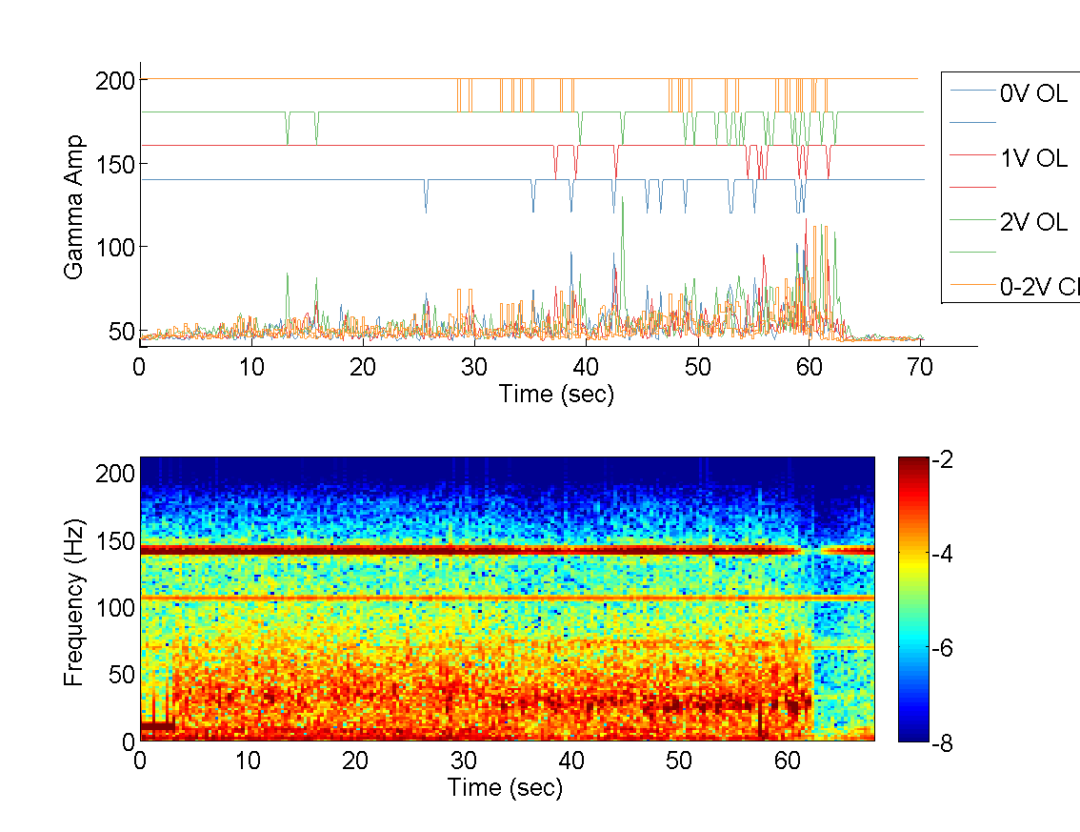
1D Gamma Detector
Non Dysk
Dysk
Detection signals of high gamma for different stim levels
Mean Gamma Signals from power channels for different stim levels
Thresh.
File played into saline tank to generate above figure (concatenated non-dyskinesia and dyskinesia file together)
No Gamma
Gamma

Slide 8
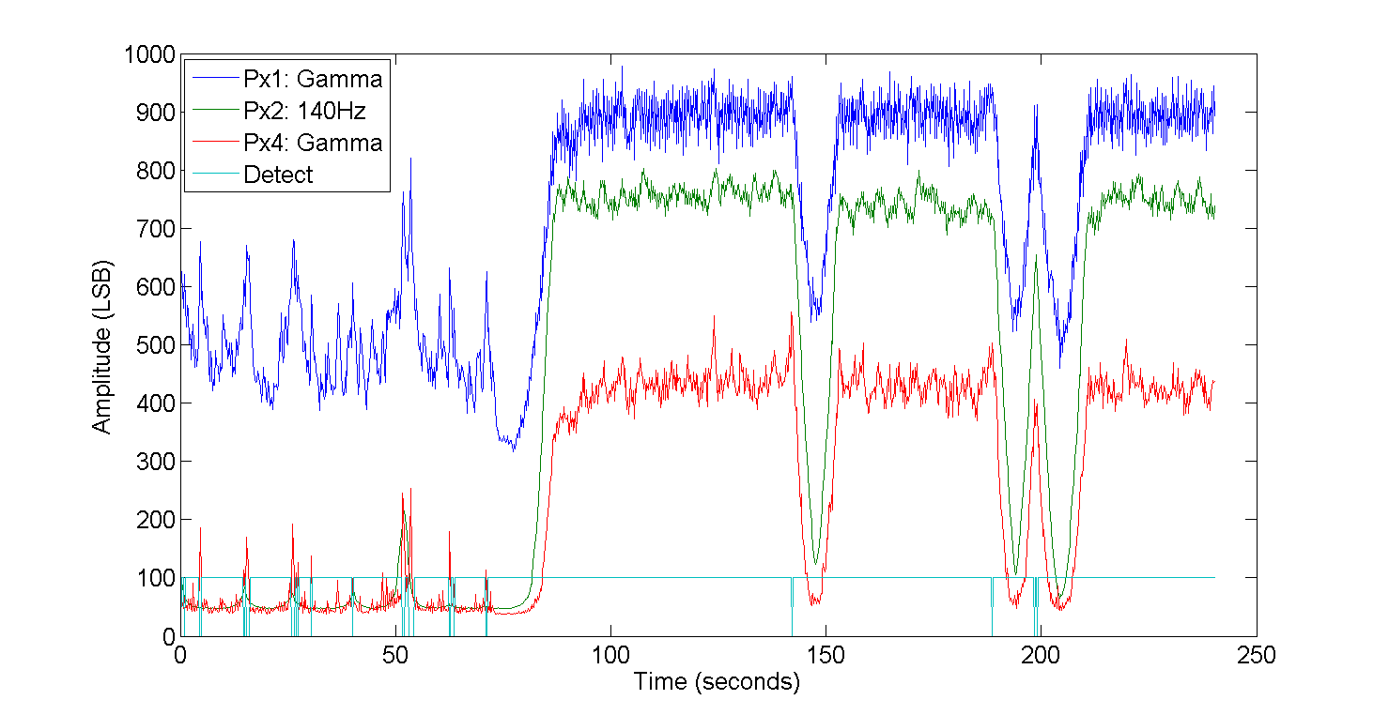
Design 2D detector that uses presence of stim to calculate threshold:
2V during non-dysk
Dysk
Non Dysk
Tracking Stim with (Px2)
Detect Events Occur When Stim is at ~1V,
~1V during dysk (0-75 sec)
Detect Events ALSO Occur When Stim is at ~2V,

Slide 9
Phase Amplitude Coupling
Can it be sensed w/ Nexus-E?
Use example files
One w/ high PAC (stim off) , one w/ low PAC (stim on)
Issues :
Stim artifact bleeding into P.A.C.
105 Hz artifact bleeding into P.A.C. calculation
Dropped packets during streaming create P.A.C artifacts (H.F amp. Coupled to L.F. phase)
BP filters can create edge effects in P.A.C plot
Approaches :
Band pass filtering
Removal of sections /w dropped packets
Stim on different lead than sensing (case of STN stim, cortical sensing)
Use longer time segment than 400 ms (concatenate data)

Slide 10
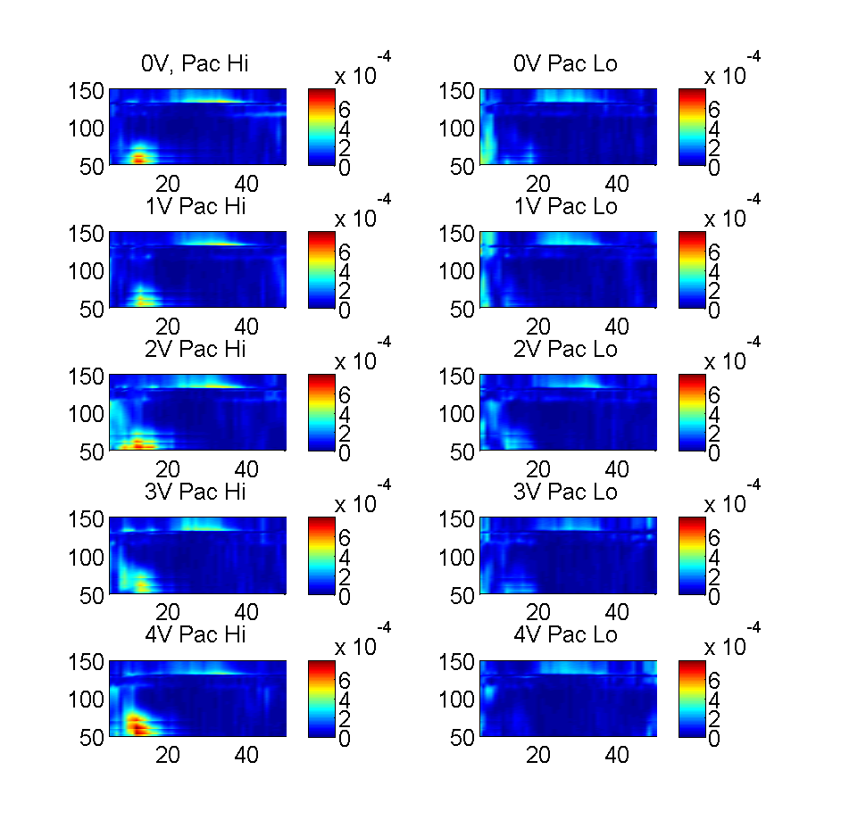
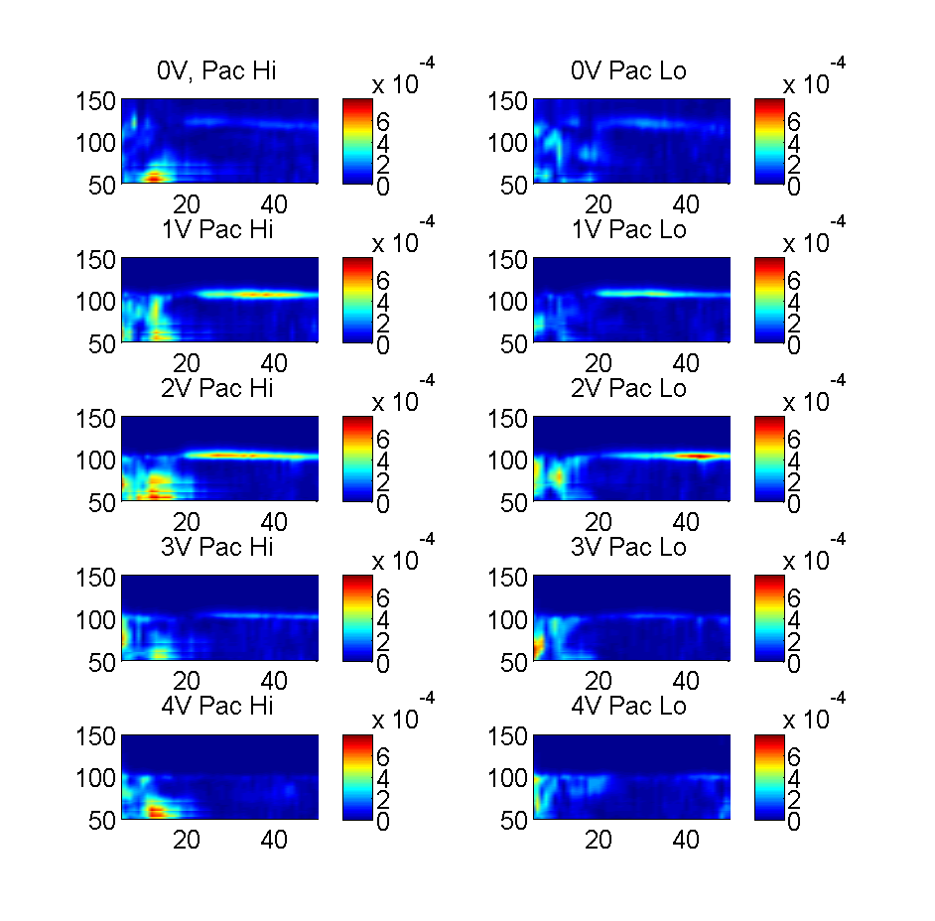
Going back to streaming, 2 leads, being aware of dropped packets and bad BP filter edge effects
BP filtered: [5 7 70 90], 3dB & 30dB
Unfiltered

Slide 11
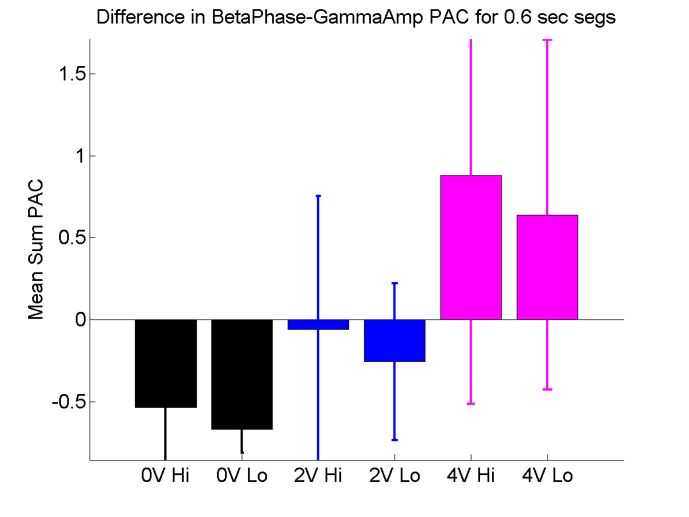
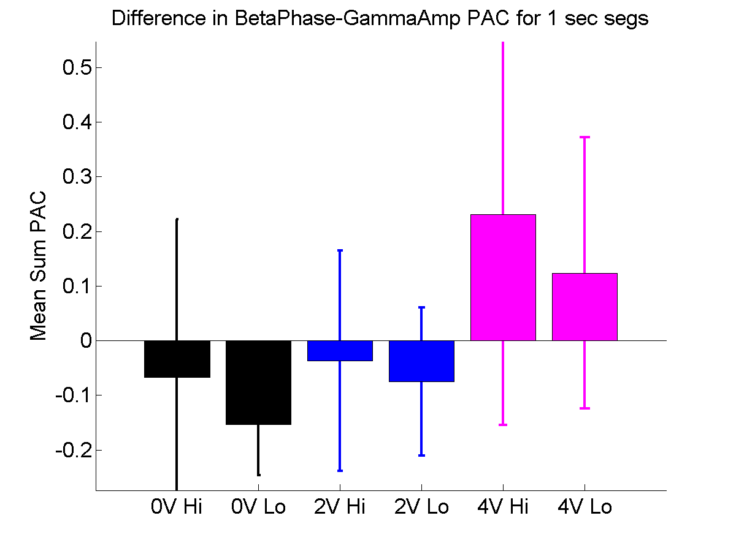
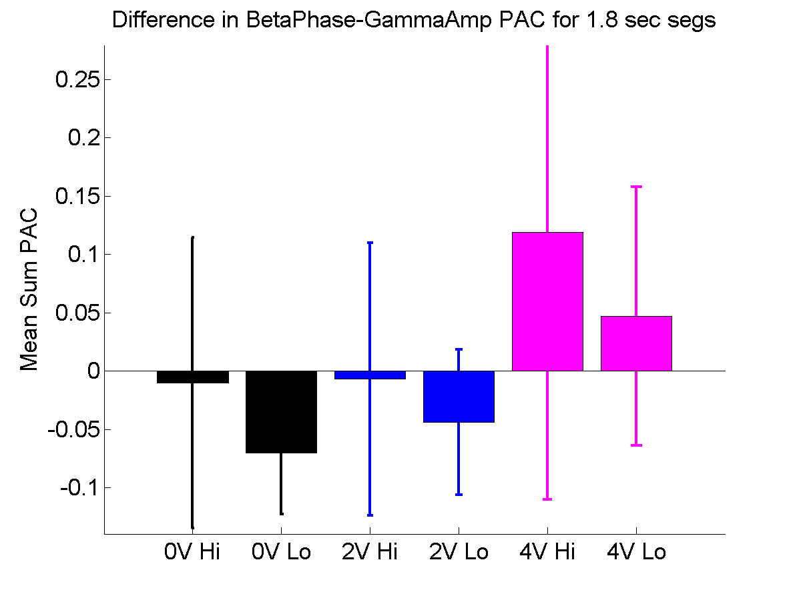
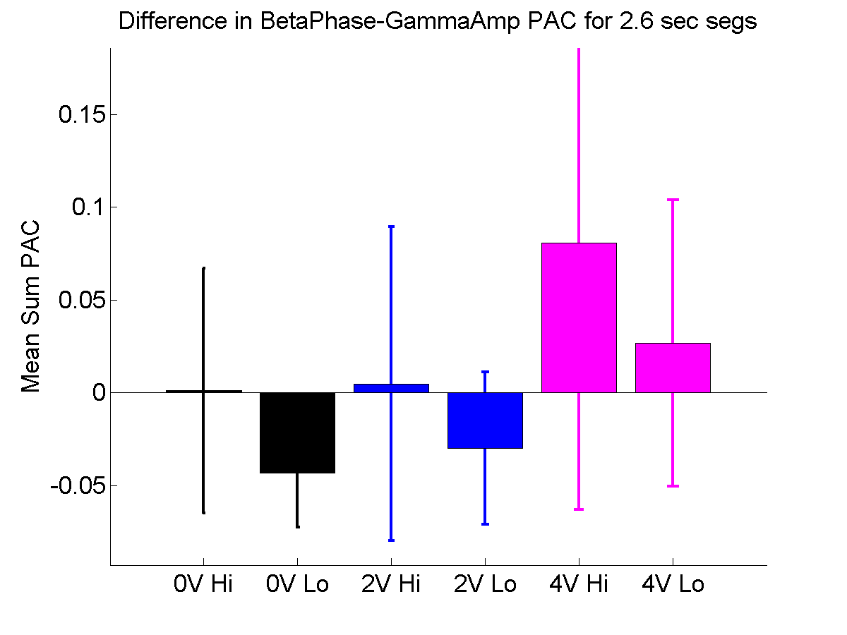
Using BP filter and different time segments, does the difference between high and low PAC improve
Notes:
Y axis is constant offset to mean PAC, and Y axis is -1*mean(PAC) : 2*mean(PAC)

