Slide 1
At-home Neurofeedback
Update with 5 days

Slide 2
Setup:
Daily:
Arm movement task to assess mean and distribution of motor cortical beta power
Fit beta to cursor mapping each day, based on the arm movement task
Neurofeedback task with tapping after each trail
Neural Recording:
Streaming M1 beta power channel (controls Neurofeedback cursor)
Streaming STN beta power channel
Other Sensor:
IMU on tapping hand
Touch sensor on tapping hand
Accelerometer on non-tapping hand
Pulse sensor on non-tapping hand

Slide 3
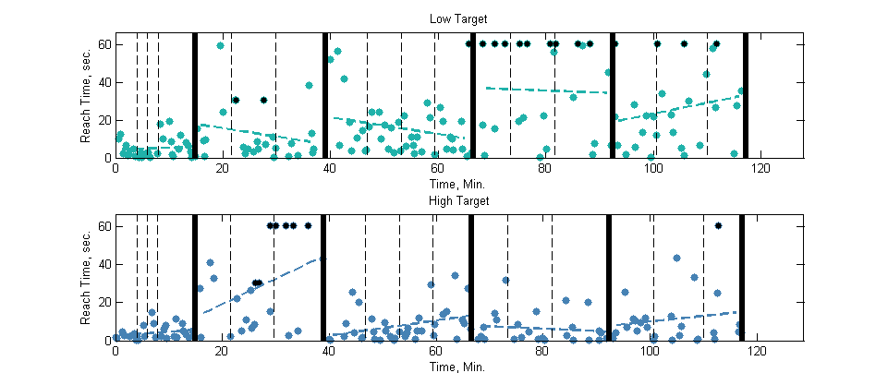
Neurofeedback Performance: Time to Target
Low Target
Timeouts
Day 1
Day 2
Day 3
Day 4
Day 5
High Target

Slide 4
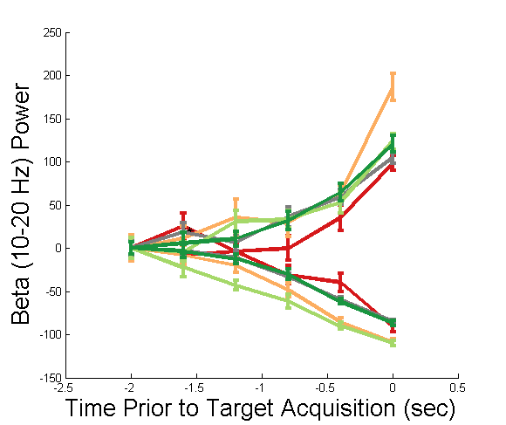
Beta Power Leading Up To Target Acquisition
Day 1
Day 2
Day 3
Day 4
Day 5
Comments:
More beta increase and decrease to acquire targets than on day 1
Separation in high/low beta power earlier before target acquisition
Each trace starts at Beta = 0
High Target
Low Target

Slide 5
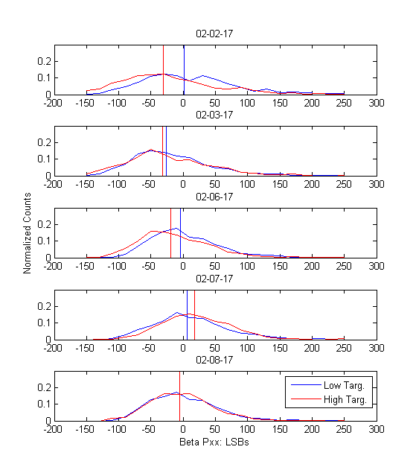
Distribution of Beta Power 5 seconds Prior to High / Low Targets
Histograms of beta power channel activity 5 sec preceding high/low beta target, aggregated for each day
Each distribution has median of arm movement beta power subtracted
Vertical bars indicate median of distribution
Oddly, in first few days, low target distribution had a higher median than high target distribution – maybe her strategy for the low target involved a synchronization followed by desynchronization ?

Slide 6
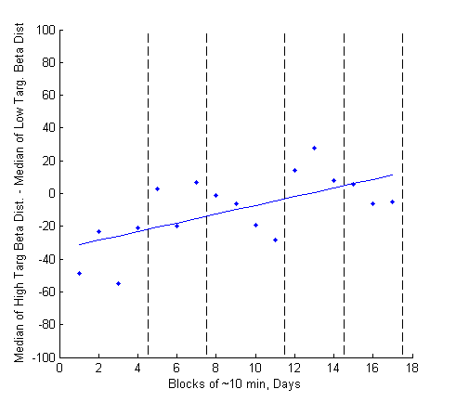
Distribution of Beta Power 5 seconds Prior to High / Low Targets
From previous plot, if break up distributions into 10 min blocks and compute :
Median (High) – Median (Low)
See improvement over the five days
Getting better at separating her distributions from one another

Slide 7
Observations
Sometimes she can do task well, then all of a sudden can’t anymore (e.g. Day 2, high target – see slide 3)
Assessed correlation between performance and baseline M1 / STN beta mean and variance
Only use data from 2/6, 2/7, 2/8
STN gain on 2/2, 2/3 was set higher and sometimes saturated

Slide 8
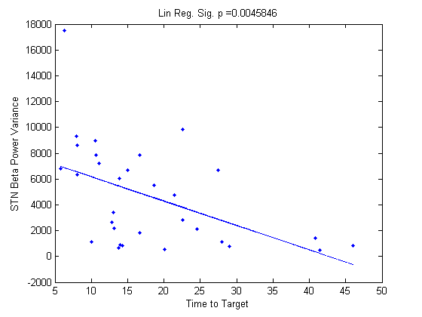
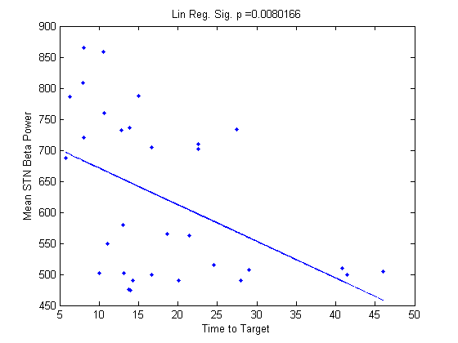
STN Power Mean and Variance vs. Time to Target
- Each point represents 2.5 minutes – mean time to target within window vs. STN power or STN variance in window
- Currently unclear if high STN power or high STN variance correlates with better performance.

Slide 9
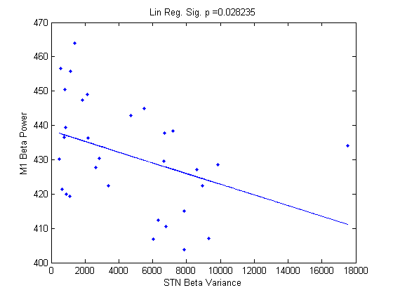
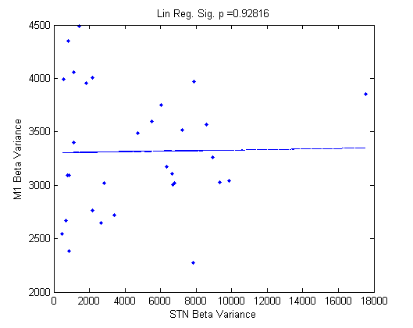
STN Power Variance vs. M1 Power
Each point represents 2.5 minutes
STN variance is correlated with lower M1 beta power
Maybe higher STN variance allows easier desynchronization – easier to get to lower beta target
STN variance not correlated with M1 variance

Slide 10
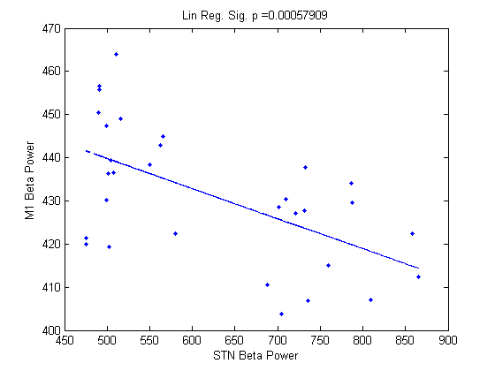
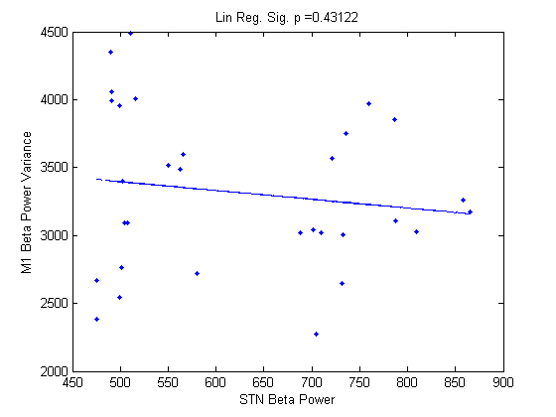
STN Mean Power vs. M1 Power
Each point represents 2.5 minutes
High STN beta power and High STN variance is correlated with lower M1 power
Lower M1 power correlated with time to target (lowest target is harder)

Slide 11
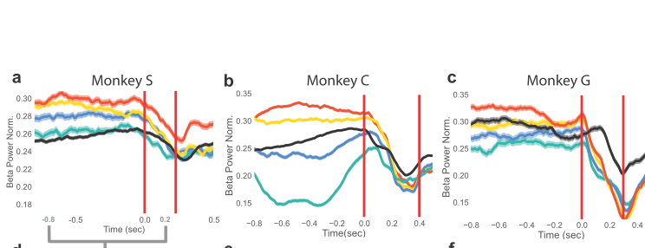
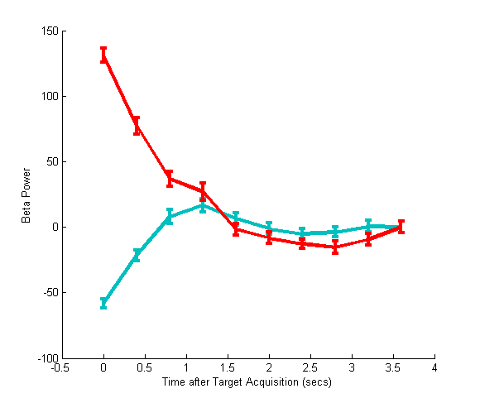
Kinematics:
Post target acquisition Beta power (target acquisition on red vertical line)
After target acquisition, baseline beta power returns to mean followed by movement related desynchronization
Patient
NHPs in Beta NF + Reaching Task
NF
Finger Tapping

