Slide 1
At-home Neurofeedback
Update with 5 days

Slide 2
Setup:
Daily:
Arm movement task to assess mean and distribution of motor cortical beta power
Fit beta to cursor mapping each day, based on the arm movement task
Neurofeedback task with tapping after each trail
Neural Recording:
Streaming M1 beta power channel (controls Neurofeedback cursor)
Streaming STN beta power channel
Other Sensor:
IMU on tapping hand
Touch sensor on tapping hand
Accelerometer on non-tapping hand
Pulse sensor on non-tapping hand

Slide 3
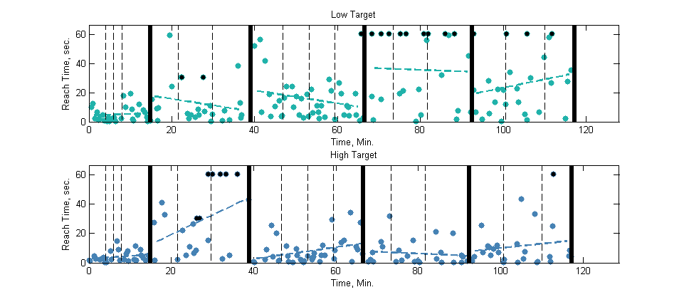
Neurofeedback Performance: Time to Target
Low Target
Timeouts
Day 1
Day 2
Day 3
Day 4
Day 5
High Target

Slide 4
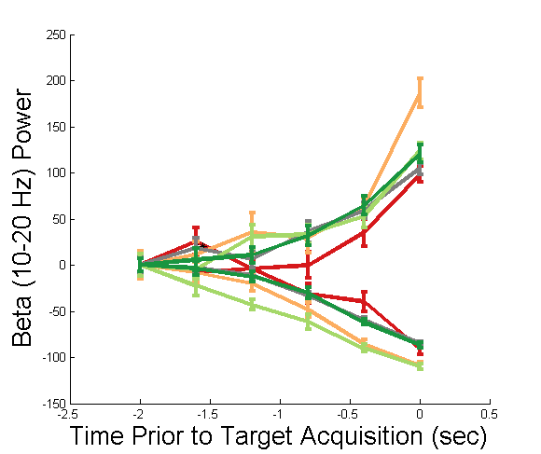
Beta Power Leading Up To Target Acquisition
Day 1
Day 2
Day 3
Day 4
Day 5
Comments:
More beta increase and decrease to acquire targets than on day 1
Separation in high/low beta power earlier before target acquisition
High Target
Low Target

Slide 5
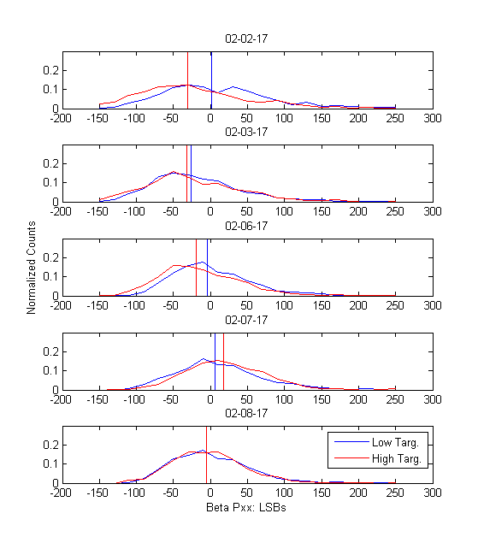
Distribution of Beta Power 5 seconds Prior to High / Low Targets
Histograms of beta power channel activity 5 sec preceding high/low beta target, aggregated for each day
Vertical bars indicate median of distribution
Oddly, in first few days, low target distribution had a higher median than high target distribution – maybe her strategy for the low target involved a synchronization followed by desynchronization ?

Slide 6
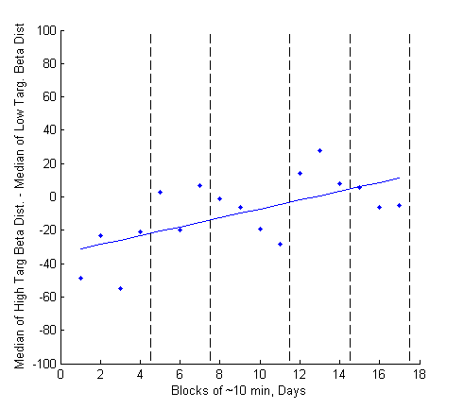
Distribution of Beta Power 5 seconds Prior to High / Low Targets
From previous plot, if break up distributions into 10 min blocks and compute :
Median (High) – Median (Low)
See improvement over the five days
Getting better at separating her distributions from one another

Slide 7
Observations
Baseline shifts in M1

