Slide 1
Overview of Patient Data
Starr Collaboration
Preeya Khanna, 1-6-2015

Slide 2
Previous Learning Figure s
Errors in p-values
Remedied here!

Slide 3
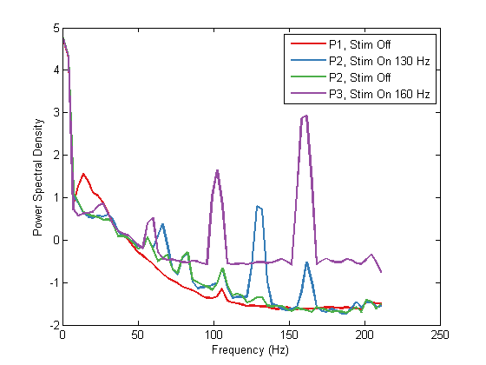
Patient 1: May 8, 2015
Power Spectral Density of Patients 1-3
Good motor cortical signal, clear beta peak: 10-20 Hz
Stim off
Learning with assist → Blocks without assist (gh)
Control with multi-taper method on time domain data

Slide 4
Time to Target Metrics:

Slide 5
Chance Level for Low and High Targets
No timeout in this task
1000 simulations
Performance is > 70% of chance
performance
Possible explanation for low chance level:
- High variability in cursor movement due to
MTM

Slide 6
Neural Signal Control during BMI
* p < 0.1, ** p < .05 (ANOVA, KW)

Slide 7
Z scored Spectrograms during Control

Slide 8
Patient 2
Weakest motor cortical signal, beta peak: 20-30 Hz
Stim ON
Learning with assist → Blocks without lower assist (i)
Control with power channel – time domain channel looks very noisy
Power Channel Settings: 15 Hz +/- 2.5 Hz, 0.5 Hz HPF
Power Spectral Density of Patients 1-3

Slide 9
Time to Target Metrics

Slide 10
Chance Level for Low and High Targets
No timeout in this task
1000 simulations
Performance is > 99.75 % of chance
performance ( p = 0.0025 )
Patient notes clear movement strategy for top and bottom targets

Slide 11
Neural Signal Control during BMI
Simultaneously Recorded
Time Domain Signal
Control Signal: Power Channel
* p < 0.1, ** p < .05 (ANOVA, KW)

Slide 12
Z scored Spectrograms during Control

Slide 13
Patient 3
Weaker motor cortical signal, beta peak: 20-30 Hz
Stim OFF
Learning with assist → Blocks without lower assist
Decoder 1: ‘df’
Decoder 2: ‘jk’
Control with time domain channel
Used welch’s method for spectral analysis
Used Kalman Filter to estimate cursor position (instead of linear transform)
Tried CLDA – convergence to minimal cursor movement
Task difference: used only 3 targets
no bottom target (-6)
Had target timeout of 15 – 60 sec (block dependent)
Power Spectral Density of Patients 1-3

Slide 14
Time to Target Metrics
Decoder 1
Decoder 2

Slide 15
Chance Level for Decoder 2 (‘jk’ blocks)
All 3 targets
60 sec timeout
1000 simulations
Performance is > 100 % of chance
performance ( p = 0.0 )
Indication that even though couldn’t get to the bottom target, that she was trying
Only Bottom Target

Slide 16
Neural Signal Control during BMI
Simultaneously Recorded
Time Domain Signal Combined Session
Simultaneously Recorded
Time Domain Signal
jk Session
Combine df / jk sessions
Looks same for jk session only
* p < 0.1, ** p < .05 (ANOVA, KW)

Slide 17
Z scored Spectrograms during Control
Combine df / jk sessions
Only jk sessions

Slide 18
Summary
All patients show beta-specific modulation
Independent of control signal (power channel vs. time domain)
Independent of stimulation (on vs. off)
Independent of cursor estimation method (linear estimator or KF)
Patients 2 -3 can do the task well above chance level for extreme targets (middle targets have very low reach times– acquired by chance)
Patient 1 shows significant learning on extreme targets (bottom and top) when assist is off
Look at phase amplitude coupling and then connect to PD therapy?
Overall – selling point is new tool for closed-loop tool
Currently implanted
Discussion –
Impact number of people at home
Link to github
Citations to MDT – recharge battery, better latency

Slide 19


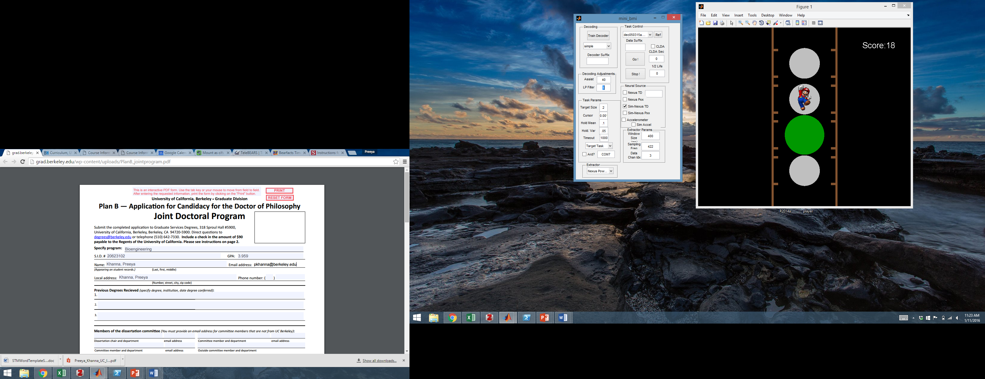
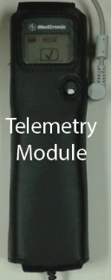
Volitional Control of Neural Activity with Visual Feedback
Cortical Sensing
Figure 1
Custom BMI Game
Link
Point-Scoring Trials
Timeout Trials
Cursor In
Target (+1)
Timeout
(15 -60 sec)
Targ #3 On
ITI: 1.2s
Targ #1 On
ITI: 1.2s

Slide 20
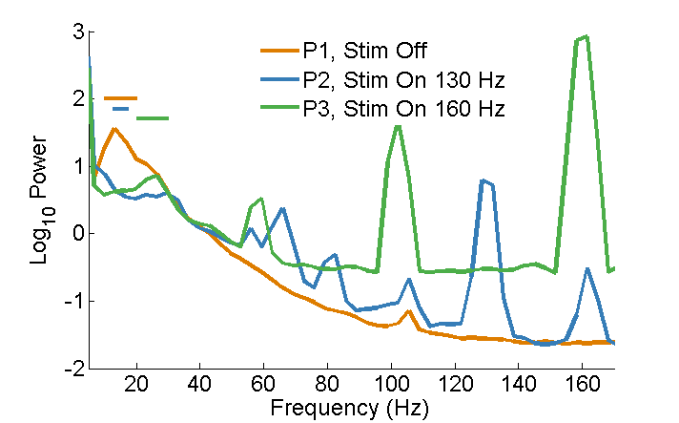
Beta Band Used for Online Control
Figure 2
Table 1
Patient | Home or UCSF | Stim On / Off | Time Domain vs. Power Channel | Beta Freq. Limits | Beta Power Calc. Method | Cursor Prediction
1 | Clinic | Off | Time Domain | 10-20 Hz | Multi-Taper | Linear Reg.
2 | Home | On | Power Channel | 12.5-17.5 Hz | n/a | Linear Reg.
3 | Clinic | On | Time Domain | 20-30 Hz | Welch | Kalman Filter

Slide 21
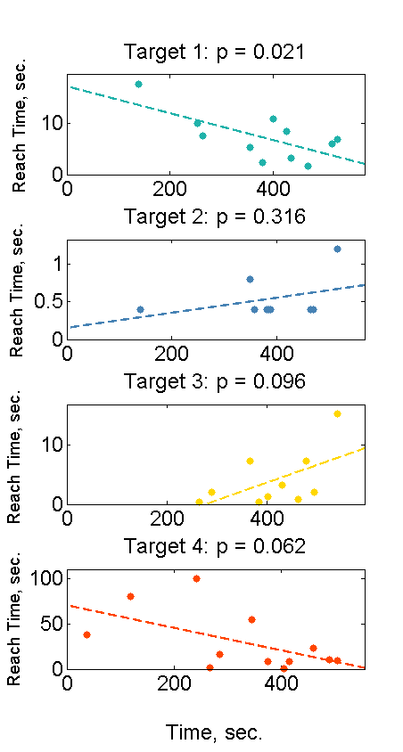
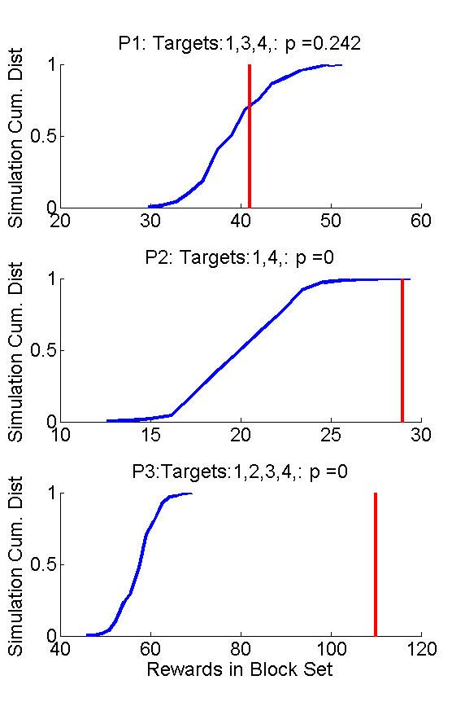
Figure 3

Slide 22
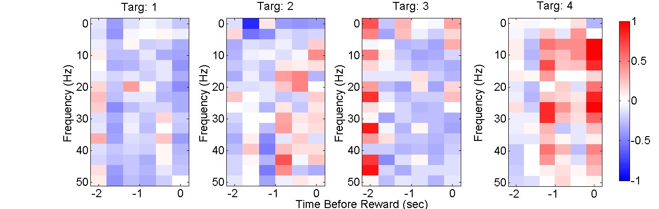
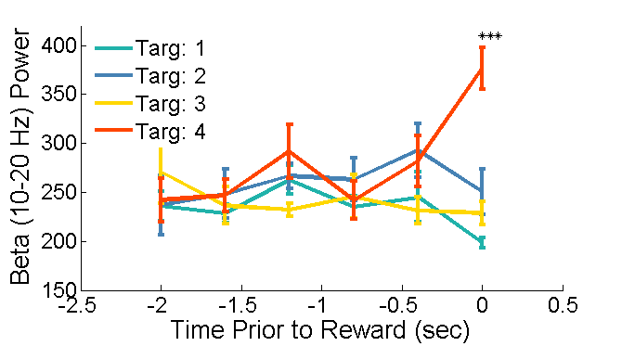
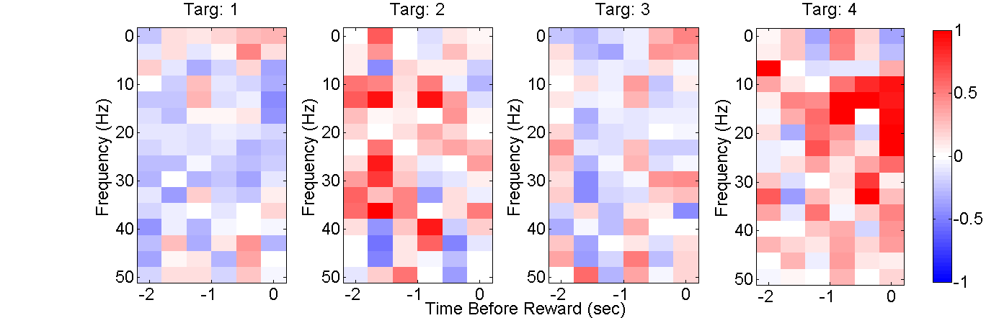
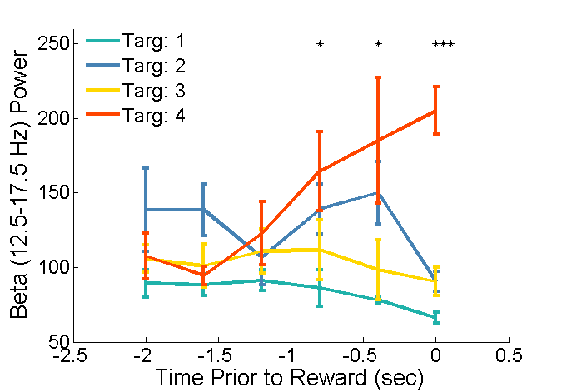
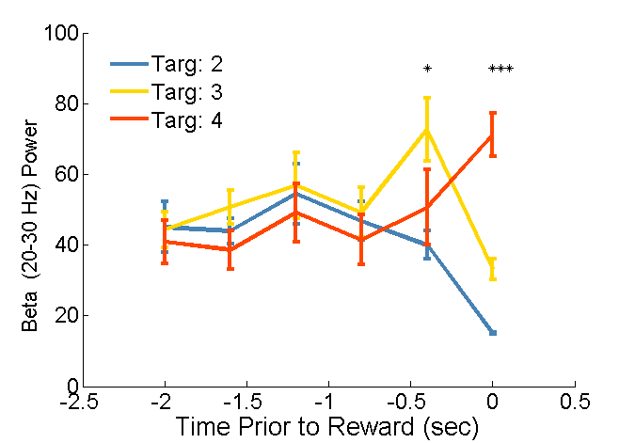
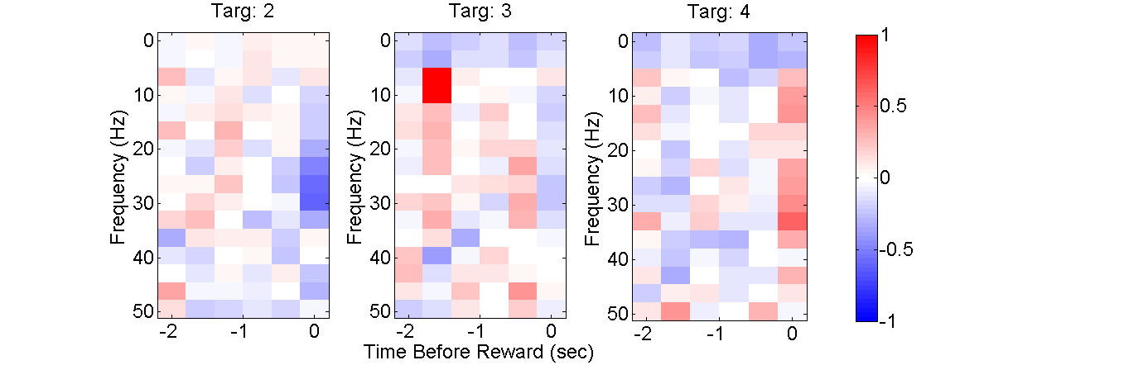
Figure 4

Slide 23
Trial averaged spectrograms of neural activity during the neurofeedback task. Trials are taken from periods of no assist (Patient 1) or constant lowest assist used (Patients 2, 3) and aligned to the time of target acquisition (x axis, time = 0 secs). Z-scored spectrograms of neural activity are computed and then averaged over trials. For each spectrogram, the trials to the lowest and highest achieved beta targets are show on the left and right respectively (Patients 1, 2: Targets 1, 4, Patient 3: Targets 2, 4). Finally, the neural input used for control of the cursor is highlighted in a dotted black box for each patient
Patient 1
Patient 2
Patient 3
Time Before Target Acquisition (secs)

