Slide 2


$$1$$
$$1$$

Slide 3
Plane
Side #1
Side #2
Normal vector #1
Normal vector #2
Flat surface

Slide 4
Plane
Back
Front
“The” normal vector
Flat surface

Slide 5
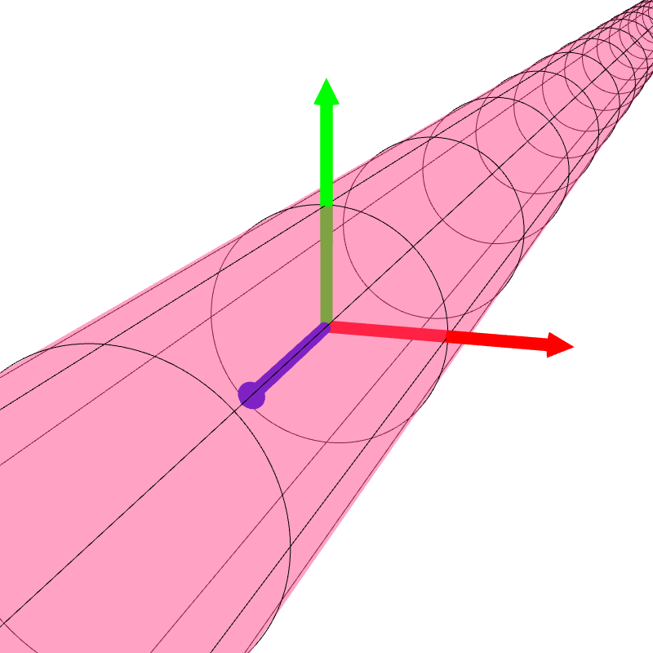



$$y$$
$$x$$
$$z$$

Slide 6
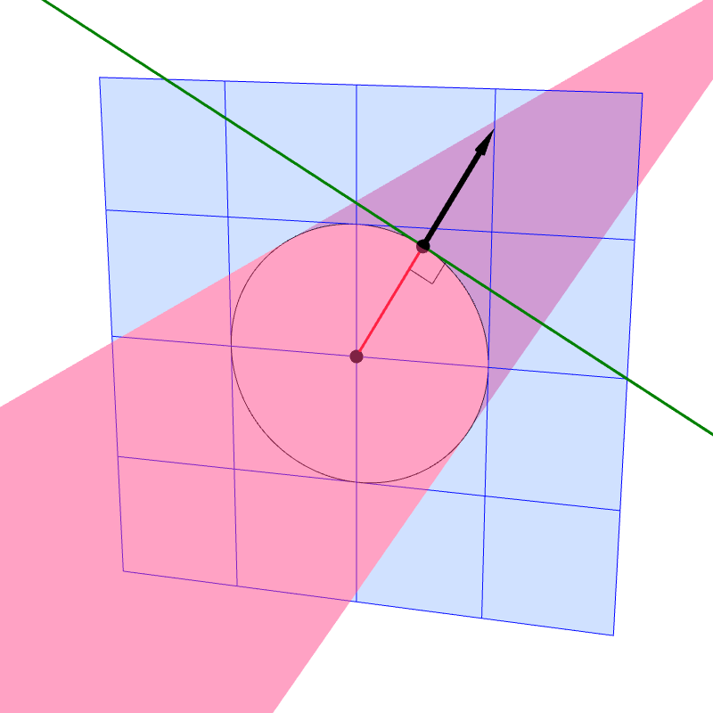





$$n$$
tangent line
$$P$$
$$\overline{OP}$$
$$O$$
plane $z=p_{z}$

Slide 7
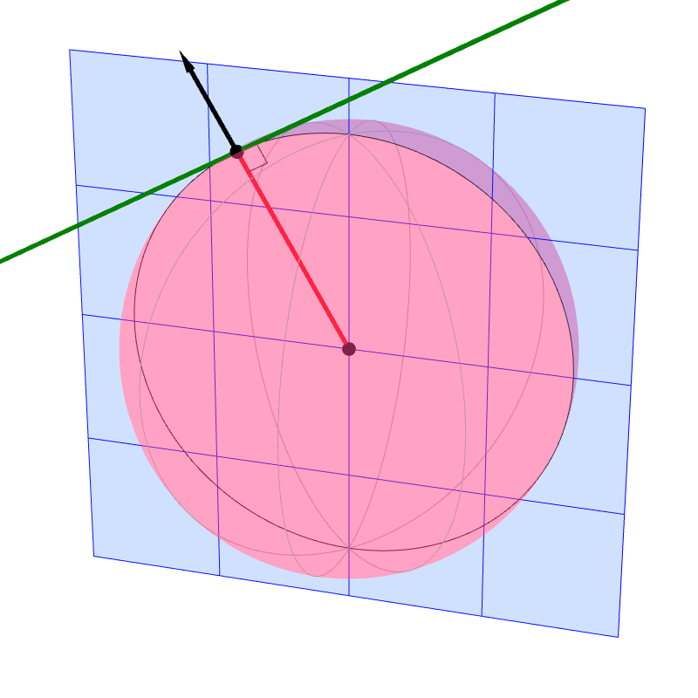



$$n$$
tangent line
$$P$$
$$\overline{OP}$$
$$O$$
plane of a great circle containing P

Slide 8
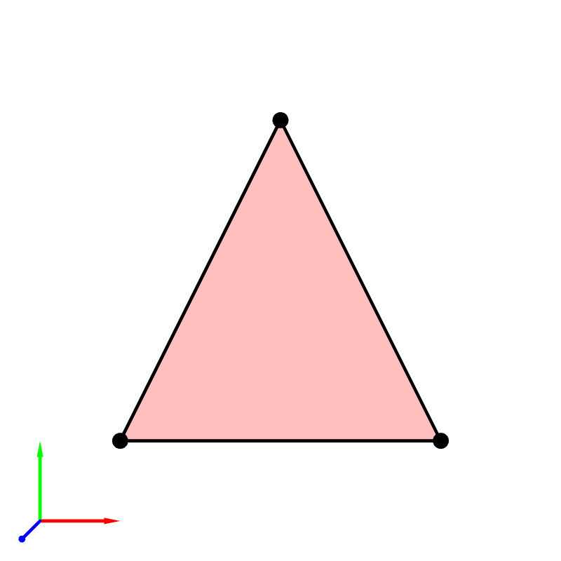






$$C$$
$$y$$
$$A$$
$$B$$
$$z$$
$$x$$

Slide 9
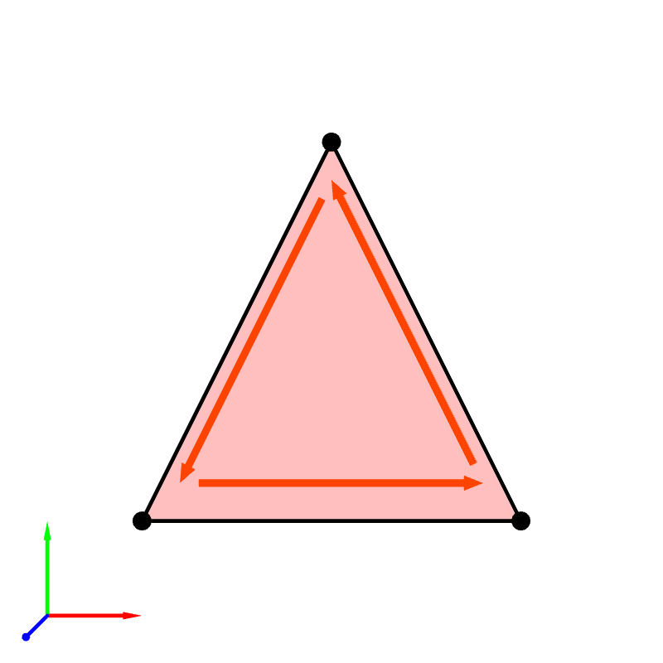
$$C$$
$$y$$
$$A$$
$$B$$
$$z$$
$$x$$

Slide 10
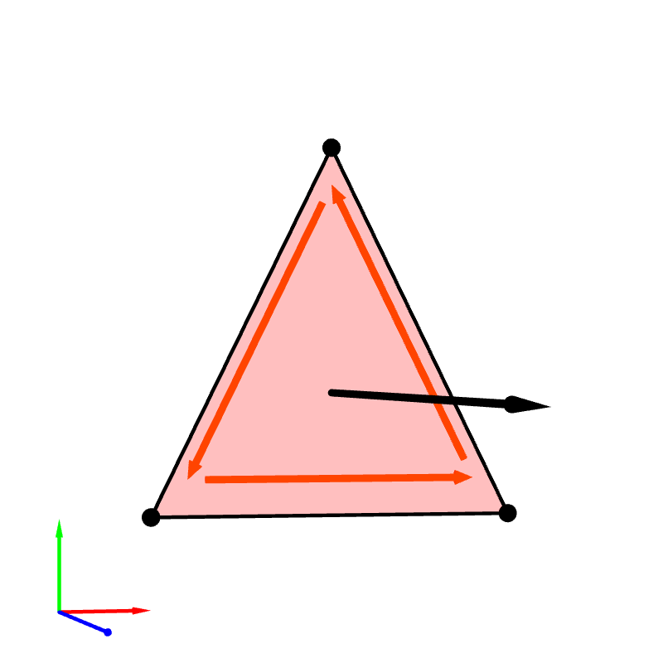





$$C$$
$$y$$
$$A$$
$$B$$
$$x$$
$$z$$

Slide 11


$$B$$
$$y$$
$$A$$
$$C$$
$$z$$
$$x$$

Slide 12

$$B$$
$$y$$
$$A$$
$$C$$
$$z$$
$$x$$

Slide 13
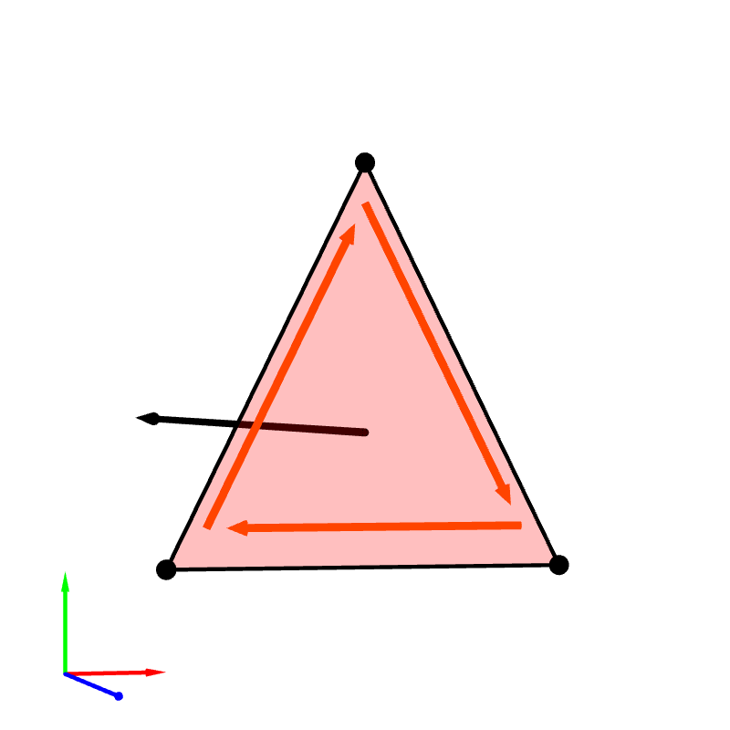

$$B$$
$$y$$
$$A$$
$$C$$
$$x$$
$$z$$

Slide 14
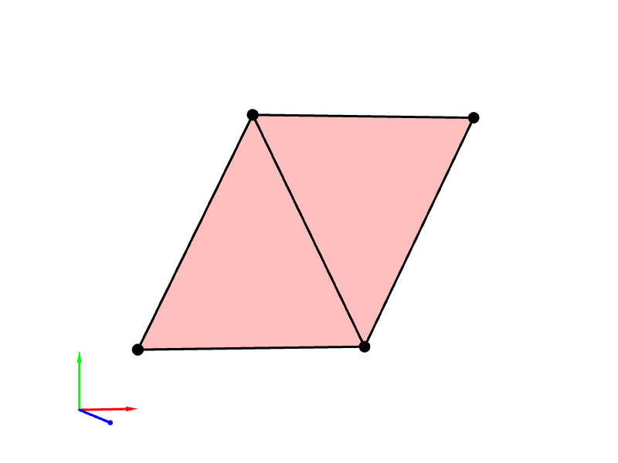







$$2$$
$$3$$
$$y$$
$$0$$
$$1$$
$$x$$
$$z$$

Slide 15
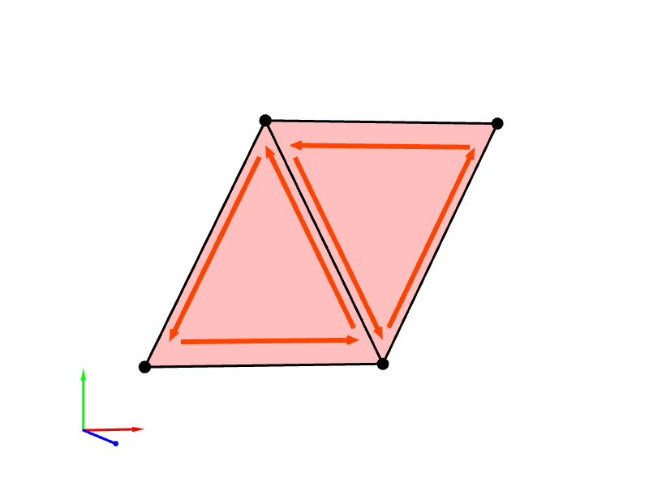
$$2$$
$$3$$
$$y$$
$$0$$
$$1$$
$$x$$
$$z$$

Slide 16
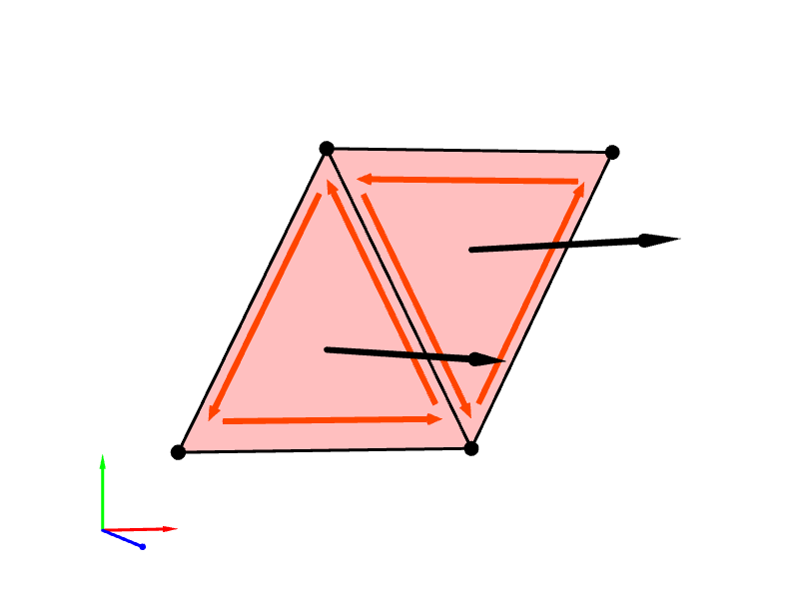
〇
$$2$$
$$3$$
$$y$$
$$0$$
$$1$$
$$x$$
$$z$$

Slide 17

$$2$$
$$3$$
$$y$$
$$0$$
$$1$$
$$x$$
$$z$$

Slide 18
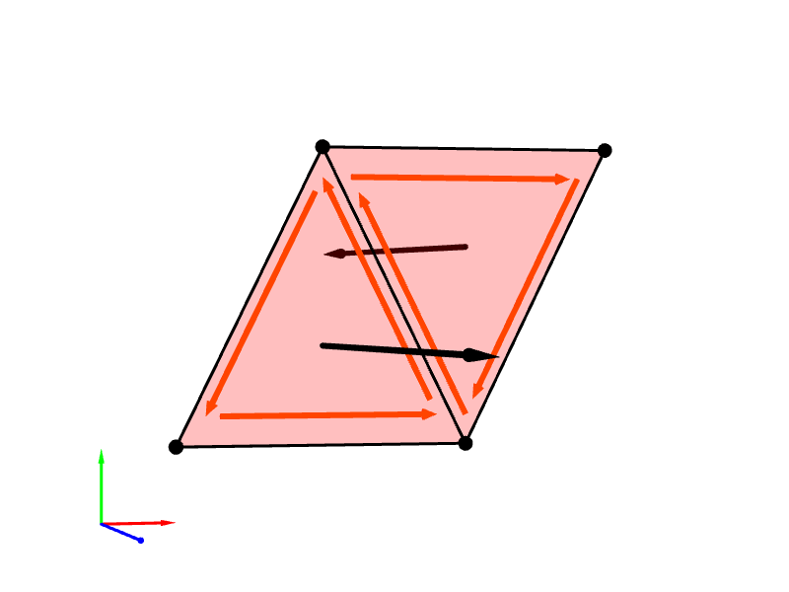
✖
$$2$$
$$3$$
$$y$$
$$0$$
$$1$$
$$x$$
$$z$$

Slide 19
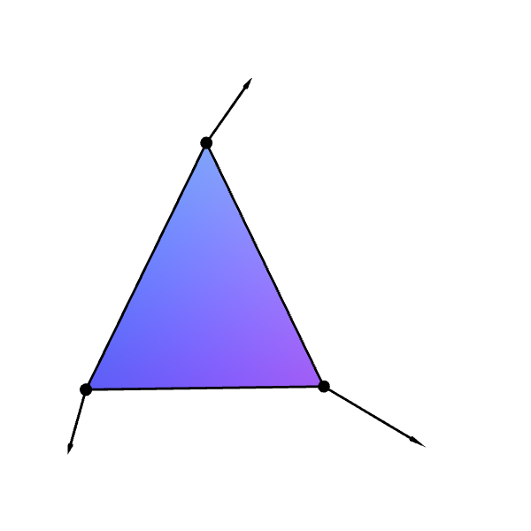

Slide 20
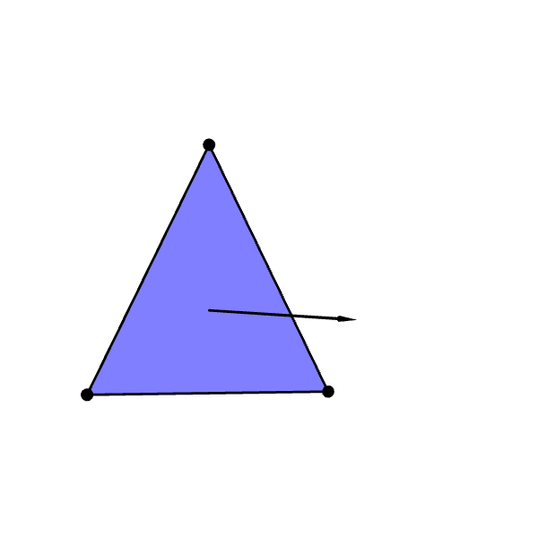

Slide 21
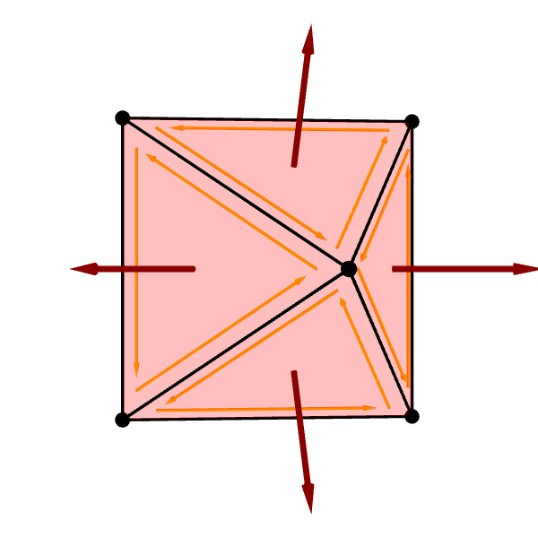
〇

Slide 22



