Slide 1


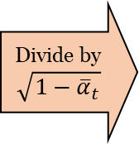
6 hidden layers
$$x$$
1
…
Positional
embedding
Fully connected
+
Leaky ReLU
Fully connected
+
Leaky ReLU
Fully connected
+
Leaky ReLU
Fully connected
Divide by
$$\sqrt{1−{\overline{α}}_{t}}$$
$$t$$
output
1
1
1
129
256
256
256

