Slide 1

TRENDS-AR
Prathiksha kini – 4nm20cs139
Sammitha s – 4nm20cs151
Keerthana - 4nm20cs094

Slide 2
OVERVIEW
Our AR-ecommerce app is designed to provide customers with an immersive shopping experience and make online shopping more interactive and engaging.
Our app is targeted towards tech-savvy shoppers who enjoy new technologies and prefer to shop online rather than in-store.

Slide 3
KEY FEATURES
3D product visualization
Real time product placement

Slide 4
TECHNOLOGIES & TOOLS USED
Augmented Reality
Android Studio
Java
Firebase
Augmented Reality SDK’s

Slide 5
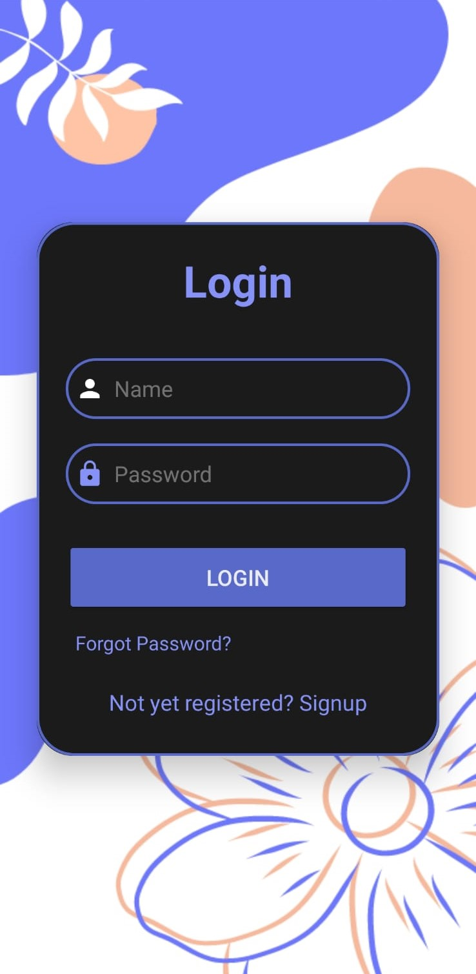
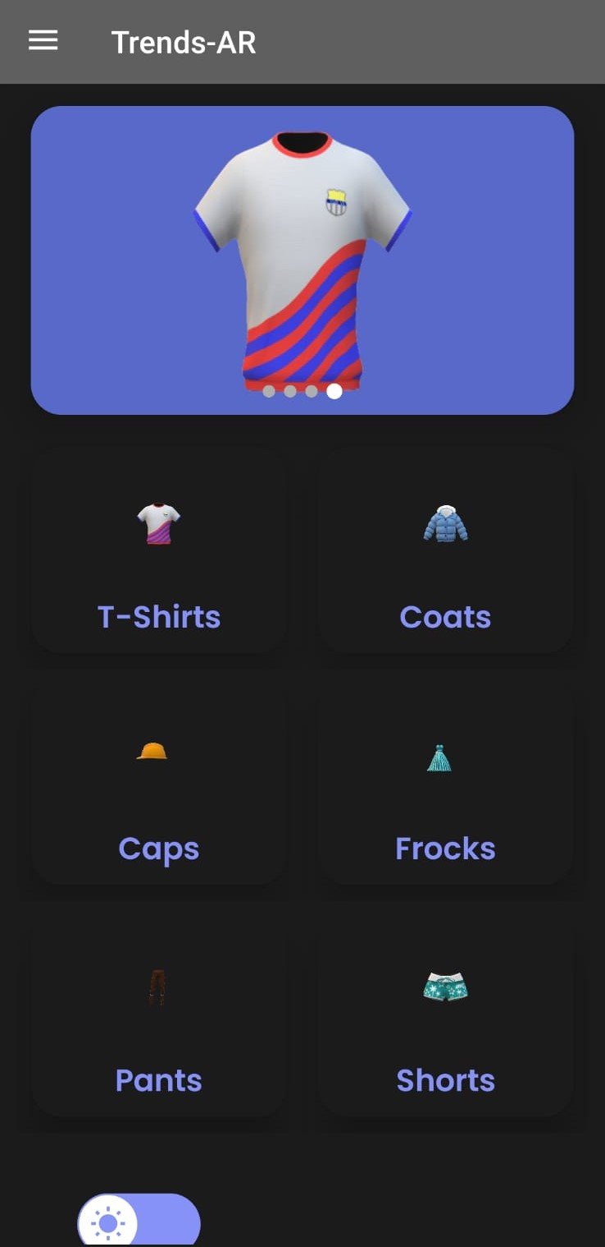
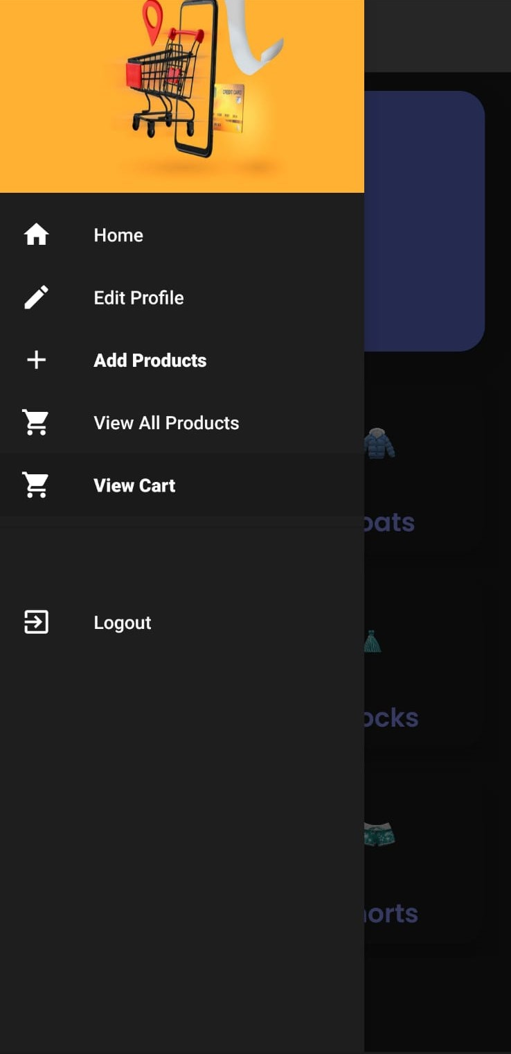
USER INTERFACE

Slide 6
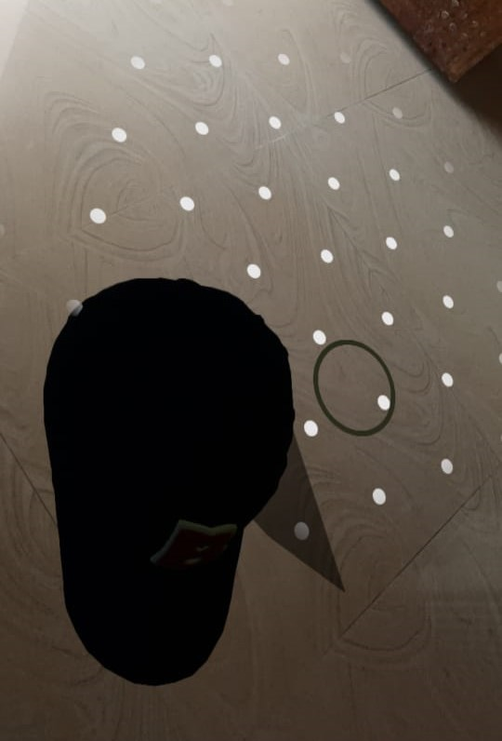

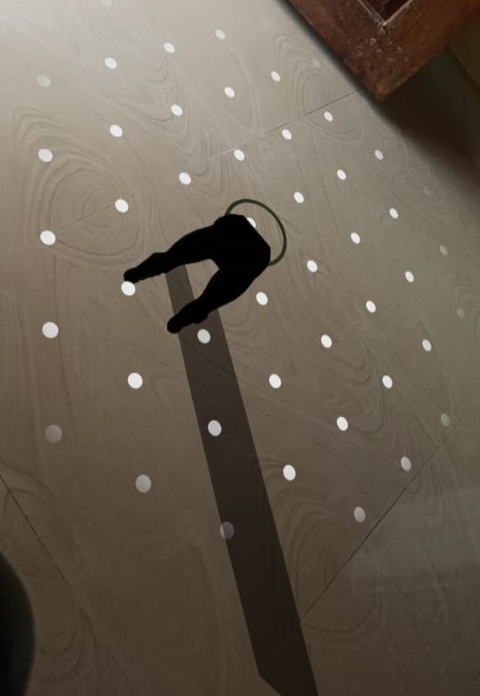
AUGMENTED REALITY

Slide 7
CHALLENGES AND SOLUTIONS
One of the biggest challenges we faced was integrating the AR technology with the E-commerce platform, as the two systems had different requirements and data structures. We solved this by developing a custom middleware layer that bridged the gap between the two systems and enabled seamless communication
Maintaining compatibility with various devices and operating systems was also a challenge, as the AR technology had different requirements depending on the device. We addressed this by conducting testing on a range of devices and creating a flexible architecture that could adapt to different environments

Slide 8
FUTURE PLANS
One of our future plans is to expand our product catalog and offer a wider range of products for users to view in augmented reality
2.We also plan to improve the performance and reliability of the application, by implementing more features and optimizing the codebase for faster rendering and response times
3.Integrating our E-commerce app with Razor pay.

Slide 9
THANK YOU

