Slide 1
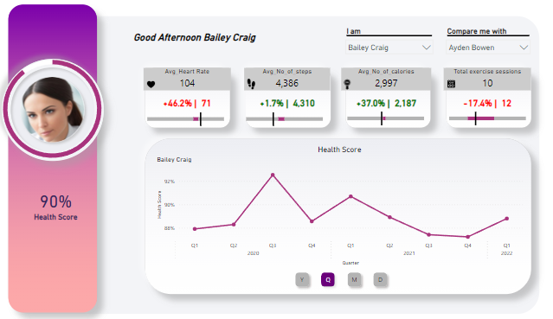

Slide 2
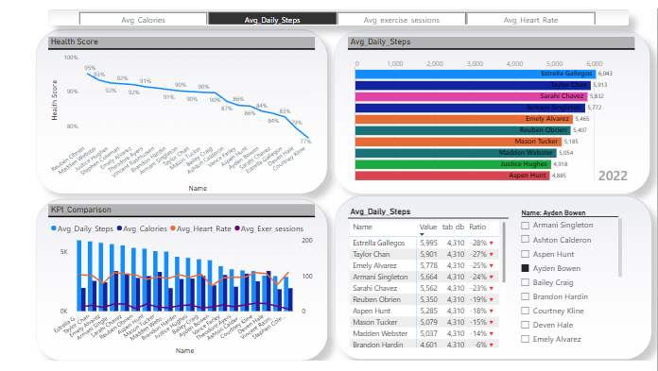

Slide 3





Avg
Avg
Healthiest-Reuben Obrien | 669 | 352 | 102 | 95 %
Unhealthiest-Courtney Kline | 147 | 110 | 109 | 77 %
Heart
Rate
Step
Count
Calorie
Count
Exercise
Sessions
Health
Score
Stephen Coleman has the highest HR (110 bpm) implying the greatest effort while exercising
Ayden Bowen has the least HR (71bpm) implying the least effort while exercising
The average HR of the sample was 97 bpm
There is almost an even split above and below the average HR-11 people have HRs above the average and 9 below
Higher the HR=>Higher the effort
Estrella Gallegos has the highest recorded step count (6043) implying a more rigorous exercise regime
Stephen Coleman has the lowest recorded step count (2904) implying a less rigorous exercise regime
Higher number of steps indicates more effort
The average number of steps is 4525
There is an even split above and below the average
Deven Hale has the highest calorie drop (3407)
Vincent Rasmussen has the lowest calorie drop(1855)
Higher number of calorie loss indicates a more effective exercise regimen
The average calorie count is 2660
There is almost an even split above and below the average Calorie Count-11 people have calories lost above the average and 9 below
Courtney Cline has the highest number of sessions (23)
Stephen Coleman has the lowest calorie drop (7)
The number of exercise sessions needed are proportional to the calories to steps ratio
The average number of exercise sessions are 15
There is an even split above and below the average
Deven Hale has the best Steps-to-Calories ratio(1.2) and the only person to have a positive value=>lesser exercise leading to the highest calorie count
Estrella Gallegos has the worst Steps-to-Calories ratio(0.33) =>highest effort leading to the least calorie count
Reuben Obrien has the best health score(95%)with Courtney Kline having the worst (77 %) despite having the highest number of
exercise sessions

Slide 4
Parameter Cards
Selected Customer’s KPI
2 options-Either a solo search or a one-to-one comparison
AI-generated Images
New KPI card with the combo of the comparison KPI and the % diff.
A combination of the 4 criteria identified in the key cards
Time-Period selection to pick the desired date hierarchy-using bookmarks

Slide 5
KPI Filter Slicer
KPI-based top N dynamic time-period display
KPI comparison vis-à-vis the slicer selection
Personnel wise KPI comparison chart

