Slide 1
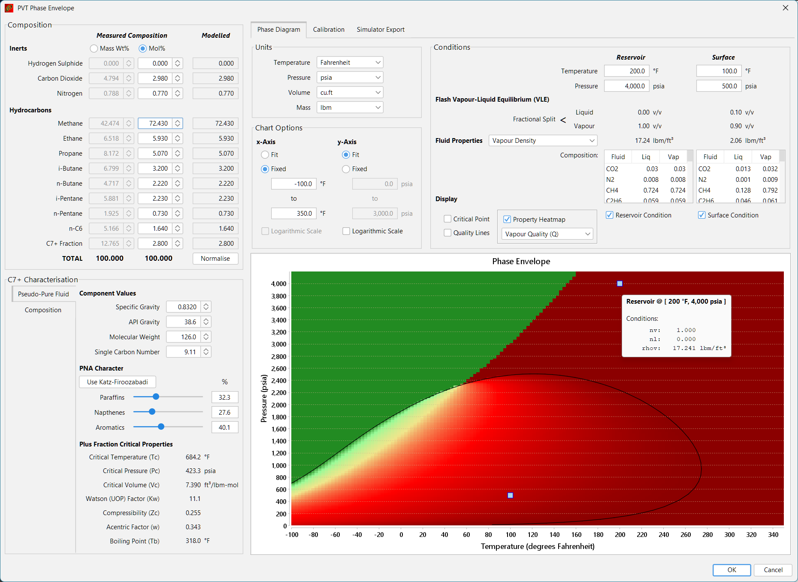
Composition definition
Output options
Phase diagram display options
C7+ and other components definition
Phase diagram display

