Slide 1
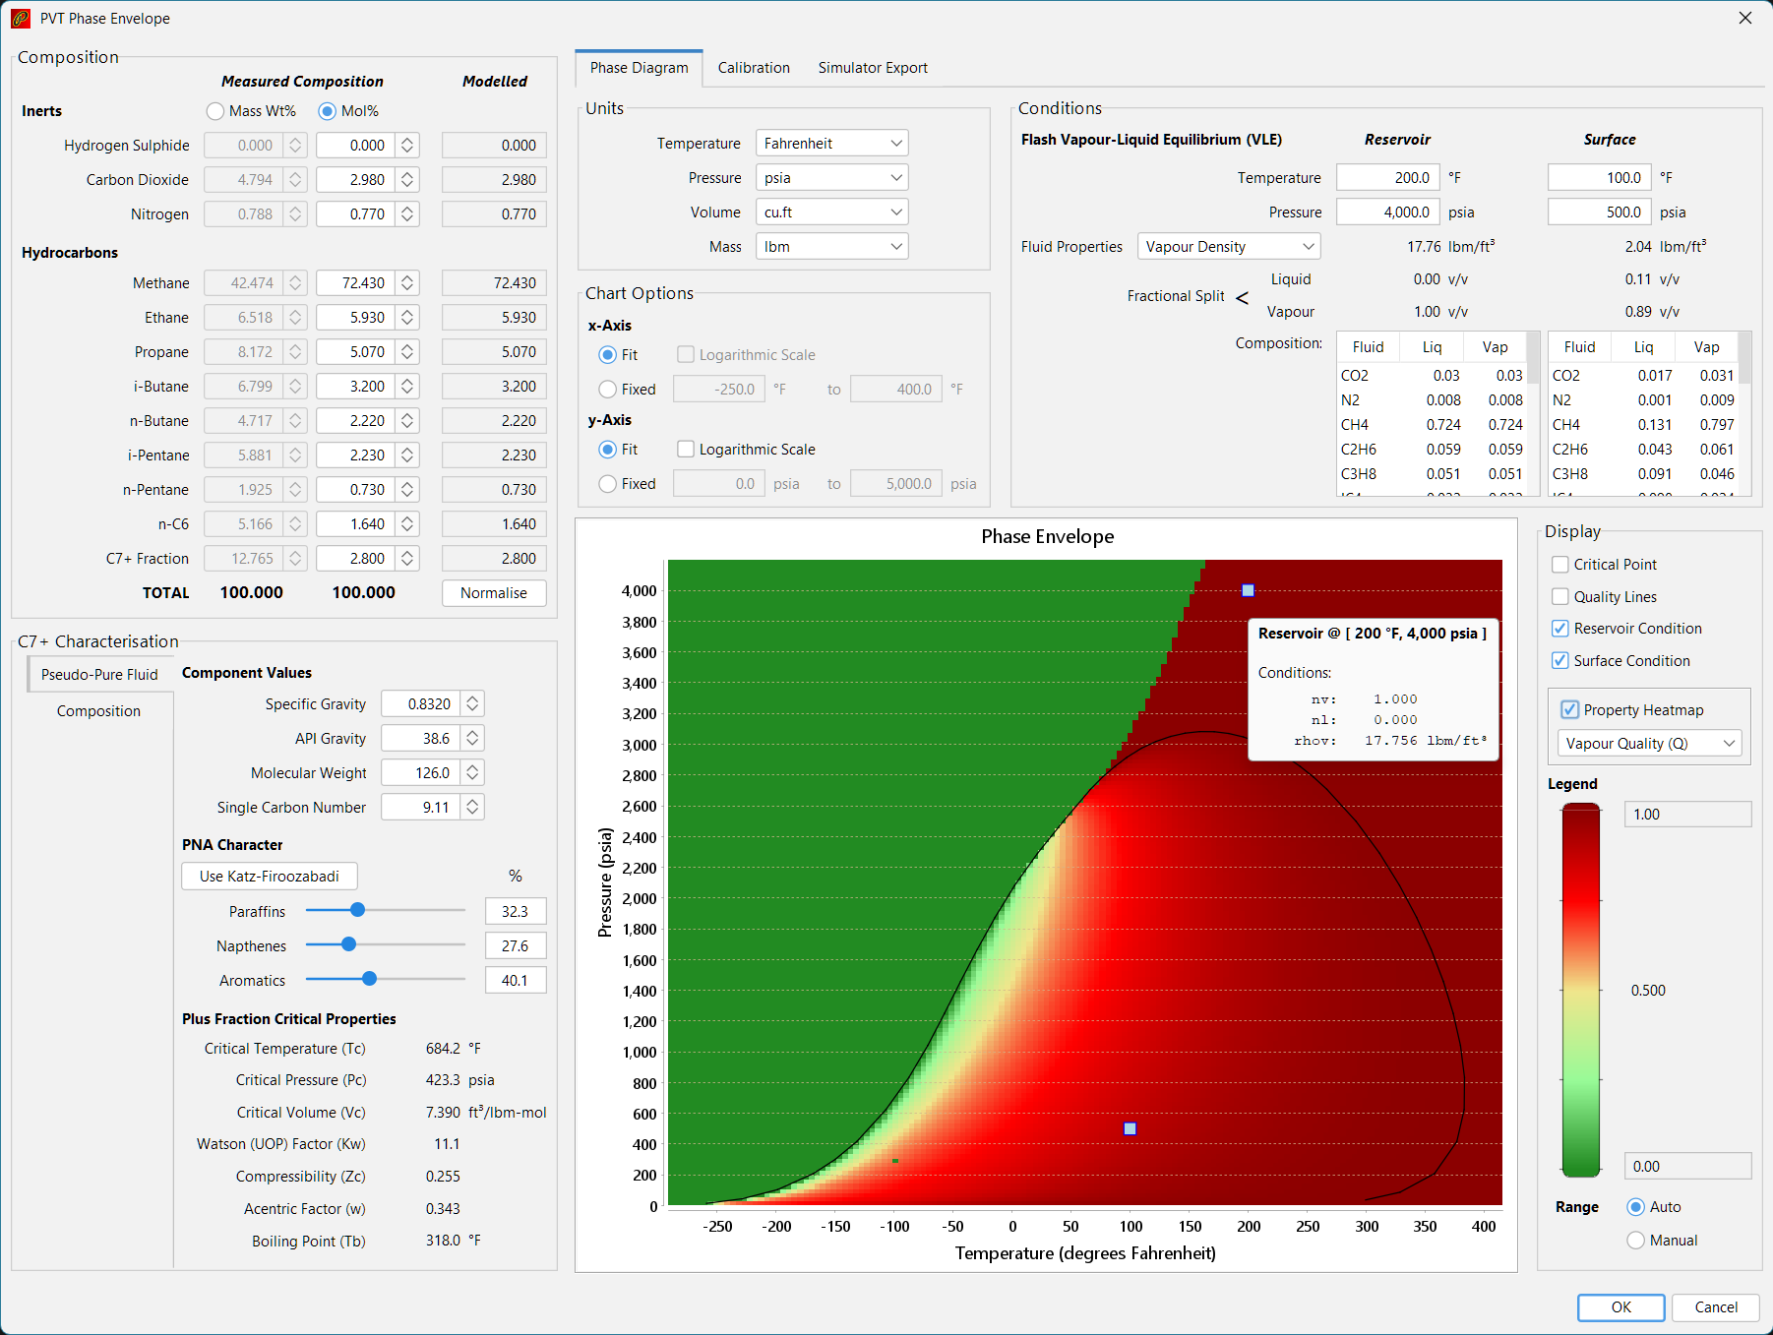
Composition definition
Output options
Phase diagram display options
Phase diagram display
C7+ and other components definition

Slide 2
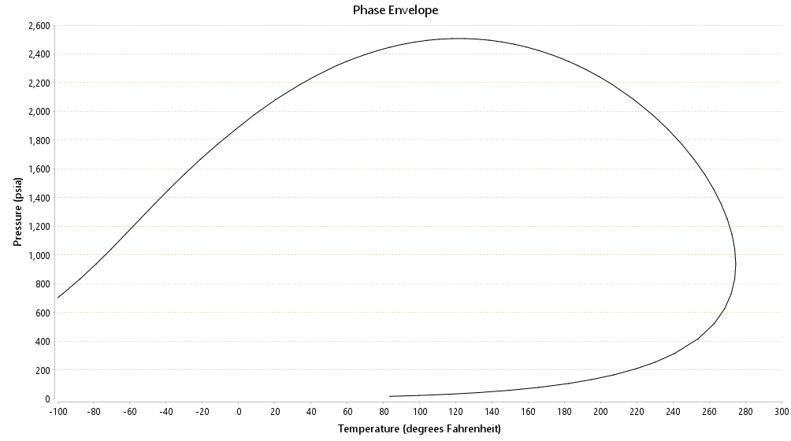
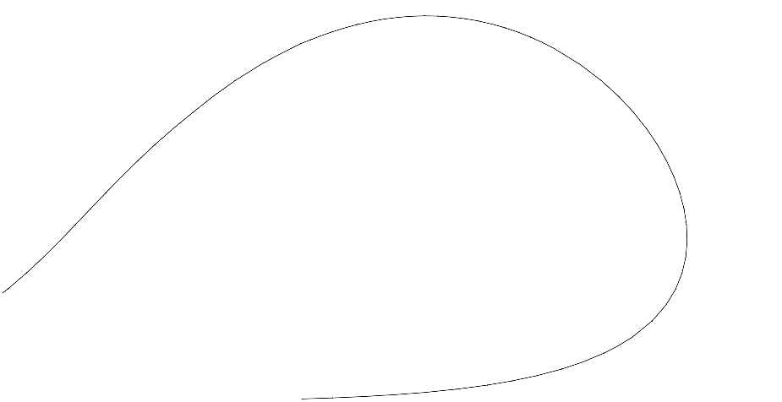
Single C7+ Pseudo-pure Fluid
Split C7+ using Gamma Distribution

