Slide 1
SCN
SCN
PNA
PNA
MW
MW
SG
SG

Slide 2
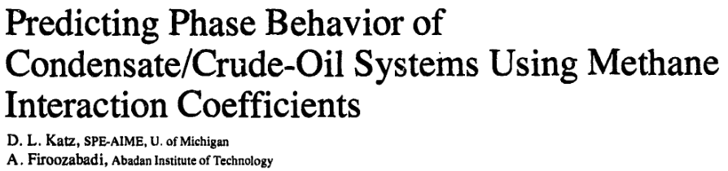
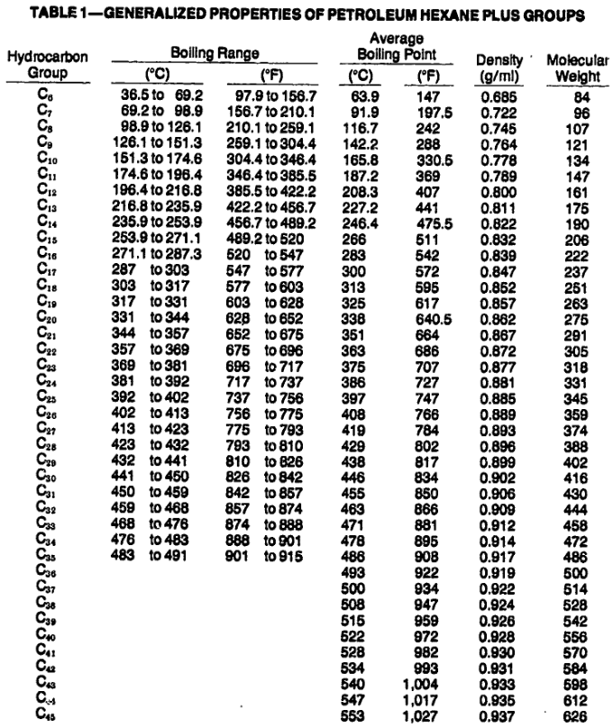

Slide 3
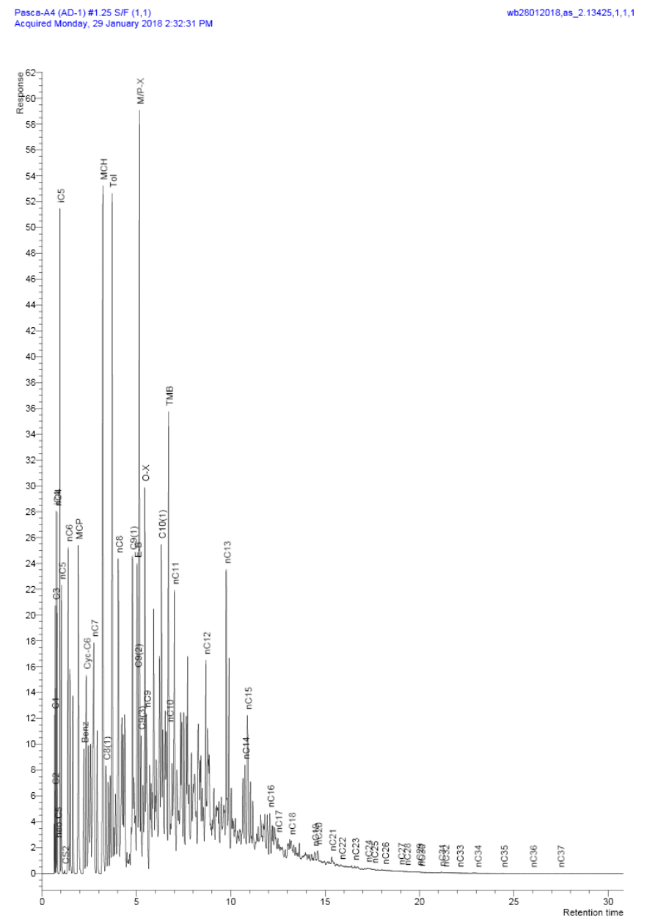
Example Gas Chromatograph Mass Spectrometer Output

