Slide 1
PRESSURE
TEMPERATURE
FWHP
FTHT
12
11
Heat flow from wellbore fluid into subsurface
10
9
8
Frictional pressure loss from motion of fluid against stationary pipe wall
7
Wellbore is broken down into multiple pipe segments and pressure loss across each segment is calculated
6
5
Varying pipe flow diameters e.g. casing flow to tubing flow
4
Hydrostatic pressure loss density of fluid in pipe
2
Drawdown
2
Inflow of oil (containing solution gas), gas (containing vaporised oil) and water from reservoir
Geothermal Gradient
Flowing bottom hole pressure node
1
FBHP
P_{res}
FBHT

Slide 2
Lower Pressure Lower Temperature
Upwards direction of flow
ANNULAR / MIST
Higher Pressure Higher Temperature
CHURN
SLUG
Solution gas effervesces from oil due to drop in pressure as fluid travels higher in wellbore. Gas expands as pressure decreases, thus increasing volumetric flow of gas relative to oil.
BUBBLE

Slide 3
BUBBLE
SLUG
CHURN
ANNULAR / MIST

Slide 4
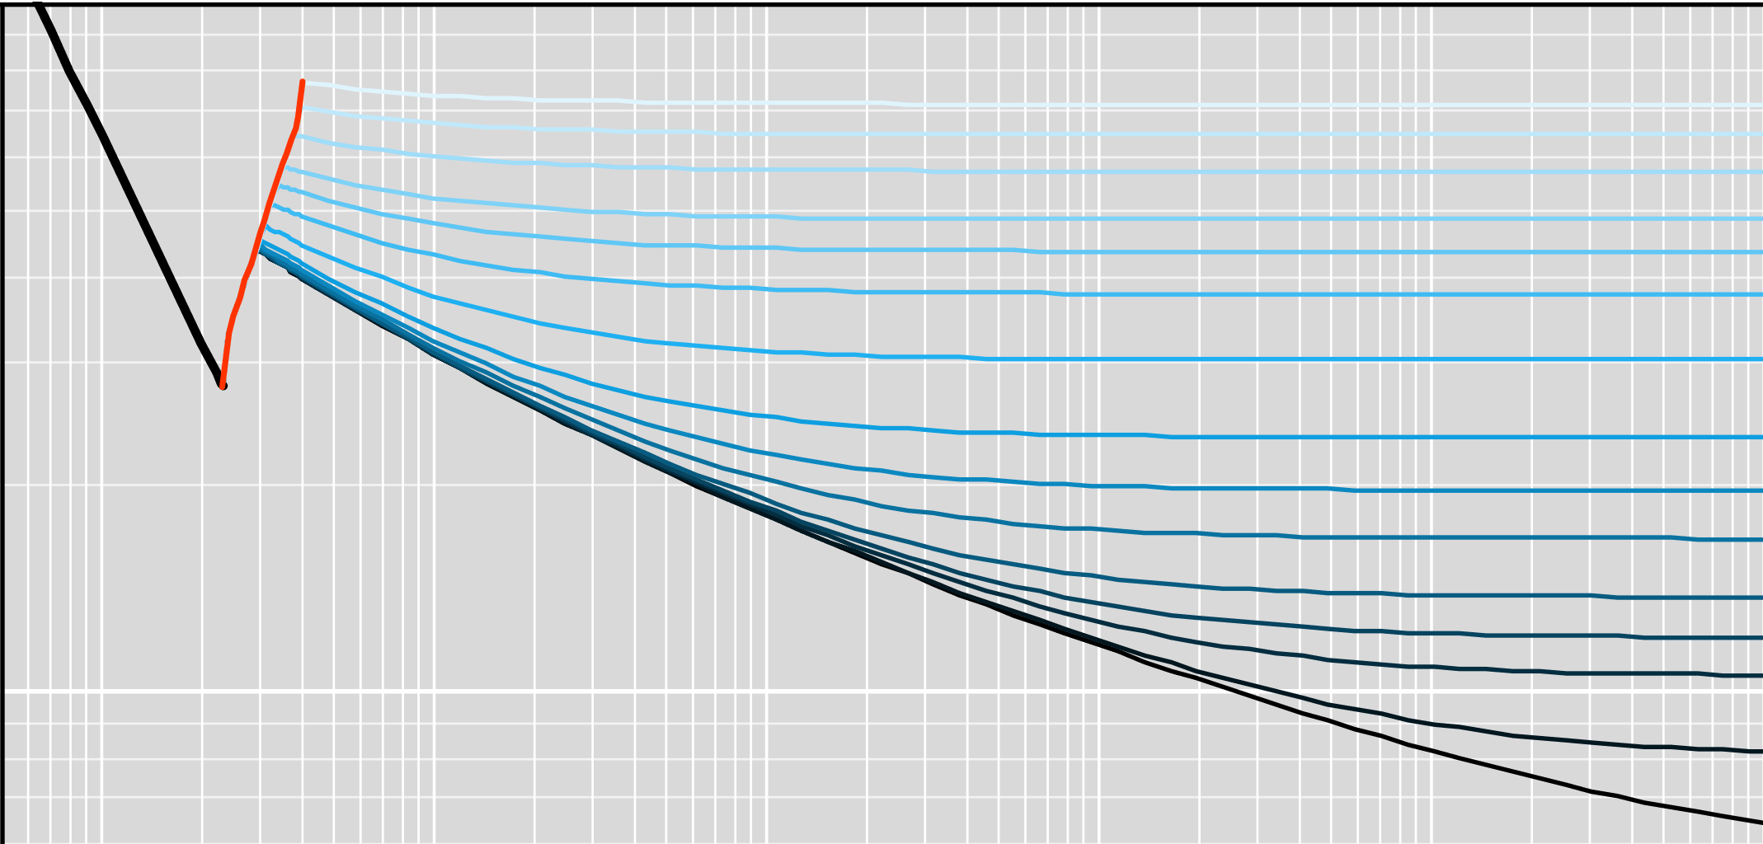

Moody Chart (from Pyrus equations)
0.1
0.09
Complete Turbulence
ε/D
0.08
0.07
0.05
0.04
0.06
0.03
0.05
0.02
0.015
0.04
0.01
0.03
0.005
Relative Pipe Roughness
Friction Factor (f_{m})
0.002
0.02
0.001
5×10⁻⁴
Laminar to Turbulent Transition
2×10⁻⁴
10⁻⁴
0.01
5×10⁻⁵
10⁻⁵
10⁻⁶
1.0e03
1.0e04
1.0e05
1.0e06
1.0e07
1.0e08
Laminar
Critical Zone
Reynolds Number $\left(\frac{ρvD_{h}}{μ}\right)$
Turbulent

Slide 5
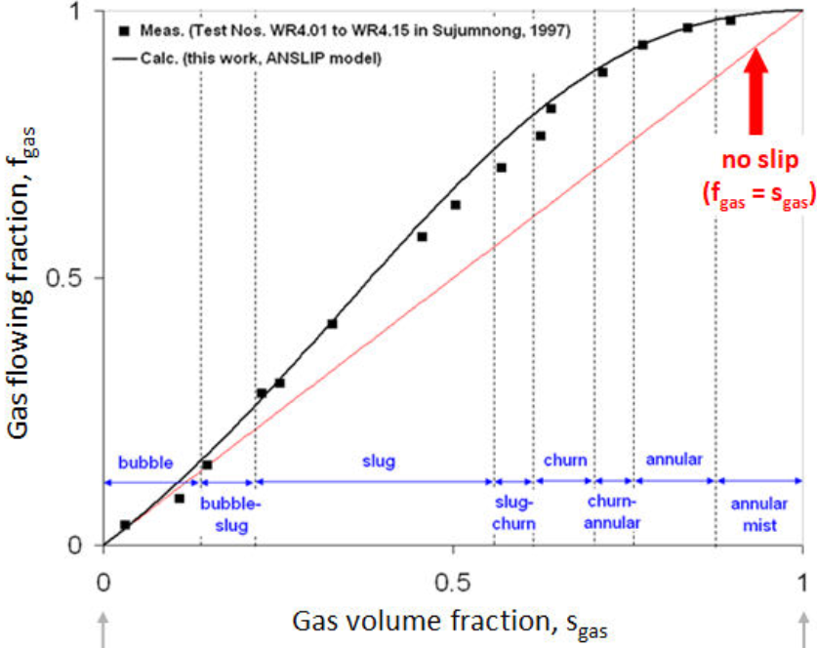
Fractional Flow versus Measurements (Nagoo)
Gas Fractional Flow (f_{g})
Gas Void Fraction (<S_{g}> = 1 - H_{L})
BUBBLE
SLUG / CHURN
ANNULAR
Fractional flow curve from analytical slip model versus measured data points across range of flow patterns exhibits good match. Shape of classical approach fractional flow curve is incorrect.

Slide 6
Simplified Willhite Radial Heat Transfer Model
r_{ti}
k_{e}
k_{cem}
k_{an}
r_{to}
r_{ci}
r_{co}
dL
r_{wb}
T_{e}
Q
T_{f}
k
T
Thermal conductivity
Temperature

Slide 7
1
Actual or Estimated Composition
EPPR78 Cubic EoS Fluid Properties for Two-Phase Combined Fluids
Total Pressure Gradient from Pipe Fractional Flow Theory
2
3
API S_{G}
GOR
Solution Gas
Flowing Vapour
Wellbore Temperature Model
Inlet Surface Rate (mmscfd)
4
Reservoir Gas
Flash
Gas
g θ
H_{L}
v_{sg}
ρ_{g}
Re_{g}
f_{m,g}
f (T_{f}, T_{e}, g, θ, J, C_{pm}, A, F_{c})
Water of Condens.
F_{c}
Joule-Thomson + Kinetic Effect
Inlet Surface Rate (stb/d)
Reservoir Oil
ε
D_{h}
Flash
Vaporised Oil
Flowing Liquid
Coefficient
A
ΔL
Oil
v_{sL}
ρ_{L}
Re_{L} f_{m,L}
Wellbore Heat Transfer Coefficient
U
Inlet Surface Rate (stbw/d)
Water
Water
HPG
FPG
KPG
Inlet P
ΔP
Inlet T
ΔT

