Slide 1
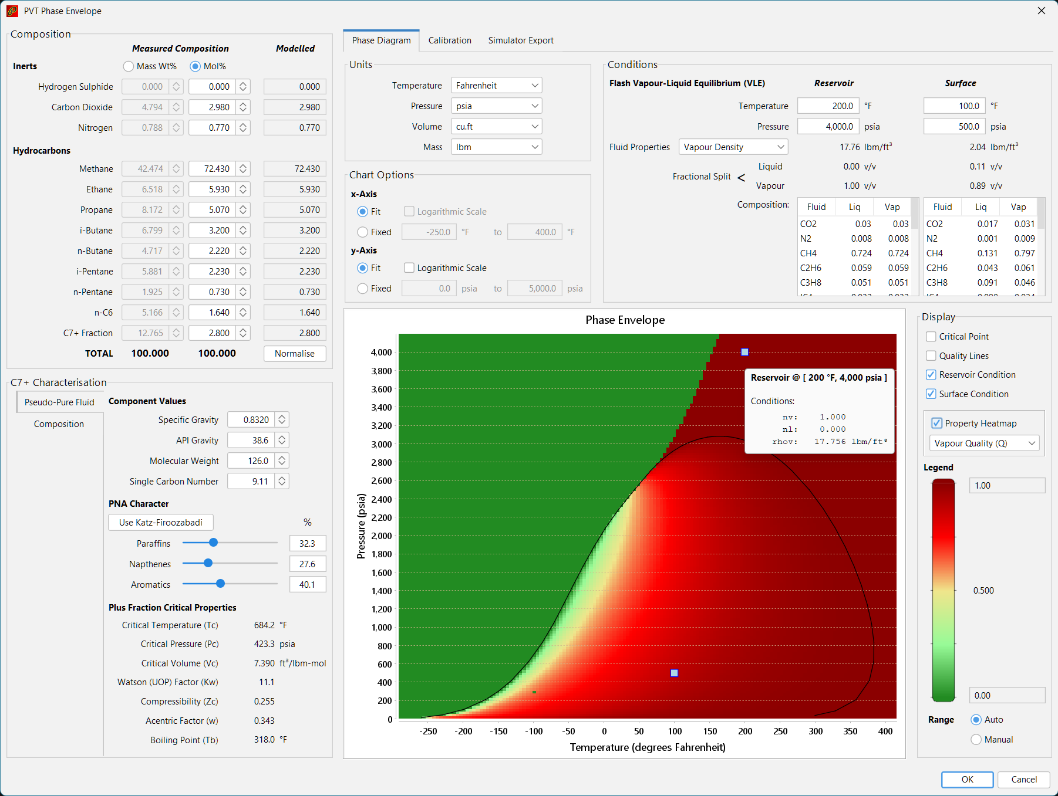
Composition definition
Output options
Phase diagram display options
C7+ and other components definition
Phase diagram display

Slide 2
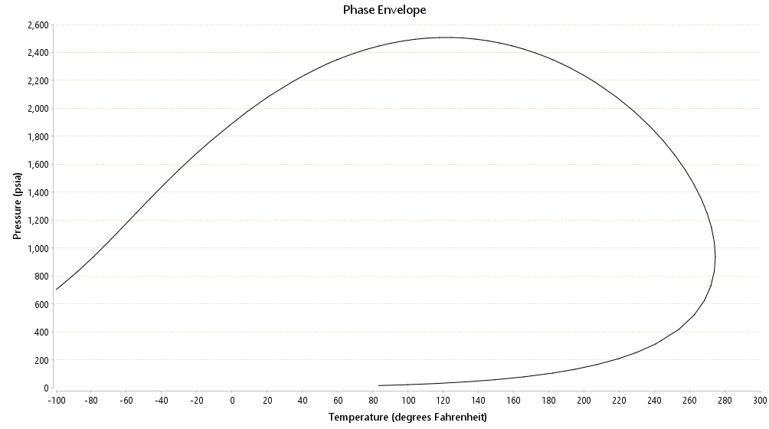
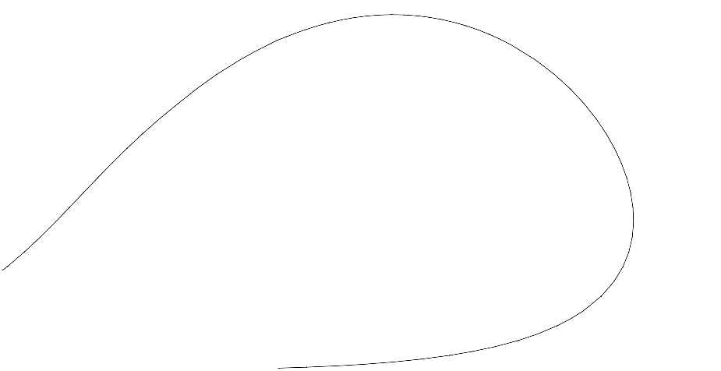
Single C7+ Pseudo-pure Fluid
Split C7+ using Gamma Distribution

