Slide 1
SCN
SCN
PNA
PNA
MW
MW
SG
SG

Slide 2
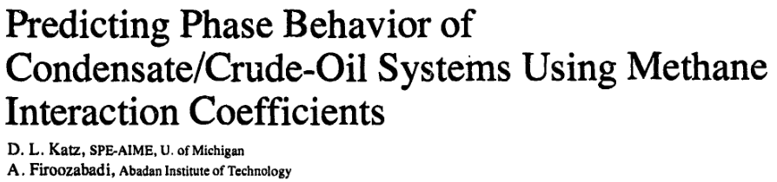
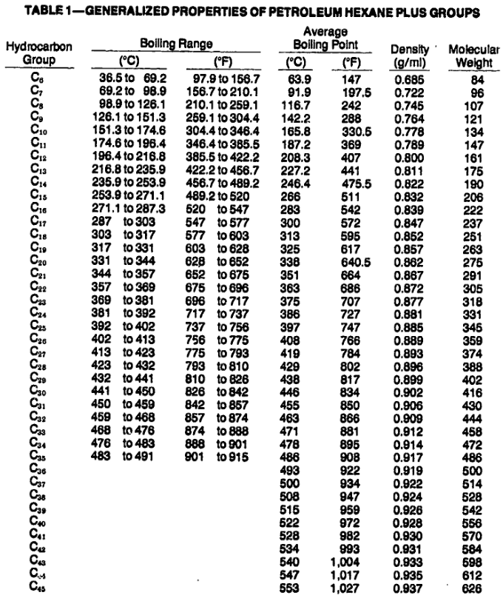

Slide 3
Small discontinuity at SCN = 22 from original Katz-Firoozabadi dataset transition
Discontinuity
Updated regression for MW > 250

Slide 4
API database of properties for pure compounds used to build new relationships. Total of 319 compounds used.
Not every single possible compound exists in the database, and there are limited compounds for higher single carbon numbers > ~12. Approach used has been to ensure that relationships do not violate the dataset, rather than using a mathematical regression such as least squares optimisation.

Slide 5
Single carbon number (SCN) used to designate a distillation cut is based on the number of carbon atoms for paraffins.
To determine an equivalent number of carbon atoms (nC) for naphthenes and aromatics, we must determine the boiling point for the paraffin SCN, and from this obtain the estimated number of carbon atoms for NA fractions associated with an SCN.

Slide 6
Plot of MW and nC/SG versus nC show roughly linear relationships.
MW vs nC relationship is least squares regression.
nC/SG vs nC relationship is tuned to match Volve dataset.

Slide 7
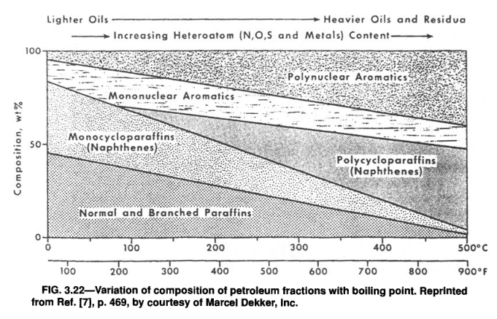
SCN | Paraffin | Aromatic
6 | 0.302 → 1 | 0 → 0.047
7 | 0.277 → 0.991 | 0 → 0.119
8 | 0.254 → 0.973 | 0 → 0.184
9 | 0.233 → 0.956 | 0 → 0.244
10 | 0.213 → 0.940 | 0.025 → 0.300
11 | 0.195 → 0.925 | 0.055 → 0.351
12 | 0.178 → 0.912 | 0.082 → 0.400
13 | 0.162 → 0.899 | 0.109 → 0.445
14 | 0.147 → 0.887 | 0.134 → 0.488
15 | 0.133 → 0.875 | 0.157 → 0.529
16 | 0.119 → 0.864 | 0.179 → 0.568
17 | 0.106 → 0.854 | 0.200 → 0.604
18 | 0.094 → 0.844 | 0.221 → 0.639
19 | 0.082 → 0.835 | 0.240 → 0.673
20 | 0.071 → 0.826 | 0.258 → 0.705
21 | 0.060 → 0.817 | 0.276 → 0.736
22 | 0.050→ 0.809 | 0.293 → 0.765
23 | 0.040→ 0.801 | 0.310 → 0.794
24 | 0.030 → 0.793 | 0.325 → 0.821
25 | 0.021 → 0.785 | 0.341 → 0.848
26 | 0.012 → 0.778 | 0.355 → 0.873
27 | 0.003 → 0.771 | 0.370 → 0.898
28 | 0 → 0.764 | 0.378 → 0.917
29 | 0 → 0.758 | 0.384 → 0.932
30 | 0 → 0.751 | 0.389 → 0.947
31 | 0 → 0.745 | 0.394 → 0.961
32 | 0 → 0.739 | 0.399 → 0.975
33 | 0 → 0.733 | 0.403 → 0.988
34 | 0 → 0.728 | 0.408 → 1
35 | 0 → 0.722 | 0.412 → 1
36 | 0 → 0.717 | 0.416 → 1
37 | 0 → 0.712 | 0.421 → 1
38 | 0 → 0.706 | 0.425 → 1
39 | 0 → 0.701 | 0.429 → 1
40 | 0 → 0.697 | 0.433 → 1
Variation of composition of petroleum fractions with boiling point from Speight (1998). Equations for lines superimposed. Ranges used for synthetic hydrocarbon mixtures shown in table loosely based on this figure.

Slide 8
Updated Riazi-Daubert PNA is used as a starting point. Constrained multi-variate optimiser is used to adjust PNA and improve match to MW and SG.
Method exhibits good match between predicted aromatics and measured aromatics for the Volve dataset.

Slide 9
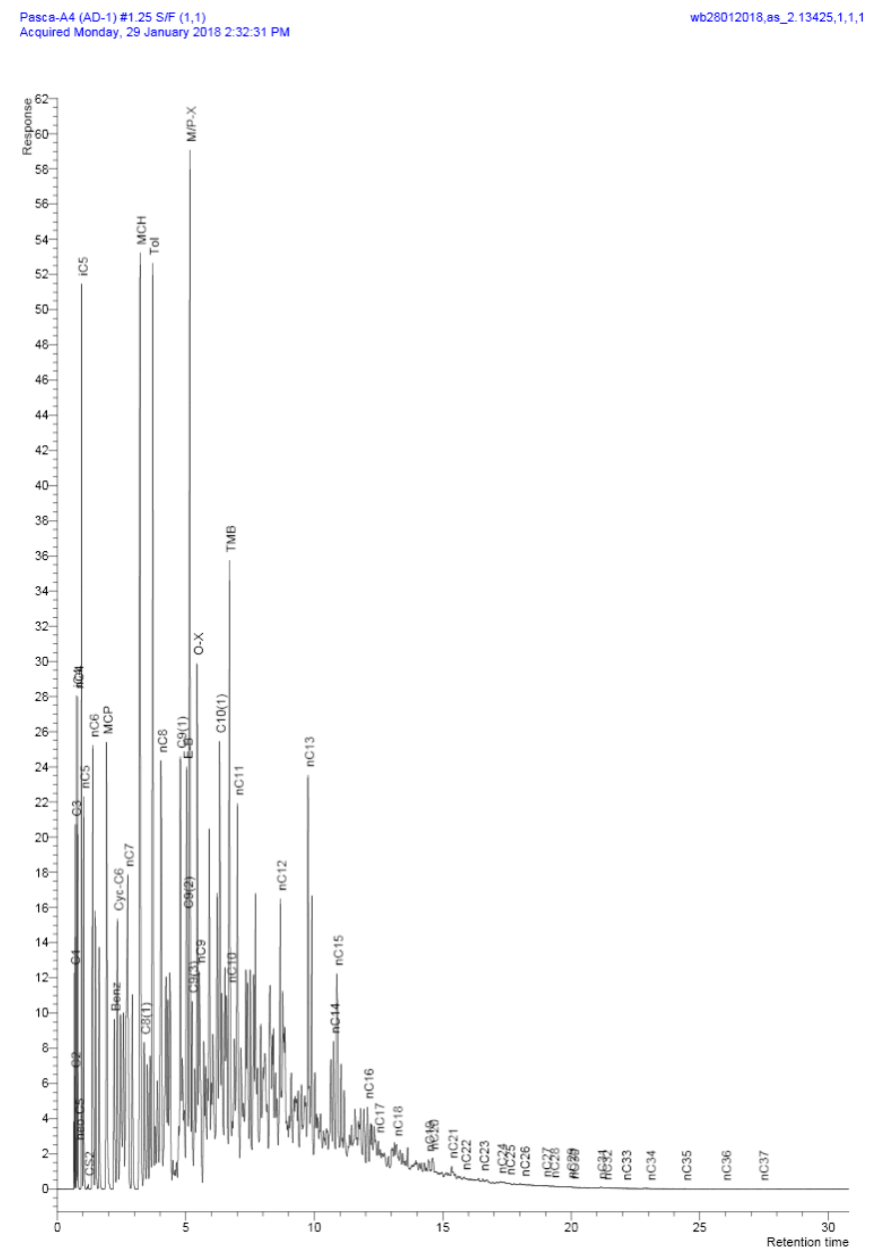
Example Gas Chromatograph Mass Spectrometer Output

