Slide 1
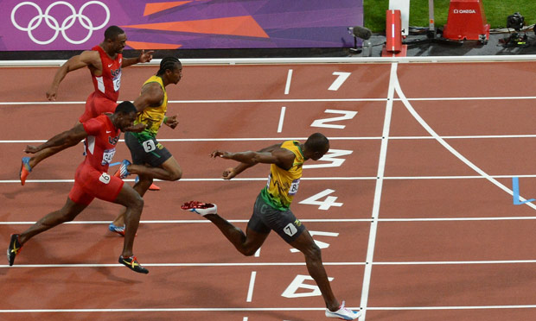
Running time of algorithms

Slide 2
How can we measure the running time of algorithms?
Idea: Use a stopwatch.
What if we run the algorithm on a different computer?
What if we code the algorithm in a different programming language?
What if the computer is doing other things in the background while timing our algorithm?
Timing the algorithm doesn’t (directly) tell us how it will perform in other cases besides the ones we test it on.

Slide 3
How can we measure the running time of algorithms?
Idea: Count the number of “basic operations” in an algorithm.
“Basic operations” are things the computer can do “in a single step,” like
Printing a single value (number or string)
Comparing two values
(simple) math, like adding, multiplying, powers
Assigning a variable a value

Slide 4
How many basic operations are done in this algorithm?
Only count printing as a basic operation.
// assume array is an array of three ints
for (int x = 0; x < 3; x++)
System.out.println(array[x]);
// assume array2 is an array of six ints
for (int x = 0; x < 6; x++)
System.out.println(array[x]);

Slide 5
How many basic operations are done in this algorithm?
Only count printing as a basic operation.
// assume array is an array of ints
for (int x = 0; x < array.length; x++)
System.out.println(array[x]);
If n = array.length, what is a general formula for how long this algorithm takes, in terms of n?

Slide 6
How many basic operations are done in this algorithm, in the worst possible case?
Only count printing as a basic operation.
// assume array is an array of ints
for (int x = 0; x < array.length; x++)
if (array[x] > 10)
System.out.println(array[x]);
If n = array.length, what is a general formula for how long this algorithm takes, in terms of n, in the worst case?

Slide 7
Computer scientists often consider the running time for an algorithm in the worst case, since we know the algorithm will never be slower than that.
Sometimes we also care about average running time.
We express the running time of an algorithm as a function in terms of “n,” which represents the size of the input to the algorithm.
For an algorithm that processes an array or arraylist, n is the length of the array/list.

Slide 8
/* Assume for both algorithms, var and n are
already defined as positive integers.
Basic ops are printing and adding. */
// algorithm A
var = var + n;
System.out.println(var);
// algorithm B
for (int x = 0; x < n; x++)
var++;
System.out.println(var);
Notes:
Compare these two algorithms in terms of running time. Basic operations are adding, multiplying, and variable assignment. What are the running times of algorithms A and B? A is 2. B is (n+1) additions for the x++, n additions for the var++, 1 for the printing = 2n+2. Which is faster as n gets really big?
So we can have two algorithms that accomplish the same thing, but have different running times.
DRAW GRAPH.

Slide 9
Time (T)
Alg B: T(n) = 2n + 2
Alg A: T(n) = 2
Input size (n)
n=1

Slide 10
Suppose we count comparisons:
double largest = vec[0];
for (int x = 0; x < vec.size(); x++)
{
if (vec[x] > largest) ← how many times?
largest = vec[x]
}
Notes:
Compare these two algorithms in terms of running time. Basic operations are adding, multiplying, and variable assignment. What are the running times of algorithms A and B? A is 2. B is 1 + n. Which is faster as n gets really big?
So we can have two algorithms that accomplish the same thing, but have different running times.
DRAW GRAPH.

Slide 11
Suppose we count comparisons:
double largest = -99999;
for (int x = 0; x < open.size(); x++)
{
for (int y = 0; y < close.size(); y++)
{
if (close[y] – open[x] > largest)
largest = close[y] – open[x]
}
}
Notes:
Compare these two algorithms in terms of running time. Basic operations are adding, multiplying, and variable assignment. What are the running times of algorithms A and B? A is 2. B is 1 + n. Which is faster as n gets really big?
So we can have two algorithms that accomplish the same thing, but have different running times.
DRAW GRAPH.

Slide 12
Suppose we count comparisons:
double largest = -99999;
for (int x = 0; x < open.size(); x++)
{
for (int y = x; y < close.size(); y++)
{
if (close[y] – open[x] > largest)
largest = close[y] – open[x]
}
}
Notes:
Compare these two algorithms in terms of running time. Basic operations are adding, multiplying, and variable assignment. What are the running times of algorithms A and B? A is 2. B is 1 + n. Which is faster as n gets really big?
So we can have two algorithms that accomplish the same thing, but have different running times.
DRAW GRAPH.

Slide 13
We group running times together based on how they grow as n gets really big.
If the running time stays exactly the same as n gets big (n has no effect on the algorithm's speed), we say the running time is constant.
If the running time grows proportionally to n, we say the running time is linear.
If the input size doubles, the running time roughly doubles.
If the input size triples, the running time roughly triples.

Slide 14
// algorithm A
var = var + n;
System.out.println(var);
What class does algorithm A fall into? [constant or linear]
// algorithm B
for (int x = 0; x < n; x++)
var++;
System.out.println(var);
What class does algorithm B fall into? [constant or linear]

Slide 15
Which is "better?"
In general, we prefer algorithms that run faster.
That is, as the algorithm's input size grows, the time required to run the algorithm should grow as slowly as possible.
Therefore, an algorithm that runs in constant time is usually preferred over a linear-time algorithm.

Slide 16
Time (T)
Alg B: linear
Alg A: constant
Input size (n)
n=1

Slide 17
// Calculate formulas for basic
// operations (adding, printing).
// algorithm C:
// assume array has n ints in it
int sum = 0;
for (int i = 0; i < array.length; i++) { sum += array[i]; }
Notes:
What are the running times constant/linear for these algorithms?
alg C = 2n+1
because n+1 for the adding to i++, n for adding to sum.

Slide 18
// Calculate formulas for basic
// operations (adding, printing).
// algorithm D:
// assume array has n ints in it
int sum = 0;
for (int i = 0; i < array.length; i++) {
if (array[i] > 10) { sum += array[i];
}
System.out.println(sum); }
Notes:
What are the running times constant/linear for these algorithms?
alg d = i++ -> n+1 times
sum += array[i] -> n times
println -> n times
3n+1

Slide 19
Time (T)
Alg B: linear
Alg D: linear
Alg C: linear
Alg A: constant
Input size (n)
n=1

Slide 20
Classes have special names, which use big-O notation.
Constant time algorithm: O(1)
Read as “big-oh of 1” or “oh of 1”
Linear time algorithm: O(n)
Read as “big oh of n” or “oh of n”
These classes give us a rough estimate of the "order of growth" of an algorithm = how the run time changes as we increase the input size, without worrying about details.

Slide 21
How many basic operations are done in this algorithm?
Only count printing as a basic operation.
# assume M is a n by n matrix of numbers
for (int x =
for col in range(0, n):
print(M[row][col])
What is a general formula for how long this algorithm takes, in terms of n?
Notes:
For an algorithm that processes a matrix, usually n is the number of rows or the number of columns, whichever is larger (since that’s the worst case).

Slide 22
Count (or estimate) the basic operations.
Assume n = array.length.
int sum = 0; for (int row = 0; row < array.length; row++)
{ for (int col = 0; col < array[row].length; col++)
{ sum += array[row][col]; } }
Notes:
What are the running times constant/linear for these algorithms?
alg d = i++ -> n+1 times
sum += array[i] -> n times
println -> n times
3n+1

Slide 23
An algorithm which doesn’t get slower as input size increases is a constant-time algorithm.
An algorithm whose running time grows proportionally to input size is a linear-time algorithm.
An algorithm whose running time grows proportionally to the square of the input size is a quadratic-time algorithm.
O(n²)
What about binary search?

Slide 24

Watch Phil Tear A Phone Book in Half

Slide 25
If a list is sorted, you can use the binary search algorithm to find the position of an element in the list.
Takes logarithmic time.
If a list is not sorted, you can't use binary search; you have to use sequential search.
Takes linear time.

Slide 26
Some problems have algorithms that run even more slowly than quadratic time.
Cubic time (n³), higher polynomials, …
Exponential time (2^{n}) is even slower! [Fibonacci]
In some situations, we depend on the fact that we don't have fast algorithms to solve problems.
For instance, many cryptographic algorithms that enable us to send passwords securely over the internet depend on us not having fast algorithms to break the encryption.

Slide 27
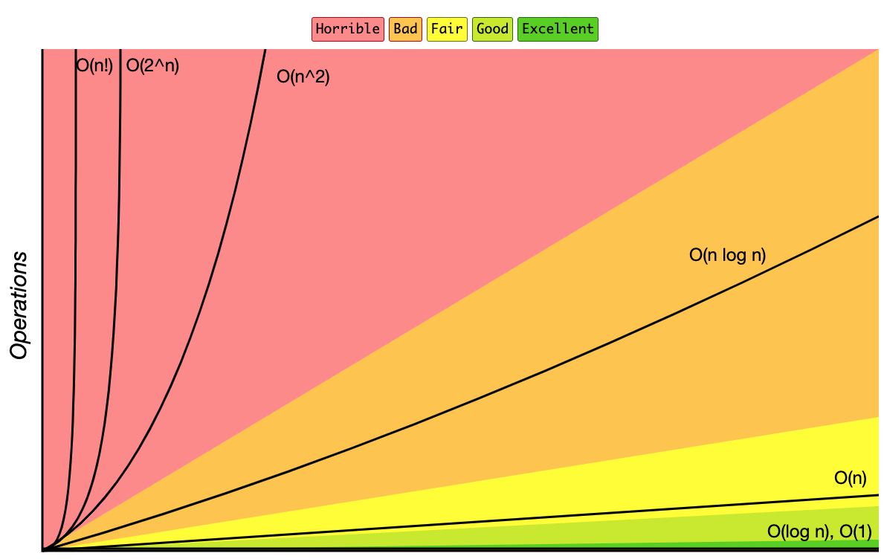

Slide 28
OK
Try to avoid

Slide 29
Time (T)
exponential
quadratic
linear
logarithmic
constant
Input size (n)

Slide 30
One million “basic” operations per second.
 | logarithmic | linear | quadratic | exponential
n = 10
n = 20
n = 30
n = 50
n = 100
n = 1,000
n = 10,000
n = 100,000
n = 1,000,000
Notes:
4 x 10^16 ~ 3 million times the age of the universe

Slide 31
One million “basic” operations per second.
 | logarithmic | linear | quadratic | exponential
n = 10 | 0.0033 ms
n = 20 | 0.0043 ms
n = 30 | 0.0049 ms
n = 50 | 0.0056 ms
n = 100 | 0.0066 ms
n = 1,000 | 0.0099 ms
n = 10,000 | 0.0133 ms
n = 100,000 | 0.0166 ms
n = 1,000,000 | 0.0199 ms
Notes:
4 x 10^16 ~ 3 million times the age of the universe

Slide 32
One million “basic” operations per second.
 | logarithmic | linear | quadratic | exponential
n = 10 | 0.0033 ms | 0.01 ms
n = 20 | 0.0043 ms | 0.02 ms
n = 30 | 0.0049 ms | 0.03 ms
n = 50 | 0.0056 ms | 0.05 ms
n = 100 | 0.0066 ms | 0.1 ms
n = 1,000 | 0.0099 ms | 1 ms
n = 10,000 | 0.0133 ms | 10 ms
n = 100,000 | 0.0166 ms | 0.1 sec
n = 1,000,000 | 0.0199 ms | 1 sec
Notes:
4 x 10^16 ~ 3 million times the age of the universe

Slide 33
One million “basic” operations per second.
 | logarithmic | linear | quadratic | exponential
n = 10 | 0.0033 ms | 0.01 ms | 0.1 ms
n = 20 | 0.0043 ms | 0.02 ms | 0.4 ms
n = 30 | 0.0049 ms | 0.03 ms | 0.9 ms
n = 50 | 0.0056 ms | 0.05 ms | 2.5 ms
n = 100 | 0.0066 ms | 0.1 ms | 0.01 sec
n = 1,000 | 0.0099 ms | 1 ms | 1 sec
n = 10,000 | 0.0133 ms | 10 ms | 1.67 min
n = 100,000 | 0.0166 ms | 0.1 sec | 2.77 hours
n = 1,000,000 | 0.0199 ms | 1 sec | 11.57 days
Notes:
4 x 10^16 ~ 3 million times the age of the universe

Slide 34
One million “basic” operations per second.
 | logarithmic | linear | quadratic | exponential
n = 10 | 0.0033 ms | 0.01 ms | 0.1 ms | 1.024 ms
n = 20 | 0.0043 ms | 0.02 ms | 0.4 ms
n = 30 | 0.0049 ms | 0.03 ms | 0.9 ms
n = 50 | 0.0056 ms | 0.05 ms | 2.5 ms
n = 100 | 0.0066 ms | 0.1 ms | 0.01 sec
n = 1,000 | 0.0099 ms | 1 ms | 1 sec
n = 10,000 | 0.0133 ms | 10 ms | 1.67 min
n = 100,000 | 0.0166 ms | 0.1 sec | 2.77 hours
n = 1,000,000 | 0.0199 ms | 1 sec | 11.57 days
Notes:
4 x 10^16 ~ 3 million times the age of the universe

Slide 35
One million “basic” operations per second.
 | logarithmic | linear | quadratic | exponential
n = 10 | 0.0033 ms | 0.01 ms | 0.1 ms | 1.024 ms
n = 20 | 0.0043 ms | 0.02 ms | 0.4 ms | 1.049 sec
n = 30 | 0.0049 ms | 0.03 ms | 0.9 ms
n = 50 | 0.0056 ms | 0.05 ms | 2.5 ms
n = 100 | 0.0066 ms | 0.1 ms | 0.01 sec
n = 1,000 | 0.0099 ms | 1 ms | 1 sec
n = 10,000 | 0.0133 ms | 10 ms | 1.67 min
n = 100,000 | 0.0166 ms | 0.1 sec | 2.77 hours
n = 1,000,000 | 0.0199 ms | 1 sec | 11.57 days
Notes:
4 x 10^16 ~ 3 million times the age of the universe

Slide 36
One million “basic” operations per second.
 | logarithmic | linear | quadratic | exponential
n = 10 | 0.0033 ms | 0.01 ms | 0.1 ms | 1.024 ms
n = 20 | 0.0043 ms | 0.02 ms | 0.4 ms | 1.049 sec
n = 30 | 0.0049 ms | 0.03 ms | 0.9 ms | 17.9 min
n = 50 | 0.0056 ms | 0.05 ms | 2.5 ms
n = 100 | 0.0066 ms | 0.1 ms | 0.01 sec
n = 1,000 | 0.0099 ms | 1 ms | 1 sec
n = 10,000 | 0.0133 ms | 10 ms | 1.67 min
n = 100,000 | 0.0166 ms | 0.1 sec | 2.77 hours
n = 1,000,000 | 0.0199 ms | 1 sec | 11.57 days
Notes:
4 x 10^16 ~ 3 million times the age of the universe

Slide 37
One million “basic” operations per second.
 | logarithmic | linear | quadratic | exponential
n = 10 | 0.0033 ms | 0.01 ms | 0.1 ms | 1.024 ms
n = 20 | 0.0043 ms | 0.02 ms | 0.4 ms | 1.049 sec
n = 30 | 0.0049 ms | 0.03 ms | 0.9 ms | 17.9 min
n = 50 | 0.0056 ms | 0.05 ms | 2.5 ms | 35.7 years
n = 100 | 0.0066 ms | 0.1 ms | 0.01 sec
n = 1,000 | 0.0099 ms | 1 ms | 1 sec
n = 10,000 | 0.0133 ms | 10 ms | 1.67 min
n = 100,000 | 0.0166 ms | 0.1 sec | 2.77 hours
n = 1,000,000 | 0.0199 ms | 1 sec | 11.57 days
Notes:
4 x 10^16 ~ 3 million times the age of the universe

Slide 38
One million “basic” operations per second.
 | logarithmic | linear | quadratic | exponential
n = 10 | 0.0033 ms | 0.01 ms | 0.1 ms | 1.024 ms
n = 20 | 0.0043 ms | 0.02 ms | 0.4 ms | 1.049 sec
n = 30 | 0.0049 ms | 0.03 ms | 0.9 ms | 17.9 min
n = 50 | 0.0056 ms | 0.05 ms | 2.5 ms | 35.7 years
n = 100 | 0.0066 ms | 0.1 ms | 0.01 sec | 4 x 10¹⁶ years
n = 1,000 | 0.0099 ms | 1 ms | 1 sec | 3 x 10²⁸⁷ years
n = 10,000 | 0.0133 ms | 10 ms | 1.67 min | ----
n = 100,000 | 0.0166 ms | 0.1 sec | 2.77 hours | ----
n = 1,000,000 | 0.0199 ms | 1 sec | 11.57 days | ----
Notes:
4 x 10^16 ~ 3 million times the age of the universe

