Slide 1
CS241 Data Structures and Algorithms
Introduction

Slide 2
What is this course about?
Data Structures!
A particular method of storing and organizing data so it can be accessed and modified quickly.
Algorithms!
A step by step procedure for accomplishing a task.

Slide 3
Goals
To introduce the fundamental data structures and algorithms you will see throughout comp sci.
To develop a level of understanding where you can:
implement them from scratch (though you will rarely need to)
use them in a program to solve some computational problem
be able to modify them to accomplish a related task
To know how to pick the right data structure or algorithm for the problem.

Slide 4
Administrivia
Textbook: no official printed textbook
I will post links to sections of online books and other resources.
Communication:
Website will be the main source.
Also Slack.
Programming:
In Java!
Highly encouraged to use IntelliJ IDEA (it's free).

Slide 5
Syllabus – Grading breakdown
Programming projects 30%
Written homework 20%
Midterm 1 15%
Midterm 2 15%
Comprehensive final exam 20%

Slide 6
Office Hours
Regular office hours will be announced soon.
Please come! These are a resource for you. Typically they are underutilized.
Also send me email or a Slack message for "unscheduled" office hours.
I can't promise I'll respond immediately, but I'll always get back to you within a day, and we can most likely schedule a time to meet.

Slide 7
Collaboration

Slide 8
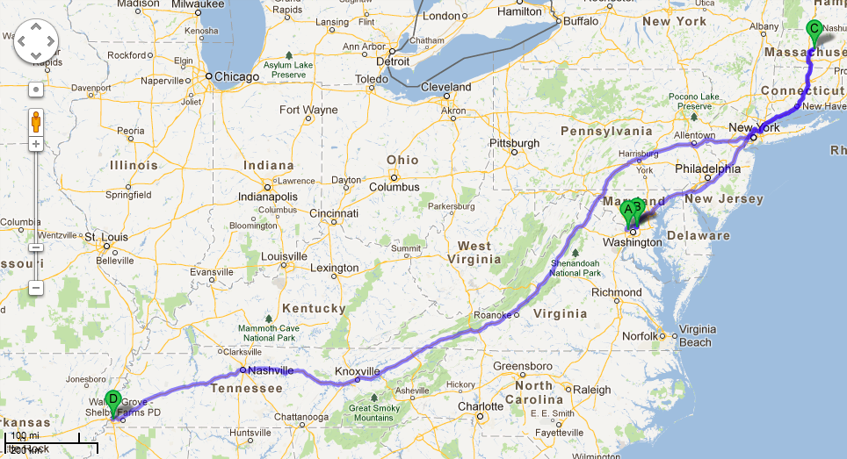
Introductions - Me

