Slide 1
NoSQL Databases

Slide 2
Earlier…
We have spent most of our time with the relational DB model so far.
There are other models:
Key-value: a hash table
Graph: stores graph-like structures efficiently
Object: good for storing OO things
Document: stores an entire “document” at a time which is usually a text-based file with some internal structure (e.g., XML, JSON).

Slide 3
NoSQL
NoSQL = “non-SQL” or “not only SQL” --- refers to anything other than the relational model.
Around since the 60s, but the term was not popularized until these types of databases became extremely popular with companies like Facebook, Amazon, and Google.
Increasingly used in big data and real-time web applications.
Advantages: Simpler DB designs (no schemas), simpler scaling to clusters of machines, faster than relational in some cases.
Disadvantages: Often no joins (low functionality), need multiple queries to answer some questions.

Slide 4
Relational Model store related data in tables require a schema which defines tables prior to use encourage normalization to reduce data redundancy support table JOINs to retrieve related data from multiple tables in a single command implement data integrity rules provide transactions to guarantee two or more updates succeed or fail as an atomic unit can be scaled (with some effort) use a powerful declarative language for querying offer plenty of support, expertise and tools. | Document Model store related data in JSON-like, name-value documents can store data without specifying a schema must usually be denormalized so information about an item is contained in a single document should not require JOINs (presuming denormalized documents are used) permit any data to be saved anywhere at anytime without verification guarantee updates to a single document — but not multiple documents provide excellent performance and scalability use JSON data objects for querying are a newer, exciting technology.

Slide 5
Scenario: Address book
First attempt: id, title, firstname, lastname, telephone, email, address, city, state, zipcode.
Problem – multiple telephone numbers, addresses, emails
Solution – Create separate tables for each of these.
New relations: original relation is now just (id, title, first, last). Three new relations for Telephones, Addresses, Emails.
Problems
Rigid schema – what if we want to add middle names, birthdays, company name, job title, anniversary, social media accounts?
Data is fragmented – split across multiple tables. Not easy to retrieve all of someone’s email addresses, telephone numbers, and postal addresses at once in an easy-to-read format.

Slide 6
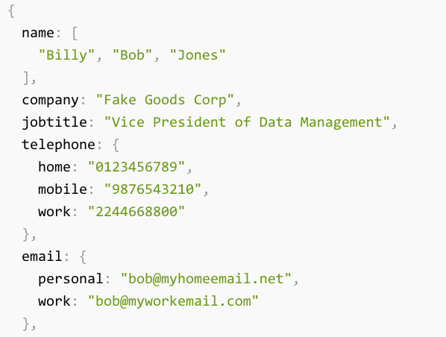
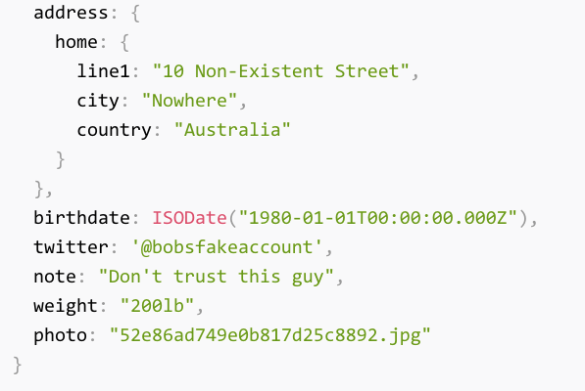
NoSQL alternative

Slide 7
Scenario: Twitter
Suppose we want to implement a relational DB to store tweets.
The overhead of a relational DB may be overkill here --- we will rarely need transactions, for instance.
A failed update is unlikely to cause a global meltdown or financial loss. We can sacrifice a little ACID for some speed.

Slide 8
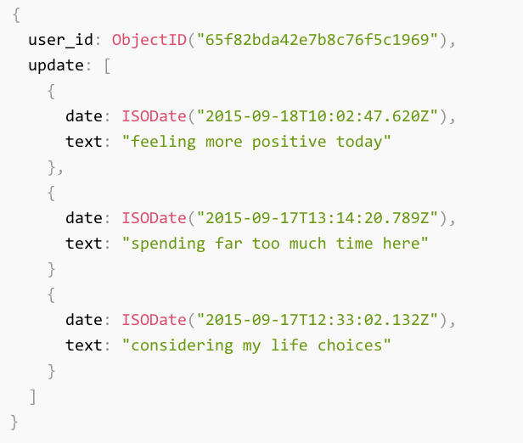
NoSQL Twitter

Slide 9
MongoDB
NoSQL document-oriented database.
Every document is represented by JSON
Javascript Object Notation
Free and open-source.
According to their website, used by Expedia, Forbes, AstraZeneca, MetLife, Facebook, Urban Outfitters, and Comcast.

Slide 10
JSON
Data interchange format, not a programming language.
In other words, used to represent and store data, not give commands.
Data types:
Number (integer or float), String (double quoted), Boolean (true/false)
Arrays: uses square bracket notation
Objects: Uses curly bracket notation
Spacing doesn’t matter.

Slide 11
JSON Example (Object)
{
“crn”: 12345
“title”: “Databases”
“department”: “Math and CS”
}
Name-value pairs. Name is quoted (must be a string). Value is quoted if it's a string, but it can be any data type.

Slide 12
JSON Example (Array)
[1, “hello world”, 2.76]

Slide 13
JSON Example (Array of Objects)
[
{
“crn”: 12345
“title”: “Databases”
“department”: “Math and CS”
},
{
“crn”: 45897
“title”: “Discrete Structures”
“department”: “Math and CS”
}
]

Slide 14
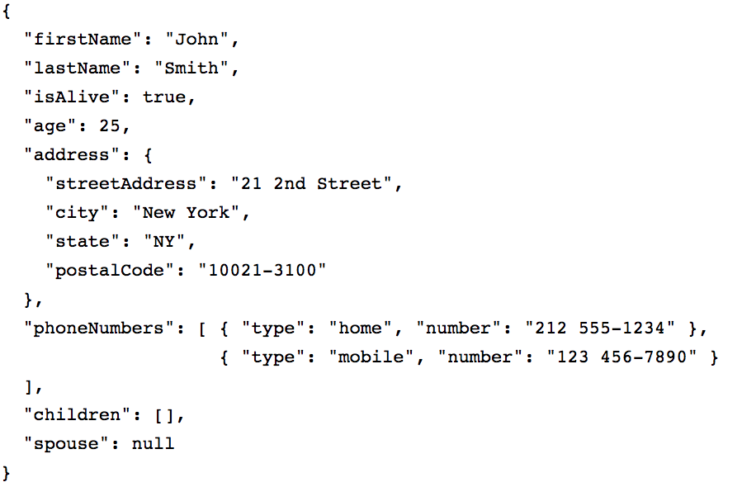

Slide 15
MongoDB concepts
In a RDBMS, we often think of rows of a table as individual records.
In MongoDB (and other document-oriented DBs), records are (JSON) documents.
A group of documents (with presumably similar structures) is called a collection in MongoDB.
Table <-> Collection
Row <-> Document
Column <-> Field

