Slide 1
Databases: Relational Algebra

Slide 2
Students
Professors
Last | First
Potter | Harry
Granger | Hermione
Weasley | Ron
Longbottom | Neville
Malfoy | Draco
Last | First
McGonagall | Minerva
Snape | Severus
Longbottom | Neville
Dumbledore | Albus
Gryffindors
Last | First
Potter | Harry
Granger | Hermione
Weasley | Ron
McGonagall | Minerva
Longbottom | Neville
Dumbledore | Albus

Slide 3
Name | ID | Major | Age
Alice | 1 | CS | 18
Bob | 2 | Math | 20
Carol | 3 | CS | 19
Dan | 4 | CS | 20
Eva | 5 | Math | 21
Frank | 6 | Physics | 18
Enrolled
Key = (ID, CRN)
Students
Key = ID
ID | CRN
1 | 101
1 | 102
2 | 104
2 | 105
3 | 101
3 | 104
4 | 103
5 | 108
5 | 105
5 | 110
6 | 107
6 | 110
6 | 106
Courses
Key = CRN
CRN | Dept | CourseName | Seats
101 | CS | Databases | 20
102 | CS | Discrete Structures | 15
103 | CS | Graphics | 25
104 | Math | Linear Algebra | 18
105 | Math | Differential Equations | 20
106 | Music | Piano Lessons | 10
107 | Physics | Optics | 16
108 | Music | Music Theory | 21
109 | Physics | Modern Physics | 15
110 | Math | Number Theory | 20

Slide 4
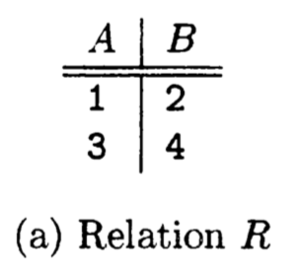
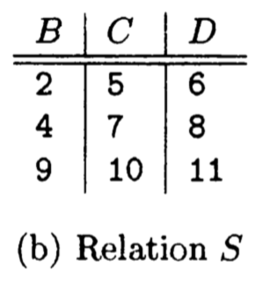
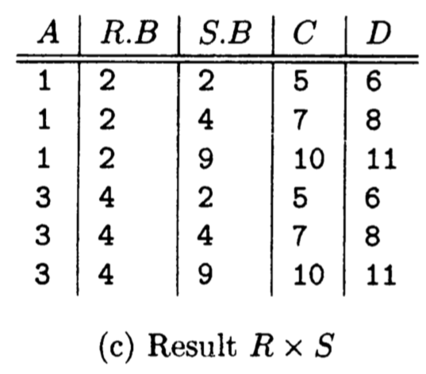
Cartesian Product

Slide 5
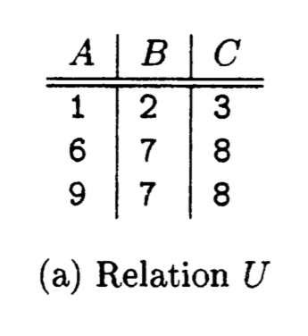
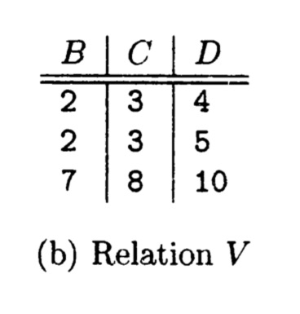
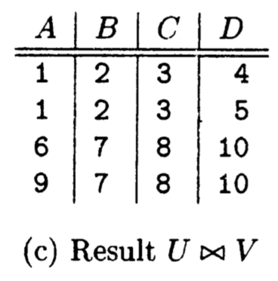
Natural Join

Slide 6
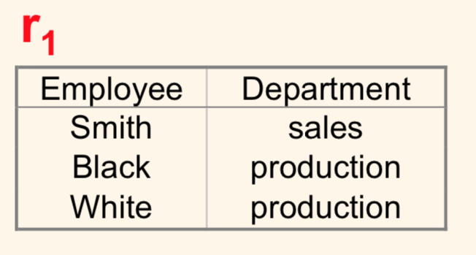
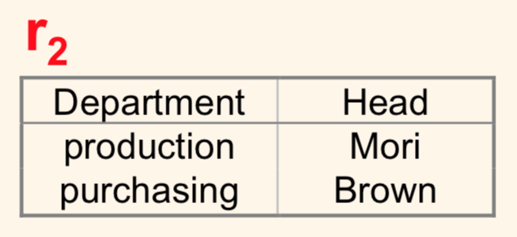
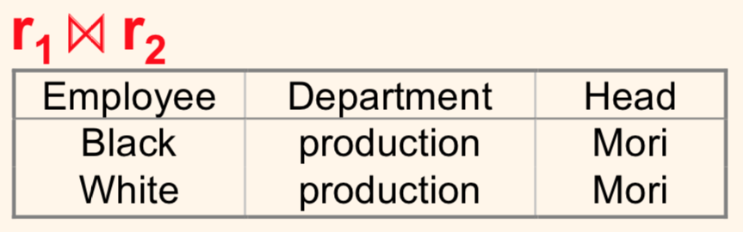
(Natural) joins can be incomplete
If a tuple from one relation doesn't have a "counterpart" in the other relation, it doesn't contribute to the join ("dangling" tuple):

Slide 7
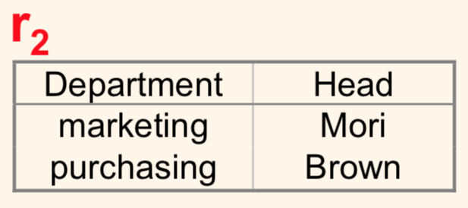
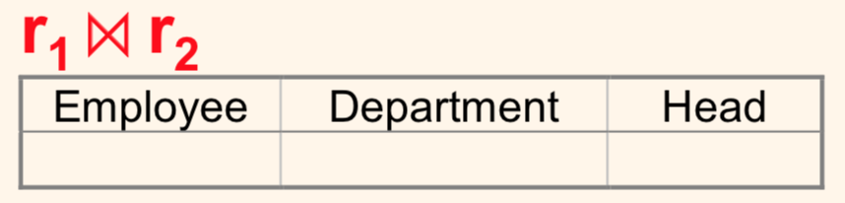
(Natural) joins can be empty!
If no tuple has a counterpart, then the resulting relation is empty.

Slide 8
New Database!
Database schema:
Person(name, age, school) name is a key
Frequents(name, pizzeria) (name, pizzeria) is a key
Eats(name, pizza) (name, pizza) is a key
Serves(pizzeria, pizza, price) (pizzeria, price) is a key
school is either “Rhodes” or “U of M”
pizzeria is the name of a pizza restaurant (e.g., “Memphis Pizza Café,” “Aldo’s” etc)
pizza is a type of pizza (e.g., “pepperoni,” “cheese,” “pineapple,”…)

