Slide 2
Last Few Things
Final project deliverables due on Friday as a .zip file. Upload to Moodle.
Turn in group/self evaluations by Friday as well. I cannot assign you or your group a grade without the evaluation.
Complete the online course evaluation by tomorrow 11:59pm. If more than 85% of the class does the evaluation, everyone gets a bonus point on the final exam.

Slide 3
Final Exam
Tuesday, December 10, 1-3:30pm
Or: Friday, December 6, 8:30-11am
One 8.5 x 11 sheet of notes, front and back.
Typed or hand-written. No magnifying glasses.
Will cover all topics roughly proportionally to the amount of time spent on them in class.
All homework solutions are posted on Moodle.

Slide 4
Final exam topics
The relational model; relational algebra
SQL
E/R diagrams
(No Python/Flask)
Functional & multivalued dependencies
BCNF, 3NF, 4NF
Indexes & B-Trees
Query optimization
Transactions
JSON & MongoDB
Hint: Keys to the game:
Know what a topic is, what it's good for, what it's bad for, how to use it, and how it relates to other topics.

Slide 5
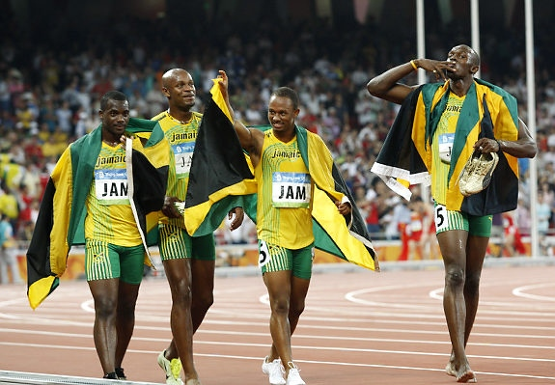
Victory Lap
A victory lap is an extra trip around the track
By the exhausted victors (us) ☺
Review course goals
See if we met them

Slide 6
Thank you!
You all made this a great class
Great attitude about learning DB topics
(Mostly) good class attendance and questions
Occasionally laughed at stuff ☺

Slide 7
For next time
Growing pains:
Will re-examine use of Google Cloud for database and Linux infrastructure.
I want to make it easier for people to collaborate on the group project.

Slide 8

Thank you!
My fourth time teaching this course.
Feedback is appreciated on projects, tests, and their respective difficulty (too hard, too easy, just right?)

Slide 9
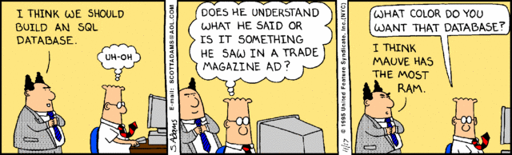

Slide 10
What will you learn? (from lecture 1)
Database design
How do you model your data so it can be stored in a database?
Database programming
How do I use a database to ask it questions?
Database implementation
How does the database itself work; i.e., how does it store, find, and retrieve data efficiently?

Slide 11
Project debriefing
Project goals
Do something cool with databases.
Learn to work in a team.
Learn self-sufficiency.

Slide 12
What's next?
Graduate-level database courses:
Focus more on other database models and database implementation.
Real world
Probably relational modeling and SQL will be most useful to you.
But NoSQL/JSON/MongoDB is becoming more prevalent.
Consider learning other stuff that employers might want: Amazon Web Services/Google Cloud Platform (cloud DB), Oracle, MS SQL Server, MySQL, PostgreSQL, Hadoop/MapReduce, Cassandra

Slide 13
Stay in touch
Tell me when this class helps you out with something cool (seriously).
Ask me questions (may not always know the answer, but I can tell you where to find it).
Don't be a stranger: let me know how the rest of your time at Rhodes (and beyond!) goes… I really do like to know.
Notes:
sabbatical

Slide 14


