Slide 1
E/R Models
(Chapter 4)

Slide 2
Three Pieces of Course
Database design
Modeling data
Database programming
SQL (other languages)
Constructing applications
Database implementation
Learning how the guts work

Slide 3
Why Learn About Database Modeling?
The way in which data is stored is very important for subsequent access and manipulation by SQL.
Properties of a good data model:
It is easy to write correct and easy-to-understand queries.
Minor changes in the problem domain do not change the schema.
Major changes in the problem domain can be handled without too much difficulty.
Can support efficient database access.

Slide 4
Purpose of the E/R Model
The E/R model allows us to sketch the design of a database informally.
Represent different types of data and how they relate to each other
Designs are drawings called entity-relationship diagrams.
Fairly mechanical ways to convert E/R diagrams to real implementations like relational databases.

Slide 5
Purpose of E/R Model
When designing E/R diagrams,
forget about relations/tables!
only consider how to model the information you need to represent in your database.

Slide 6
Tools
Entities (‘entity sets’)
Relationships and mapping constraints
Attributes
N
M
P
Notes:
Entity sets are kind of like classes in OO.
Entities are instances of that class (or the individual objects)
Attributes are like data members of the class.
Relationships don't have a good analogy in OO. They usually represent some kind of connection between two or more entity sets.

Slide 7
Entity Sets
Entity = "thing" or "object instance" or "noun"
Entity set = collection of similar entities.
Similar to a class in object-oriented languages. (whereas an entity is an instance of that class, or an object)
Attribute = property of an entity set.
Generally, all entities in a set have the same set of properties.
Attributes can only be “primitive” types, like strings, ints, floats. No “collection” types or objects.
Notes:
In our Hogwarts examples, each STUDENT is an ENTITY. The entire set of students constitutes an ENTITY SET.
ATTRIBUTES of STUDENTS would be first name, last name, house and pet.

Slide 8
E/R Diagrams
In an entity-relationship diagram, each entity set is represented by a rectangle.
Each attribute of an entity set is represented by an oval, with a line to the rectangle representing its entity set.

Slide 9
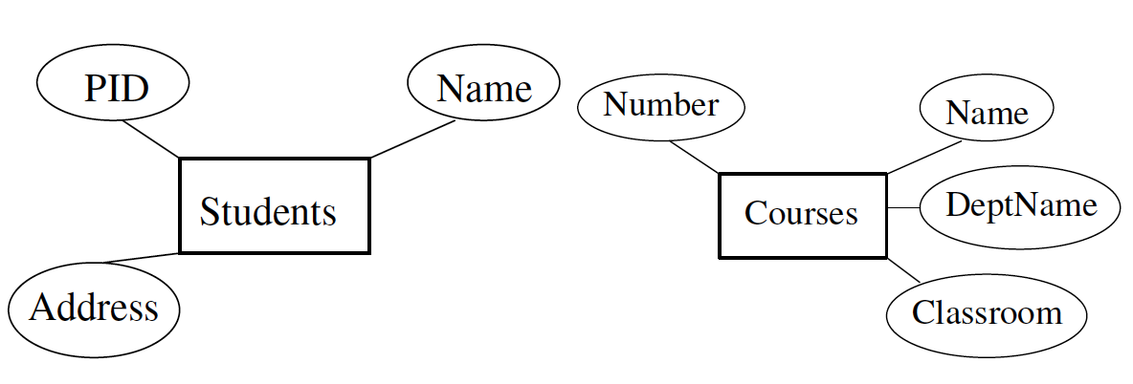
Example: Entity Sets
Notes:
Do example for AMAZON (assume just selling books). What entities would an online store need?
BOOK
CUSTOMER
SELLER
TRANSACTION

Slide 10
Relationships
A relationship connects two or more entity sets.
It is represented by a diamond, with lines to each of the entity sets involved.
Don’t confuse ‘relationships’ with ‘relations’!
Notes:
Students, Courses, Profs
Students TAKE courses
Professors Teach Courses
Professors ADVISE students
Continue with amazon example.

Slide 11
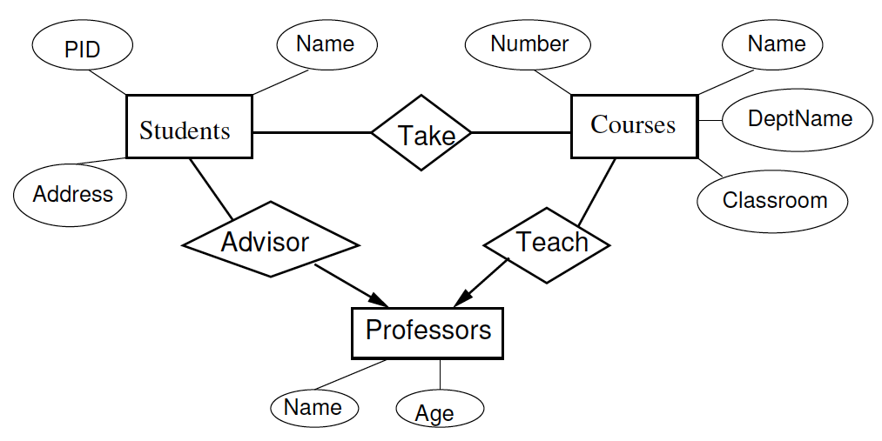
Example: Relationships
Students Take Courses
Professors Teach Courses
Professors Advise Students
(ignore arrows for now)
Notes:
Don’t worry about arrow

Slide 12
Instance of an E/R Diagram
E/R diagram describes a schema, not the DB content itself.
However, we can visualize what the DB tuples might look like by thinking of an instance of the E/R diagram:
contains instances of entity sets and
instances of relationship sets.
Notes:
Lingo here is not supercritical, as long as everyone knows what they're talking about.

Slide 13
Instance of an Entity Set
For each entity set, an instance of that entity set stores a specific set of entities.
Each entity is a tuple containing specific values for each attribute.
What are the examples of entity sets for our relations so far?
Notes:
Relations so far-students, profs, courses, amazon.com stuff.
Examples of entity set of students: 3 students, each with PID, name, addr.

Slide 14
Instances of (binary) relationship sets
Binary relation with entities E and F:
Instance is a set of pairs {(e, f) : e is in E and f is in F}
Instance need not relate every tuple in E with every tuple in F. Depends on what the relationship means.
(At the moment) Hard to visualize an instance of relationship set as a table (or relation) because e and f are entities, not simple scalar values.

Slide 15
Instance of a Relationship Set
Example: Instance of relationship Takes (no DeptName)
Relationship R between (entity sets) E and F
Relates some entities in E to some entities in F

Slide 16
Attributes for a Relationship
Question: What is Grade an attribute of?

Slide 17
Multiplicity of binary relationships
Many-one from A to B: when each entity in A is connected to at most one entity in B.
If I give you a particular instance of entity A, you can give me back at most one entity in B.
But, each instance of B may have multiple As.
One-one: when a relationship is many-one from A to B and from B to A.
Many-many: everything else.
Notes:
many-one –
one-one- presidents and colleges

Slide 18
Many-Many Relationships
In a many-many relationship, an entity of either set can be connected to many entities of the other set.
Notes:
Examples in our ER models so far?
students to classes.

Slide 19
Many-One Relationships
Some binary relationships are many-one from one entity set to another.
Each entity of the first set is connected to at most one entity of the second set.
But an entity of the second set can be connected to zero, one, or many entities of the first set.
Notes:
Examples so far?
Students have AT MOST ONE first year advisor.

Slide 20
One-One Relationships
In a one-one relationship, each entity of either entity set is related to at most one entity of the other set.

Slide 21
Representing Multiplicity
Show a many-one relationship by an arrow entering the "one" side.
Show a one-one relationship by arrows entering both entity sets.

Slide 22
Different kinds of relationships
Profs.
Advise
Students
many-many
many-one
one-one
Students
Take
Courses
Profs.
Office
Rooms

Slide 23
Exactly one
In some situations, we can also assert “exactly one,” i.e., each entity of one set must be related to exactly one entity of the other set. To do so, we use a rounded arrow.

Slide 24
Example: Exactly One
Consider favorite-course between Students and Courses.
Some courses are not the favorite-course of any student, so an arrow pointing into Students would be inappropriate.
But a student has to have a favorite-course.
Favorite
course
Students
Courses
Notes:
What are appropriate EXACTLY one situations for amazon.com in a many-one relationship?
A PACKAGE has EXACTLY one ADDRESS.

Slide 25
E/R Diagrams Day 2: Review
Entity sets (rectangles)
Attributes (ovals)
Relationships (diamonds connecting entity sets)
Multiplicity of relationships (arrows)
Running examples: Workday DB, Amazon DB

Slide 26
Attributes on relationships
Attributes can also be placed on a relationship, as well as on an entity set.
Only necessary if the attribute cannot be determined from a single entity instance.
Example:
Students and Courses: where do we store grades?
Notes:
What are examples for amazon.com books? USER rates a BOOK, needs a rating.

Slide 27
Multiway relationships
Rare
An arrow pointing to entity set E means if we select one entity from each of the other entity sets in the relationship, those entities are related to (at most/exactly) one entity in E.
Multiway relationships can often be converted into multiple binary relationships. (later)
Notes:
Classic example:
Assume we have entity sets for COURSES(name), PROFS(name), STUDENTS(name).
Three-way relationship ENROLLS. Why is each possible 2-way relationship deficient?
Use example from book, 3-way btw STARS, MOVIES, STUDIOS. Arrow pointing into Studios.

Slide 28
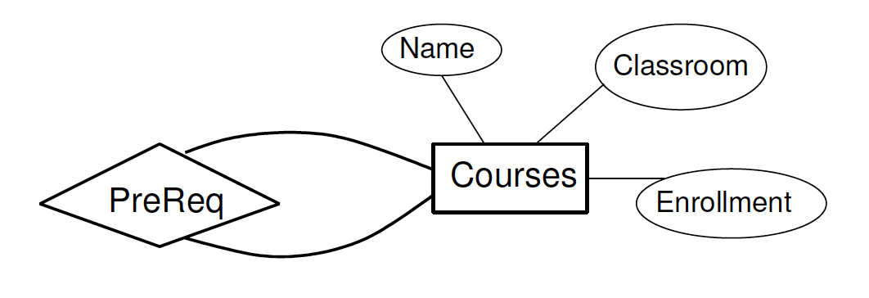
Roles in Relationships
Can the same entity set appear more than once in the same relationship?
Prerequisite relationship between two Courses
But which course is the pre-req?
Notes:
Facebook friend relationship.

Slide 29
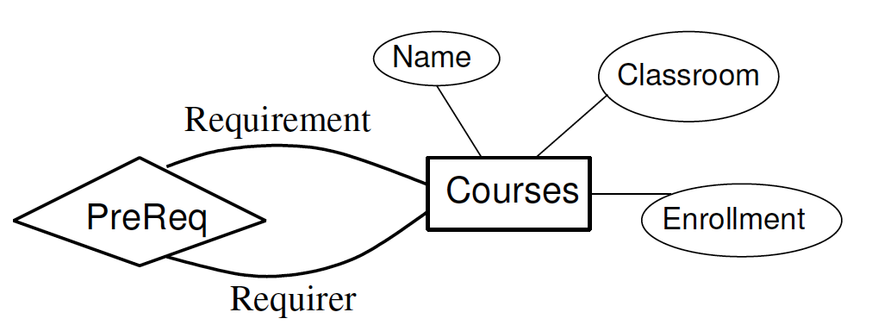
Roles in Relationships
Label the connecting lines with the role of the entity
Notes:
Facebook example – if a friendship is not bi-directional.
How about with amazon.com books? [sequel to, inspired by, uses characters in, ]
Amazon.com users: [watching wishlist of]

Slide 30
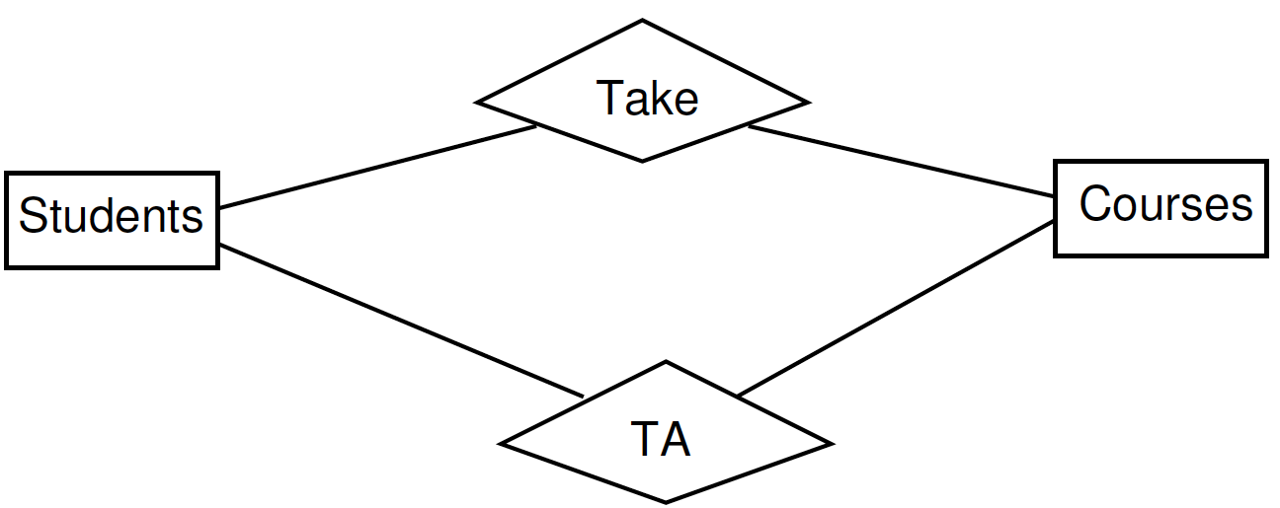
Parallel Relationships
Can there be more than one relationship between the same pair of entities?
TA and Take relationship between Students and Classes
Notes:
Amazon.com books.
How about USERS and BOOKS.
USERS recommend BOOKS.
USERS buy BOOKS.

Slide 31
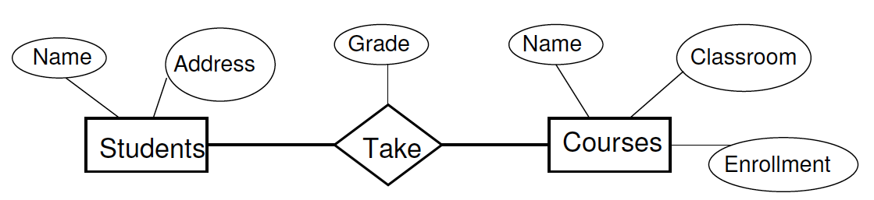
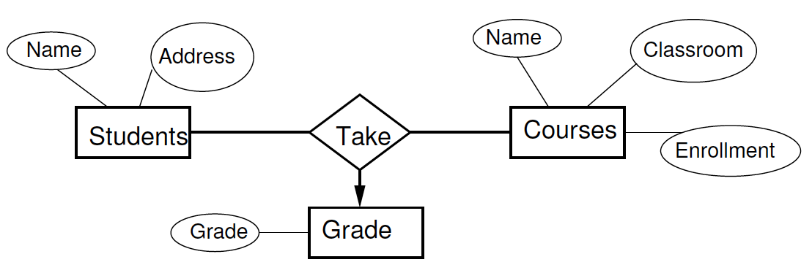
Are Attributes on Relationships Needed?
Attribute on relationship → Attribute to an entity and make relationship multi-way

Slide 32
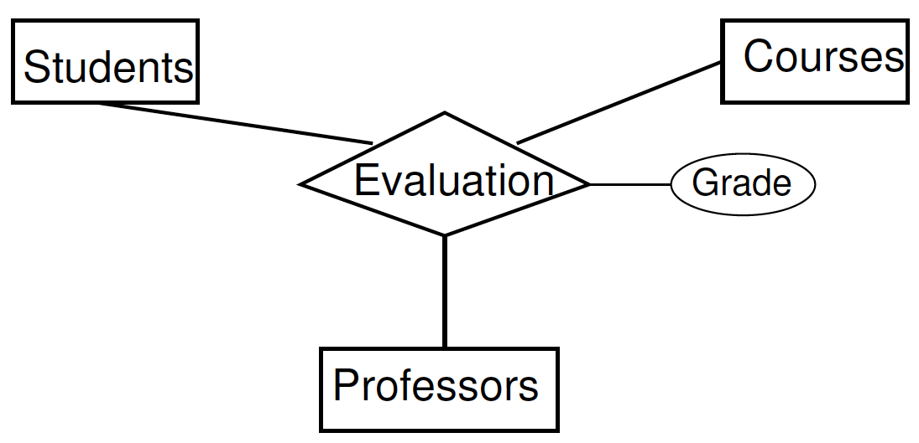
Multi-way Relationships
Relationships may connect more than 2 entity sets
>= 1 professor can teach a course but each student evaluates each professor separately
Three-way Evaluation relationship between Students, Professors, and Classes

Slide 33

Multi-way Relationships
>= 1 professor can teach a course but each student taught by at most one professor, and each student only evaluates that professor
Add arrow directed towards Professors

Slide 34
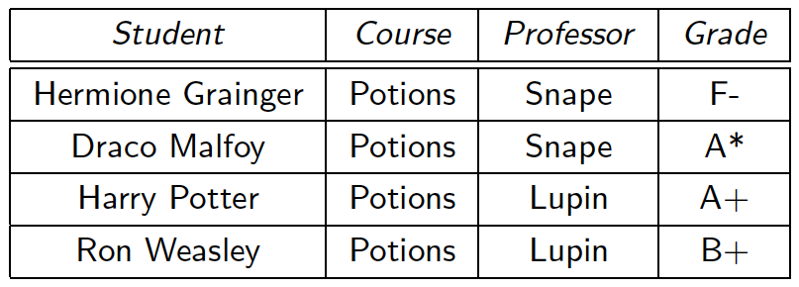
Multiplicity in Multiway Relationships
An arrow pointing to an entity set E => if we select an entity from each of the other entity sets, the selected entities are related to at most one entity in E
E/R diagram forbids connections between “Hermione Grainger”, “Potions" and two different professors.

Slide 35
Converting Multiway to Binary
It is easy to convert a multiway relationship to multiple binary relationships
Create a new connecting entity set. Think of its entities as the tuples in the relationship set for the multiway relationship
Introduce many-one relationships from the connecting entity set to each of the entities in the original relationship
If an entity set plays > 1 role, create a relationship for each role
Notes:
first example – Suppose we have STUDENTS, PROFS, and DEPTS. We could have a Course relationship btw these 3.
Do example with Enroll relationship between STUDENTS, PROFS, COURSES. (this shouldn't be a 3-way relnship in 1st place)
Flights: AIRPORT 2x (depart, arrive), PERSON. Relationship = Flies ATTRIB=flight number.

Slide 36
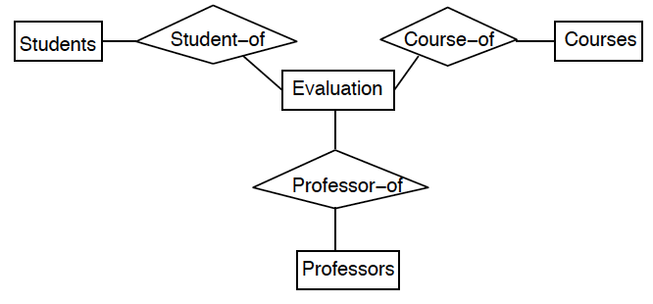
Converting Multiway to Binary
What is the multiplicity of the relationships?

Slide 37
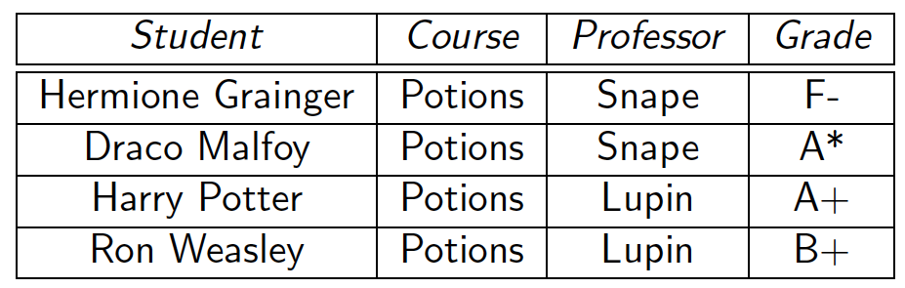
Example of the Conversion
Instance of Evaluation (ternary) relationship before conversion:

Slide 38
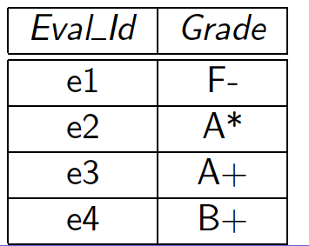
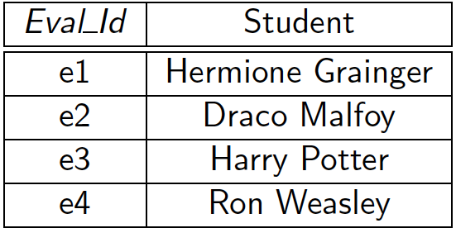
Example of the Conversion
Instance of Evaluation (ternary) relationship before conversion:
After
Evaluation entity set Student_of entity set

Slide 39
Details of the Conversion
Create an entity in the new Evaluation entity set for each instance (row) in the ternary Evaluation relationship.
In the Student_of relationship, relate each entity in the Evaluation entity set with the corresponding student entity.
How many students can the Student_of relationship relate an Evaluation entity to?
Only one!
Therefore, the multiplicity of Student_of is many-to-one from Evaluation to Student.

Slide 40
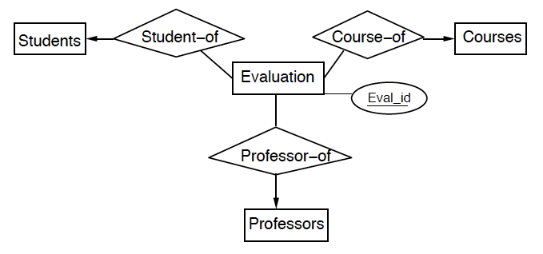
Conversion

Slide 41
Subclasses in the E/R Model
A subclass of an entity set E is an entity set F such that
each entity in F is an entity in E
the entity set F must have at least one attribute or participate in at least one relationship that E does not
Connect E to F using an isa relationship denoted by a triangle
Convention is to draw E above F
Each isa relationship is one-one but we do not draw the arrows.
The set of isa relationships must form a tree.

Slide 42
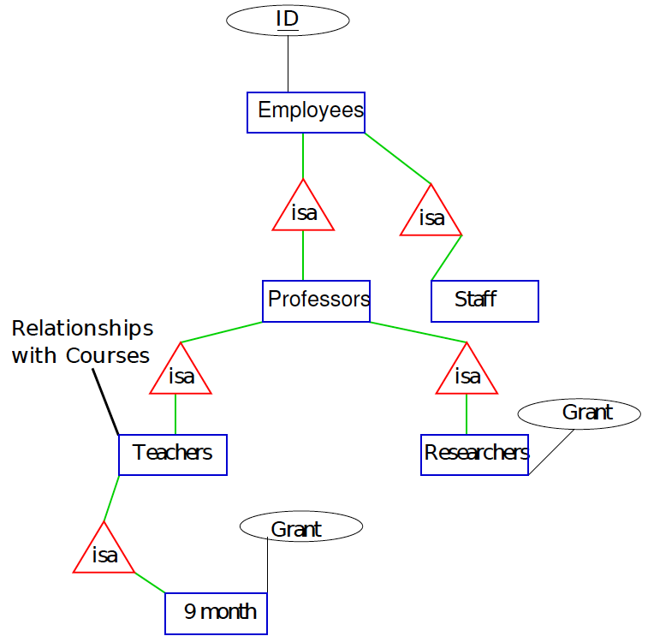
Subclasses: Example
University Employees, Handout 2

Slide 43
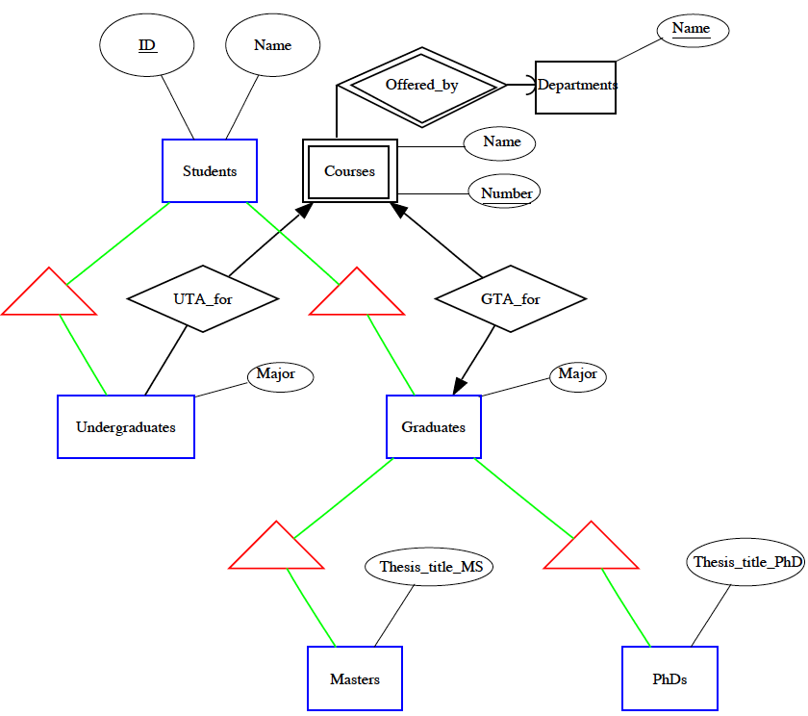
Subclasses: Example
University Students, Handout 2

Slide 44
E/R vs. OO Subclasses
In object-oriented programming languages, each object is in only one class.
A subclass inherits variables and methods from the superclasses.
In an E/R diagram, an entity has components in all the subclasses to which it belongs
If an entity e has a component in an subclass, then e has a component in the superclass
Does e have a component in the root?
The attributes of e are the union of the attributes of its components
e participates in all the relationships its components participate in

Slide 45
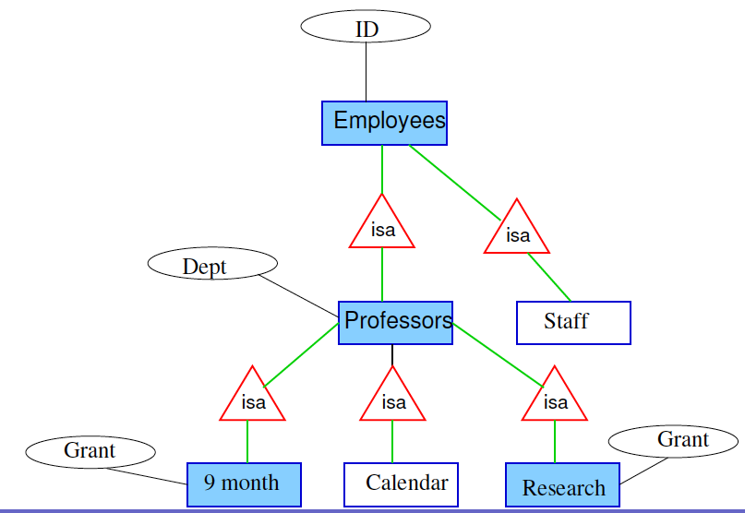
Components of an Entity
Prof. Fingers InMany Pies has a 9-month appointment, teaches in one semester every year, and does not teach in the other semester.
In the other semesters, his research grant pays his salary.
Which entity sets does he have components in? (using a different isa hierarchy)

Slide 46
Components of an Entity
How do we represent students enrolled in combined Bachelors-Masters programs?
Such a student has components in multiple entity sets

Slide 47
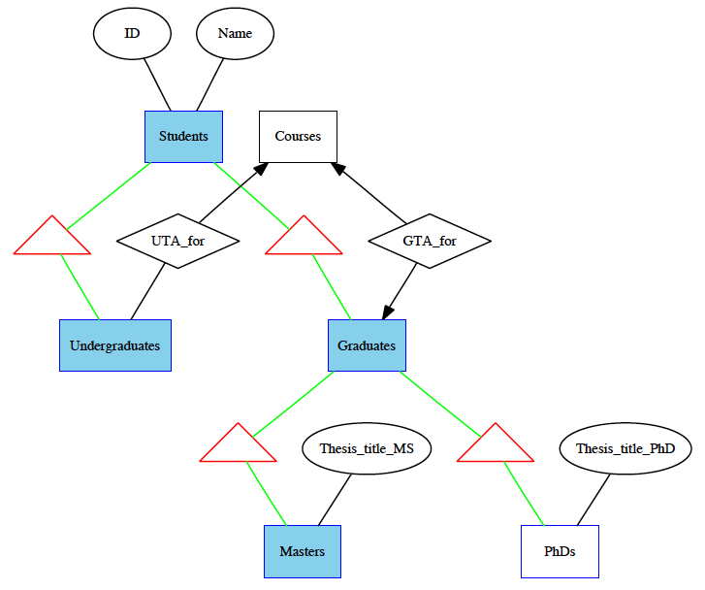
Components of an Entity
Such a student has components in multiple entity sets

Slide 48
Try this
Partners or triples.
Design an E/R diagram for a bank, including info about customers and accounts.
Customer info: name, addr, phone, SSN.
Account info: type (checking/savings), balance.
Accounts may have multiple customers; customers may have multiple accounts.

Slide 49
Try this
What if an account can have only one customer?
What if a customer can have only one account?
What if a customer can have multiple addresses and multiple phones?
(Think pre-cell-phones) What if we want to associate phones with addresses?
Notes:
Item 4 = make LOCATION entity set, has attributes phone/addr

Slide 50
Is-A Hierarchies (Subclasses)
Certain entities might need to store special properties that not all entities possess.
Create two entity sets: a “super-entity” and a “sub-entity” and connect them with a Is-A relationship (triangle instead of diamond).
Notes:
Amazon bookstore. BOOKS might have subclasses for BIOGRAPHY (attrib=subject name). TEXTBOOK (topic).

Slide 51
Good design principles (4.2)
Faithfulness
Entity sets & attributes should reflect reality in choice of attributes and multiplicity of relationships.
The real-world situation can dictate what faithfulness means.
E/R diagram cannot convey all the information.
Consider Students/Courses/Profs & multiplicity – can be different ways to do this diagram.

Slide 52
Good design principles
Avoid redundancy
Watch out for an attribute duplicating a relationship.
Choosing the right relationships
Does every relationship express all the information you need it to express?
Notes:
Ex for avoid redundancy---State, Capital City, Cities. If State and City are entity sets, then maybe there is a part-of relationship connecting them. But capital city shouldn't be an attrib of state, then. (Maybe a Boolean attrib of the rel'nship?)
choosing right relnship – consider courses and students. Classic multiway relnship. But what about if a student drops a course? How is this represented? How do we store the drop date?

Slide 53
Good design principles
Picking an attribute or entity set
Replace E by an attribute when
All relationships involving E must have arrows entering E.
If E has >1 attribute, then no attribute depends on any other attribute.
No relationship involves E more than once.
Notes:
State, Capital City, Cities.

Slide 54
Keys in E/R diagrams (4.3)
Entity sets will have one or more keys.
Customary to choose a primary key and underline the attributes.
Possible for an entity set's key attributes to belong to another entity set in certain situations.
Is-a hierarchies
weak entity sets (later)

Slide 55
One perspective on real-world keys
Multi-attribute and/or string keys…
…can be time consuming and sometimes may not guarantee a lack of duplicates.
movie(title, year, date-released, etc)
title + year = lots to type to identify a movie in SQL.
integer key movieID saves typing!
…break encapsulation
patient(first, last, DOB, etc)
Are these keys being transmitted in an insecure manner? Is this a security/privacy risk?
integer key patientID fixes this.
…are brittle
Name change? Two movies with the same name/year?
Unique integer ID always exists, never changes.

Slide 56
Referential integrity in E/R
Referential integrity: requires every value of an attribute in one relation to appear as the value of an attribute in another (or the same) relation.
Enforced through multiplicity arrows
Degree constraints can be added to further restrict multiplicity.
Notes:
Example – Professors ←-Headof relationship -→ Houses.

Slide 57
Try US Congress/Iron Chef handout

Slide 58
Review of Constraints
Keys are attributes or sets of attributes that uniquely identify an entity within its entity set.
E/R: underline primary key
Referential integrity constraints require that a value referred to actually exists in the DB.
E/R: Enforced with rounded arrows or annotations on the arrows.
Domain constraints specify what set of values an attribute can take
E/R: usually types (varchar, int) are omitted, but you can "mark up" an E/R diagram to show others.
Notes:
start here feb 13
Quick review – States and governors. Every state has at most one governor (can be no gov). Every governor governs exactly one state. (Rounded to states, pointed to govs)
REPHRASE AS: What if states and govs, but other entity is People. Now rounded arrow to states becomes pointed.

Slide 59
Weak entity sets (4.4)
A weak entity set is an entity set whose (primary) key contains attributes from one or more other entity sets.
In other words, an entity set E is weak if in order to identify entities of E uniquely, we need to follow one or more many-one relationships from E and include the key of the related entity sets in E's key.
Possible that all attributes in a weak entity set's key come from other entity sets.

Slide 60
Example
Consider players in a sports league:
Name is not a key (might be duplicate names)
Uniform number is certainly not a key (numbers will be duplicated across teams)
But number + team should be a key
Use double border for weak entity sets and their supporting many-one relationships.
name
uni_number
name
Players
Plays-
on
Teams

Slide 61
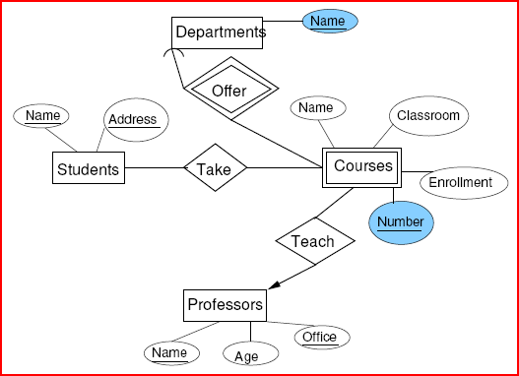
How about courses and departments?
Notes:
SAY: Suppose we don’t have a CRN on each course. We have a course entity with name and number. DEPTS with name.
Similar thing with FLIGHTS(airline, number). What if we upgrade airline to an entity set?

Slide 62
Keys for a weak entity set
A relationship R from a weak entity set E to F is supporting if
R is a binary, many-one relationship from E to F.
R has referential integrity from E to F (curved arrow into F).
F supplies its key attributes to define E's key.
If F itself is a weak entity set, then we must find F’s supporting relationships and also use the keys from those supporting entity sets.
Notes:
Referential integrity bit – arrow is curvy, meaning the entity must exist in F.

Slide 63
Where do weak entity sets come from?
Cause 1: Implicit hierarchies not from an "is-a" relationship.
A player “belongs to” a team, or a flight “is flown by” an airline.
Happens when a piece of a key is represented as an entity set rather than an attribute.
Can (technically) be solved by putting a unique ID on an entity set, but sometimes this causes more trouble than it’s worth.
"is-a" hierarchies seem to lead to weak entity sets (subclasses), but we don't notate them with double borders because their hierarchical relationships are always one-one.
Notes:
CRN added to courses causes COURSE to no longer be weak.

Slide 64
Where do weak entity sets come from?
Cause 2: Connecting entity sets created by eliminating a multi-way relationship.
Often, connecting entity sets have no attributes of their own; they must pick up their key attributes from the entity sets they connect.
Example: A CUSTOMER rents a CAR from a SALESPERSON.
Notes:
Show three way relationship between CUSTOMER, CAR, SALESPERSON.
Convert to binary relationships.
How does this change if I need to RENT more than one CAR at the same time?
Seemingly has the same ternary relationship. Can’t put arrows on any of the lines in the 3-way relationship.
But then you end up with the same set of binary relationships in either situation.
ASK YOURSELF –

Slide 65
Converting E/R diagrams to relational designs
Entity set -> Relation
Attribute of entity set -> attribute of relation
Key of entity set -> primary key of relation
Relationship -> Relation
Attribute of relationship -> attribute of relation
Key attribute of connecting entity set -> key attribute of relation
Special cases: weak entity sets, "is-a" hierarchies, combining relations.

Slide 66
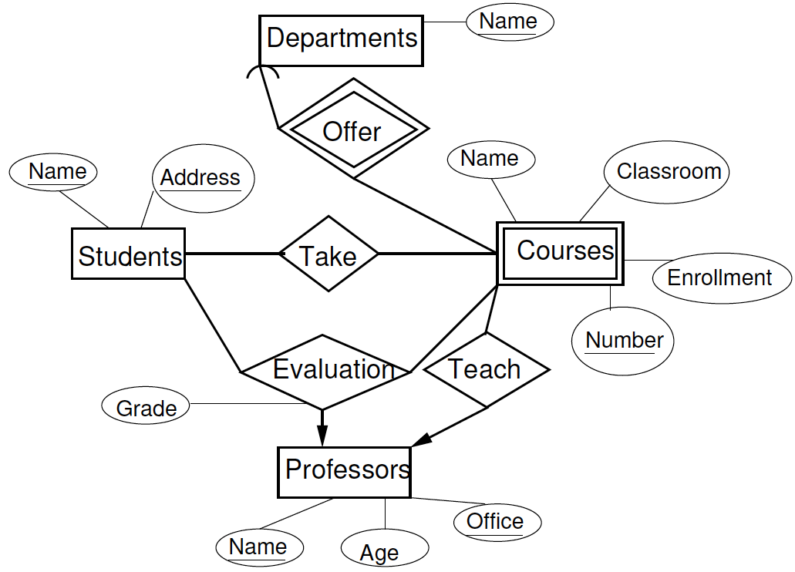
Notes:
do students, profs, depts, take, teach, eval

Slide 67
Handling multiple roles
Requester
name
Friend-of
Person
email
Recipient
If an entity set E appears k > 1 times in a relationship R, then the key attributes for E appear k times in the relation for R, appropriately renamed.
Notes:
Facebook person
Person(name, email)
FriendOf(RequesterEmail, RecipientEmail)

Slide 68
Handling weak entity sets
For each weak entity set W, create a relation with attributes:
attributes of W
attributes of supporting relationships for W
key attributes of supporting entity sets for W
Notes:
do courses(num, deptname, coursename, classroom, enrollment)

Slide 69
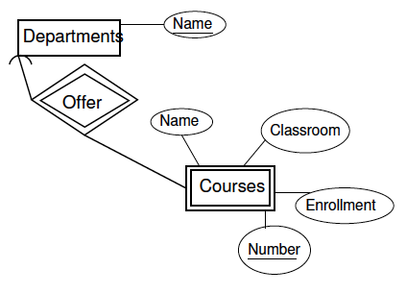
Supporting Relationships
Schema for Departments is Departments(Name)
Schema for Courses is Courses(Number, DeptName, CourseName, Classroom, Enrollment)
What is the schema for Offer?
Notes:
No schema for OFFER!

Slide 70
Supporting Relationships
What is the schema for offer?
Offer(Name, Number, DeptName)
But Name and DeptName are identical, so the schema for Offer is Offer(Number, DeptName)
The schema for Offer is a subset of the schema for the weak entity set, so we can dispense with the relation for Offer.
Key point: Don't make a relation for supporting relationships.

Slide 71
Summary of Weak Entity Sets
If W is a weak entity set, the relation for W has a schema whose attributes are
all attributes of W
all attributes of supporting relationships for W
for each supporting relationship for W to an entity set E
the key attributes of E
There is no relation for any supporting relationship for W

Slide 72
Combining Relations
Consider many-one Teach relationship from Courses to Professors
Schemas are:
Courses(Number, DepartmentName, CourseName, Classroom, Enrollment)
Professors(Name, Office, Age)
Teach(Number, DepartmentName, ProfessorName, Office)

Slide 73
Combining Relations
Courses(Number, DepartmentName, CourseName, Classroom, Enrollment)
Professors(Name, Office, Age)
Teach(Number, DepartmentName, ProfessorName, Office)
The key for Courses uniquely determines all attributes of Teach
We can combine the relations for Courses and Teach into a single relation whose attributes are
All the attributes for Courses,
Any attributes of Teach, and
The key attributes of Professors

Slide 74
Rules for Combining Relations
We can combine into one relation Q
The relation for an entity set E
all many-to-one relationships R1, R2, …, Rk from E to other entity sets E1, E2, …, Ek respectively
The attributes of Q are
All the attributes of E
Any attributes of R1, R2, …, Rk
The key attributes of E1, E2, …, Ek
Combining a many-many relationship with one of its entity sets often leads to redundancy. You probably never want to do this!

Slide 75
Is-a to Relational
Three approaches:
E/R viewpoint
Object-oriented viewpoint
“Flatten” viewpoint

Slide 76
Rules Satisfied by an Is-a Hierarchy
The hierarchy has a root entity set.
The root entity set has a key that identifies every entity represented by the hierarchy.
A particular entity can have components that belong to entity sets of any subtree of the hierarchy, as long as that subtree includes the root.

Slide 77
Example ISA hierarchy
Notes:
Create one with BOOK(name, author, isbn), TEXTBOOK(topic), BIOGRAPHY(subjectName), maybe CS-TEXT(language).

Slide 78
Is-a to Relational Method I: E/R Approach
Create a relation for each entity set
The attributes of the relation for a non-root entity set E are
the attributes forming the key (obtained from the root) and
any attributes of E itself
An entity with components in multiple entity sets has tuples in all the relations corresponding to these entity sets
Do not create a relation for any is-a relationship
Create a relation for every other relationship

Slide 79
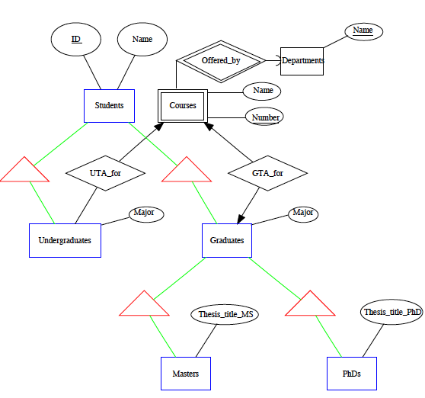
Example: ISA to Relational Method I: E/R Approach
Students(ID, Name)
Undergraduates(ID, Major)
Graduates(ID, Major)
Masters(ID, Thesis_title_MS)
PhDs(ID, Thesis_title_PhD)
UTA_for(ID, CourseNum,
DeptName)
GTA_for(ID, CourseNum,
DeptName)

Slide 80
Is-a to Relational Method II: Object Oriented Approach
Treat entities as objects that are members of a particular subtree in the tree.
Subtrees must contain the root.
Subtrees may contain more than one entity set.
What are all the logically-possible classes for books in our hierarchy?
Notes:
BOOK, TEXTBOOK+BOOK, BIO+BOOK, CS-TEXT+TEXT+BOOK.

Slide 81
Is-a to Relational Method II: Object Oriented Approach
Enumerate all subtrees of the hierarchy that contain the root.
For each such subtree,
Create a relation that represents entities that have components in exactly that subtree.
The schema for this relation has all the attributes of all the entity sets in that subtree.

Slide 82
Is-a to Relational Method III: “Flatten” Approach (or "NULLs")
Make one relation for the whole hierarchical structure.
Use NULL for any attribute that is not defined for a particular entity.

Slide 83
Example: ISA to Relational Method III: Object Oriented Approach
Subtrees are:

Slide 84
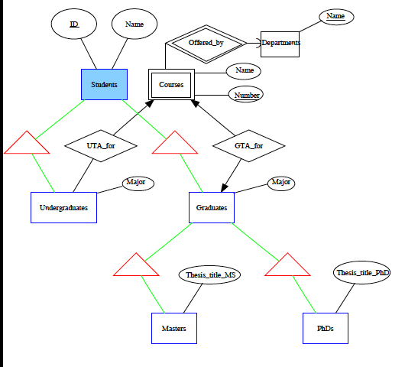
Example: ISA to Relational Method III: Object Oriented Approach
Subtrees are:
Students(ID)

Slide 85
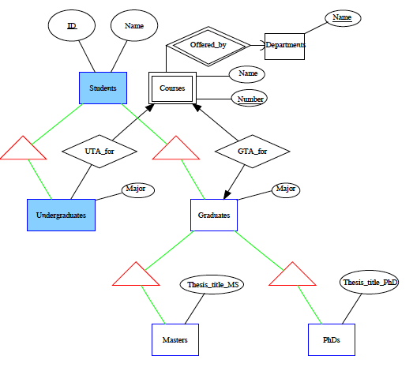
Example: ISA to Relational Method III: Object Oriented Approach
Subtrees are:
Students(ID)
StudentsUGs(ID, Major)

Slide 86
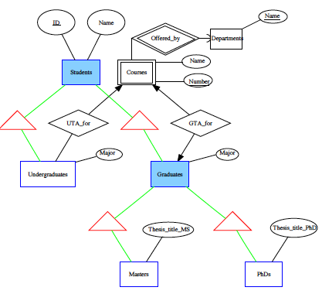
Example: ISA to Relational Method III: Object Oriented Approach
Subtrees are:
Students(ID)
StudentsUGs(ID, Major)
StudentGs(ID, Major)

Slide 87
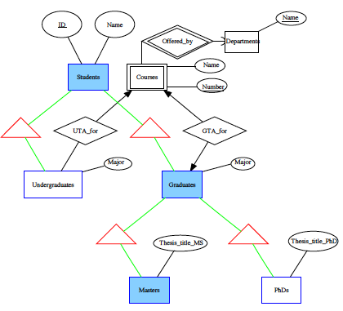
Example: ISA to Relational Method III: Object Oriented Approach
Subtrees are:
Students(ID)
StudentsUGs(ID, Major)
StudentGs(ID, Major)
StudentGsMasters(ID,
Major, Thesis_title_MS)

Slide 88
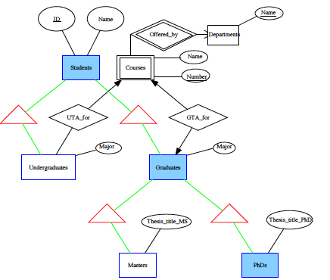
Example: ISA to Relational Method III: Object Oriented Approach
Subtrees are:
Students(ID)
StudentsUGs(ID, Major)
StudentGs(ID, Major)
StudentGsMasters(ID,
Major, Thesis_title_MS)
StudentsGsPhDs(ID,
Major, Thesis_title_PhD)

Slide 89
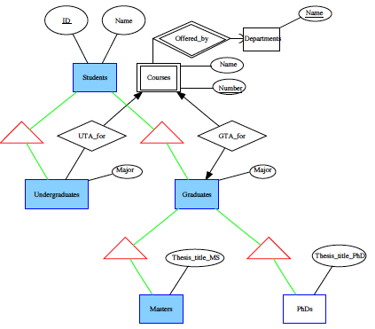
Example: ISA to Relational Method III: Object Oriented Approach
Subtrees are:
Students(ID)
StudentsUGs(ID, Major)
StudentGs(ID, Major)
StudentGsMasters(ID,
Major, Thesis_title_MS)
StudentsGsPhDs(ID,
Major, Thesis_title_PhD)
StudentsUGsGsMasters
(ID,UGMinor,GradMinor,
Thesis_title_MS)

Slide 90
Example: ISA to Relational Method III: Object Oriented Approach
Subtrees are:
Students(ID)
StudentsUGs(ID, Major)
StudentGs(ID, Major)
StudentGsMasters(ID,
Major, Thesis_title_MS)
StudentsGsPhDs(ID,
Major, Thesis_title_PhD)
StudentsUGsGsMasters
(ID,UGMinor,GradMinor,
Thesis_title_MS)
What other subtrees exist?

Slide 91
Comparison of the Three Approaches
Trade-offs
In general, we want to minimize joins (takes time) and also minimize duplicated or redundant information (takes space [memory]).
It is expensive to answer queries involving several relations (advantage: flatten)
E/R approach works well for some queries where info is duplicated among relations.
E/R approach is hard for other queries because we may need joins.

Slide 92
Comparison of the Three Approaches
Number of relations for n relations in the hierarchy
We like to have a small number of relations
Flatten
1
E/R
n
OO
Can be 2^n

Slide 93
Comparison of the Three Approaches
Redundancy and space usage
Flatten
May have a large number of NULLs
(also prevents you from using NULL to denote something besides class membership)
E/R
Several tuples per entity, but only key attributes are repeated
OO
Only one tuple per entity

