Slide 1
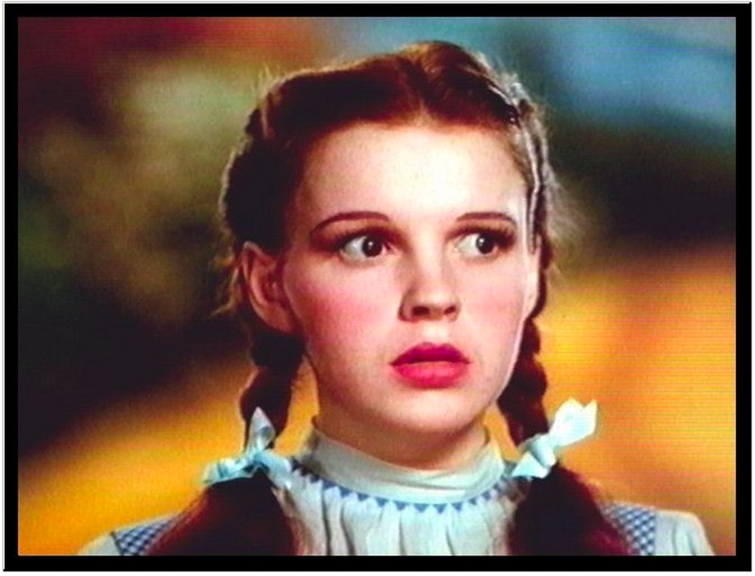
Events and Timers and Listeners, Oh My!

Slide 2
Control flow
"Traditional" program: one statement at a time, line by line.
Threaded program: CPU determines execution order
Controlled with synch, wait/notifyAll
Event-driven program: controlled by the order that "events" happen

Slide 3
Event-driven programming is often seen in threaded programs, as another model of communication between threads.
Thread 1
…
Event happened!
…
…
Another event happened!
Thread 2
Handle this event
Thread 3
Handle this event

Slide 4
An "event" is something that happens in your program that another piece of code wants to be aware of.
Simple things: mouse clicks, key presses, …
Complex things: file is done loading, calculation is finished, received request from a client
Event-driven programming is no better or worse than other models of thread communication, it's just different.
Often forced on programmers because so many graphics libraries use it.

Slide 5
Sources, event objects, and listeners.
Event listener
Event source
event object
Event source
event object
Event listener
Event objects are objects that are sent to the listeners that contain information about the event that occurred (e.g., where the mouse was clicked).
(Event) Listeners are objects that have registered to receive certain types of events from event sources.
Event listener

Slide 6
JButton: a class that models a button.
Also an event source.
HelloWorldListener: a class designed to listen for button presses.
The code that runs when the action happens (inside actionPerformed) is called an event handler.
ActionEvent (arg type to actionPerformed) is the event class.
Whenever the JButton is pushed, it triggers (fires) an ActionEvent.
Has methods for determining which object caused the event, when it happened, etc.
Connected through addActionListener function.

Slide 7
Purpose of events: separate the code that causes the event from the code that handles the event.
Lets one event source trigger multiple actions
JButton can have multiple listeners added.
Lets one listener listen to multiple event sources.
Could have HelloWorldListener connected to a many buttons, key presses, drop-down menus, etc.

Slide 8
Java has (many) classes for Events:
ActionEvent, MouseEvent, KeyEvent, …
and classes for Listeners:
ActionListener, MouseListener, KeyListener, …
We're going to examine just buttons and the mouse today.

Slide 9
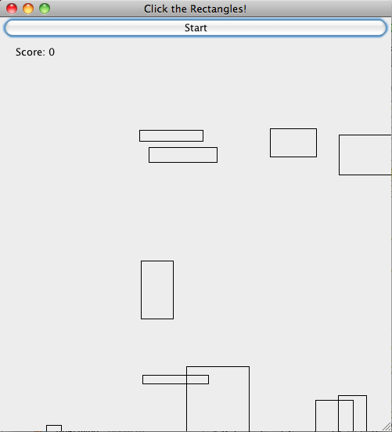

Slide 10
GameFrame: represents the window that holds the game.
Contains a "panel" to hold the moving rectangles, and a Jbutton to start the game.
GamePanel: represents the moving rectangles area.
moveShapesToLeft: moves all rectangles to the right.
handleMouseClick: event handler for when the panel is clicked.
paintComponent: draws the rectangles on the screen.

Slide 11
Run It

Slide 12
Task 1: Start Button
In StartButtonActionListener
Write actionPerformed.
This method should call gameArea.moveShapesToLeft().
Then call repaint() [tells Java to redraw the rectangles]
Uncomment lines to attach listener to button.
When done, you should be able to click the button and the shapes should move to the left.

Slide 13
Task 2: Mouse clicks
In GameMouseClickListener:
Write mouseReleased.
This should call handleMouseClick.
arguments should be event.getX() and event.getY()
Call repaint() [asks Java to redraw the rectangles]
In GameFrame constructor, uncomment lines to attach the listener to the mouse.

Slide 14
Task 3: Automatic scrolling
We don't want to click the start button to advance the rectangles.
We need a way to automatically fire events in rapid succession.
In order to repeatedly call moveShapes every few milliseconds to give the illusion of scrolling.

Slide 15
Solution: Timer
Timer objects will fire an ActionEvent repeatedly every x milliseconds.
Timer t = new Timer(x, <action listener>);
t.start();

Slide 16
In MoveShapesActionListener:
Write actionPerformed to do two things:
call moveShapesToLeft on gameArea
call repaint() [request that Java redraw the rectangles]
Rewrite start button listener:
actionPerformed should do three things:
Create a new MoveShapesActionListener
Create a timer: args are 10 (milliseconds), and your move shapes action listener.
Start the timer.

