Slide 1
Programming Languages Victory Lap

Slide 2
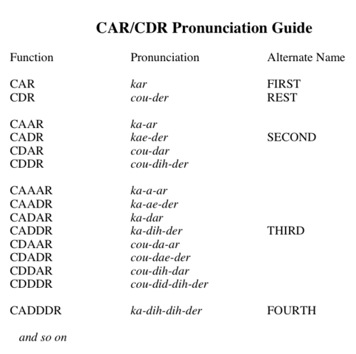

Slide 3
Final Exam
Wednesday, December 16, 5:30PM
Material will be split somewhat evenly between pre-midterm and post-midterm
Including topics on homeworks and not on homeworks
You will need to write code (Java, Racket) and English

Slide 4
Final Exam
Topics will be a subset of the following:
All the stuff from the midterm (Racket in general, closures, recursion/tail-recursion, no mutation, lexical/dynamic scoping)
Delayed evaluation, thunks
Streams
Memoization
More in-depth static/dynamic typing
More advanced OO concepts (e.g., circle-ellipse problem, late binding)
Threading
Interpreters and compilers
Event-driven programming
Keys to the game:
Know what a topic is, what it's good for, what it's bad for, how to use it, how it relates to other topics, and how to code it.

Slide 5
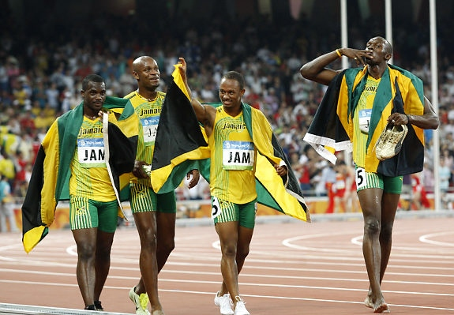
Victory Lap
A victory lap is an extra trip
around the track
By the exhausted victors (us) ☺
Review course goals
See if we met them
Some big themes and perspectives
Stuff for five years from now more than for the final

Slide 6
Thank you!
You all made this a great class
Great attitude about a very different view of software
Good class attendance and questions
Occasionally laughed at stuff ☺

Slide 7
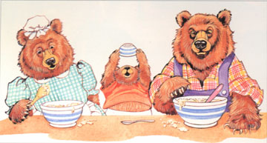
Thank you!
My second time teaching this course; not my area of expertise. (But I had a great time!)
Feedback is appreciated on projects, tests, and their respective difficulty (too hard, too easy, just right?)

Slide 8
[From Lecture 1]
We have 14 weeks to learn the fundamental concepts of programming languages
With hard work, patience, and an open mind, this course makes you a much better programmer
Even in languages we won’t use
Learn the core ideas around which every language is built, despite countless surface-level differences and variations
Poor course summary: “We learned Racket and Java”
Today’s class:
Course mechanics
[A rain-check on motivation]
Dive into Racket

Slide 9
[From Lecture 1]
Many essential concepts relevant in any programming language
And how these pieces fit together
Use Racket and Java (possibly others) because:
They let many of the concepts “shine”
Using multiple languages shows how the same concept can “look different” or actually be slightly different
A big focus on functional programming
Not using mutation (assignment statements) (!)
Using first-class functions (can’t explain that yet)

Slide 10
[From Lecture 1]
Learning to think about software in this “PL” way will make you a better programmer even if/when you go back to old ways
It will also give you the mental tools and experience you need for a lifetime of confidently picking up new languages and ideas

Slide 11
[From motivation lecture]
A good mechanic might have a specialty, but also understands how “cars” (not 2014 Honda Civics) work
And that the syntax, I mean upholstery color, isn’t essential
A good mechanical engineer really knows how cars work, how to get the most out of them, and how to design better ones
To learn how cars work, it may make sense to start with a classic design rather than the latest model
A popular car may not be a good car for learning how cars work

Slide 12
[From motivation lecture]
This course focuses as much as it can on semantics and idioms
Correct reasoning about programs, interfaces, and interpreters or compilers requires a precise knowledge of semantics
Not “I feel that conditional expressions might work like this”
Not “I like curly braces more than parentheses”
Much of software development is designing precise interfaces; what a PL means is a really good example
Idioms make you a better programmer
Best to see in multiple settings, including where they shine
See PL X in a clearer light even if I never show you X

Slide 13
[From motivation lecture]
No such thing as a “best” PL
There are good general design principles for PLs
A good language is a relevant, crisp interface for writing software
Software leaders should know PL semantics and idioms
Learning PLs is not about syntactic tricks for small programs
Functional languages have been on the leading edge for decades
Ideas get absorbed by the mainstream, but very slowly
Meanwhile, use the ideas to be a better programmer in C++ and Python.

Slide 14
Benefits of No Mutation
Can freely alias or copy values/objects.
No need to make local copies of data.
No Circle-Ellipse problem.
Allowing mutation is appropriate when you are modeling a phenomenon that is inherently state-based (meaning there are variables that hold the "state" of the system and will need to change.)
Performing an accumulation over a collection (e.g., summing a list) isn't!

Slide 15
Some other highlights
Function closures are really powerful and convenient…
… and implementing them is not magic
Dynamic dispatch for OO really convenient…
… and implementing that isn't magic either
Static typing (and static checking) prevents certain errors…
… but makes some types of code more complicated
Multi-threading can make really neat programs…
… but introduces a lot of sticky situations (synch, wait/notifyAll)
… partially addressed by event-driven programming

Slide 16
From the syllabus
[Caveat: I wrote the goals, so not surprising I hope we met them.]
Successful course participants will:
obtain an accurate understanding of what functional and object-oriented programs mean,
develop the skills necessary to learn new programming languages quickly,
master specific language concepts such that they can recognize them in strange guises,
learn to evaluate the power and elegance of programming languages and their constructs,
attain reasonable proficiency in a number of popular programming languages, and,
become more proficient in languages they already know

Slide 17
From the "so-called experts" ☺
Once a decade or so, ACM/IEEE updates a "standard CS curriculum"
A specification of what every CS undergraduate degree should teach its students
Last updated in 2013!
Let's take a look at a draft and see how well we did.
(Note that not everything in the PL section of the draft will be taught in a single course.)

Slide 18
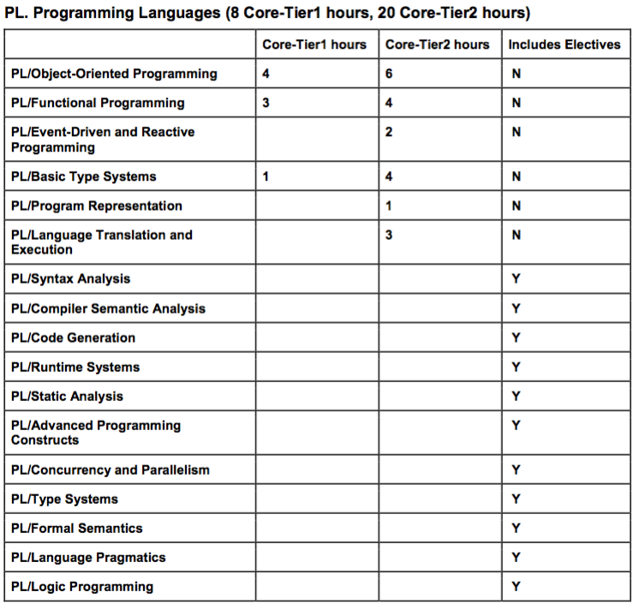

Slide 19
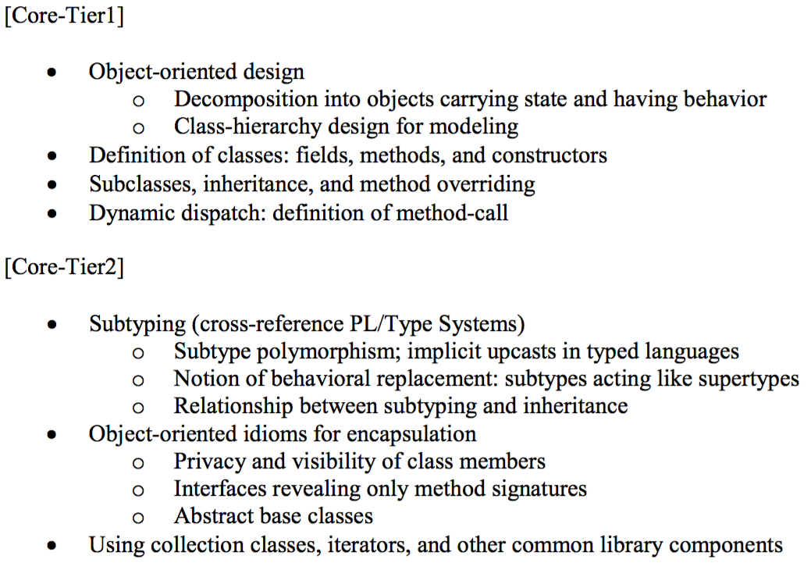
PL/Object-Oriented Programming

Slide 20
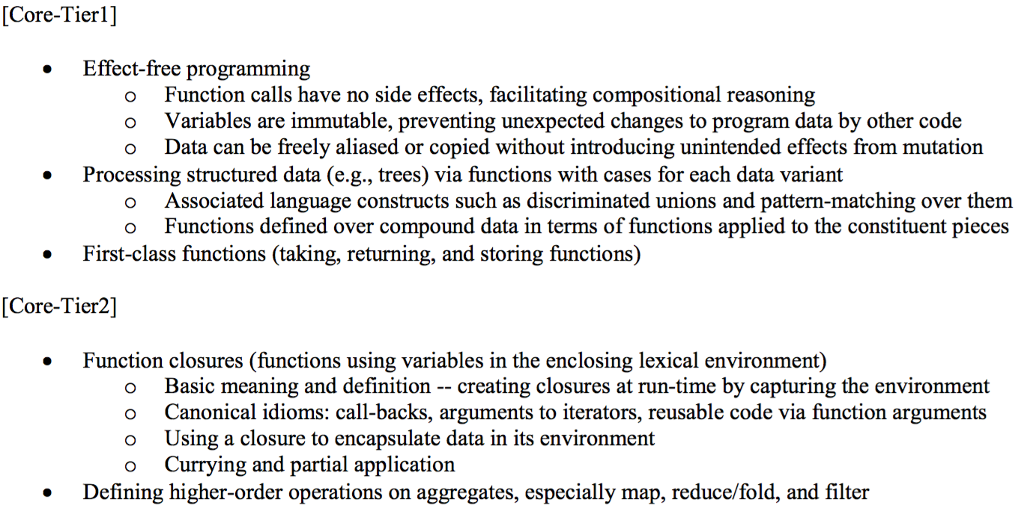
PL/Functional Programming

Slide 21
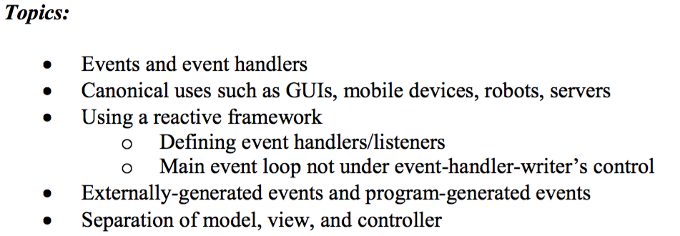
PL/Event-Driven and Reactive Programming

Slide 22
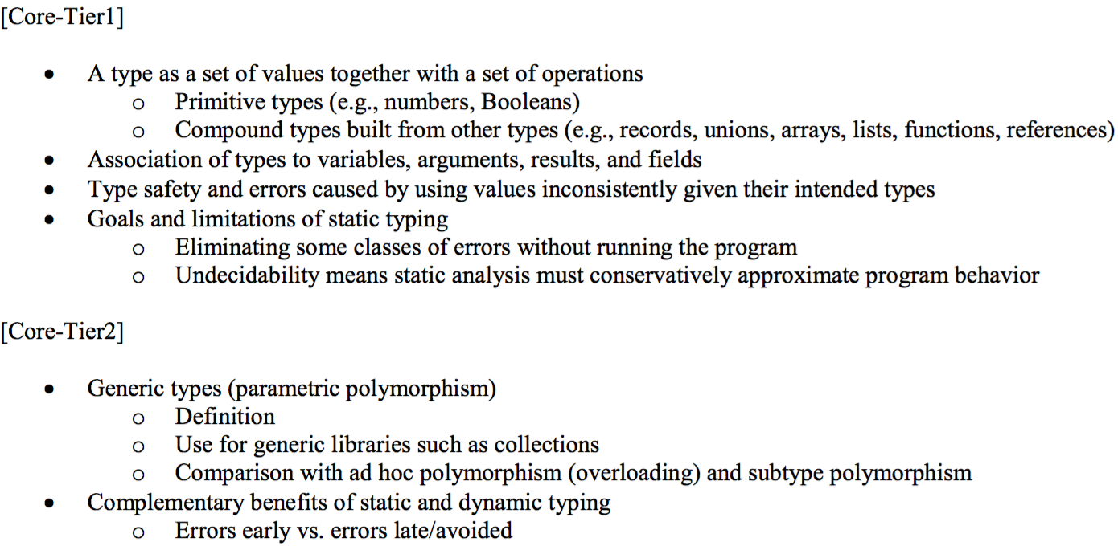
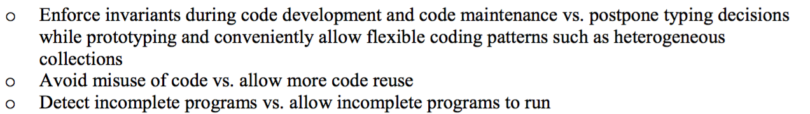
PL/Basic Type Systems

Slide 23
Not bad
These outcomes are for a curriculum, not necessarily a course
[In separate document; not in slides or posted]
I think this quarter's CSE341 hit 9 out of 13 directly
Brushed up on another 2, as do other courses
Other 2 covered in CSE351

Slide 24
What next?
Take these ideas and use them in practice!
(But only where it makes sense)
Be confident when reading documentation, unfamiliar code, learning a {new PL, new PL library, new programming paradigm}.
Learn more Java!
Stay in touch
Tell me when this class helps you out with something cool (seriously)
Ask me cool PL questions (may not always know the answer, but I can tell you where to find it)
Don't be a stranger: let me know how the rest of your time at Rhodes (and beyond!) goes… I really do like to know

Slide 25
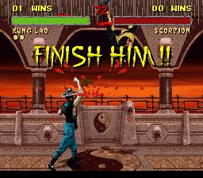
YOUR INTERPRETER!

Slide 26
Course evaluations
I am going to distribute course evaluation forms so you may rate the quality of this course. Your participation is voluntary, and you may omit specific items if you wish. To ensure confidentiality, do not write your name on the forms. There is a possibility your handwriting on the yellow written comment sheet will be recognizable; however, I will not see the results of this evaluation until after the quarter is over and you have received your grades. Please be sure to use a No. 2 PENCIL ONLY on the scannable form.
I have chosen (name) to distribute and collect the forms. When you are finished, he/she will collect the forms, put them into an envelope and mail them to the Office of Educational Assessment. If there are no questions, I will leave the room and not return until all the questionnaires have been finished and collected.
Thank you for your participation.

