Slide 1
Intro to Javascript
<number>
CS380

Slide 2
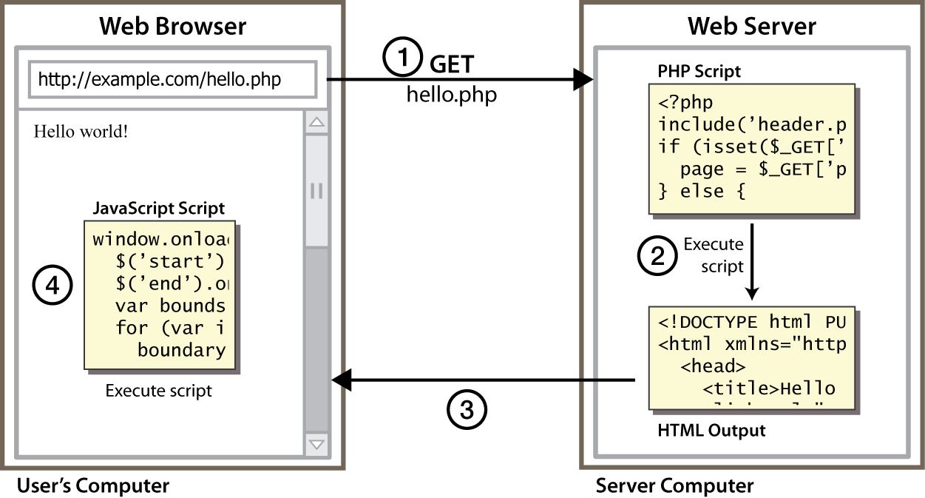
Client Side Scripting
<number>
CS380
Notes:
client-side script: code runs in browser after page is sent back from server
often this code manipulates the page or responds to user actions
<number>

Slide 3
Why use client-side programming?
<number>
PHP already allows us to create dynamic web pages. Why also use client-side scripting?
client-side scripting (JavaScript) benefits:
usability: can modify a page without having to post back to the server (faster UI)
efficiency: can make small, quick changes to page without waiting for server
event-driven: can respond to user actions like clicks and key presses
CS380

Slide 4
Why use client-side programming?
<number>
server-side programming (PHP) benefits:
security: has access to server's private data; client can't see source code
compatibility: not subject to browser compatibility issues
power: can write files, open connections to servers, connect to databases, ...
CS380

Slide 5
What is Javascript?
<number>
a lightweight programming language ("scripting language")
used to make web pages interactive
insert dynamic text into HTML (ex: user name)
react to events (ex: page load user click)
get information about a user's computer (ex: browser type)
perform calculations on user's computer (ex: form validation)
CS380

Slide 6
What is Javascript?
<number>
a web standard (but not supported identically by all browsers)
NOT related to Java other than by name and some syntactic similarities
CS380

Slide 7

Javascript vs Java
<number>
interpreted, not compiled
more relaxed syntax and rules
fewer and "looser" data types
variables don't need to be declared
errors often silent (few exceptions)
key construct is the function rather than the class
"first-class" functions are used in many situations
contained within a web page and integrates with its HTML/CSS content
CS380

Slide 8


Javascript vs Java
<number>
+
=
CS380

Slide 9
JavaScript vs. PHP
<number>
similarities:
both are interpreted, not compiled
both are relaxed about syntax, rules, and types
both are case-sensitive
both have built-in regular expressions for powerful text processing
CS380

Slide 10

JavaScript vs. PHP
<number>
differences:
JS is more object-oriented: noun.verb(), less procedural: verb(noun)
JS focuses on user interfaces and interacting with a document; PHP is geared toward HTML output and file/form processing
JS code runs on the client's browser; PHP code runs on the web server
JS <3
CS380

Slide 11
Linking to a JavaScript file: script
<number>
<script src="filename" type="text/javascript"></script> HTML
script tag should be placed in HTML page's head
script code is stored in a separate .js file
JS code can be placed directly in the HTML file's body or head (like CSS)
but this is bad style (should separate content, presentation, and behavior
CS380
Notes:
<number>

Slide 12
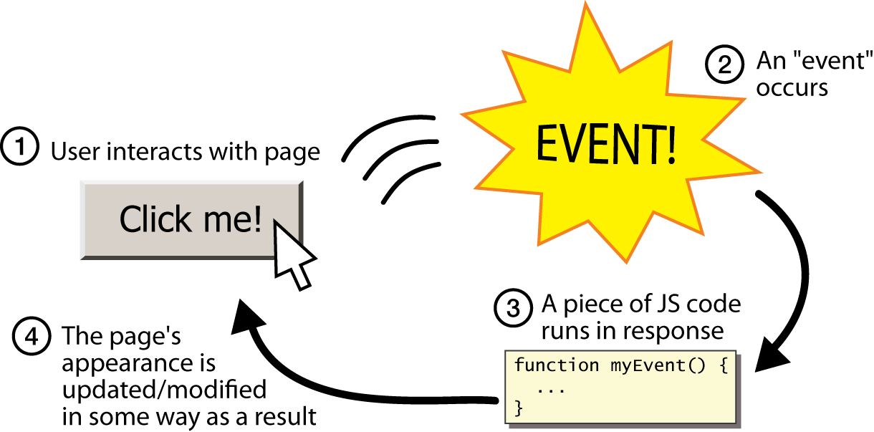
Event-driven programming
<number>
split breaks apart a string into an array using a delimiter
can also be used with regular expressions (seen later)
join merges an array into a single string, placing a delimiter between them
CS380
Notes:
<number>

Slide 13
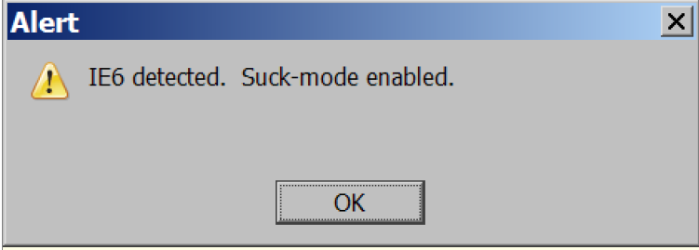
A JavaScript statement: alert
<number>
alert("IE6 detected. Suck-mode enabled."); JS
a JS command that pops up a dialog box with a message
CS380
Notes:
<number>

Slide 14
Event-driven programming
<number>
you are used to programs start with a main method (or implicit main like in PHP)
JavaScript programs instead wait for user actions called events and respond to them
event-driven programming: writing programs driven by user events
Let's write a page with a clickable button that pops up a "Hello, World" window...
CS380
Notes:
<number>

Slide 15
Buttons
<number>
<button>Click me!</button> HTML
button's text appears inside tag; can also contain images
To make a responsive button or other UI control:
choose the control (e.g. button) and event (e.g. mouse 1. click) of interest
write a JavaScript function to run when the event occurs
attach the function to the event on the control
CS380
Notes:
Reset is not working here! Debug! test1.html
<number>

Slide 16
JavaScript functions
<number>
function name() {
statement ;
statement ;
...
statement ;
} JS
function myFunction() {
alert("Hello!");
alert("How are you?");
} JS
the above could be the contents of example.js linked to our HTML page
statements placed into functions can be evaluated in response to user events
CS380
Notes:
<number>

Slide 17
Event handlers
<number>
<element attributes onclick="function();">... HTML
<button onclick="myFunction();">Click me!</button> HTML
JavaScript functions can be set as event handlers
when you interact with the element, the function will execute
onclick is just one of many event HTML attributes we'll use
but popping up an alert window is disruptive and annoying
A better user experience would be to have the message appear on the page...
CS380
Notes:
<number>

Slide 18
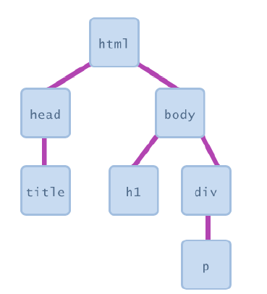
Document Object Model (DOM)
<number>
most JS code manipulates elements on an HTML page
we can examine elements' state
e.g. see whether a box is checked
we can change state
e.g. insert some new text into a div
we can change styles
e.g. make a paragraph red
Notes:
<number>

Slide 19
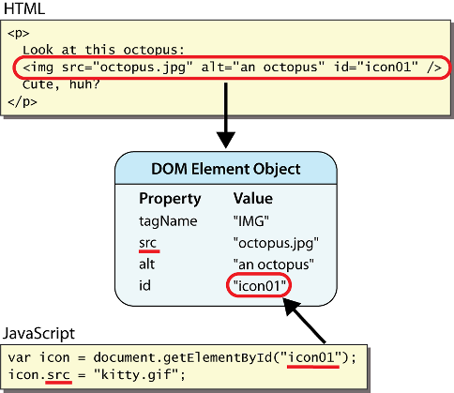
DOM element objects
<number>
Notes:
every element on the page has a corresponding DOM object access/modify the attributes of the DOM object with objectName.attributeName
<number>

Slide 20
Accessing elements: document.getElementById
<number>
var name = document.getElementById("id");
JS
<button onclick="changeText();">Click me!</button>
<span id="output">replace me</span>
<input id="textbox" type="text" /> HTML
function changeText() {
var span = document.getElementById("output");
var textBox = document.getElementById("textbox");
textbox.style.color = "red";
} JS
CS380
Notes:
span.innerHTML = textBox.value;
<number>

Slide 21
Accessing elements: document.getElementById
<number>
document.getElementById returns the DOM object for an element with a given id
can change the text inside most elements by setting the innerHTML property
can change the text in form controls by setting the value property
CS380
Notes:
<number>

Slide 22
Changing element style: element.style
<number>
Attribute | Property or style object
color | color
padding | padding
background-color | backgroundColor
border-top-width | borderTopWidth
Font size | fontSize
Font famiy | fontFamily
CS380
Notes:
<number>

Slide 23
Preetify
<number>
function changeText() {
//grab or initialize text here
// font styles added by JS:
text.style.fontSize = "13pt";
text.style.fontFamily = "Comic Sans MS";
text.style.color = "red"; // or pink?
} JS
CS380
Notes:
<number>

Slide 24
More Javascript Syntax
<number>
CS380

Slide 25
Variables
<number>
var name = expression; JS
var clientName = "Connie Client";
var age = 32;
var weight = 127.4; JS
variables are declared with the var keyword (case sensitive)
types are not specified, but JS does have types ("loosely typed")
Number, Boolean, String, Array, Object, Function, Null, Undefined
can find out a variable's type by calling typeof
CS380
Notes:
<number>

Slide 26
Number type
<number>
var enrollment = 99;
var medianGrade = 2.8;
var credits = 5 + 4 + (2 * 3); JS
integers and real numbers are the same type (no int vs. double)
same operators: + - * / % ++ -- = += -= *= /= %=
similar precedence to Java
many operators auto-convert types: "2" * 3 is 6
CS380
Notes:
<number>

Slide 27
Comments (same as Java)
<number>
// single-line comment
/* multi-line comment */ JS
identical to Java's comment syntax
recall: 4 comment syntaxes
HTML: <!-- comment -->
CSS/JS/PHP: /* comment */
Java/JS/PHP: // comment
PHP: # comment
CS380
Notes:
<number>

Slide 28
Math object
<number>
var rand1to10 = Math.floor(Math.random() * 10 + 1);
var three = Math.floor(Math.PI); JS
methods: abs, ceil, cos, floor, log, max, min, pow, random, round, sin, sqrt, tan
properties: E, PI
CS380
Notes:
<number>

Slide 29
Special values: null and undefined
<number>
var ned = null;
var benson = 9;
// at this point in the code,
// ned is null
// benson's 9
// caroline is undefined JS
undefined : has not been declared, does not exist
null : exists, but was specifically assigned an empty or null value
Why does JavaScript have both of these?
CS380
Notes:
<number>

Slide 30
Logical operators
<number>
> < >= <= && || ! == != === !==
most logical operators automatically convert types:
5 < "7" is true
42 == 42.0 is true
"5.0" == 5 is true
=== and !== are strict equality tests; checks both type and value
"5.0" === 5 is false
CS380
Notes:
<number>

Slide 31
if/else statement (same as Java)
<number>
if (condition) {
statements;
} else if (condition) {
statements;
} else {
statements;
}
JS
identical structure to Java's if/else statement
JavaScript allows almost anything as a condition
CS380
Notes:
<number>

Slide 32
Boolean type
<number>
var iLike190M = true;
var ieIsGood = "IE6" > 0; // false
if ("web devevelopment is great") { /* true */ }
if (0) { /* false */ } JS
any value can be used as a Boolean
"falsey" values: 0, 0.0, NaN, "", null, and undefined
"truthy" values: anything else
converting a value into a Boolean explicitly:
var boolValue = Boolean(otherValue);
var boolValue = !!(otherValue);
CS380
Notes:
<number>

Slide 33
for loop (same as Java)
<number>
var sum = 0;
for (var i = 0; i < 100; i++) {
sum = sum + i;
} JS
var s1 = "hello";
var s2 = "";
for (var i = 0; i < s.length; i++) {
s2 += s1.charAt(i) + s1.charAt(i);
}
// s2 stores "hheelllloo" JS
CS380
Notes:
<number>

Slide 34
while loops (same as Java)
<number>
while (condition) {
statements;
} JS
do {
statements;
} while (condition); JS
break and continue keywords also behave as in Java
CS380
Notes:
<number>

Slide 35
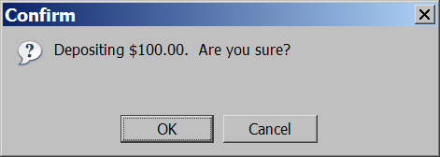
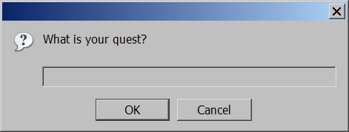
Popup boxes
<number>
alert("message"); // message
confirm("message"); // returns true or false
prompt("message"); // returns user input string JS
CS380
Notes:
<number>

Slide 36
Arrays
<number>
var name = []; // empty array
var name = [value, value, ..., value]; // pre-filled
name[index] = value; // store element JS
var ducks = ["Huey", "Dewey", "Louie"];
var stooges = []; // stooges.length is 0
stooges[0] = "Larry"; // stooges.length is 1
stooges[1] = "Moe"; // stooges.length is 2
stooges[4] = "Curly"; // stooges.length is 5
stooges[4] = "Shemp"; // stooges.length is 5 JS
CS380
Notes:
two ways to initialize an array
length property (grows as needed when elements are added)
<number>

Slide 37
Array methods
<number>
var a = ["Stef", "Jason"]; // Stef, Jason
a.push("Brian"); // Stef, Jason, Brian
a.unshift("Kelly"); // Kelly, Stef, Jason, Brian
a.pop(); // Kelly, Stef, Jason
a.shift(); // Stef, Jason
a.sort(); // Jason, Stef JS
array serves as many data structures: list, queue, stack, ...
methods: concat, join, pop, push, reverse, shift, slice, sort, splice, toString, unshift
push and pop add / remove from back
unshift and shift add / remove from front
shift and pop return the element that is removed
Notes:
<number>

Slide 38
String type
<number>
var s = "Connie Client";
var fName = s.substring(0, s.indexOf(" ")); // "Connie"
var len = s.length; // 13
var s2 = 'Melvin Merchant'; JS
methods: charAt, charCodeAt, fromCharCode, indexOf, lastIndexOf, replace, split, substring, toLowerCase, toUpperCase
charAt returns a one-letter String (there is no char type)
length property (not a method as in Java)
Strings can be specified with "" or ''
concatenation with + :
1 + 1 is 2, but "1" + 1 is "11"
Notes:
<number>

Slide 39
More about String
<number>
escape sequences behave as in Java: \' \" \& \n \t \\
converting between numbers and Strings:
var count = 10;
var s1 = "" + count; // "10"
var s2 = count + " bananas, ah ah ah!"; // "10 bananas, ah ah ah!"
var n1 = parseInt("42 is the answer"); // 42
var n2 = parseFloat("booyah"); // NaN JS
accessing the letters of a String:
var firstLetter = s[0]; // fails in IE
var firstLetter = s.charAt(0); // does work in IE
var lastLetter = s.charAt(s.length - 1); JS
CS380
Notes:
<number>

Slide 40
Splitting strings: split and join
<number>
var s = "the quick brown fox";
var a = s.split(" "); // ["the", "quick", "brown", "fox"]
a.reverse(); // ["fox", "brown", "quick", "the"]
s = a.join("!"); // "fox!brown!quick!the" JS
split breaks apart a string into an array using a delimiter
can also be used with regular expressions (seen later)
join merges an array into a single string, placing a delimiter between them
Notes:
<number>

