Slide 1
Relational Model
Lecture Slides 3

Slide 2
Chapter 3 Objectives
Terminology of relational model.
How tables are used to represent data.
Connection between mathematical relations and relations in relational model.
Properties of database relations.
How to identify candidate ,primary and foreign key.
Meaning of entity integrity and referential integrity.
Purpose and advantages of views.

Slide 3
Relational Model Terminology.
A relation is a table with columns and rows.
Attribute is a named column of a relation.
Domain is a set of allowable values for one or more attributes.
Tuple is a row of a relation.

Slide 4
Degree is the number of attributes in a relation.
Cardinality is the number of tuples in a relation.
Relational Database is a collection of normalized relations with distinct relation names.

Slide 5
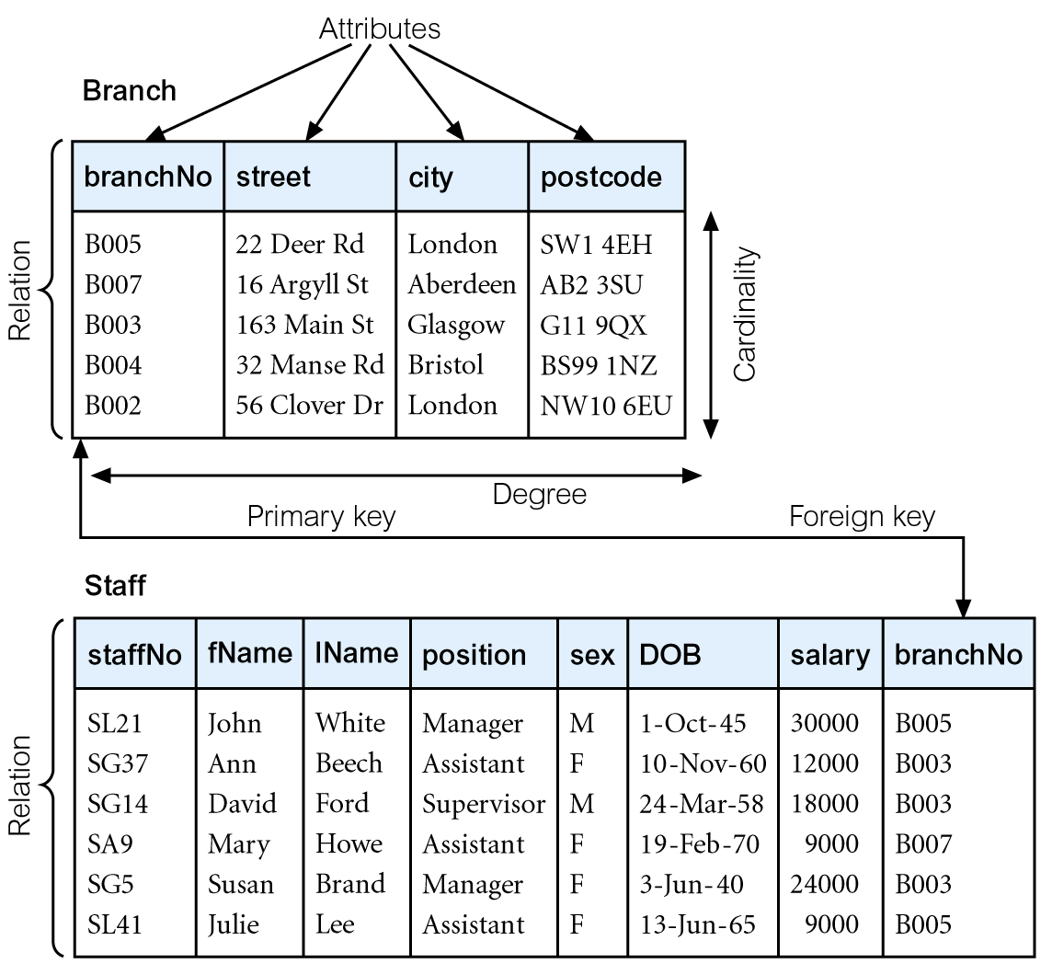
Instances of Branch and Staff Relations

Slide 6
Alternative Terminology for Relational Model
Formal Terms | Alternative 1 | Alternative 2
Relation | Table | File
Tuple | Row | Record
Attribute | Column | Field

Slide 7
Conceptual Modeling
The process of constructing a model of information use in an enterprise that is independent of the implementation details. E.g. DBMS, application programs, Programming language.
Gives rise to a conceptual data model
Note: Logical model assume knowledge of the underlying DBMS

Slide 8
The Relational Model
Allows a high degree of data independence
Provides grounds for dealing with data semantics, consistency and redundancy problems
Based on mathematical relation.

Slide 9
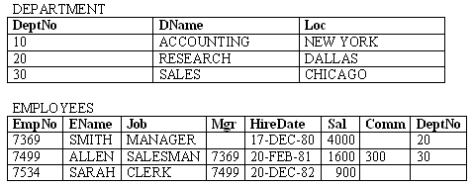
Example of a Relational DB
A company needs to store information on departments and employees.
Each table contains data that describes exactly one entity - a thing of significance about which information needs to be known.
1.<number>

Slide 10
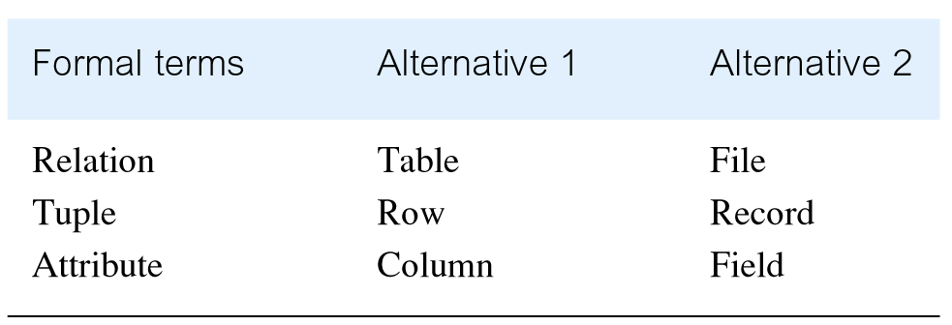
Alternative Terminology for Relational Model

Slide 11
Relational Database Concepts Cont’d
Relational database – a finite set of relational schemas.
Representation of a relational database schema for a company that stores information on departments and employees.
  DEPARTMENT (DeptNo, DName, Loc)
  EMPLOYEES (EmpNo, EName, Job, Mgr, HireDate, Sal, Comm, DeptNo)
  Data Constraints:
  A department name value must never be repeated.
  No employee should earn a salary that is more than 5000.
1.<number>

Slide 12
Relational Database Concepts Cont’d
Properties of Relations:
Uniqueness of relation names in a relational database schema.
Uniqueness of attributes for a given relation.
Uniqueness of tuples for a given relation.
Order of attributes / tuples for a given relation is not significant
1.<number>

Slide 13
Properties of Relations:
Values of an attribute are from the same domain.
A cell of a relation contains exactly one atomic (single) value.
Each tuple is distinct ; there are no duplicate tuples.

Slide 14
Database Languages
Database Languages are known as data Sublanguages.
DBMSs have a facility for embedding the sublanguage in a high-level programming language e.g. C, C++, Java Or VB. The high-level language is then known as a host Language.
Most data sublanguages also provide interactive commands that can be input directly from a terminal.
1.2.<number>

Slide 15
Mathematical Definition of Relation
Consider two sets, D₁ & D₂, where D₁ = {2, 4} and D₂ = {1, 3, 5}.
Cartesian product, D₁ × D₂, is set of all ordered pairs, where first element is member of D₁ and second element is member of D₂.
    D₁ × D₂ = {(2, 1), (2, 3), (2, 5), (4, 1), (4, 3), (4, 5)}
Alternative way is to find all combinations of elements with first from D₁ and second from D₂.

Slide 16
Mathematical Definition of Relation
Any subset of Cartesian product is a relation; e.g.
  R = {(2, 1), (4, 1)}
May specify which pairs are in relation using some condition for selection; e.g.
  second element is 1:
  R = {(x, y) | x ∈D₁, y ∈D₂, and y = 1}
  first element is always twice the second:
  S = {(x, y) | x ∈D₁, y ∈D₂, and x = 2y}

Slide 17
Mathematical Definition of Relation
Consider three sets D₁, D₂, D₃ with Cartesian Product D₁ × D₂ × D₃; e.g.
  D₁ = {1, 3} D₂ = {2, 4} D₃ = {5, 6}
  D₁ × D₂ × D₃ = {(1,2,5), (1,2,6), (1,4,5), (1,4,6), (3,2,5), (3,2,6), (3,4,5), (3,4,6)}
Any subset of these ordered triples is a relation.

Slide 18
Mathematical Definition of Relation
Cartesian product of n sets (D₁, D₂, . . ., D_{n}) is:
  D₁ × D₂ × . . . × D_{n} = {(d₁, d₂, . . . , d_{n}) | d₁ ∈D₁, d₂ ∈D₂, . . . , d_{n}∈D_{n}}
usually written as:
  n
  XD_{i}
  ^{i = 1}
Any set of n-tuples from this Cartesian product is a relation on the n sets.

Slide 19
Database Relations
Relation schema
  Named relation defined by a set of attribute and domain name pairs.
Relational database schema
  Set of relation schemas, each with a distinct name.

Slide 20
Relational Keys
Superkey
  An attribute, or set of attributes, that uniquely identifies a tuple within a relation.
Candidate Key
  Superkey (K) such that no proper subset is a superkey within the relation.
  In each tuple of R, values of K uniquely identify that tuple (uniqueness).
  No proper subset of K has the uniqueness property (irreducibility).

Slide 21
Relational Keys
Primary Key
  Candidate key selected to identify tuples uniquely within relation.
Alternate Keys
  Candidate keys that are not selected to be primary key.
Foreign Key
  Attribute, or set of attributes, within one relation that matches candidate key of some (possibly same) relation.

Slide 22
Integrity Constraints
Null
  Represents value for an attribute that is currently unknown or not applicable for tuple.
  Deals with incomplete or exceptional data.
  Represents the absence of a value and is not the same as zero or spaces, which are values.

Slide 23
Integrity Constraints
Entity Integrity
  In a base relation, no attribute of a primary key can be null.
Referential Integrity
  If foreign key exists in a relation, either foreign key value must match a candidate key value of some tuple in its home relation or foreign key value must be wholly null.

Slide 24
Relational Constraints
Enterprise Constraints
  Additional rules specified by users or database administrators that define or constrain some aspect of the enterprise.

Slide 25
Views
Base Relation
  Named relation corresponding to an entity in conceptual schema, whose tuples are physically stored in database.
View
  Dynamic result of one or more relational operations operating on base relations to produce another relation.

Slide 26
Views
A virtual relation that does not necessarily actually exist in the database but is produced upon request, at time of request.
Contents of a view are defined as a query on one or more base relations.
Views are dynamic, meaning that changes made to base relations that affect view attributes are immediately reflected in the view.

Slide 27
Purpose of Views
Provides powerful and flexible security mechanism by hiding parts of database from certain users.
Permits users to access data in a customized way, so that same data can be seen by different users in different ways, at same time.
Can simplify complex operations on base relations.

Slide 28
Updating Views
All updates to a base relation should be immediately reflected in all views that reference that base relation.
If view is updated, underlying base relation should reflect change.

Slide 29
Updating Views
There are restrictions on types of modifications that can be made through views:
  Updates are allowed if query involves a single base relation and contains a candidate key of base relation.
  Updates are not allowed involving multiple base relations.
  Updates are not allowed involving aggregation or grouping operations.

Slide 30
Updating Views
Classes of views are defined as:
  theoretically not updateable;
  theoretically updateable;
  partially updateable.

