Slide 1
Input/OUTPUT
[I/O Module structure]

Slide 2
Lecture Objectives
I/O module
External devices / Peripherals
Structure of I/O
I/O Techniques

Slide 3
Overview
Input / Output modules are the third critical element of the computer system (others are the CPU and the memory)
All computer systems must have efficient means to receive input and deliver output
– Failure to address I/O concerns has doomed many otherwise good systems

Slide 4
Input/Output Module
The computer’s I/O architecture is its interface to the outside world
An I/O module is not simply a set of mechanical connectors that wire a device into the system bus, rather the module contains some intelligence, that is, it contains logic for performing a communication function between the peripheral and the bus.

Slide 5
Key elements of a computer system
Computer
Recall (Lecture 1)
  Processor
  Memory module
  Input/Output module
Note:
  Each module interfaces with the system bus.
  I/O module contains logic for performing a communication function between a peripheral and the bus.
Central
Processing
Unit
Main
Memory
Systems
Interconnection
Input
Output

Slide 6
The I/O has two major functions, it acts as:
An interface to the processor and Memory via the bus
an interface to one or more peripheral devices by tailored data links.
Relieves the CPU of the management of the I/O devices .

Slide 7
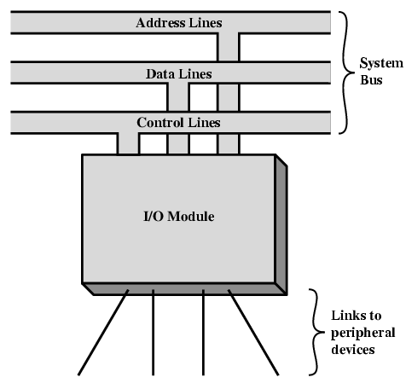
Generic Model of I/O Module

Slide 8
Why are peripherals not directly connected to the system bus
– Wide variety of devices require different logic interfaces -- impractical to expect CPU to “know how” to control each device.
Peripherals often use different data formats than the computer to which they are attached

Slide 9
Why are peripherals not directly connected to the system bus
Mismatch of data rates. The data transfer rate of peripherals is often much slower than that of the memory or processor
Data transfer rate of some peripherals is faster that of the memory or processor.
Thus an I/O module is required.

Slide 10
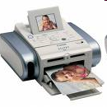
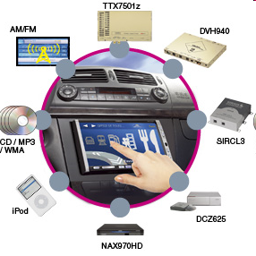
External / Peripheral devices
What is an external / Peripheral device?
Are equipments that might be added to a computer system to enhance its functionality.
Examples:
  Printer
  Digital camera
  Scanner

Slide 11
External /Peripheral Devices
An external device connected to an I/O module is often referred to as a peripheral device . We can broadly classify external devices into three categories.

Slide 12
Classification of External devices
External devices provide a means of exchanging data between the external environment and the computer.
Human readable
  A human-readable format is a representation of data or information that can be naturally read by humans. Suitable for communicating with the computer users
    Screen, printer, keyboard

Slide 13
Classification of External devices
Machine readable
  Machine readable data includes files stored on disk or tape. Suitable for communicating with equipment. capable of being read by a mechanical device without additional processing
    Magnetic disk, Tape
Communication
  Suitable for communicating with remote devices.
    Modem
    Network Interface Card (NIC)

Slide 14
I/O Module
Interface consists of Control, Status, Data Signals.

Slide 15
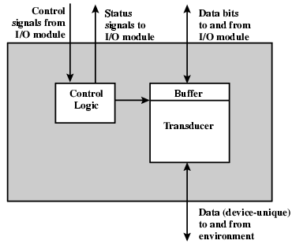
External Device Block Diagram

Slide 16
Transducer
A transducer is an electronic device that converts energy from one form to another. Common examples include microphones, loudspeakers, thermometers.
LED converts electricity to light.
Loudspeaker converts electricity to sound.
.

Slide 17
External device
Interface to the I/O module is in form of:-
  Control
    Determines the function the device will perform e.g. send data (INPUT/READ), accept data (OUTPUT/WRITE)
  Data
    Are in form of a set of bits to be sent to or from the I/O module.
  Status signal
    Indicates the state of the device e.g. READY, BUSY

Slide 18
I/O Modules - Functions
The major functions or requirements for an I/O module fall into the following categories.
  Control & Timing
    Coordinates the flow of traffic between internal resources and external devices. The internal sources such as main memory and the system bus must be shared among a number of activities. Therefore this function is needed to coordinate the flow of traffic between internal resources and external devices.
  Processor Communication
    Communication with the processor and external device.
Notes:
Critical performance bottleneck when using high-performance processors is the interface to the main memory.

Slide 19
  3. Device Communication
    Involves commands, status info and data
  Data Buffering
  The temporary collection and storage of data awaiting further processing in physical storage devices, allowing a computer and its peripheral devices to operate at different speeds.
  Error Detection
    Communication of errors to the processor.
      E.g. Mechanical error.

Slide 20
I/O Steps
The CPU checks / Interrogates the I/O module to check the device status
I/O module returns the device status
If ready, CPU requests data transfer
I/O module gets data from the external device
Data is transferred from I/O module to the processor.

Slide 21
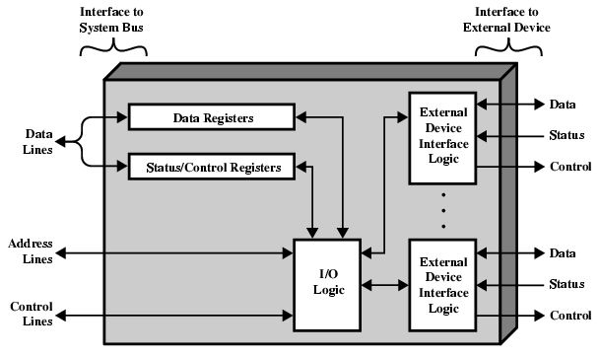
I/O Module Diagram

Slide 22
I/O Module Operation
The module connects to the rest of the computer through the system buses.
Data transferred to and from the module are buffered in one or more data registers. There may also be one or more status registers that provide current status information.

Slide 23
The logic within which, the module interacts with the processor via a set of control lines.
The processor uses the control lines to issue commands to the I/O module
The module must also be able to recognize and generate addresses associated with the devices it controls. Each I/O module has a unique address.
Finally, the I/O module contains logic specific to the interface with each device that it controls.

Slide 24
Summary
I/O module
  Contains logic for communication between the bus and peripheral.
Why peripherals are not connected directly to the system bus.
Functions of I/O module
  Interface processor and memory; Interface peripherals and data links.
Classification of external devices
  Human readable; Machine readable; Communication.
I/O module functions
  Control & Timing; Processor Communication; Device communication ; Data buffering; Error detection

Slide 25
Review Questions
What is the main purpose of the I/O module in the computer structure?
Why cant we have peripherals connected directly to the system bus?
What are the classifications of external devices?
Explain the major functions of the I/O module
5.How does the keyboard and monitor interact with the system

Slide 26
Differentiate between cache and virtual memory.2marks
Cache memory gives faster access to main memory while virtual memory uses disk storage to
give the illusion of having a large main memory.
Cache maps blocks of main memory to blocks of cache memory while Virtual memory maps page frames to virtual pages

