Slide 1
Introduction to DB II
By Paul kisambira
Email: pkisambira@ucu.ac.ug

Slide 2
Course Description
This course builds on the theory of database management systems that were introduced in the previous course of database systems 1.
In database systems II, the emphasis shifts from conceptual and theoretical modelling to use of the application .
Hence we will spend the greater part of this course introducing and using the various capabilities of the Structured Query Language (SQL).

Slide 3
Expectations
Upon successful completion of this unit, you should be able to:
Be familiar and manipulate Relational Algebra (The mathematical basis of SQL )
Explain the basic terminologies and symbols of Relational algebra
Understand use of the various capabilities of SQL.
Formulate SQL queries by translating requests on the database into the relevant SQL queries..

Slide 4
Definitions
Data: Meaningful facts, text, graphics, images, sound, video segments
Database: An organized collection of logically related data
Information: Data processed to be useful in decision making
Metadata: Data that describes data

Slide 5
Introduction
Relational algebra : is a theoretical language with operations that work on one or more relations to define another relation without changing the original relation(s).
Informally, relational algebra is a (high-level) procedural language; can tell the DBMS how to build a new relations from other relations in the database.
Relational Algebra is a basis for other Data Manipulation Languages for relational databases-illustrates the basic operations required for any DML.
<number>
Relational Algebra
<number>

Slide 6
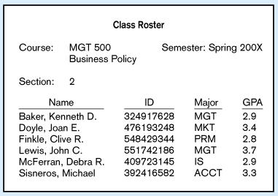
Data in Context
Large volume of facts, difficult to interpret or make decisions based on

Slide 7
Summarized data
Useful information that managers can use for decision making and interpretation

Slide 8
Relational Algebra
5 basic operations in relational algebra:
Selection, Projection, Cartesian product, Union, and Set Difference.
These perform most of the data retrieval operations needed.
Also have Join, Intersection, and Division operations, which can be expressed in terms of 5 basic operations.
<number>
Relational Algebra
<number>

Slide 9
Anatomy of a Relation
StudentId | Name | CourseId
S1 | Anne | C1
attribute name
attribute values
n-tuple, or tuple. This is a 3-tuple. The tuples constitute the body of the relation. The number of tuples in the body is the cardinality of the relation.
Heading (a set of attributes) The degree of this heading is 3,
which is also the degree of the relation.

Slide 10
Relational Algebra Operations cont’d
These operations can be categorised into two groups; unary and binary operations.
Unary Operations: These operate on one relation. Examples of unary operations include; selection and projection
Binary Operations; These work on pairs of relations. Examples include the; Cartesian product, union, set difference, join, intersections and division operations
Relational Algebra
<number>

Slide 11
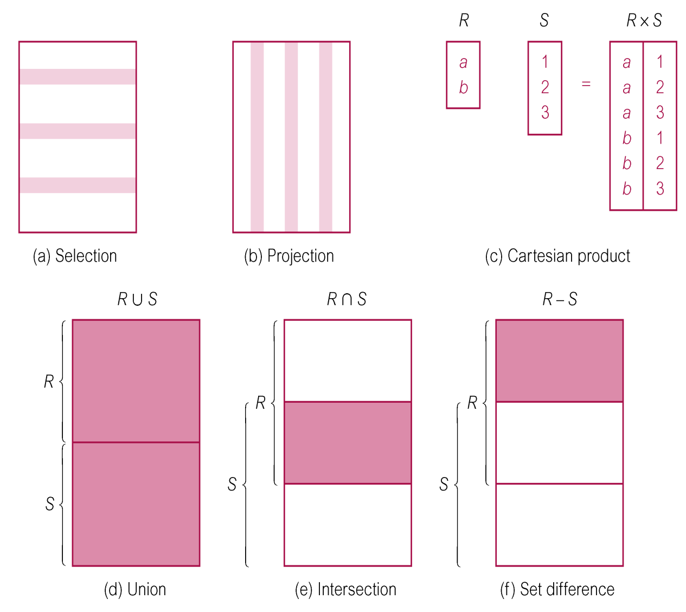
Relational Algebra Operations
(illustrations showing the functions of the relational algebra operations)
<number>
Relational Algebra
<number>

Slide 12
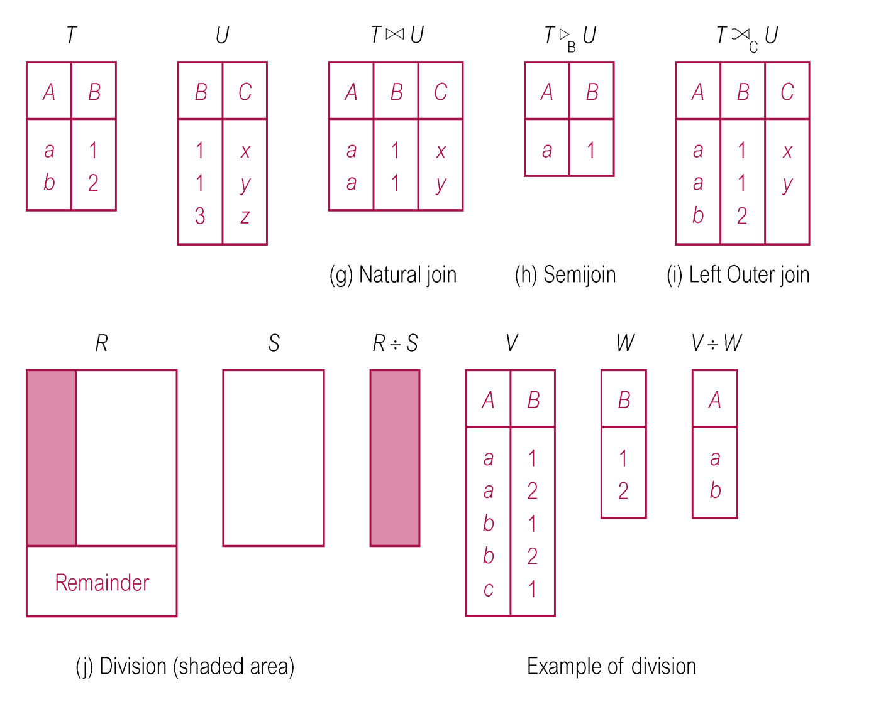
Relational Algebra Operations
<number>
Relational Algebra
<number>

Slide 13
Selection (or Restriction)‏
σ_{predicate} (R)‏
Purpose : Picks rows according to some criteria.
Works on a single relation R and defines a relation that contains only those tuples (rows) of R that satisfy the specified condition (predicate).
More complex predicates can be generated using the logical operators; Λ (AND), ν (OR) and ~ (NOT)‏
Eg;
σ salary>10000 AND σ SALARY <20000
sigma
<number>
Relational Algebra
<number>

Slide 14
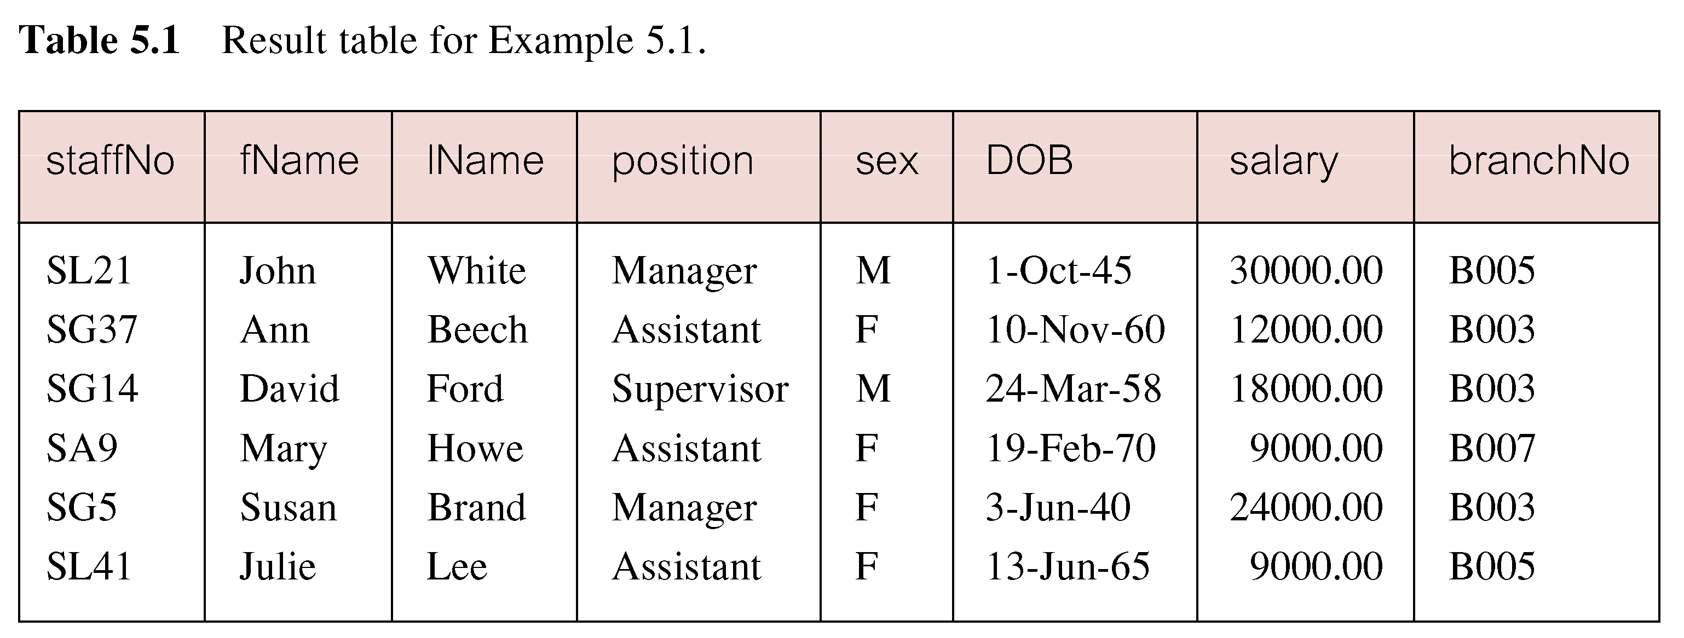

Relational Algebra
<number>

Slide 15
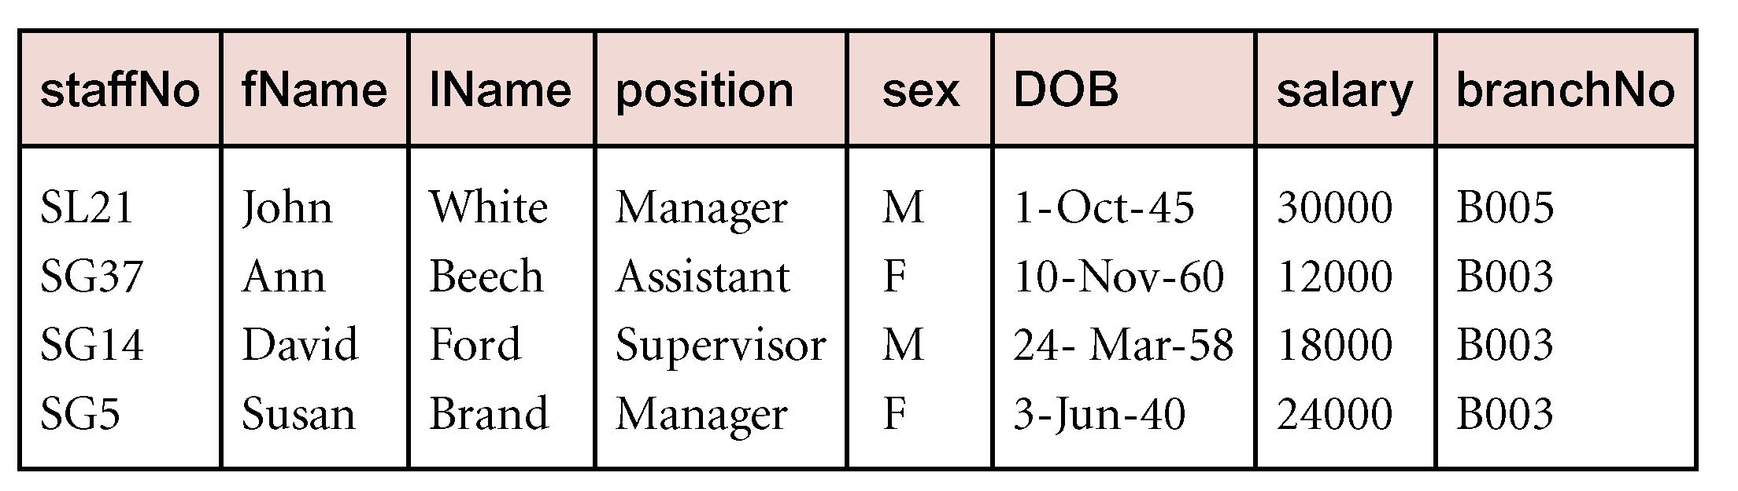
Example - Selection (or Restriction)‏
List all details of staff with a salary greater than £10,000.
σ_{salary > 10000} (Staff)‏
Relational Algebra
<number>

Slide 16
Projection
Purpose : Picks some of the attributes of the relation.
Π_{col1, . . . , coln}(R)‏
Works on a single relation R and defines a relation that contains a vertical subset of R, extracting the values of specified attributes and eliminating duplicates.
For example : Picking Reg No’s and all names of students.
<number>
Relational Algebra
<number>

Slide 17
Example - Selection (or Restriction)‏
List all details of staff with a salary greater than £10,000.
σ_{salary > 10000} (Staff)‏
Relational Algebra
<number>

Slide 18
Projection
Purpose : Picks some of the attributes of the relation.
Π_{col1, . . . , coln}(R)‏
Works on a single relation R and defines a relation that contains a vertical subset of R, extracting the values of specified attributes and eliminating duplicates.
For example : Picking Reg No’s and all names of students.
<number>
Relational Algebra
<number>

Slide 19
Example - Projection
Produce the names and respective marks from student table
Π_{fName, marks}(Student)‏
Name | Age | Regno | Marks
Peter | 19 | S09b13/311 | 80
Sam | 20 | S09b13/230 | 75
Mary | 21 | S09b13/567 | 65
Name | Marks
Peter | 80
Sam | 75
Mary | 65
<number>
Relational Algebra
<number>

Slide 20
Union
R ∪ S
Union of two relations R and S defines a relation that contains all the tuples of R, or S, or both R and S, duplicate tuples being eliminated.
If R and S have I and J tuples, respectively, union is obtained by concatenating them into one relation with a maximum of (I + J) tuples.
<number>
Relational Algebra
<number>

Slide 21
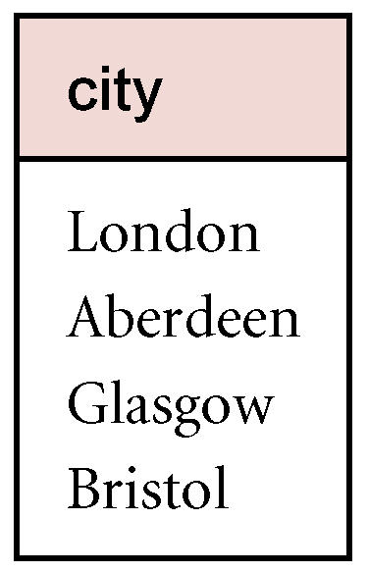
Example – Union
The union of two relations R and S defines a relation that contains all the tuples of R, or S, or both R and S, duplicate tuples being eliminated.
List all cities where there is either a branch office or a property for rent.
Π_{city}(Branch) ∪ Π_{city}(PropertyForRent)‏
Make use of Connolly & BEGG
Page 80. PropertyForRent &
Branch Table.
<number>
Relational Algebra
<number>

Slide 22
Set Difference
R – S
Defines a relation consisting of the tuples that are in relation R, but not in S.
<number>
Relational Algebra
<number>

Slide 23
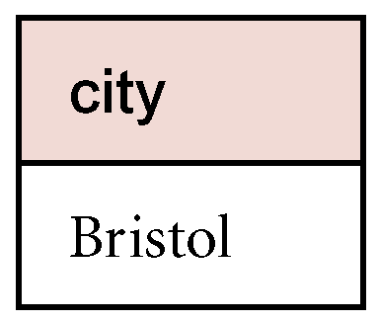
Example - Set Difference
List all cities where there is a branch office but no properties for rent.
Π_{city}(Branch) – Π_{city}(PropertyForRent)‏
<number>
Relational Algebra
<number>

Slide 24
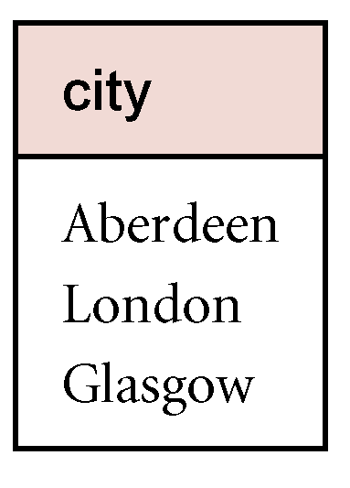
Intersection ( And )
R ∩ S
Defines a relation consisting of the set of all tuples that are in both R and S.
List all cities where there is both a branch office and at least one property for rent.
Π_{city}(Branch) ∩ Π_{city}(PropertyForRent)
<number>
Relational Algebra
<number>

Slide 25
Cartesian product
Purpose: Pairs rows from 2 tables.
R X S
Defines a relation that is the concatenation of every tuple of relation R with every tuple of relation S; relation with all possible pairs of tuples from the two relations.
In case the relations have attributes with the same names, these are prefixed with the relation name to maintain the uniqueness of attribute names in the resulting relation.
Output: For each row r in R and each row s in S, output a row rs; the output table has the columns of R and the columns of S
<number>
Relational Algebra
<number>

Slide 26
Example - Cartesian Product
List the names and comments of all clients who have viewed a property for rent.
(Π_{clientNo, fName, lName}(Client)) X (Π_{clientNo, propertyNo,comment} (Viewing))‏
<number>
Relational Algebra
<number>

Slide 27
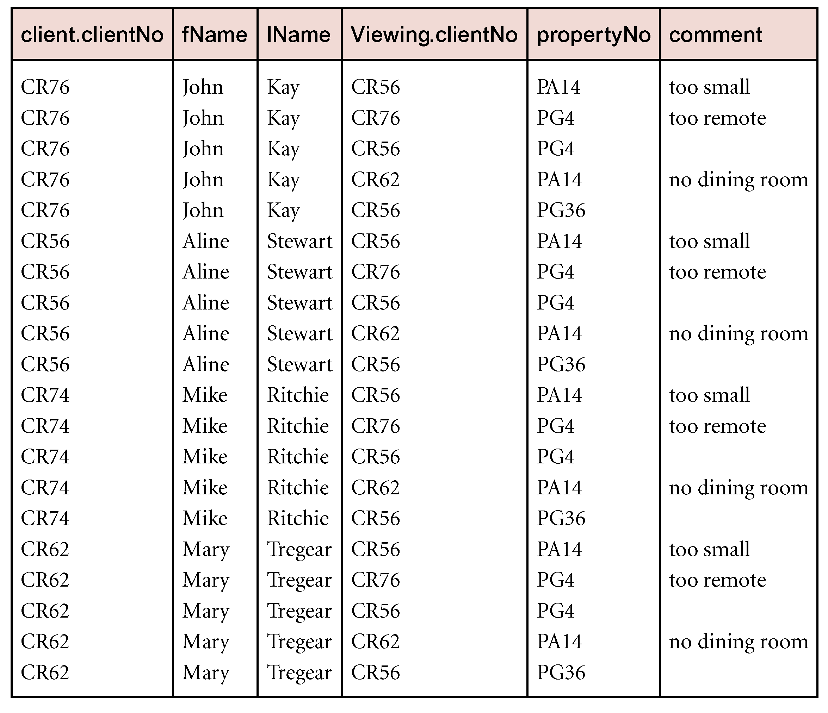
Example - Cartesian Product cont’d
<number>
Relational Algebra
<number>

Slide 28
Join Operations
This is one of the essential operations in relational algebra; a join operation combines two relations to form a new one.
A Join is a derivative of Cartesian product; Equivalent to performing a Selection, using join predicate as selection formula, over Cartesian product of the two operand relations (Cartesian product that satisfies a given condition(s)).
One of the most difficult operations to implement efficiently in an RDBMS and one reason why RDBMSs have intrinsic performance problems.
<number>
Relational Algebra
<number>
Notes:
N.B: In reality we are usually interested only in combinations of the cartesian product that satisfies certain conditions. These are commonly known as join operations rather than restricted cartesian products.

Slide 29
Join Operations
Various forms of join operation
Theta join
Equi -join‏
Natural join
Outer join
Left Outer Join
Right Outer Join.
<number>
Relational Algebra
<number>

Slide 30
Theta join (θ-join)‏
R _{F}S
Defines a relation that contains tuples satisfying the predicate F from the Cartesian product of R and S.
The predicate F is of the form R.a_{i} θ S.b_{i} where θ may be one of the comparison operators (<, ≤, >, ≥, ≠).
<number>
Relational Algebra
<number>

Slide 31
Theta join (θ-join)‏
Can rewrite Theta join using basic Selection and Cartesian product operations.
R _{F}S = σ_{F}(R Χ S)‏
Degree of a Theta join is sum of degrees of the operand relations R and S; as the Cartesian product.
If predicate F contains only equality (=), the term Equijoin is used.
<number>
Relational Algebra
<number>

Slide 32
Example Theta join Suppose a customer wants to buy a Toshiba and Dell, but doesn’t want 2 spend more money for the Dell than for the Toshiba Ie Toshiba >= Dell Price
Toshiba Model | Toshiba Price
Toshiba Slide | 20000
Toshiba 1600 | 30000
Toshiba X101 | 50000
Dell model | Dell Price
Dell E101 | 10000
Dell G700 | 40000
Dell K750 | 60000

Slide 33
Example – Equijoin
Qn . Generate the resultant equi join from the Employee and Dept Table below
Employee TABLE
NAME | EMP ID | DEPT NAME
HARRY | 3415 | FINANCE
SALLY | 2241 | SALES
GEORGE | 3401 | FINANCE
HARRIET | 2202 | SALES
DEPT TABLE
DEPT NAME | MANAGER
FINANCE | GEORGE
SALES | HARRIET
PRODN | CHARLES
<number>
Relational Algebra
<number>

Slide 34
NAME | EMPID | DEPTNAME | MANAGER
HARRY | 3415 | FINANCE | GEORGE
SALLY | 2241 | SALES | HARRIET
GEORGE | 3401 | FINANCE | GEORGE
HARRIET | 2202 | SALES | HARRIET
Relational Algebra
<number>

Slide 35
Natural Join
R S
An Equijoin of the two relations R and S over all common attributes x. One occurrence of each common attribute is eliminated from the result.
The degree of a natural join is the sum of the degrees of the relations R and S less the number of attributes in x.
<number>
Relational Algebra
<number>

Slide 36
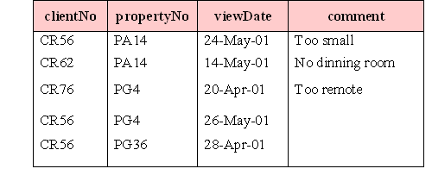
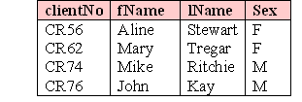
Example
VIEWING
CLIENT

Slide 37
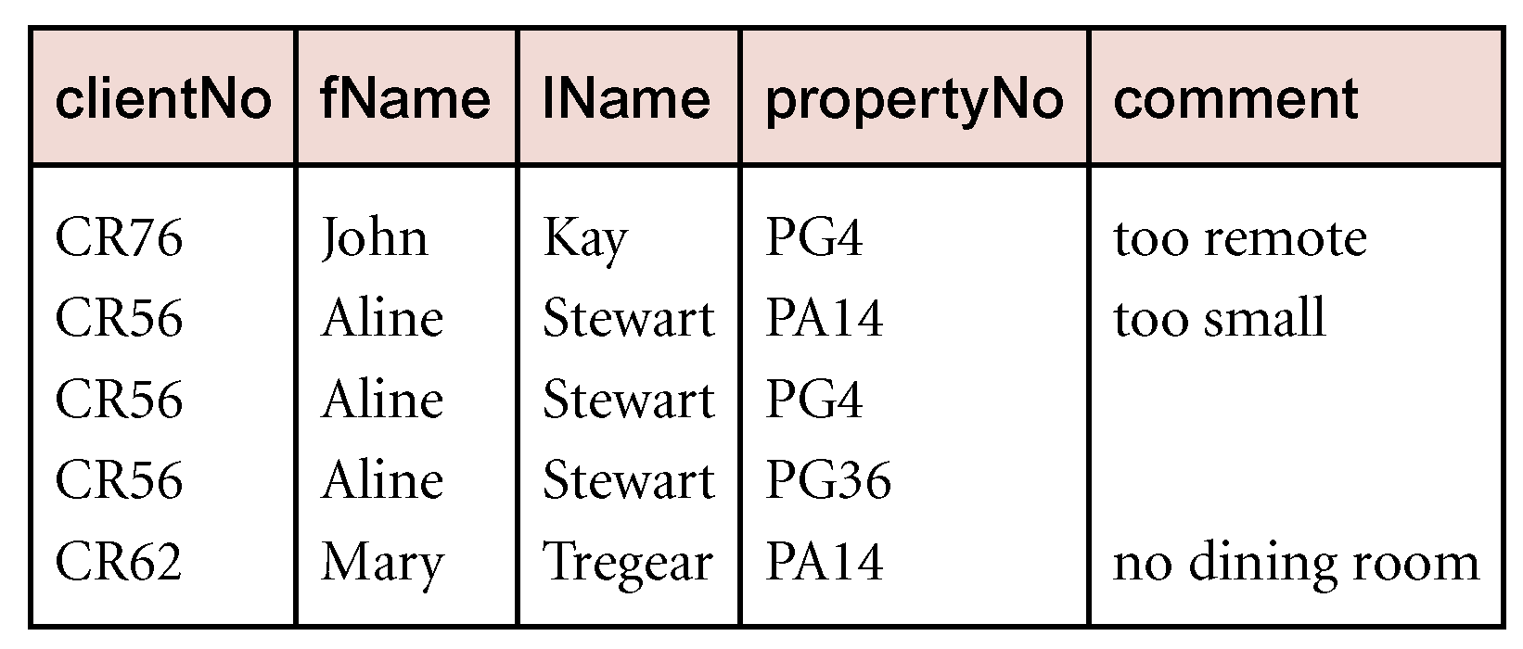
Example - Natural Join
List the names and comments of all clients who have viewed a property for rent.
(Π_{clientNo,fName,lName}(Client)) (Π_{clientNo,propertyNo,comment}(Viewing))‏
<number>
Relational Algebra
<number>

Slide 38
Outer join
To display rows in the result that do not have matching values in the join column, use Outer join.
Advantage: preservation of information (that would otherwise be lost).
There are basically three types of outer join operations
Left (natural) Outer join
Right Outer join
Full Outer join
<number>
Relational Algebra
<number>

Slide 39
Outer Join
To display rows in the result that do not have matching values in the join column, use Outer join.
R S
(Left ) Outer join is the join in which tuples from R that do not have matching values in common columns with S are also included in result relation.
R S Resultant
A | B
a | 1
b | 2
A | B | C
a | 1 | x
a | 1 | y
b | 2 | Null
B | C
1 | x
1 | y
3 | z

Slide 40
Left Outer join ( )
R S
(Left) outer join is join in which tuples from R that do not have matching values in common columns of S are also included in result relation.
The missing values in the second relation are set to null.
Returns all values from the left table , plus matched values from the right table ( or Null in case of No matching join predicate)
Relational Algebra
<number>
Notes:
They maintain the concept of the natural join with the exception of including the tuples in the left hand side relation that have no matching values in the common attributes.

Slide 41
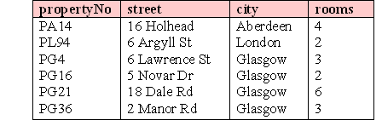
Example
PropertyForRent
Viewing

Slide 42
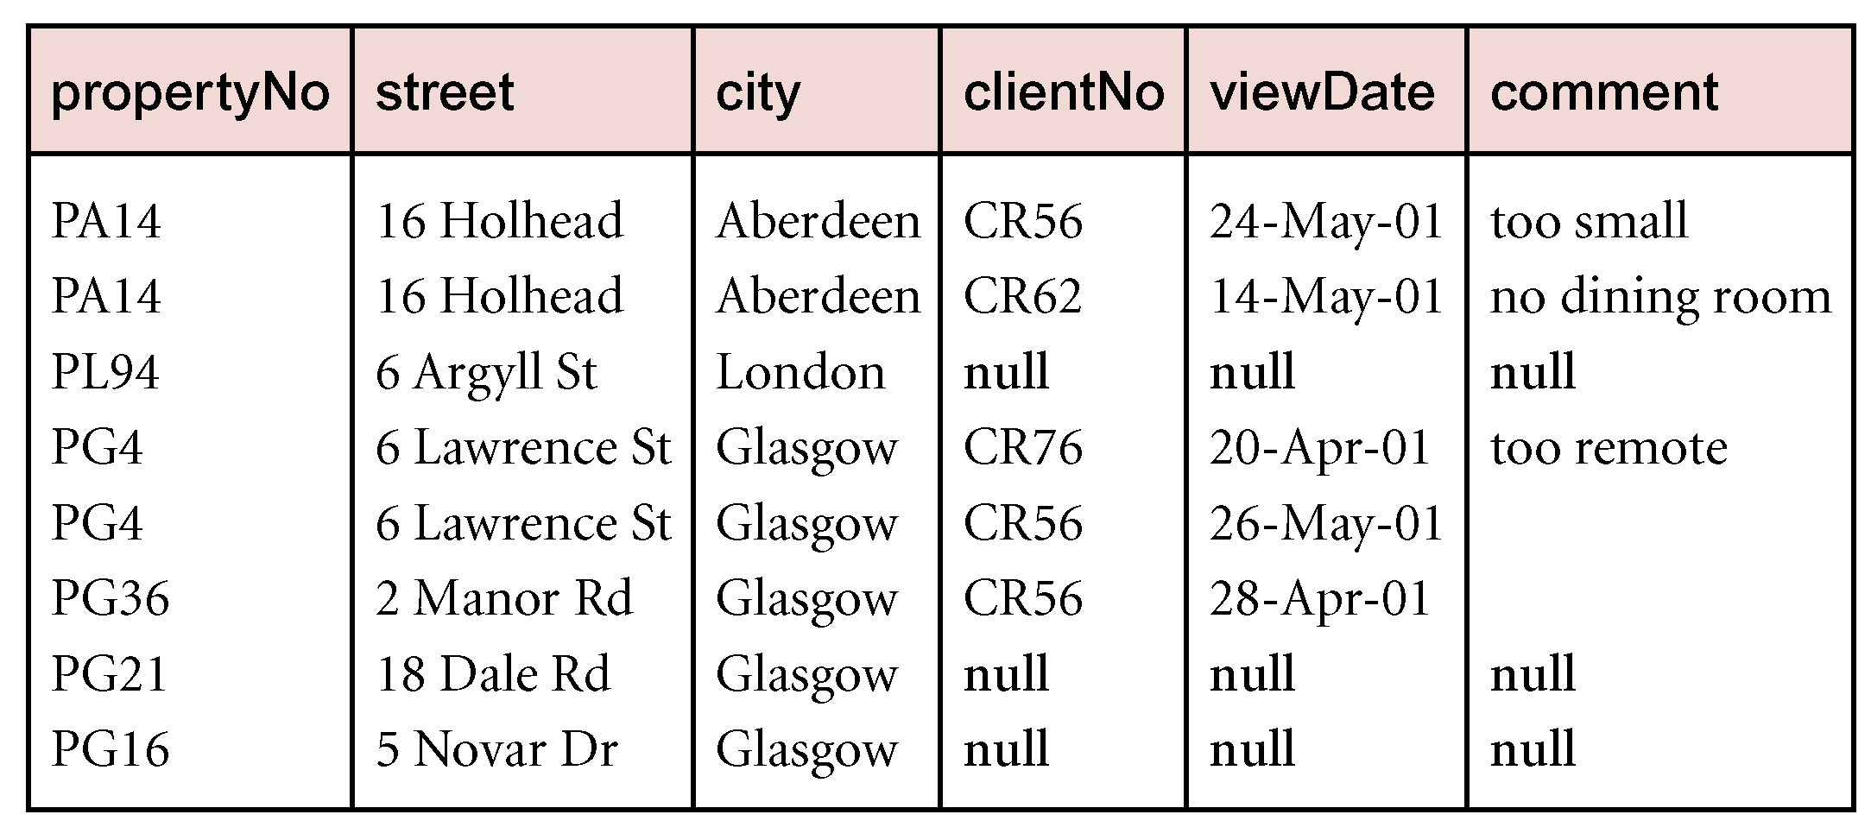
Example - Left Outer join
Produce a status report on property viewings.
Π_{propertyNo,street,city}(PropertyForRent) Viewing
<number>
Relational Algebra
<number>

Slide 43
Outer joins cont’d
Right Outer Join:
This join keeps all the tuples in the right-hand relation in the result.
Returns all the values from the right table and matched values from the left table. ( Null in case of no matching join predicate)
Full Outer Join:
Combines the result of both left and right outer join . The joined table will contain records from both tables and fill in Nulls for missing matches on either tables.
Relational Algebra
<number>

Slide 44
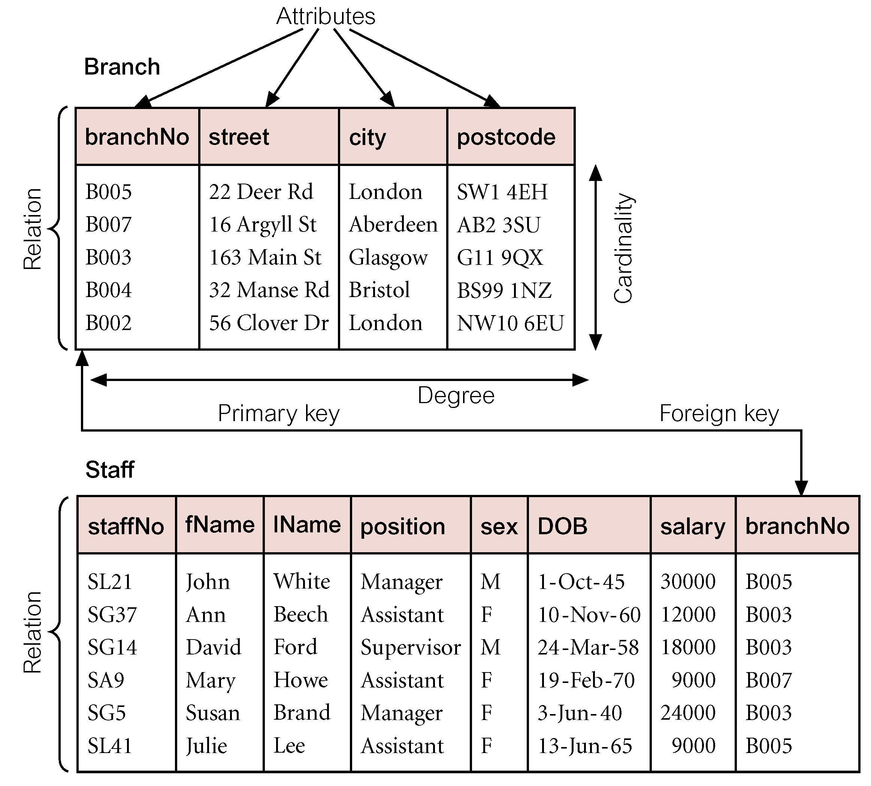
Example

Slide 45
Division (R ÷ S)
Defines a relation over the attributes C that consists of set of tuples from R (with attribute set A) that match combination of every tuple in S (with attribute set B) . Note: C is the set of attributes of R that are not attributes of S (A-B)
<number>
Relational Algebra
<number>

Slide 46
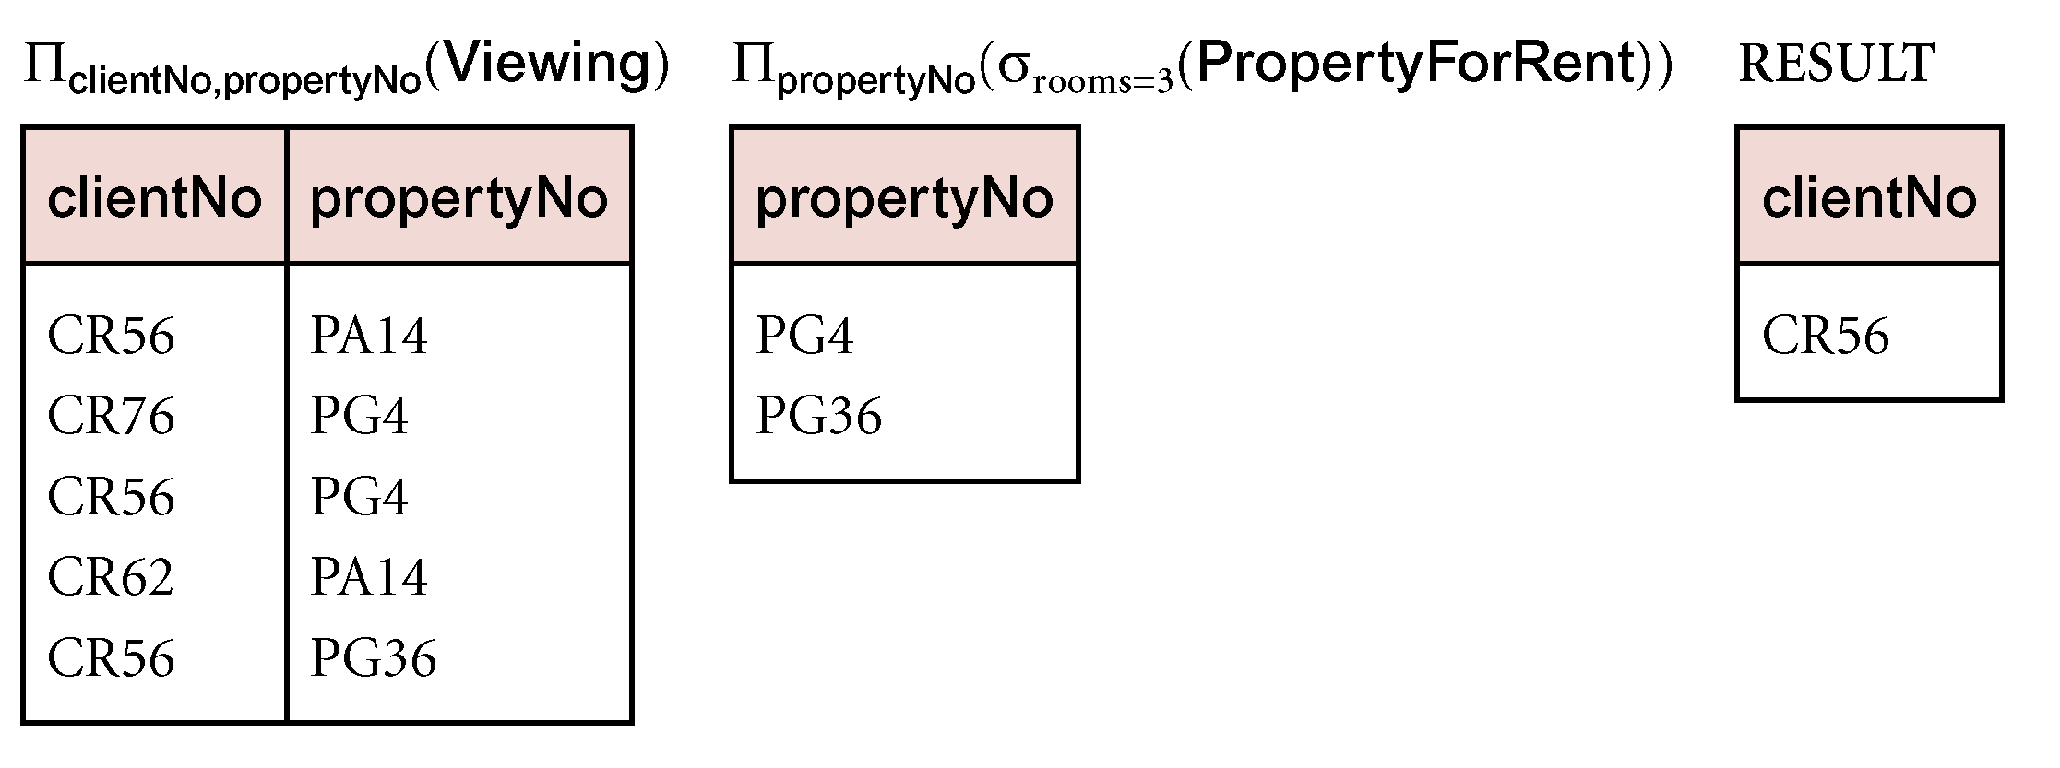
Example - Division
Identify all clients who have viewed all properties with three rooms.
(Π_{clientNo,propertyNo}(Viewing)) ÷ (Π_{propertyNo}(σ_{rooms = 3} (PropertyForRent)))‏
<number>
Relational Algebra
<number>

