Slide 1
Database Design:
Conceptual Model to Logical Model (ER diagrams to tables)

Slide 2
Database Design Process
Application 1
Application 2
Application 3
Application 4
External
Model
External
Model
External
Model
External
Model
Application 1
Conceptual
requirements
Application 2
Conceptual
requirements
Conceptual
Model
Logical
Model
Internal Model
Application 3
Conceptual
requirements
Application 4
Conceptual
requirements
IS 257 – Fall 2006

Slide 3
Developing a Conceptual Model
Overall view of the database that integrates all the needed information discovered during the requirements analysis.
Elements of the Conceptual Model are represented by diagrams, Entity-Relationship or ER Diagrams, that show the meanings and relationships of those elements independent of any particular database systems or implementation details.
Can also be represented using other modeling tools (such as UML)

Slide 4
Developing a Conceptual Model
We looked at the bus transportation system
We identified key scenarios
Limited our scope
Made our initial ER diagram
  Identified Entities
  Indicated relevant attributes
  Specified unique identifiers
  Worked out relationships between entities (& cardinality)
Still to do:
  Still needs to be integrated
  May be full of flaws!
IS 257 – Fall 2006

Slide 5
Normalization of ER Diagram
(expand repeating attributes)
Ship Via
ShipVia
ship
Customer No
DiveCust
Orders
DiveOrds
Customer No
Order No
DiveItem
Repeating
attribute

Slide 6
Normalization
Ship Via
ShipVia
Item No
Ship
Customer No
Order No
Qty
DiveCust
Orders
DiveOrds
Contains
DiveItem
Order No
Rental/sale
Customer No

Slide 7
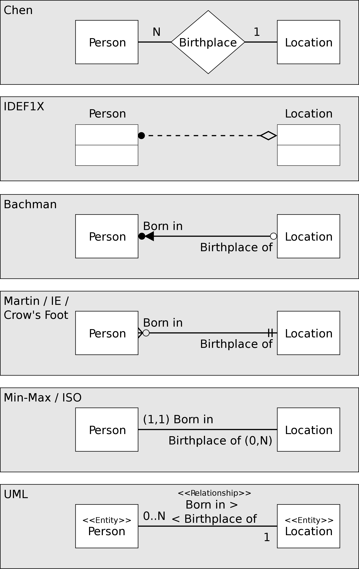
Some ER Diagram Styles
01/24/17

Slide 8
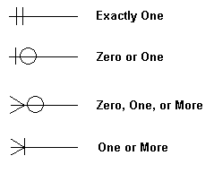
Crow's Feet Notation is as follows:
Cardinality: maximum (1 or many)
Modality: minimum (0 or 1)
01/24/17

Slide 9
Notation used in the following slides
http://www.philblock.info/hitkb/i/interpreting_entity-relationship_diagrams.html
01/24/17

Slide 10
Chapter 7
Logical Database Design
Fundamentals of Database Management Systems
by
Mark L. Gillenson, Ph.D.
University of Memphis
John Wiley & Sons, Inc.

Slide 11
7-<number>
Chapter Objectives
Describe the concept of logical database design.
Design relational databases by converting entity-relationship diagrams into relational tables.
Describe the data normalization process.

Slide 12
7-<number>
Chapter Objectives
Perform the data normalization process.
Test tables for irregularities using the data normalization process.

Slide 13
7-<number>
Logical Database Design
The process of deciding how to arrange the attributes of the entities in the business environment into database structures, such as the tables of a relational database.
The goal is to create well structured tables that properly reflect the company’s business environment.

Slide 14
7-<number>
Logical Design of Relational Database Systems
(1) The conversion of E-R diagrams into relational tables.
(2) The data normalization technique.
(3) The use of the data normalization technique to test the tables resulting from the E-R diagram conversions.

Slide 15
7-<number>
Converting E-R Diagrams into Relational Tables
Each entity will convert to a table.
Each many-to-many relationship or associative entity will convert to a table.
During the conversion, certain rules must be followed to ensure that foreign keys appear in their proper places in the tables.

Slide 16
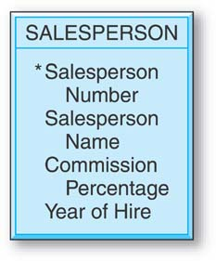

Converting a Simple Entity
The table simply contains the attributes that were specified in the entity box.
Salesperson Number is underlined to indicate that it is the unique identifier of the entity and the primary key of the table.
7-<number>

Slide 17
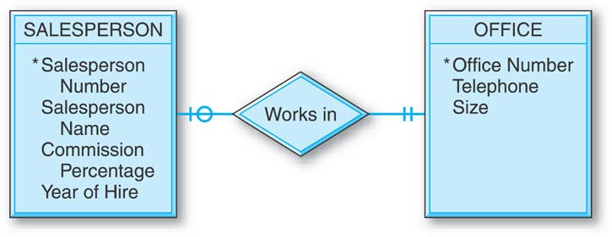
Converting Entities in Binary Relationships: One-to-One
There are three options for designing tables to represent this data.
7-<number>

Slide 18
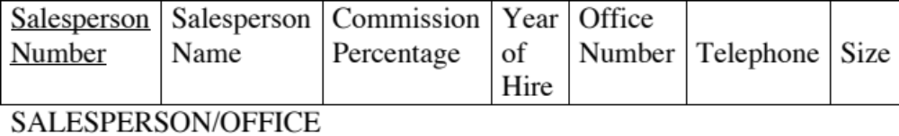
One-to-One: Option #1
The two entities are combined into one relational table.
7-<number>

Slide 19


One-to-One: Option #2
Separate tables for the SALESPERSON and OFFICE entities, with Office Number as a foreign key in the SALESPERSON table.
7-<number>

Slide 20


One-to-One: Option #3
Separate tables for the SALESPERSON and OFFICE entities, with Salesperson Number as a foreign key in the OFFICE table.
7-<number>

Slide 21
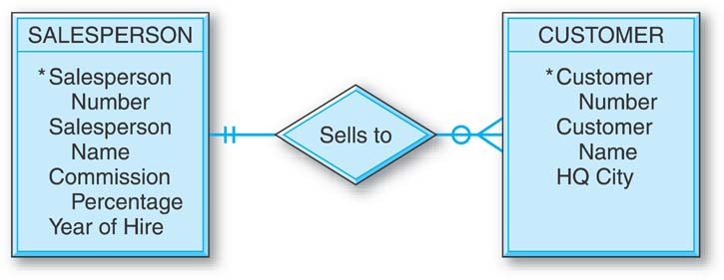
Converting Entities in Binary Relationships: One-to-Many
The unique identifier of the entity on the “one side” of the one-to-many relationship is placed as a foreign key in the table representing the entity on the “many side.”
So, the Salesperson Number attribute is placed in the CUSTOMER table as a foreign key.
7-<number>

Slide 22


Converting Entities in Binary Relationships: One-to-Many
7-<number>

Slide 23
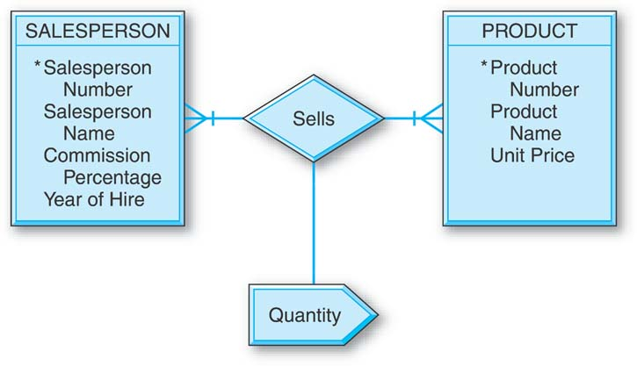
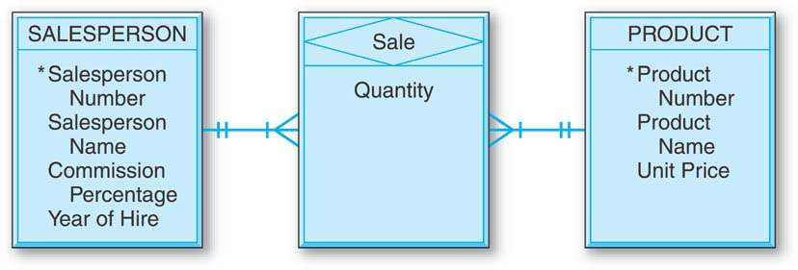
Converting Entities in Binary Relationships: Many-to-Many
E-R diagram with the many-to-many binary relationship and the equivalent diagram using an associative entity.
7-<number>

Slide 24
7-<number>
Converting Entities in Binary Relationships: Many-to-Many
An E-R diagram with two entities in a many-to-many relationship converts to three relational tables.
Each of the two entities converts to a table with its own attributes but with no foreign keys (regarding this relationship).
In addition, there must be a third “many-to-many” table for the many-to-many relationship.

Slide 25
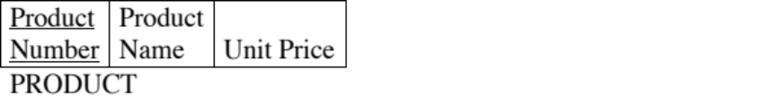



Converting Entities in Binary Relationships: Many-to-Many
The primary key of SALE is the combination of the unique identifiers of the two entities in the many-to-many relationship. Additional attributes are the intersection data.
7-<number>

Slide 26
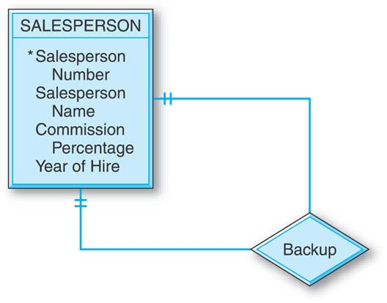

Converting Entities in Unary Relationships: One-to-One
With only one entity type involved and with a one-to-one relationship, the conversion requires only one table.
7-<number>

Slide 27
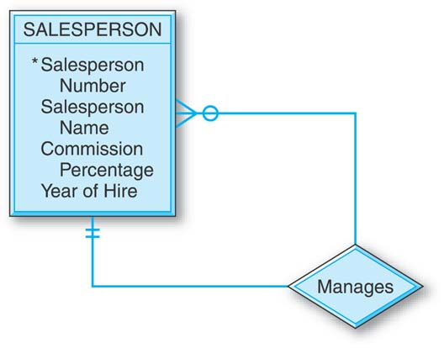
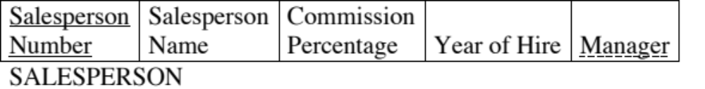
Converting Entities in Unary Relationships: One-to-Many
Very similar to the one-to-one unary case.
7-<number>

Slide 28
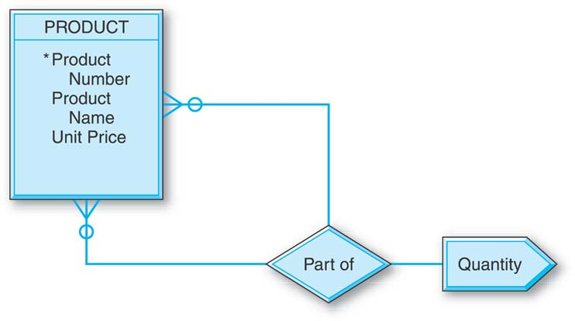


Converting Entities in Unary Relationships: Many-to-Many
This relationship requires two tables in the conversion.
The PRODUCT table has no foreign keys.
7-<number>

Slide 29
Converting Entities in Unary Relationships: Many-to-Many
A second table is created since in the conversion of a many-to-many relationship of any degree — unary, binary, or ternary — the number of tables will be equal to the number of entity types (one, two, or three, respectively) plus one more table for the many-to-many relationship.
7-<number>

Slide 30
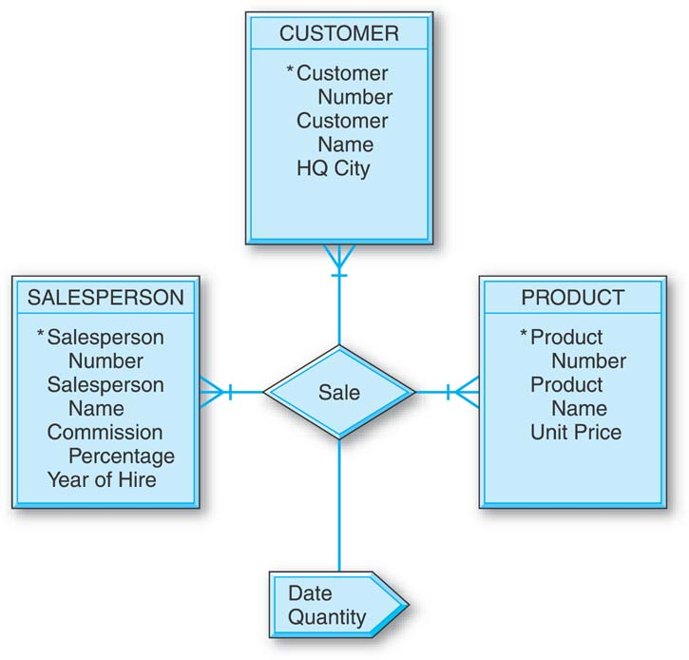



Converting Entities in
Ternary Relationships
The primary key of the SALE table is the combination of the unique identifiers of the three entities involved, plus the Date attribute.
7-<number>

Slide 31
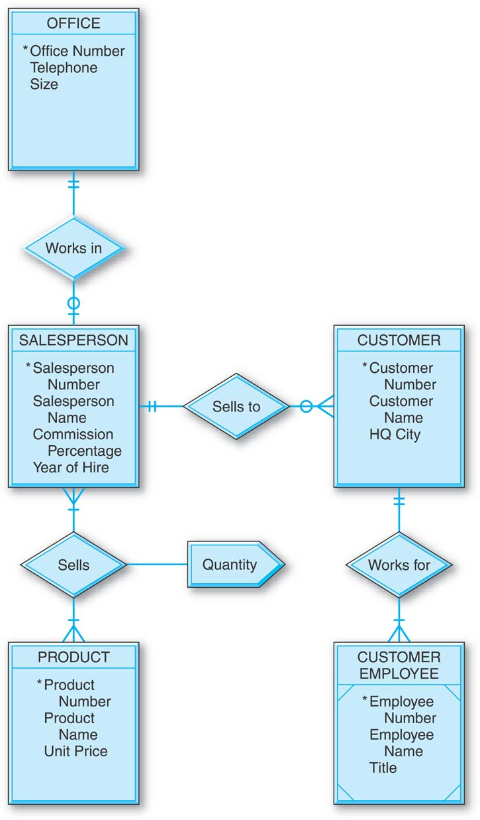
Designing the General Hardware Company Database
7-<number>

Slide 32




Designing the General Hardware Company Database
7-<number>

Slide 33
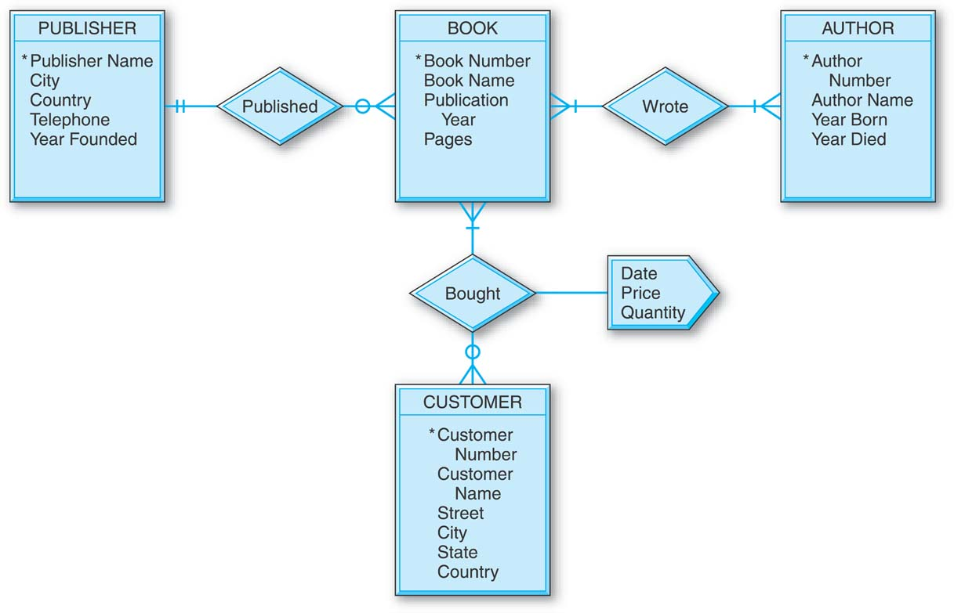
Designing the Good Reading Bookstores Database
7-<number>

Slide 34






Designing the Good Reading Bookstores Database
7-<number>

Slide 35
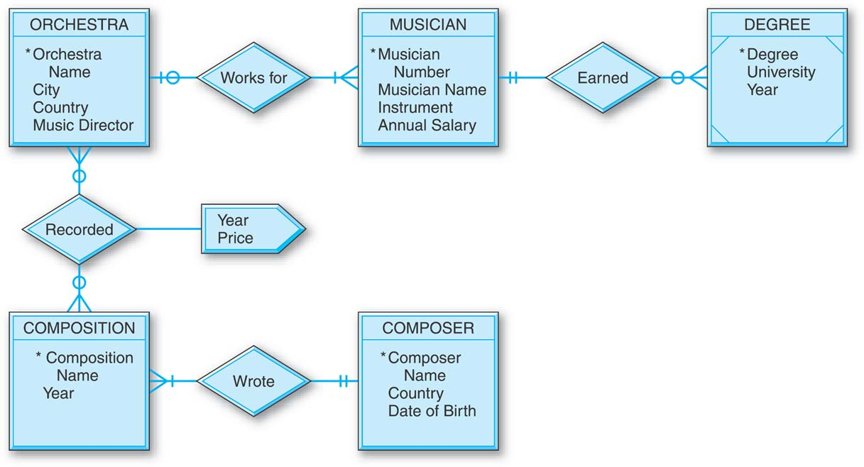
Designing the World Music Association Database
7-<number>

Slide 36






Designing the World Music Association Database
7-<number>

Slide 37
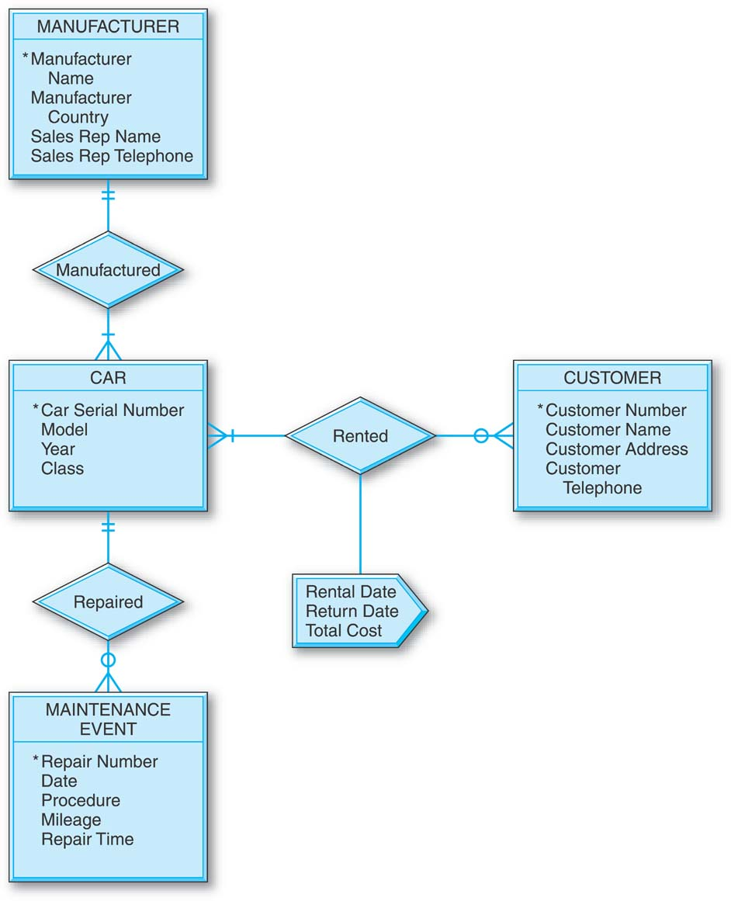
Designing the Lucky
Rent-A-Car Database
7-<number>

Slide 38





Designing the Lucky
Rent-A-Car Database
7-<number>

Slide 39
7-<number>
Next up: The Data Normalization Process
A methodology for organizing attributes into tables so that redundancy among the nonkey attributes is eliminated.
The output of the data normalization process is a properly structured relational database.

