Slide 1

Microsoft Access
Introduction to Database Programs

Slide 2
Lesson Objectives
After completing this lesson, you will be able to:
Explain basic concepts of a database.
Two different ways to create a database.
Work with records in a database.
Explain what database queries are and how they work.
Work with reports

Slide 3
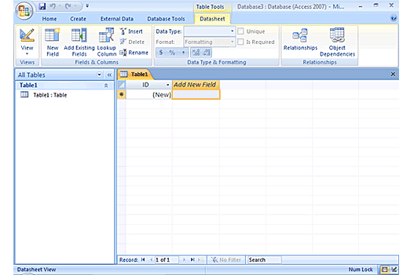
Overview of Access
A database contains objects that store, edit, and format information. Data is organized in a database in the form of tables.
Two common types of databases Flat file and Relational.
Flat file: database contains all the data in a single table,
Relational: database stores data in multiple tables.

Slide 4
Access Objects
Tables: - a collection of data about a topic arranged in rows and columns.
Forms: - a place to enter data easily
Queries: - a tool that lets you view, change, and analyze data in different ways
Reports: - a method to present your data in a printed format, such as charts & invoices

Slide 5
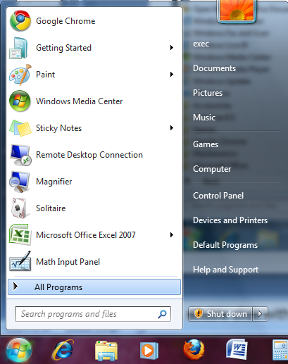
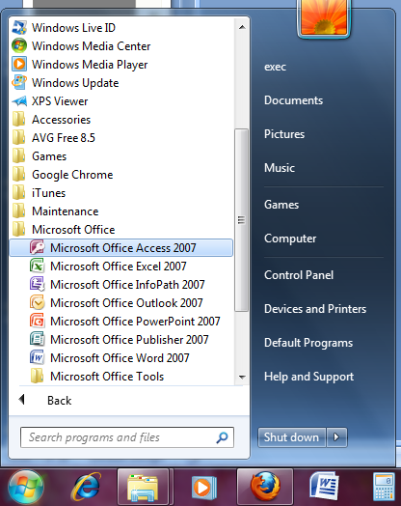

Create a Database
click the Start button, and then click All Programs
click Microsoft Office, and then click Microsoft Office Access 2007

Slide 6
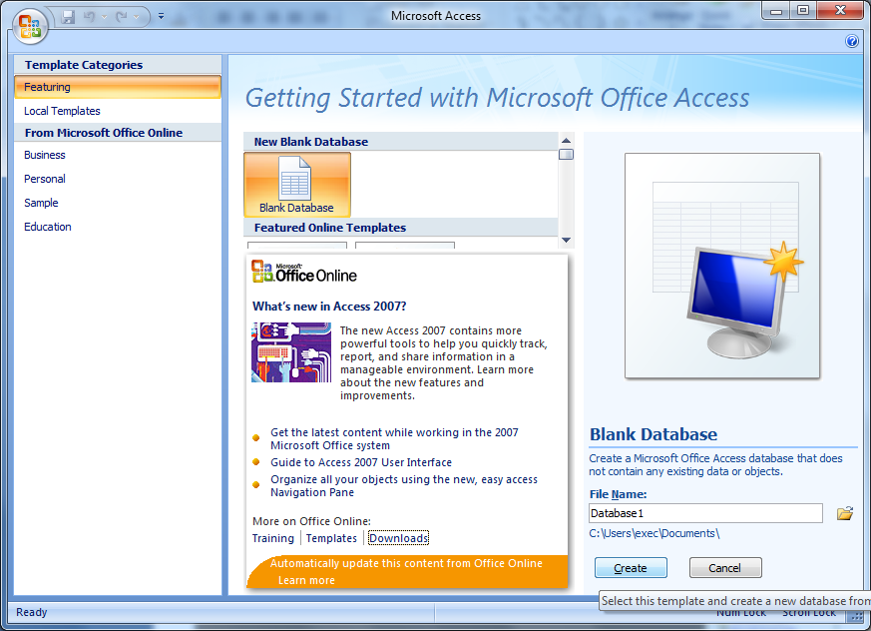
Create a Database (cont.)
Click Blank Database. Type a name for your database in the File Name Box.

Slide 7
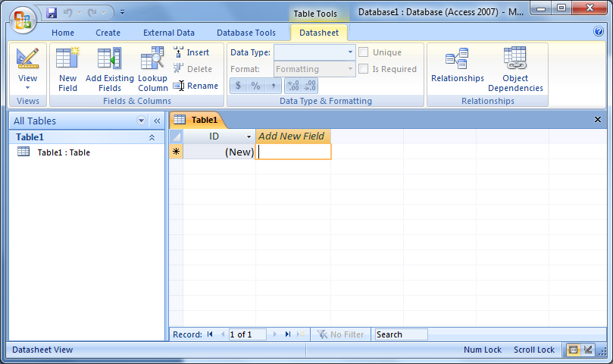
Create a Database
Create a Database (cont.)
To create fields for the table, double click the Add New Field cell, type First Name and press the ENTER key.

Slide 8
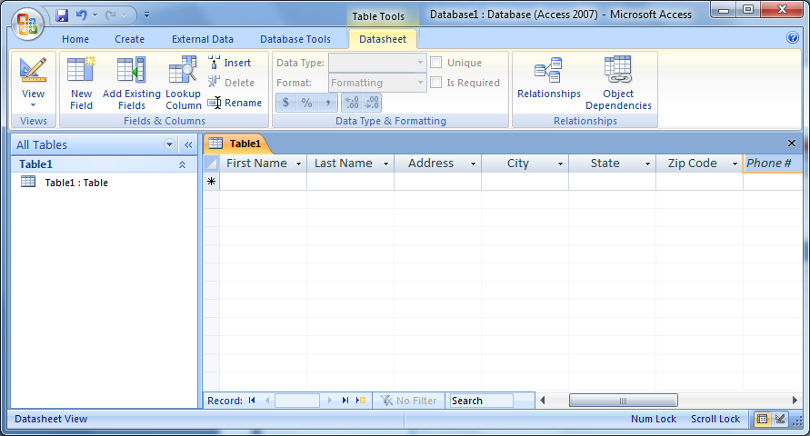
Create a Database (cont.)
To add data to the table, type in the data in each field cell.

Slide 9
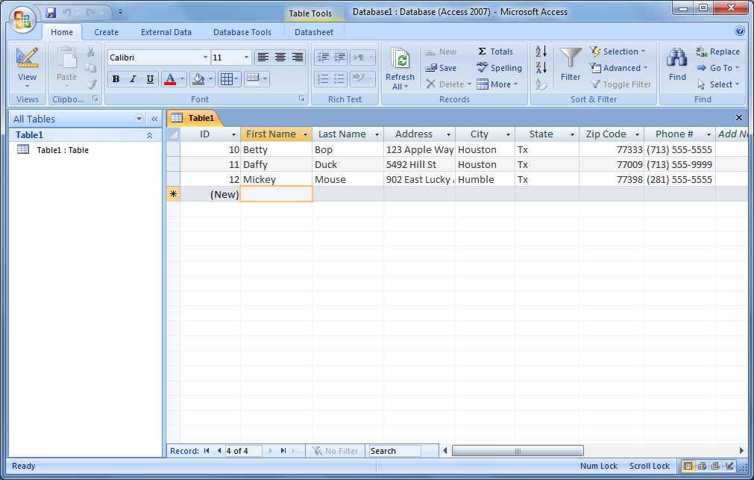
Entering data
Create a Database (cont.)
Entering Data

Slide 10
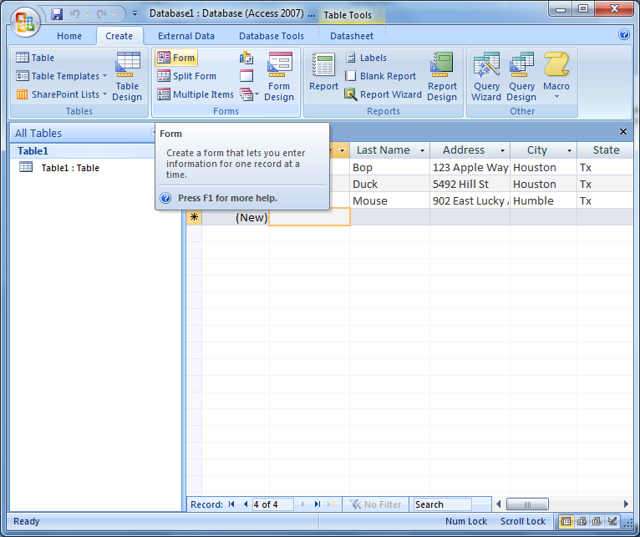
Creating Forms
To create a form from a table, click on the Form icon from the Create tab.

Slide 11
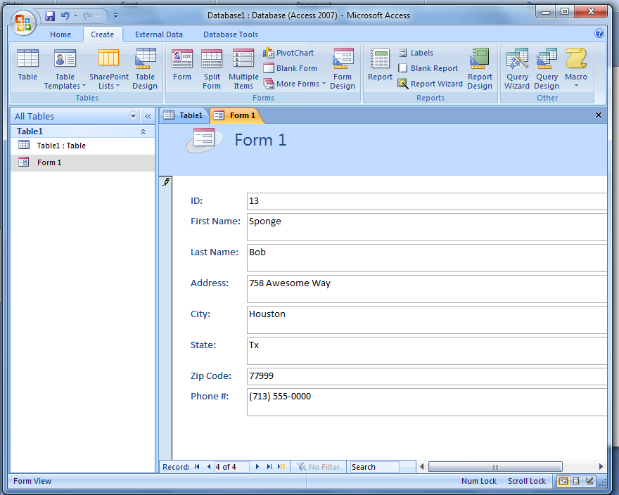
Creating Forms (cont.)
Entering Data

Slide 12
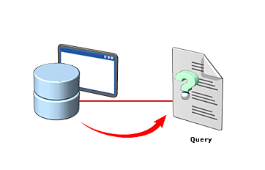
Database Queries
You use a query to retrieve specific information from a database.
A query is a question that you enter in a database program.
The database program then performs the required operations to present the answer in the form of a report.
A query helps you view specific data to modify or analyze it.

Slide 13
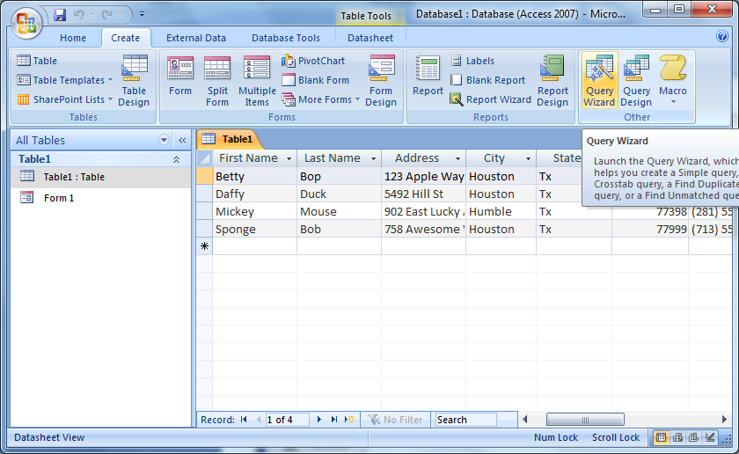
Creating Queries
To create a query, click the Create tab. In the Ribbon, click Query Wizard.

Slide 14
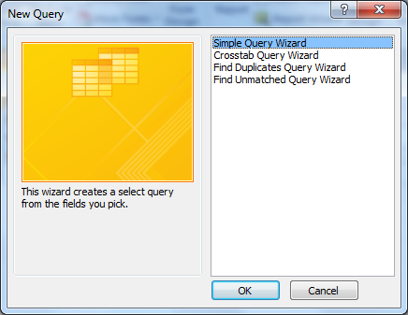
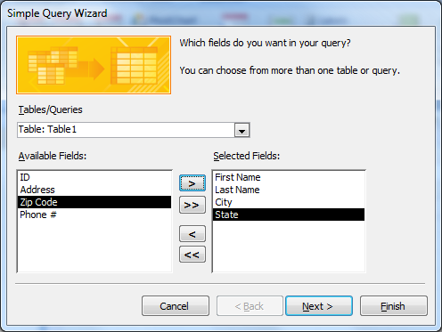
Creating Queries (cont.)
When the New Query window appears, make sure Simple Query Wizard is selected.
Transfer data from the Available Field to the Selected Field one at a time using >

Slide 15
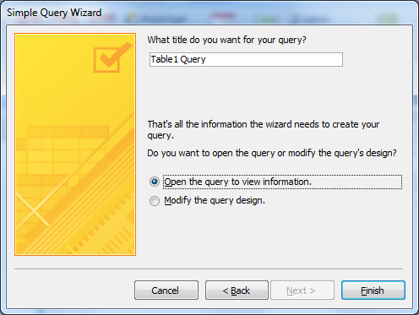
Creating Queries (cont.)
When the final screen appears, type the Names of the query

Slide 16
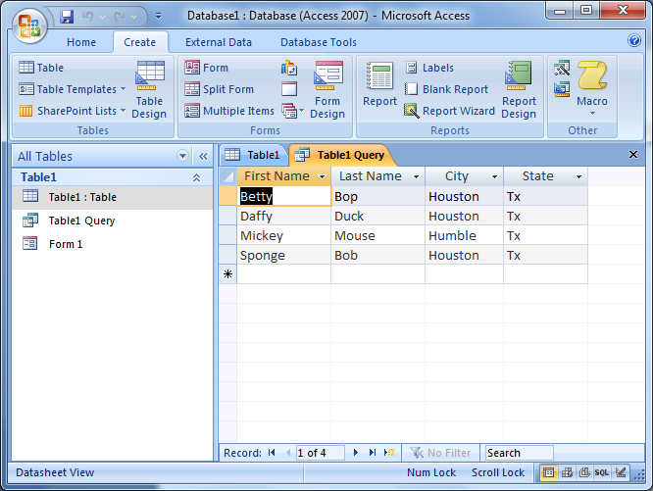
Click the button.
.
Creating Queries (cont.)
The query is automatically saved and executed.

Slide 17
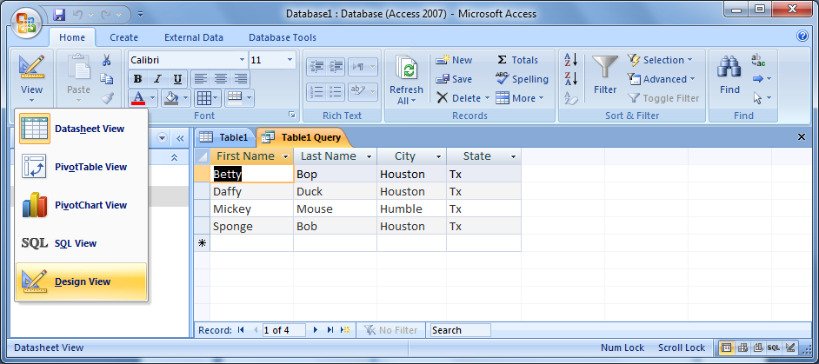
Creating Queries (cont.)

Slide 18
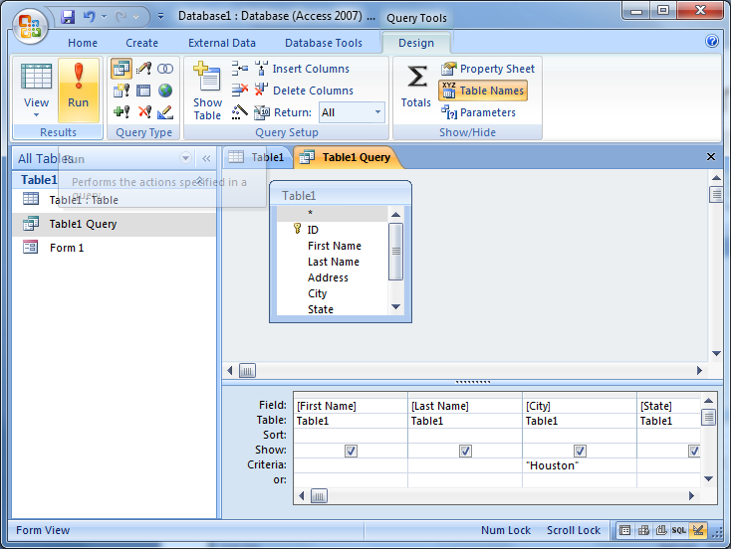
Creating Queries (cont.)

Slide 19
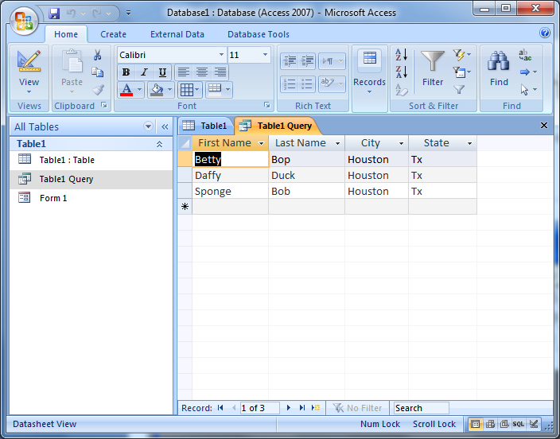
Creating Queries (cont.)

Slide 20
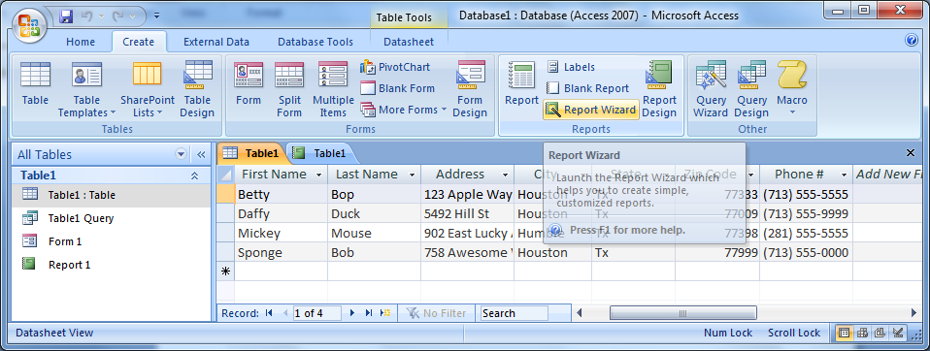
Working with Reports
To create a report by using the Report Wizard, click the Create tab, and in the Reports group, click Report Wizard.

Slide 21
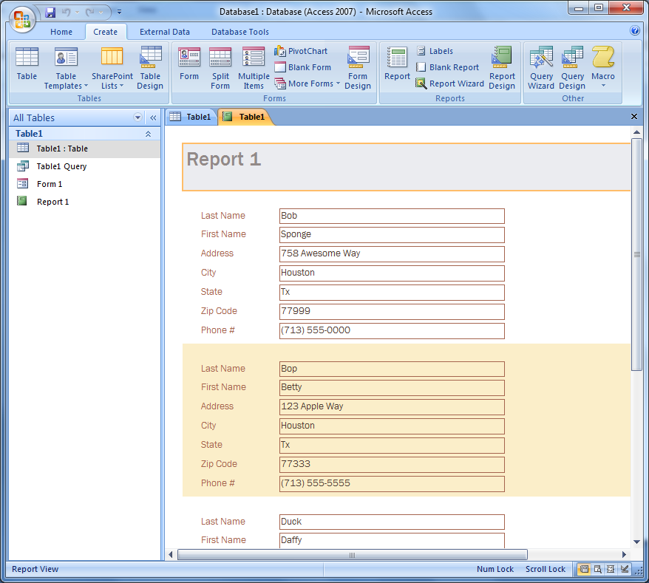
Working with Reports

Slide 22

Questions

