Slide 1
CSS Layout
Mimi Opkins

Slide 2
Benefits of CSS for Layout
One of the major benefits of using CSS is that you’re not forced to lay your sites out in tables.
The layout possibilities of CSS give you complete control over the positions and dimensions of all page elements.

Slide 3
Working with <div>s
The <div> element is well-suited as a layout tool.
It is a block-level element that is used to divide the page into logical sections, and can hold whatever you need inside it.
You can have blocks of text in <div>s and then put them together in a layout. You have immense freedom, with the ability to add these blocks, or “layers”, on top of each other.
Check out this example.

Slide 4
Working with <div>s
The div tag has few attributes of its own (along with align="left | right | center"), with all of its formatting applied through stylesheets.
To set up a simple navigation block, we would use code like this (with the CSS being in an external .css file or style block):
div#navigation {width: 200px; background: gray; padding: 10px; }
<div id="navigation">...navigation links...</div>

Slide 5
Working with <div>s
This example code uses some very simple CSS code. All block-level elements can have a width property, specified in units or as a percentage,
Background color and some padding space were added around the div content.

Slide 6
Floating Elements
Since divisions are block-level (i.e., they default to 100% of the available screen width and add line breaks between each other), they will all just stack up underneath one another unless you position them in some way.
The simplest way to do this is to use the CSS float property, the backbone of most CSS layouts. You can float any element left or right, and it will align itself over to the side of whatever element it is contained within.
#column1 {float: left; width: 200px; padding: 10px; } #column2 {float: left; width: 200px; padding: 20px; }

Slide 7
Floating Elements
To create columned layouts, you simply float all of the column divisions to the same side and they will line up beside each other, as long as they fit.
Laying out content in this way has immediate benefits such as progressive downloading (as the text is loaded it is displayed onto the page immediately, so your visitor can read as the page is forming around the text).
You can also give each column specific margins and padding, giving you greater freedom to space your content out.

Slide 8

Floating Elements
Below is an example of code like the CSS above, with both div elements given the float: left; property:

Slide 9
Floating Elements
With these floating elements you can mimic a table structure, and have your page in a traditional layout without all the drawbacks of tables.
Floating elements takes a little bit of practice (especially if the columns are not the same height), but can result in many traditional and non-traditional layouts.
But CSS wasn’t content to merely emulate the layout mechanisms of the past — now you can control the position of elements on the page down to the pixel.

Slide 10
CSS Positioning
There are two other types of positioning beyond floating: absolute and relative. The codes you’ll be using are
tag {position: choice; top: 0px; bottom: 0px; left: 0px; right: 0px; }

Slide 11
Absolute Positioning
If you position an element (an image, a table, or whatever) absolutely on your page, it will appear at the exact pixel you specify.
If you wanted a graphic to appear 46 pixels from the top of the page and 80 pixels in from the right, you could do it.
The CSS code you’ll need to add into the image is
img {position: absolute; top: 46px; right: 80px; }

Slide 12
Absolute Positioning
You just add in which method of positioning you’re using at the start, and then push the image out from the sides it’s going to be closest to.
You can add the CSS directly into the tag using the style attribute or you can use classes and ids and put them into your stylesheet. It works the same way.
The recommended method is to add classes for layout elements that will appear on every page, but put the code inline for once-off things.

Slide 13
Absolute Positioning
The image would appear like this. As you can see, it is possible to have things overlapping with absolute positioning.

Slide 14
Positioning Layers
To create what we call layers with the div tag, use code like this:
<div style="position: absolute; left: 610px; top: 80px; height: 400px; width: 100px; padding: 1em;">layer stuff
</div>
First you specify the position of the layer, then its dimensions (which is optional, the layer will resize itself).

Slide 15
Positioning Layers
If you want to give color to the layer’s background, add the background-color: red; attribute in with the rest of your CSS code.
Anything that could go on a normal page can be positioned with <div>s. With layers, all the information a browser needs is contained in the style attributes you’ve added. Therefore, it will display as soon as any part of it is downloaded.

Slide 16
Positioning Layers
To get layers overlapping each other you need to use the z-index command.
Add z-index: 1 in with the positioning code and this element will appear above everything without this command. If you want something else to go over this layer too, add z-index: 2 and so on.
The higher the index, the closer the div will appear to the front of the page.

Slide 17
Positioning Layers
Put the layer that holds your page’s content at the top of your code. This is what readers want to see immediately.
Your navigation and other presentational components can then load around this, allowing your reader to begin reading as soon as possible and making your navigation available when it is most likely to be used: after the page has been read.
To see some examples of designs laid out with both float and absolute positioning
http://www.yourhtmlsource.com/redesigns/

Slide 18

Relative Positioning
When you position something relatively, you are modifying its position from where it would have been if you hadn’t changed anything.
For instance, in the next sentence, we’ll offset “some words” 12px down and 22px right relative to their start position.

Slide 19
Relative Positioning
The words in parentheses are the words in their original positions, and the bold ones are the moved words. The CSS code to move them was
<span style="position: relative; top: 12px; left: 22px;">some words</span>
You should notice that if you want to move something left, you use the right code, and push it away from that side and vice-versa.
To override an inherited position property, and make the element just a normal part of the page again, set it to position: static.

Slide 20
Horizontal Centering
Centering a div or any other block-level element horizontally is a special case for CSS layout, even more so because there is a bug in Internet Explorer’s implementation of the standard way of doing it. The standard way is to set the element’s horizontal margin values to auto, like so:
#wrapper {width: 760px; margin: 0 auto; }

Slide 21
Horizontal Centering
body {text-align: center; }
One final step is then necessary. The line above will, of course, center all the text inside the centered elements as well, which is generally not what we want, so we need to align the text within back to the left. So here’s all the code:
body {text-align: center; } #wrapper {width: 760px; margin: 0 auto; text-align: left; }

Slide 22
Horizontal Centering
Be careful if you’re planning on mixing absolute positioning and this centering method in the same layout. If you want other elements to be absolutely positioned inside the wrapper, make it relatively positioned first.
#wrapper {position: relative; width: 760px; margin: 0 auto; text-align: left; }
This will make an inner element that you absolutely position at, for example, top: 0; left: 0; appear at the top left corner of the wrapper, and not of the top left of the entire window.

Slide 23
Credits
This presentation is taken from
HTML Source : HTML Tutorials

Slide 24
Objectives
Create boxes for layout
Size and position boxes
Determine how to control overflow for a box
Use the <div> tag to create formatting sections of a document
New Perspectives on Blended HTML, XHTML, and CSS
<number>

Slide 25
Objectives
List the positioning properties
Use the z-index property to stack elements
Use the media attribute and its values
Create print styles
Use multiple style sheets
New Perspectives on Blended HTML, XHTML, and CSS
<number>

Slide 26
Sizing and Positioning Boxes
Web page developers refer to the header area as the masthead, banner, or header
They call the main window the main, content, body, container, box, or frame area
They often refer to the bottom of the page as the footer
New Perspectives on Blended HTML, XHTML, and CSS
<number>

Slide 27
Sizing and Positioning Boxes
Designers typically use layouts that include one or more of the following design components:
a horizontal banner, or bar, at the top of the page that usually includes a corporate logo
a sidebar, which is a narrow vertical column commonly used for links
the main document window, which is the largest window and contains most of the page content
a footer, which is a row at the bottom of the page, which usually displays the contact information for the Web site, such as the address
New Perspectives on Blended HTML, XHTML, and CSS
<number>

Slide 28
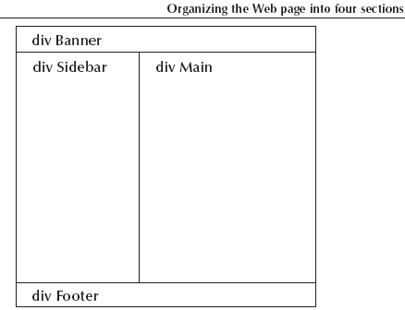

Sizing and Positioning Boxes
New Perspectives on Blended HTML, XHTML, and CSS
<number>

Slide 29
Sizing and Positioning Boxes
The overflow property is used to determine what happens if there is too much text (or an image is too large) to be displayed in the space for the box
visible allows the box to expand as much as possible
hidden does not display overflow text; no scroll bars
scroll displays scroll bars so users can scroll through the box; the size of the box remains the same.
auto displays scroll bars only if necessary; the size of the box remains the same
New Perspectives on Blended HTML, XHTML, and CSS
<number>

Slide 30
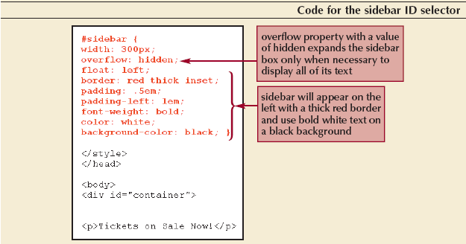
Sizing and Positioning Boxes
New Perspectives on Blended HTML, XHTML, and CSS
<number>

Slide 31
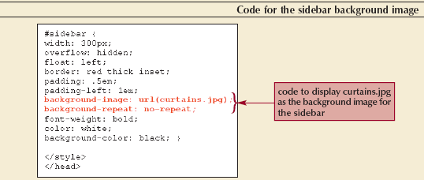
Sizing and Positioning Boxes
To add a background image to a sidebar:
New Perspectives on Blended HTML, XHTML, and CSS
<number>

Slide 32
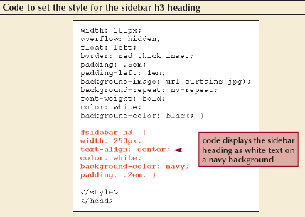
Sizing and Positioning Boxes
To center the text of the sidebar:
New Perspectives on Blended HTML, XHTML, and CSS
<number>

Slide 33
Sizing and Positioning Boxes
If you lay out pages using boxes, create styles for elements by using descendant selectors
If you are styling the same element more than once, make sure that the elements all have the same properties (though they can have different values)
New Perspectives on Blended HTML, XHTML, and CSS
<number>

Slide 34
Using the Positioning Properties
The largest box is the browser window itself (the HTML element)
Inside this box is the body box, which in turn contains other smaller boxes, such as headings, paragraphs, and em and strong elements
This is called the normal flow of the HTML document
New Perspectives on Blended HTML, XHTML, and CSS
<number>

Slide 35
Using the Positioning Properties
The positioning properties allow you to display an element out of the normal flow
CSS positioning allows you to create pages with elements with layering, which means that you can have text or images overlap each other
The position property takes several values, with the two most important values being absolute and relative
New Perspectives on Blended HTML, XHTML, and CSS
<number>

Slide 36
Using the Positioning Properties
When you use absolute positioning, the element is displayed in the exact position you specify
When you use relative positioning, you are shifting the element’s position from the point where that element normally would be displayed
New Perspectives on Blended HTML, XHTML, and CSS
<number>

Slide 37
Using the Positioning Properties
The left property with:
A positive value positions an element a certain distance from the left edge of the screen, moving the element to the right
A negative value positions an element to the left
The top property with:
A positive value positions an element a certain distance from the top edge of the screen, moving the element down
A negative value positions an element above the normal position
New Perspectives on Blended HTML, XHTML, and CSS
<number>

Slide 38
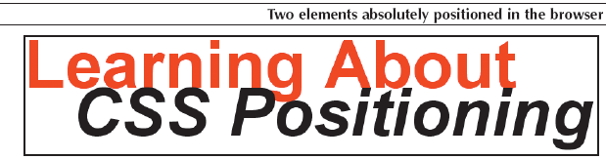
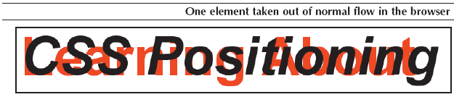
Using the Positioning Properties
New Perspectives on Blended HTML, XHTML, and CSS
<number>

Slide 39

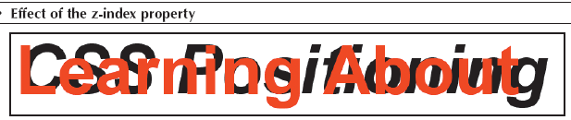

Using the Positioning Properties
The z-index property is used to stack elements in the browser window
The value for the z-index property determines the stacking order
The higher the z-index value, the higher the text or the image is in the stack
New Perspectives on Blended HTML, XHTML, and CSS
<number>

Slide 40
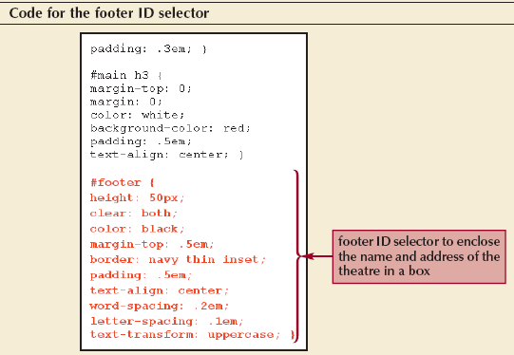
Using the Positioning Properties
Although HTML does not have a headers and footers feature, it is a common convention to set the style for the last line of a Web page and describe that line as being the footer box
New Perspectives on Blended HTML, XHTML, and CSS
<number>

