Slide 1
Introduction to HTML

Slide 2
HTML: HyperText Markup Language
HTML documents are simply text documents with a specific form
  Documents comprised of content and markup tags
  Content: actual information being conveyed
  The markup tags tell the Web browser how to display the page
  An HTML file must have an htm or html file extension
  An HTML file can be created using a simple text editor

Slide 3
Our First Example
If you are running Windows, start Notepad
If you are on a Mac, start SimpleText
If you telnet to csupomona.edu, use “pico”
Type in the following:
Open this file using a browser, and you will see…
<html>
<head>
<title>Title of page</title>
</head>
<body>
This is my first homepage. <b>This text is bold</b>
</body>
</html>

Slide 4
HTML Tags
HTML tags are used to mark-up HTML text
  Surrounded by angle brackets < and >
  HTML tags normally come in pairs, like <tagname> (start tag) and </tagname> (end tag)
  The text between the start and end tags is the element content
  Not case-sensitive
  Follow the latest web standards:
    Use lowercase tags

Slide 5
Tag Attributes
Tags can have attributes that provide additional information to an HTML element
  Attributes always come in name/value pairs like: name=“value”
  Attributes are always specified in the start tag
  Attribute values should always be enclosed in quotes. Double quotes are most common.
  Also case-insensitive: however, lowercase is recommended
  <tagname a1=“v1” a2=“v2”></tagname>
  For example, <table border=“0”> is a start tag that defines a table that has no borders

Slide 6
HTML Document Structure
Entire document enclosed within <html> and </html> tags
Two subparts:
  Head
    Enclosed within <head> and </head>
    Within the head, more tags can be used to specify title of the page, meta-information, etc.
  Body
    Enclosed within <body> and </body>
    Within the body, content is to be displayed
    Other tags can be embedded in the body

Slide 7
We’ll Study…
HTML Basics (http://www.w3schools.com/html/html_intro.asp):
  HTML Elements
  HTML Headings
  HTML Paragraphs
  HTML Formatting
  HTML Styles
  HTML Images
  HTML Tables
  HTML Lists
  HTML Forms
  HTML Colors

Slide 8
More Basic Examples
Using basic tags: http://www.csupomona.edu/~ftang/www/courses/CS299-S09/examples/ex1.html
Text formatting: http://www.csupomona.edu/~ftang/www/courses/CS299-S09/examples/ex2.html
HTML links: http://www.csupomona.edu/~ftang/www/courses/CS299-S09/examples/ex3.html

Slide 9
HTML Layout
One common way is to use HTML tables to format the layout of an HTML page
  The trick is to use a table without borders, and maybe a little extra cell-padding
Other tips:
  Keep screen resolution in mind
  Use color to define spaces
  Align your images
  Balance the graphics and text on a page
  Think about text width – scan length 7 – 11 words
  Centering text is inadvisable
  Here is the link: http://webdesign.about.com/od/layout/a/aa062104.htm

Slide 10
HTML Frames
HTML frames are a means of having several browser windows open within a single larger window
Each HTML document is called a frame
Disadvantages:
  Must keep track of more HTML documents
  Difficult to print the entire page
Example of using frame
  http://www.csupomona.edu/~ftang/www/courses/CS299-S09/examples/frame.html
  http://www.w3schools.com/html/html_frames.asp

Slide 11
HTML Advanced

Slide 12
Topics Covered
From HTML tutorial on w3schools.com
  HTML CSS
  HTML Entities
  HTML Head
  HTML Meta
  HTML URLs
  HTML Scripts
  HTML Attributes
  HTML Events
  HTML URL Encode
  HTML Webserver

Slide 13
Script Examples
Add scripts to HTML pages can make them more dynamic and interactive
Examples from W3schools
Our simple example:
  http://www.csupomona.edu/~ftang/www/courses/CS299-S09/examples/jscript.html

Slide 14
HTML and XHTML Full References
Full Reference from W3schools:
  http://www.w3schools.com/tags/
Test your HTML
  http://www.w3schools.com/html/html_whyusehtml4.asp

Slide 15
XHTML
http://www.w3schools.com/xhtml/

Slide 16
What is XHTML?
XHTML is a stricter and cleaner version of HTML
  EXtensible HyperText Markup Language
  aimed to replace HTML
  identical to HTML 4.01
  combination of HTML and XML (EXtensible Markup Lanuage)
  W3C Recommendation

Slide 17
Why XHTML?
Many pages contain “bad” HTML
  <html>
  <head> <title>This is bad HTML</title>
  <body> <h1>Bad HTML </body>
XML is a markup language where everything has to be marked up correctly, which results in “well-formed” documents
Different browser technologies require “good” markup language
XHTML combines the strengths of HTML and XML

Slide 18
Most Important Differences From HTML
XHTML elements must be properly nested
XHTML elements must always be closed
XHTML elements must be in lowercase
XHTML documents must have one root element
Examples
  http://www.w3schools.com/xhtml/xhtml_html.asp

Slide 19
XHTML Syntax
More XHMTL Syntax Rules
  Attribute names must be in lower case
  Attribute values must be quoted
  Attribute minimization is forbidden
  The id attribute replaces the name attribute
  Mandatory elements
Examples
  http://www.w3schools.com/xhtml/xhtml_syntax.asp
Test your XHTML with the W3C Validator

Slide 20
The idea is:
Use a high-end software tool like DreamWeaver to do most of your web editing work.
But also…
Know a little about HTML codes so you can tell what’s going on behind the scenes (if you need to know).

Slide 21
You don’t have to be an expert
“Codes” don’t mean programming.
There is a relatively small set of basic HTML codes.
Many of the codes are logical and easy to remember.
Once you understand the general rules, most codes will make sense.

Slide 22
What do HTML codes do?
Codes establish the formatting for a web page. For example:
  What typeface to use
  What color background for the page
  What graphic and where to position it
  What kind of indentation for text
  When to use bullet points
  Etcetera

Slide 23
What are the HTML code rules?
There are really only a few “rules”.
(And -- of course -- there are some exceptions to the rules.)
HTML codes appear in brackets.
HTML codes are “paired”.

Slide 24
Example
To “turn on” bolding: <b>
To “turn off” bolding: </b>
This code:
The quick <b> red fox </b> jumped over the lazy dog.
Appears as:
The quick red fox jumped over the lazy dog.

Slide 25
Another concept
You can stack up codes to get multiple effects
This code:
The quick <b><i><u>red fox</u></i></b> jumped over the lazy dog.
Appears as:
The quick red fox jumped over the lazy dog.

Slide 26
3 HTML codes
Bolding: <b> </b>
Italicizing: <i> </i>
Underlining: <u> </u>
“Rules” for these codes: They
  appear in brackets
  are paired
  surround the text they affect

Slide 27
Examples of exceptions
Examples of codes that affect layout:
  <br> generates a line break
  <p> starts a new paragraph
  &nbsp; adds a space
These codes do not have to be paired.
And notice that the “space” code does not appear in brackets.

Slide 28
<br> code example
This code:
The quick, <br> red fox <br> jumped over the lazy dog.
Appears as:
The quick,
red fox
jumped over the lazy dog.

Slide 29
<p> code example
This code:
Where’s the fox? <p> Where’s the lazy dog?
Appears as:
Where’s the fox?
Where’s the lazy dog?

Slide 30
&nbsp; code example
This code:
The quick red dog &nbsp; &nbsp; &nbsp; &nbsp; jumped over the lazy fox.
Appears as:
The quick red dog jumped over the lazy fox.

Slide 31
Another layout code
<center> </center>
This code:
<center>The Story of the Fox</center>
Appears like:
The Story of the Fox

Slide 32
Some codes provide “canned” services
<h1>This is a main header</h1>
<h2>This is a secondary header</h2>
<h3>This is a tertiary header</h3>
These “header tags” are a convenient way to control both font size and bolding.

Slide 33
“Canned” headers might look like this
This is a main header
This is a secondary header
This is a tertiary header
The text on the web page would be sized proportionately smaller.

Slide 34
A set of “list codes” formats a list
Code for an “ordered” (numbered) list:
<OL>My favorite trees:
<li> oak
<li> beech
<li> maple
</OL>

Slide 35
Another set of list codes
Code for an “un-ordered” (bulleted) list:
<UL>My favorite trees:
<li> oak
<li> beech
<li> maple
</UL>

Slide 36
The list results
Ordered List
My favorite trees:
1. oak
2. beech
3. maple
Unordered List
My favorite trees:
• oak
• beech
• maple

Slide 37
Linking
A very important web page topic.
Kinds of links include links:
  to another part of the same page
  to an entirely different web page
  to a document (for download)
  to an e-mail screen (a “mail-to” link)
  to an electronic bulletin board

Slide 38
What about linking codes?
HTML link codes are special.
A simple link has 4 components:
  1. An “anchor reference” to start.
  2. The item to link to.
  3. What the reader sees underlined.
  4. A “close link” code to end.

Slide 39
Example: A link to another web page
How do we write the code for this sentence:
Birds native to North Carolina include the fantastic-looking pileated woodpecker.
…so when the reader clicks the underlined link they go to a page about this particular bird?

Slide 40
How to link to another web page
1. The starting “anchor reference”:
<A HREF=
2. The item to link to:
“woodpecker.htm”>
3. What the reader sees underlined:
pileated woodpecker
4. A “close link” code to end:
</A>

Slide 41
Put it all together
This code:
Birds native to North Carolina include the fantastic-looking <A HREF=“woodpecker.htm”>pileated woodpecker</A>.
Appears as:
Birds native to North Carolina include the fantastic-looking pileated woodpecker.

Slide 42
One more link code example
This code:
For problems with Microsoft products, send electronic mail to Bill <A HREF="mailto:Bill.Gates@Microsoft.
com">Gates</A>.
Appears as:
For problems with Microsoft products, send electronic mail to Bill Gates.

Slide 43
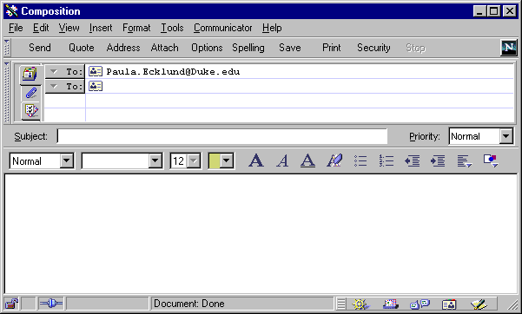
Bill.Gates@Microsoft.com
Clicking the mail-to link opens up a special
e-mail window in the web browser.

Slide 44
Key concepts to remember
It’s useful to know a little about HTML codes if you need to:
  fix a problem on one of your web pages
  see what’s “really” going on behind the scenes
There’s a small set of basic codes.
You can always look up the meaning of any code you don’t know.

Slide 45
How can you look up an html code?
Use the handout for quick reference to basic codes.
Fuqua’s library has HTML books in its collection.
Do a web search on the word “HTML”.

Slide 46
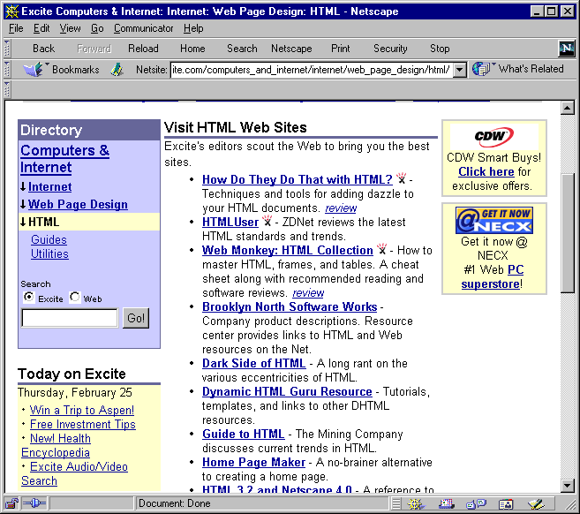

Slide 47
Practice recognizing
how HTML codes work.

Slide 49
Other link examples
Appendix
Link to a document for download
This code:
For more information get this <A HREF=“Excel.xls”>Excel</A>file.
Reads like this:
For more information get this Excel file.

Slide 50
Other link examples
Appendix
Link to a bulletin board
This code:
<A HREF= "news://news.fuqua.duke.edu/Announce.General”>Announce</A>Bulletin board.
Reads like this:
Announce Bulletin board.

Slide 51
Other link examples
Appendix
Link to another location on the same page
Enter this code:
<A HREF="#PPT">Excel Overview</A>.
Then further down the page enter this code:
<A NAME="PPT">
The link reads like this:
Excel Overview.
Click this link to jump to the part of the page that has the <A NAME> code.

