Slide 1
HTML and Forms

Slide 2
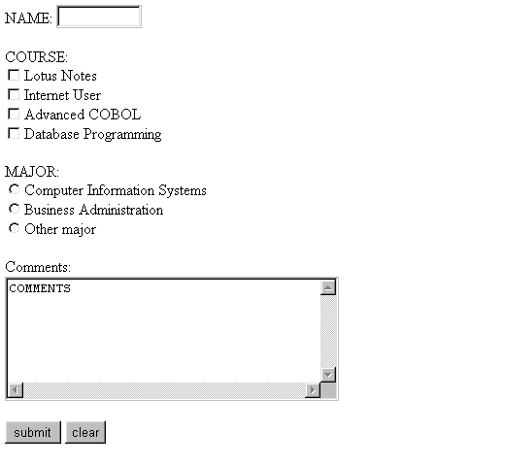
Web10.html

Slide 3
Web10.html
The information about the FORM are enclosed between <FORM with its attributes and </FORM>.
<HTML>
<HEAD>
<TITLE>Testing forms</TITLE>
</HEAD>
<BODY>
<FORM ACTION="mailto:pgrocer@bristol.mass.edu" METHOD="POST" ENCTYPE="TEXT/PLAIN">
<P>NAME: <INPUT TYPE="TEXT" NAME="name" SIZE="10”>
<P>COURSE:<BR>
<INPUT TYPE="CHECKBOX" NAME="course" VALUE="CIS40">Lotus Notes<BR>
<INPUT TYPE="CHECKBOX" NAME="course" VALUE="CIS44">Internet User<BR>
<INPUT TYPE="CHECKBOX" NAME="course" VALUE="CIS51">Advanced COBOL<BR>
<INPUT TYPE="CHECKBOX" NAME="course" VALUE="CIS61">Database Programming<BR>
<P>MAJOR:<BR>
<INPUT TYPE="RADIO" NAME="major" VALUE="CI">Computer Information Systems<BR>
<INPUT TYPE="RADIO" NAME="major" VALUE="BU">Business Administration<BR>
<INPUT TYPE="RADIO" NAME="major" VALUE="other">Other major<BR>
<P>Comments:<BR>
<TEXTAREA ROWS="6" COLS="40" NAME="comments">COMMENTS</TEXTAREA>
<P>
<INPUT TYPE="SUBMIT" VALUE="submit">
<INPUT TYPE="RESET" VALUE="clear">
</FORM>
</BODY>
</HTML>

Slide 4
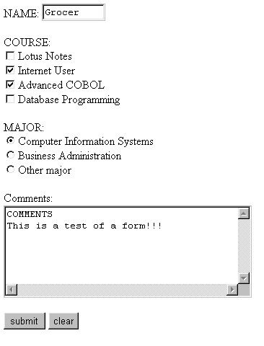
FORM sent using Web10.html and receipt from that form in my e-mail.
Contents of e-mail received from form in left panel.
name=Grocer
course=CIS44
course=CIS51
major=CI
comments=COMMENTS
This is a test of a form!!!

Slide 5
Web10.html - 1st part of form
INPUT with TYPE=“TEXT” creates a text box for data entry. The box is given the NAME=“name” and SIZE=“10” meaning it will only show 10 characters.
<BODY>
<FORM ACTION="mailto:pgrocer@bristol.mass.edu" METHOD="POST" ENCTYPE="TEXT/PLAIN">
<P>NAME: <INPUT TYPE="TEXT" NAME="name" SIZE="10”>
<P>COURSE:<BR>
<INPUT TYPE="CHECKBOX" NAME="course" VALUE="CIS40">Lotus Notes<BR>
<INPUT TYPE="CHECKBOX" NAME="course" VALUE="CIS44">Internet User<BR>
<INPUT TYPE="CHECKBOX" NAME="course" VALUE="CIS51">Advanced COBOL<BR>
<INPUT TYPE="CHECKBOX" NAME="course" VALUE="CIS61">Database Programming<BR>
name=Grocer
course=CIS44
course=CIS51
major=CI
comments=COMMENTS
This is a test of a form!!!
INPUT with TYPE = “CHECKBOX” sets up a series of checkboxes each with the NAME=“course”. This allowed me to check multiple checkboxes. Each check box is labeled with the words shown such as Lotus Notes or Internet User, but the VALUE is what is sent via e-mail. Note that the course information received in my e-mail was CIS44 & CIS51

Slide 6
Web10.html (2nd part)
Text that appears on the screen helping to clarify the form.
TYPE=RADIO” will set up a radio button. In this case it will be named major (NAME=‘major)and the VALUE will be sent when the form is submitted. Note that these three lines of code set up three radio buttons each named major but with different values.
<P>MAJOR:<BR>
<INPUT TYPE="RADIO" NAME="major" VALUE="CI">Computer Information Systems<BR>
<INPUT TYPE="RADIO" NAME="major" VALUE="BU">Business Administration<BR>
<INPUT TYPE="RADIO" NAME="major" VALUE="other">Other major<BR>
<P>Comments:<BR>
<TEXTAREA ROWS="6" COLS="40" NAME="comments">COMMENTS</TEXTAREA>
<P>
<INPUT TYPE="SUBMIT" VALUE="submit">
<INPUT TYPE="RESET" VALUE="clear">
</FORM>
</BODY>
</HTML>
The word COMMENTS appears in the comments box. I think it would look better with this omitted. You can just omit it and leave >< there.
The TEXTAREA is an area for comments. Note you can designate rows and columns to determine size.
TYPE=“SUBMIT” means the form will be set while TYPE=“RESET” clears the form. The value is the designation that appears on the button.
name=Grocer
course=CIS44
course=CIS51
major=CI
comments=COMMENTS
This is a test of a form!!!
Data received via e-mail. Note the name on the radio button above is major and major appears here in the left column. CI is the value of the major that was checked.

Slide 7
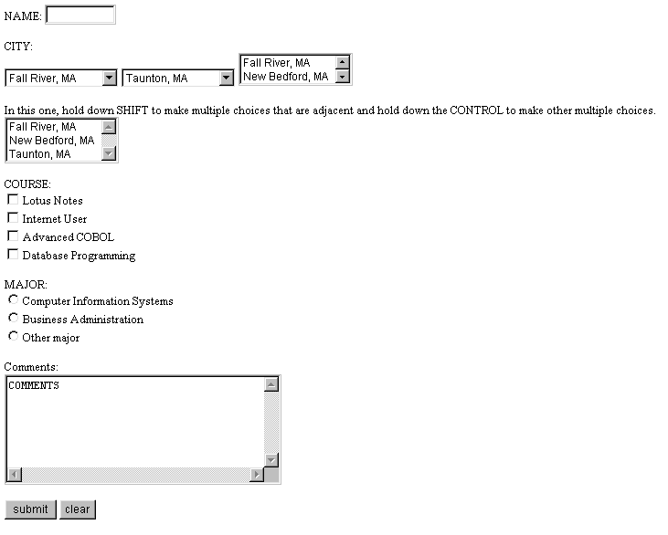
Web13.html - as seen

Slide 8
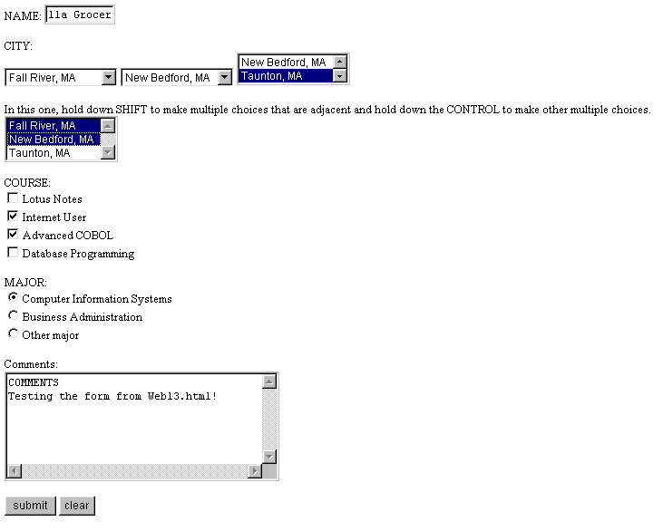
Web13.html - output and e-mail receipt
This is the output from web13.html that was sent.
name=Priscilla Grocer
city1=Fall River
city2=New Bedford
city3=Taunton
city4=Fall River
city4=New Bedford
course=CIS44
course=CIS51
major=CI
comments=COMMENTS
Testing the form from Web13.html!

Slide 9
Web13.html (1st part of HTML code)
<HTML>
<HEAD>
<TITLE>Testing forms</TITLE>
</HEAD>
<BODY>
<FORM ACTION="mailto:pgrocer@bristol.mass.edu" METHOD="POST" ENCTYPE="TEXT/PLAIN">
<P>NAME: <INPUT TYPE="TEXT" NAME="name" SIZE="10">
<P>CITY:<BR>
<SELECT NAME="city1">
<OPTION VALUE="Fall River">Fall River, MA
<OPTION VALUE="New Bedford">New Bedford, MA
<OPTION VALUE="Taunton">Taunton, MA
</SELECT>
<SELECT NAME="city2">
<OPTION VALUE="Fall River">Fall River, MA
<OPTION VALUE="New Bedford">New Bedford, MA
<OPTION VALUE="Taunton" SELECTED>Taunton, MA
</SELECT>
The SELECT allows the user to make a selection by scrolling down and highlighting. OPTION shows the values that will be seen. Note there must also be a </SELECT>.
SELECTED means that this selection will show when the form is loaded.
name=Priscilla Grocer
city1=Fall River
city2=New Bedford

Slide 10
Web13.html (2nd part of HTML code)
SIZE=“2” means that 2 options will be shown. The VALUE is what is sent, the data after <OPTION…> is what appears on the screen.
<SELECT NAME="city3" SIZE="2">
<OPTION VALUE="Fall River">Fall River, MA
<OPTION VALUE="New Bedford">New Bedford, MA
<OPTION VALUE="Taunton">Taunton, MA
</SELECT>
<BR>
<BR>In this one, hold down SHIFT to make multiple choices that are adjacent
and hold down the CONTROL to make other multiple choices.<BR>
<SELECT NAME="city4" MULTIPLE>
<OPTION VALUE="Fall River">Fall River, MA
<OPTION VALUE="New Bedford">New Bedford, MA
<OPTION VALUE="Taunton">Taunton, MA
</SELECT>
MULTIPLE means that multiple OPTIONs can be selected.
city3=Taunton
city4=Fall River
city4=New Bedford

Slide 11
Web13.html (3rd part of HTML code)
The words COURSE:, MAJOR: and Comments: are being used to help designate information for the user.
<P>COURSE:<BR>
<INPUT TYPE="CHECKBOX" NAME="course" VALUE="CIS40">Lotus Notes<BR>
<INPUT TYPE="CHECKBOX" NAME="course" VALUE="CIS44">Internet User<BR>
<INPUT TYPE="CHECKBOX" NAME="course" VALUE="CIS51">Advanced COBOL<BR>
<INPUT TYPE="CHECKBOX" NAME="course" VALUE="CIS61">Database Programming<BR>
<P>MAJOR:<BR>
<INPUT TYPE="RADIO" NAME="major" VALUE="CI">Computer Information Systems<BR>
<INPUT TYPE="RADIO" NAME="major" VALUE="BU">Business Administration<BR>
<INPUT TYPE="RADIO" NAME="major" VALUE="other">Other major<BR>
<P>Comments:<BR>
<TEXTAREA ROWS="6" COLS="40" NAME="comments">COMMENTS</TEXTAREA>
<P>
<INPUT TYPE="SUBMIT" VALUE="submit">
<INPUT TYPE="RESET" VALUE="clear">
</FORM>
</BODY>
</HTML>
course=CIS44
course=CIS51
major=CI
comments=COMMENTS
Testing the form from Web13.html!

