Slide 1
USER INTERACTIONS:
FORMS

Slide 2
Form Processing
B
r
o
w
s
e
r
HTML
Form
Input
Data from
Form
User
Data from
Form
Web
Server
Form
Processing
Program
(CGI)
HTML
Document
Output
Data
Flow
HTML
Document
Database
Management
System
Flow of Information for Forms

Slide 3
Forms
The FORM element is used to create a data input form.
A region using forms is enclosed within the <FORM> </FORM> tags.
A document can have several forms, but the forms should not be embedded.
The FORM element has three attributes:
  ACTION, METHOD, and ENCTYPE.

Slide 4
Forms
METHOD:
  Specifies the way in which the data from the user are encoded.
  The default METHOD is GET, although the POST method is preferred.
  GET: The CGI program receives the encoded form input in the QUERY_STRING variable, which follows the “?” in the URL that calls the script.
  POST: The CGI script or program receives the encoded form input in its standard input stream. The CONTENT_LENGTH must be used.

Slide 5
Forms
ACTION:
  Specifies the destination URL to which the form should be submitted, once it has been completed by the user.
  If no URL is specified, the URL of the current document containing the form is used.
  MAILTO Action: The data from the form is mailed to the specified E-mail address. Use the POST method.

Slide 6
Forms
ENCTYPE:
  Tell the browser how the data from a form should be encoded when it is returned to the server.
  The default is “application/x-www-form-urlencoded” that converts spaces to “+” and uses “&” to delineated different data fields.

Slide 7
Form Tag
<Form Action=“getemp.asp” Method=“post”>
(all form elements inside)
</Form>

Slide 8
Forms
Form Input: INPUT
  Only used within a FORM element and is denoted by <INPUT>.
  Attributes:
    NAME: The name of the particular element.
    MAXLENGTH: The maximum number of characters that can be entered by users in a text field.
    SIZE: Specifies the size of the field and depends on its type.
    SRC: Denote URL for an image.
    VALUE: Contain the initial value displayed to users.
    TYPE: Defines the type of data used in the field.
    CHECKED: Indicates that a checkbox or radio button is selected.
    DISABLED: Prevents the field from receiving focus.
    ALIGN: Alignment if image is used.
    READONLY: Prevents modification of the contents of the field.

Slide 9
TYPE Attribute
Checkbox:
  An object where several values can be selected at the same time.
  The checkbox is submitted as separate name/value pair for each selected value.
  Checkbox that are grouped together should have
    a different name.
    a unique value.

Slide 10
TYPE Attribute
Checkbox:
  <FORM>
  What pets do you own?
  <P><INPUT TYPE=CHECKBOX name = petdog value=“dog”> DOG
  <BR><INPUT TYPE=CHECKBOX name = petcat value=“cat”> CAT
  <BR><INPUT TYPE=CHECKBOX name = petbird value=“bird”> BIRD
  <BR><INPUT TYPE=CHECKBOX name = petfish value=“fish”> FISH
  </FORM>

Slide 11
TYPE Attribute
Radio Boxes:
  An object that defines an item where only one value can be selected from a set of possibilities.
  A set is defined as the group of radio boxes with the same NAME attribute.
  Never set more than one radio box at a time with the CHECKED attribute.
  <P><B>Charge Card:</B>
  <INPUT NAME = “cc” VALUE=“visa” TYPE = “radio”>VISA
  <INPUT NAME = “cc” VALUE=“mc” TYPE = “radio”>Master Card
  <INPUT NAME = “cc” VALUE=“amex” TYPE = “radio”>American Express

Slide 12
TYPE Attribute
HIDDEN Type:
  When this type is chosen, no field is presented to the user.
  Primary use is record keeping for programs that may parse user input from forms.
  May be used for shopping carts.

Slide 13
TYPE Attribute
TEXT type:
  Specifies a single line text entry field.
  Can be used with the MAXLENGTH and SIZE attributes (MAXLENGTH >= SIZE)
  <P><B> First Name:</B> <INPUT NAME=“fname” TYPE = text MAXLENGTH=30 SIZE =30></P>
  <P><B> Last Name:</B> <INPUT NAME=“lname” TYPE = text MAXLENGTH=30 SIZE =30></P>

Slide 14
TYPE Attribute
PASSWORD Type:
  Same as text except the text entered by the user is obscured.
  Use the MAXLENGTH and SIZE attributes.
  <P><B> Enter Your Password:</B>
  <INPUT NAME=“password” TYPE = password MAXLENGTH=30 SIZE =30></P>

Slide 15
TYPE Attribute
SUBMIT and RESET Types:
  SUBMIT: Used to submit the form’s content, as specified by the ACTION attribute.
  RESET: Set all fields in the form to their initial values.
  <P>INPUT TYPE=SUBMIT>
  <INPUT TYPE=RESET>
  <P><INPUT TYPE=SUBMIT VALUE = “Place Your Order”>
  <INPUT TYPE=RESET VALUE = “Start over”>

Slide 16
TYPE Attribute
BUTTON Input Type:
  Creates a button whose use can be defined through scripting and onClick event.
  Use to create a back button.
  Only useful to browsers that support scripting.
  <FORM><P><INPUT TYPE=“button” VALUE=“Back to Last Document” onClick=“history.back( )”></P></FORM>

Slide 17
TEXTAREA
Let users enter more than one line of text.
Uses attributes ROWS and COLS to size.
WRAP Attribute:
  OFF: No wrapping
  VIRTUAL: Display wraps but long lines are sent as one line.
  PHYSICAL: Word wraps and text is sent with wrap points.

Slide 18
PullDown Menu
Use SELECT and OPTION to create pulldown menu.
SELECT:
  Allows the user to choose one (or possibly more) items from a list.
  Attributes: MULTIPLE, SIZE, and NAME.
OPTION:
  Specifies the list items.
  Attributes: SELECTED, VALUE, and LABEL

Slide 19
PullDown Menu
Example:
  <P><B>Pick your favorite baseball team:</B>
  <BR><SELECT NAME=“team”>
  <OPTION>Dodgers
  <OPTION>Braves
  <OPTION>Cardinals
  <OPTION>Yankees
  </SELECT>

Slide 20
Form Programming
Handling GET Forms:
  A typical invocation of a GET-style applicatoin might use a URL like this:
  http://www.kumquat.com/cgi-bin/dump_get?name=bob&phone=555-1212
  When the server processes this URL, it invokes the application named dump_get stored in the directory named cgi-bin. Everything after the question mark is passed to the application as parameters.
  The parameters are placed in a variable named QUERY_STRING.

Slide 21
Form Programming
Handling POST Method:
  Data is sent in the format:
  name=bob&phone=555-1212
  No URL is sent.

Slide 22
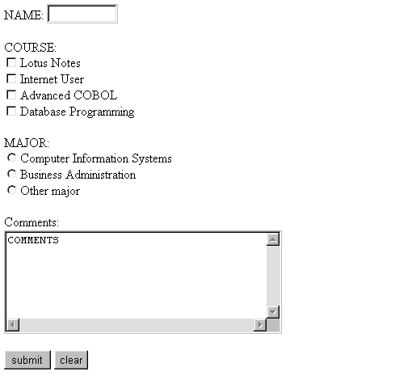
Web10.html
Notes:
This slide shows a form that can be filled out by the user and submitted via e-mail to the designated address.
This is not a secure form, it should not be used for confidential information.
Notice the different types of data entry that are allowed. There is a box for the name (the developer controls the size), check boxes, radio buttons, a comments area and buttons to submit or clear the form.
The next slides will show the code used to generate this form.

Slide 23
Web10.html
The information about the FORM are enclosed between <FORM with its attributes and </FORM>.
<HTML>
<HEAD>
<TITLE>Testing forms</TITLE>
</HEAD>
<BODY>
<FORM ACTION="mailto:pgrocer@bristol.mass.edu" METHOD="POST" ENCTYPE="TEXT/PLAIN">
<P>NAME: <INPUT TYPE="TEXT" NAME="name" SIZE="10”>
<P>COURSE:<BR>
<INPUT TYPE="CHECKBOX" NAME="course" VALUE="CIS40">Lotus Notes<BR>
<INPUT TYPE="CHECKBOX" NAME="course" VALUE="CIS44">Internet User<BR>
<INPUT TYPE="CHECKBOX" NAME="course" VALUE="CIS51">Advanced COBOL<BR>
<INPUT TYPE="CHECKBOX" NAME="course" VALUE="CIS61">Database Programming<BR>
<P>MAJOR:<BR>
<INPUT TYPE="RADIO" NAME="major" VALUE="CI">Computer Information Systems<BR>
<INPUT TYPE="RADIO" NAME="major" VALUE="BU">Business Administration<BR>
<INPUT TYPE="RADIO" NAME="major" VALUE="other">Other major<BR>
<P>Comments:<BR>
<TEXTAREA ROWS="6" COLS="40" NAME="comments">COMMENTS</TEXTAREA>
<P>
<INPUT TYPE="SUBMIT" VALUE="submit">
<INPUT TYPE="RESET" VALUE="clear">
</FORM>
</BODY>
</HTML>
Notes:
This is the HTML to display the form shown in the previous box.
The part of the code that produces the form is between <FORM> and </FORM>.
The <FORM contains attributes: ACTION, METHOD, ENCTYPE. You should read about these in one of the articles in my links.
The ACTION here is to mailto: followed by an e-mail address.
The METHOD is post and the ENCTYPE is TEXT/PLAIN.
The form will be received as shown in the next slide.
The details of this are covered in slides to follow.

Slide 24
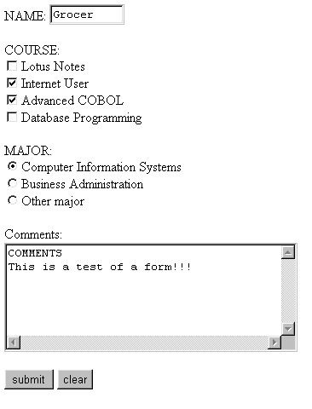
FORM sent using Web10.html and receipt from that form in my e-mail.
Contents of e-mail received from form in left panel.
name=Grocer
course=CIS44
course=CIS51
major=CI
comments=COMMENTS
This is a test of a form!!!
Notes:
After filling in the form in the left panel, I pressed submit. The form was then sent to me as e-mail. The message received had the information as shown.
When you look at the code, notice where name, course, major and comments came from on the form.

Slide 25
Web10.html - 1st part of form
INPUT with TYPE=“TEXT” creates a text box for data entry. The box is given the NAME=“name” and SIZE=“10” meaning it will only show 10 characters.
<BODY>
<FORM ACTION="mailto:pgrocer@bristol.mass.edu" METHOD="POST" ENCTYPE="TEXT/PLAIN">
<P>NAME: <INPUT TYPE="TEXT" NAME="name" SIZE="10”>
<P>COURSE:<BR>
<INPUT TYPE="CHECKBOX" NAME="course" VALUE="CIS40">Lotus Notes<BR>
<INPUT TYPE="CHECKBOX" NAME="course" VALUE="CIS44">Internet User<BR>
<INPUT TYPE="CHECKBOX" NAME="course" VALUE="CIS51">Advanced COBOL<BR>
<INPUT TYPE="CHECKBOX" NAME="course" VALUE="CIS61">Database Programming<BR>
name=Grocer
course=CIS44
course=CIS51
major=CI
comments=COMMENTS
This is a test of a form!!!
INPUT with TYPE = “CHECKBOX” sets up a series of checkboxes each with the NAME=“course”. This allowed me to check multiple checkboxes. Each check box is labeled with the words shown such as Lotus Notes or Internet User, but the VALUE is what is sent via e-mail. Note that the course information received in my e-mail was CIS44 & CIS51
Notes:
This shows the part of the form where the FORM is set up with ACTION followed by a mailto address. In this example the address is mine, so I will receive the contents of this form at my site. The METHOD and the ENCTYPE define how I will receive the mail. Be sure to read about this in articles or tutorials.
INPUT is followed by TYPE. If the TYPE="TEXT" a data entry box is set up. If the TYPE="CHECKBOX" a check box is set up. Note that the VALUE of check box is sent while the name after <INPUT...>is the name that appears on the screen.

Slide 26
Web10.html (2nd part)
Text that appears on the screen helping to clarify the form.
TYPE=RADIO” will set up a radio button. In this case it will be named major (NAME=‘major)and the VALUE will be sent when the form is submitted. Note that these three lines of code set up three radio buttons each named major but with different values.
<P>MAJOR:<BR>
<INPUT TYPE="RADIO" NAME="major" VALUE="CI">Computer Information Systems<BR>
<INPUT TYPE="RADIO" NAME="major" VALUE="BU">Business Administration<BR>
<INPUT TYPE="RADIO" NAME="major" VALUE="other">Other major<BR>
<P>Comments:<BR>
<TEXTAREA ROWS="6" COLS="40" NAME="comments">COMMENTS</TEXTAREA>
<P>
<INPUT TYPE="SUBMIT" VALUE="submit">
<INPUT TYPE="RESET" VALUE="clear">
</FORM>
</BODY>
</HTML>
The word COMMENTS appears in the comments box. I think it would look better with this omitted. You can just omit it and leave >< there.
The TEXTAREA is an area for comments. Note you can designate rows and columns to determine size.
TYPE=“SUBMIT” means the form will be set while TYPE=“RESET” clears the form. The value is the designation that appears on the button.
name=Grocer
course=CIS44
course=CIS51
major=CI
comments=COMMENTS
This is a test of a form!!!
Data received via e-mail. Note the name on the radio button above is major and major appears here in the left column. CI is the value of the major that was checked.
Notes:
Note: multiple checkboxes can be checked but only one radio button can be selected.
The radio button selected will send a value under the name major - see e-mail received at the bottom of the page.
TEXTAREA is for comments. NAME="comments" causes the word comments to be sent. The word COMMENTS designated after <TEXTAREA...> actually appears in the comments box and gets sent in the e-mail Personally, I think it should be omitted so the comments box comes up empty.
The <P>Comments: appears on the screen telling the user to enter comments.

Slide 27
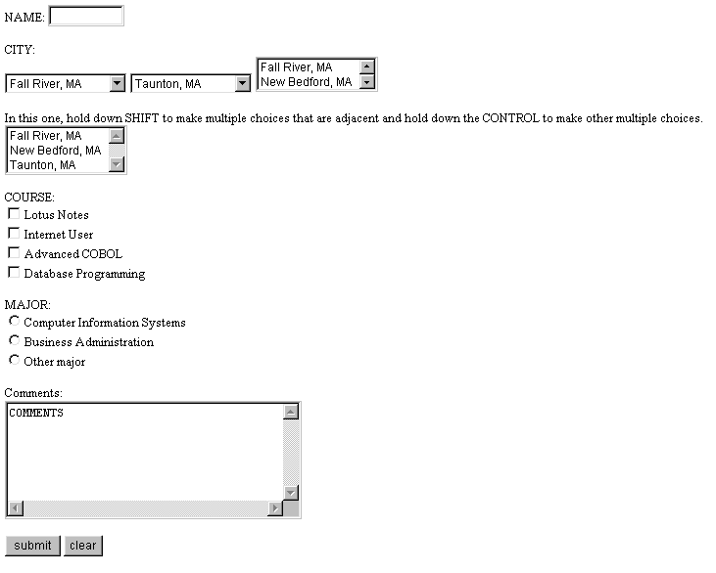
Web13.html - as seen
Notes:
This is the form shown in web13.html. This form introduces more FORM concepts.

Slide 28
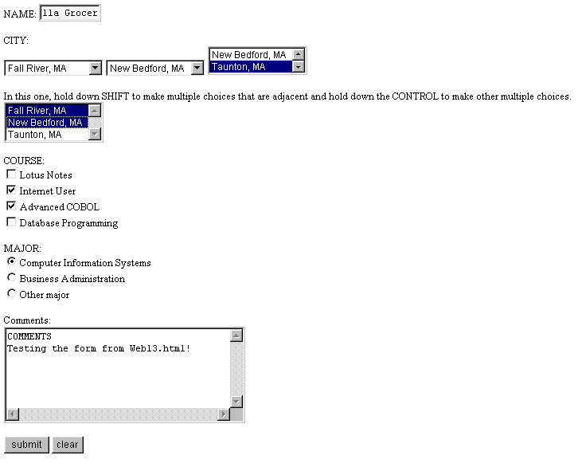
Web13.html - output and e-mail receipt
This is the output from web13.html that was sent.
name=Priscilla Grocer
city1=Fall River
city2=New Bedford
city3=Taunton
city4=Fall River
city4=New Bedford
course=CIS44
course=CIS51
major=CI
comments=COMMENTS
Testing the form from Web13.html!
Notes:
This slide shows the data that was received when the form was filled in and submitted.
Note: The name does not hold the whole name but the size is not fixed. When you type in a name that is too big, it will scroll. Check out this feature in the articles or tutorials.
Note: The city fields use scroll bars. They are set up differently. Look at the code on the next slides and also be sure to read about this in the articles and tutorials.

Slide 29
Web13.html (1st part of HTML code)
<HTML>
<HEAD>
<TITLE>Testing forms</TITLE>
</HEAD>
<BODY>
<FORM ACTION="mailto:pgrocer@bristol.mass.edu" METHOD="POST" ENCTYPE="TEXT/PLAIN">
<P>NAME: <INPUT TYPE="TEXT" NAME="name" SIZE="10">
<P>CITY:<BR>
<SELECT NAME="city1">
<OPTION VALUE="Fall River">Fall River, MA
<OPTION VALUE="New Bedford">New Bedford, MA
<OPTION VALUE="Taunton">Taunton, MA
</SELECT>
<SELECT NAME="city2">
<OPTION VALUE="Fall River">Fall River, MA
<OPTION VALUE="New Bedford">New Bedford, MA
<OPTION VALUE="Taunton" SELECTED>Taunton, MA
</SELECT>
The SELECT allows the user to make a selection by scrolling down and highlighting. OPTION shows the values that will be seen. Note there must also be a </SELECT>.
SELECTED means that this selection will show when the form is loaded.
name=Priscilla Grocer
city1=Fall River
city2=New Bedford
Notes:
The output from the name, city1, and city2 are shown at the bottom of the screen. Note again that name has a size of 10 but the data entry is not limited to 10 characters. The size simply shows what will appear on the form.

Slide 30
Web13.html (2nd part of HTML code)
SIZE=“2” means that 2 options will be shown. The VALUE is what is sent, the data after <OPTION…> is what appears on the screen.
<SELECT NAME="city3" SIZE="2">
<OPTION VALUE="Fall River">Fall River, MA
<OPTION VALUE="New Bedford">New Bedford, MA
<OPTION VALUE="Taunton">Taunton, MA
</SELECT>
<BR>
<BR>In this one, hold down SHIFT to make multiple choices that are adjacent
and hold down the CONTROL to make other multiple choices.<BR>
<SELECT NAME="city4" MULTIPLE>
<OPTION VALUE="Fall River">Fall River, MA
<OPTION VALUE="New Bedford">New Bedford, MA
<OPTION VALUE="Taunton">Taunton, MA
</SELECT>
MULTIPLE means that multiple OPTIONs can be selected.
city3=Taunton
city4=Fall River
city4=New Bedford
Notes:
Note: There are two variations on the SELECT illustrated here. SIZE shows how many OPTIONs will be displayed and MULTIPLE allows multiple selections. The user should be prompted to hold down SHIFT to select OPTIONS that are adjacent and to hold down CONTROL to select multiple choices that are not adjacent.

Slide 31
Web13.html (3rd part of HTML code)
The words COURSE:, MAJOR: and Comments: are being used to help designate information for the user.
<P>COURSE:<BR>
<INPUT TYPE="CHECKBOX" NAME="course" VALUE="CIS40">Lotus Notes<BR>
<INPUT TYPE="CHECKBOX" NAME="course" VALUE="CIS44">Internet User<BR>
<INPUT TYPE="CHECKBOX" NAME="course" VALUE="CIS51">Advanced COBOL<BR>
<INPUT TYPE="CHECKBOX" NAME="course" VALUE="CIS61">Database Programming<BR>
<P>MAJOR:<BR>
<INPUT TYPE="RADIO" NAME="major" VALUE="CI">Computer Information Systems<BR>
<INPUT TYPE="RADIO" NAME="major" VALUE="BU">Business Administration<BR>
<INPUT TYPE="RADIO" NAME="major" VALUE="other">Other major<BR>
<P>Comments:<BR>
<TEXTAREA ROWS="6" COLS="40" NAME="comments">COMMENTS</TEXTAREA>
<P>
<INPUT TYPE="SUBMIT" VALUE="submit">
<INPUT TYPE="RESET" VALUE="clear">
</FORM>
</BODY>
</HTML>
course=CIS44
course=CIS51
major=CI
comments=COMMENTS
Testing the form from Web13.html!
Notes:
The information on this part of the form is taken from web10.html.
Note again that the button can be given any name in VALUE but it must be TYPE="SUBMIT". This is the command that causes the e-mail to be sent.

