Slide 1
Web development
Paul Kisambira
pkisambira@ucu.ac.ug

Slide 2

The world before the web
We called them books.
http://www.flickr.com/photos/jm3/4683685/
Notes:
<number>

Slide 3
Your world with the web
Need some information?
Google it. Read on Wikipedia. Ask Yahoo Answers.
Need to manage your money?
Track spending with Mint. Do taxes on TurboTax.
Want to solve world poverty?
Lend money via Kiva. Contribute to Khan Academy
Want to win friends and influence people?
Connect on Facebook. Tweet on Twitter. Post on YouTube
Notes:
<number>

Slide 4










What the web is, put simply.
Web server
SMTP server
Programs
Browser
Web server
Database
Programs
SMTP server
Programs
Web server
Other server
Programs
Web server
Database
Programs
Notes:
<number>

Slide 5



What a web application is
1. Software constantly running, waiting for browsers to connect
3. Programs read and/or write data stored in the database
Web server
Database
6. Web server sends page to browser.
SMTP server
Programs
4. Programs might also contact other servers
(e.g., send email via SMTP)
2. When browser connects,
web server sends data to the browser from the programs
5. Program makes a web page and hands it back to the web server.
Notes:
<number>

Slide 6
Web pages can contain programs, too
Web server
Database
SMTP server
Browser
Programs
Programs
7. Any programs inside the web page execute.
Notes:
<number>

Slide 7
Web Communication Protocols
A Web page is identified by a unique address called the URL
Each URL consists of two basic parts:
A protocol (usually HTTP) and
Either the domain name for a Web server or a Web server’s Internet Protocol address
Hypertext Transfer Protocol (HTTP) manages the hypertext links that are used to navigate the Web
<number>

Slide 8
Web Communication Protocols (continued)
A host refers to a computer system that is being accessed by a remote computer
A domain name is a unique address used for identifying a computer such as a Web server on the Internet
The domain identifier identifies the type of institution or organization (.biz, .com, .edu, .org)
An Internet Protocol, or IP address, is another way to identify computers or devices connected to the Internet
<number>

Slide 9
Web Communication Protocols (continued)
An IP address consists of a series of four groups of numbers separated by periods
Each Internet domain name is associated with a unique IP address
HTTP is a component of Transmission Control Protocol/Internet Protocol (TCP/IP)
Hypertext Transfer Protocol Secure (HTTPS) provides secure Internet connections for transactions that require security and privacy
<number>

Slide 10
Web Communication Protocols (continued)
http://www.google.com/help/index.html
Protocol Domain name Directory Filename
<number>

Slide 11
Publishing Your Web Site
Web Hosting:
The publication of a Web site for public access
Internet access (cable modem, DSL, satellite, dial-up modem, ISP)
Internet Service Provider (ISP):
Provides access to the Internet along with other types of services such as e-mail
America Online, CompuServe, and EarthLink
<number>

Slide 12
Publishing Your Web Site (continued)
File Transfer Protocol (FTP)
Is a TCP/IP protocol used for transferring files across the Internet
Transfers files between an FTP client (your computer) and an FTP server (a server capable of running FTP)
The vehicle that allows you to get your Web page files to the Web server
<number>

Slide 13
Publishing Your Web Site (continued)
File Transfer Protocol (continued)
Your ISP provides a username and password to log on to the FTP site and upload files to the FTP server
Examples of FTP clients include Filezilla, Firefox, Internet Explorer
Allows you to use your browser to log on to an FTP server and upload your files
<number>

Slide 14
Client/Server Architecture
Server (“back end”):
A database from which a client requests information
Fulfills a request for information by managing the request or serving the requested information to the client
Responsible for data storage and management
A system consisting of a client and a server is known as a two-tier system
<number>

Slide 15
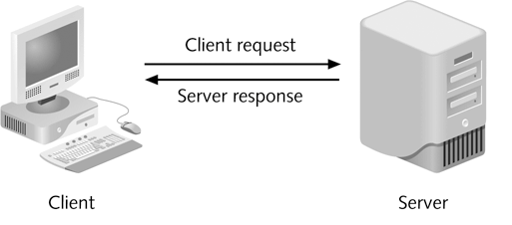
Client/Server Architecture (continued)
Client (“front end”):
Presents an interface to the user
Gathers information from the user, submits it to a server, then receives, formats, and presents the results returned from the server
<number>

Slide 16
Client/Server Architecture (continued)
A three-tier, or multi-tier, client/server system consists of three distinct pieces:
Client tier, or user interface tier, is the Web browser
Processing tier, or middle tier, handles the interaction between the Web browser client and the data storage tier
Performs necessary processing or calculations based on the request from the client tier
Handles the return of any information to the client tier
<number>

Slide 17
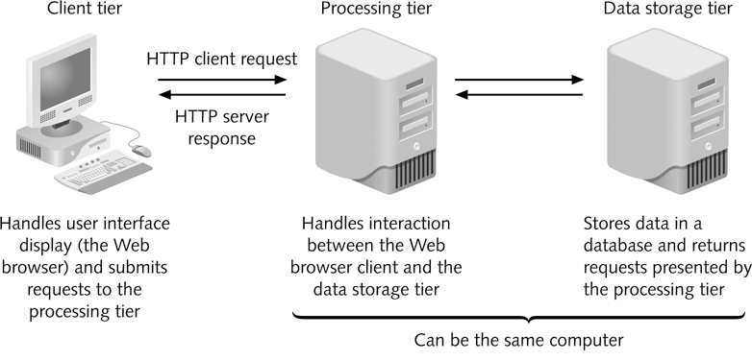
Client/Server Architecture (continued)
Figure 1-16 The design of a three-tier client/server system
<number>

Slide 18
JavaScript and Client-Side Scripting
JavaScript is:
A client-side scripting language that allows Web page authors to develop interactive Web pages and sites
Used in most Web browsers including Firefox and Internet Explorer
Client-side scripting is a language that runs on a local browser (on the client tier) instead of on a Web server (on the processing tier)
<number>

Slide 19
JavaScript and Client-Side Scripting (continued)
JavaScript allows you to:
Turn static Web pages into applications such as games or calculators
Change the contents of a Web page after a browser has rendered it
Create visual effects such as animation
Control the Web browser window itself
<number>

Slide 20
Server-Side Scripting and PHP
Server-side scripting refers to a scripting language that is executed from a Web server
Hypertext Preprocessor (PHP) is a server-side scripting language that is used to develop interactive Web sites
Is easy to learn
Includes object-oriented programming capabilities
Supports many types of databases (MySQL, Oracle, Sybase, ODBC-compliant)
<number>

Slide 21
Server-Side Scripting and PHP (continued)
PHP (continued):
PHP is an open source programming language
Open source refers to software where source code can be freely used and modified
Can’t access or manipulate a Web browser like JavaScript
Exists and executes solely on a Web server, where it performs various types of processing or accesses databases
<number>

Slide 22
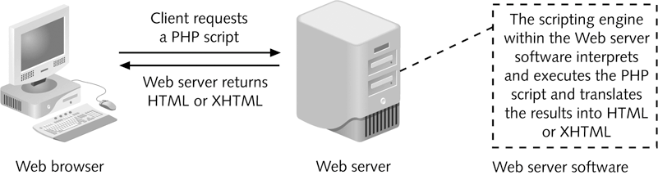
Server-Side Scripting and PHP (continued)
General rule: Use client-side scripting to handle user interface processing and light processing, such as validation; use server-side scripting for intensive calculations and data storage
Figure 1-17 How a Web server processes a PHP script
<number>

