Slide 1

PHP
Using Arrays

Slide 2
Arrays
Topics:
  Numerically indexed arrays
  Non-numerically indexed arrays (hashes, associative arrays)
  Array operators
  Multidimensional arrays - read
  Array sorting
  Other array functions
  Complete reference for arrays at http://www.php.net/array

Slide 3
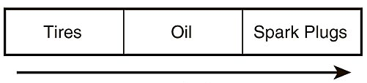
Arrays
An array = a set of data represented by a single variable name
Example, the $products array:
In PHP, each array element consists of :
  A value
  A key or index that is used to access the element
  (internally, all arrays in PHP are associative = hashes…)
The keys / indexes can be:
  Non-negative integers → these PHP arrays have the logical structure similar to a classic array in other languages (Java, C) and can be used in the traditional way
  Strings → associative arrays or hashes
  Mixture of both

Slide 4
Creating Numerically Indexed Arrays
Create a numerically-indexed (shortly indexed) array with the language construct array:
  Syntax:
  $array_name = array(values);
  Examples:
  $products = array(‘Tires’, ‘Oil’, ‘Spark Plugs’);
  $list = array(2, 4, 6, 8);
  Keys are automatically 0, 1, 2 etc.
  Note: $array_name = array(); creates an empty array

Slide 5
Creating Numerically Indexed Arrays
Create an indexed array by assigning a value to an element of an array that doesn’t exist (the array!):
  $array_name[index] = value; or $array_name[] = value;
  Writing to an indexed array with empty [ ] creates the new element at end of the array ⇒ PHP arrays don’t have fixed length!
  Example:
  $list = array(2, 4, 6, 8);
  $list[ ] = 10; ⇒ $list is now array(2, 4, 6, 8, 10)
  Example:
  $Provinces[] = "Newfoundland and Labrador";
  $Provinces[] = "Prince Edward Island";
  ⇒if $Provinces didn’t exist before, it is created and has 2 elements, indexed 0 and 1.

Slide 6
Creating Numerically Indexed Arrays
Other ways to create indexed arrays:
  $new_array = $existing_array; // as a single unit
  The range(…) function creates an array with a range of values
    Can be used with either numbers or characters (single letters)
    $n = range(4, 7); is same as $n = array(4, 5, 6, 7);
    $c = range(‘p’, ‘s’); is same as $c = array(‘p’, ‘q’, ‘r’, ‘s’);
    A third parameter allows to specify a step size between values:
    $odds = range(1, 10, 2); creates an array containing (1, 3, 5, 7, 9)
  Load an array contents directly from a file
  Load an array contents directly from a database
  Functions to extract parts of an array or reorder an array

Slide 7
Creating Associative Arrays (Hashes)
Create an associative array with the language construct array:
  $prices = array(‘Tires’ => 100, ‘Oil’ => 10, ‘Spark Plugs’ => 4);
  $hash = array(‘QB’ => “Palmer”, ‘WR’ => “OchoCinco”, …);
  After first keys, if you don’t supply more, you get numeric keys starting from 0:
  $mixed = array('QB' => "Palmer", 'WR' => OchoCinco', 'Smith', 'Williamson');
  ⇒ 'Smith‘ is indexed 0, 'Williamson‘ is indexed 1
Create an associative array by assigning a value to an element of an array that doesn’t exist (the array!):
  $prices[‘Tires’] = 100;
  $prices[‘Oil’] = 10;
  $prices[‘Spark Plugs’] = 4;

Slide 8
Accessing Array Contents
Use array name plus the index / key in square brackets to access array elements.
  $Provinces[0]
  $prices[‘Tires’] or $prices[“Tires”]
The quotes around the string keys are optional for single-word keys (a warning might be generated), but generally are used
However, quotes cannot be used when interpolating an element of an array; solutions:
  Don’t rely on interpolation, e.g. use instead regular string concatenation: echo “The price for tires is”. $prices[‘Tires’];
  Omit quotes: e.g. echo “The price for tires is $prices[Tires]”;

Slide 9
Accessing Array Contents
Read/modify an array element’s value as usual
Writing to array with a currently-undefined key (or beyond the end of an indexed array) creates a new element.
Use the unset(…) function to eliminate:
  An array:
  $products = array(‘Tires’, ‘Oil’, ‘Spark Plugs’);
  unset($products); // $products doesn’t exist after this statement
  An array element:
  $products = array(‘Tires’, ‘Oil’, ‘Spark Plugs’);
  unset($products[0]);
  // $products remains with 2 elements only, indexed 1 and 2

Slide 10
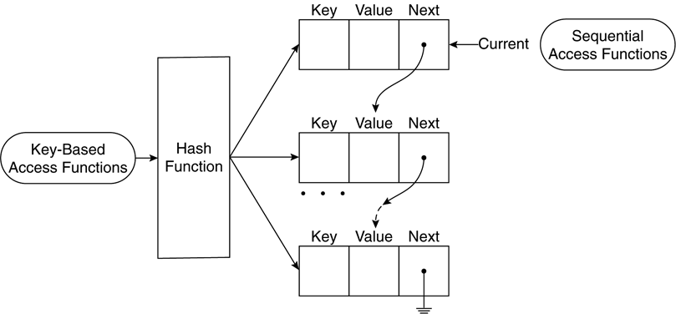
Sequential Access to Array Elements
Logical internal structure of arrays:
  elements are stored in a linked list of cells;
  each cell includes both the key and the value of the element;
  cells are linked in the order they are created - numerically indexed arrays too ⇒ classic arrays are ordered by index, PHP arrays are ordered by creation order
⇒ array elements can be can accessed in creation order or key order if keys are numbers

Slide 11
Sequential Access to Array Elements
Regular for loops for numerically indexed arrays:
$products = array('Tires', 'Oil', 'Spark Plugs');
for ($i=0; $i<3; $i++) {
echo $products[$i] . ", ";
}

Slide 12
Sequential Access to Array Elements
Foreach loops, specially designed for arrays, can be used for all types of indexes.
For numerically indexed arrays, use:
  foreach($arrayName as $val)
  $val steps through each of the values in $arrayName
For associative arrays, you can also use:
  foreach($arrayName as $key => $val)
  $key and $val are set to each key - value in the hash in turn (in the defined order = creation order)

Slide 13
Sequential Access to Array Elements
Foreach loops, examples:
$products = array('Tires', 'Oil', 'Spark Plugs');
foreach ($products as $val) {
echo $val . ", ";
}
$prices = array('Tires' => 100, 'Oil' => 10, 'Spark Plugs' => 4);
foreach ($prices as $key => $val) {
echo "$key - $val, ";
}

Slide 14
Sequential Access to Array Elements
Important - to modify the array elements’ values in a foreach loop, use the reference operator:
$prices = array('Tires' => 100, 'Oil' => 10, 'Spark Plugs' => 4);
foreach ($prices as $key => &$val) {
$val *= 1.05; // increases product prices by 5%
}
By using &, $val will successively be an alias (alternative name) for each array element value, instead of being a separate variable that holds a copy of the array element value!

Slide 15
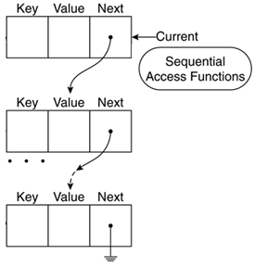
Sequential Access to Array Elements
Each array has an internal pointer (or marker) that references one element in the array → called current pointer
Various functions exist to (in)directly manipulate
this pointer to navigate in the array:
  reset($a) sets the current element of array $a
  to the start of the array; returns $a’s first element
  end($a) sends the pointer to the end of the
  array $a; returns last array element
  current($a) or pos($a) return the array element
  pointed to by the current pointer
  next($a) and each($a) advance the pointer forward one element; return the current element before (each) / after (next) advancing the pointer
  prev($a) is the opposite of next()

Slide 16
Array Operators
Most of them have an analogue in the scalar operators, but with a different meaning!
+ | $a + $b performs the union of $a and $b arrays; $b is appended to $a, except for $b’s elements that have the same keys as some elements already in $a, which are not added
= = | $a ==$b is true if $a and $b contain the same elements
= = = | $a ===$b is true if $a and $b contain the same elements, with the same type, in the same order
!= | $a !=$b is true if $a and $b do NOT contain the same elements
<> | Same as !=
!= = | $a !==$b is true if $a and $b do NOT contain the same elements, with the same type, in the same order

Slide 17
Size of an Array
Two functions get the number of elements of an array passed to them; return 0 for an empty array and 1 for a scalar variable:
  count($a )
  sizeof($a)
array_count_values($array_name) returns an associative array with:
  keys = the distinct values from $array_name
  the value for each key is the number of times that key occurs in $array_name
Example: $list = array(1, 2, 6, 6, 6, 2);
$c = count($list); // $c contains 6
$ac = array_count_values($list);// $ac contains 1=>1, 2=>2, 6=>3

Slide 18
Sorting Arrays
3 types of sort:
  Indexed array – sort values and reset indexes
  Hash – sort by values
  Hash – sort by keys
3 ways to sort (function names follow above order):
  Ascending – sort( ), asort( ), ksort( )
  Descending – rsort( ), arsort( ), krsort( )
  User-defined – usort( ), uasort( ), uksort( )

Slide 19
Sorting Arrays
The ascending and descending sort routines are just called with the array name
  ascending/descending sort() also take an optional argument that specifies the sort type: SORT_REGULAR (the default; alphabetically for strings, numeric order for numbers), SORT_NUMERIC, or SORT_STRING
They sort the original array
User-defined sort takes second argument
  The name of a function that returns <0, 0 or >0 given 2 input arguments based on their relative order (<0 means 1st is less than 2nd)

Slide 20
Loading Arrays from Files
Recall that file($file_name) returns the entire file content as an array: each line in the file is one element of this array.
A line can be split into fields using
array explode(string $separator, string $line_string [, int $limit])
  Ex: $s = "15:42, 20th April\t4 tires\t1 oil\t6 spark plugs\t$434.00\t22 4th St, Troy";
  $a = explode (“\t”, $s);
  // $s is exploded into: "15:42, 20th April", "4 tires", "1 oil", "6 spark plugs",
  // "$434.00", and "22 4th St, Troy", which are stored in the array $a
  The optional limit parameter can be used to limit the number of parts returned
Opposite for explode(): string implode(string $separator, array $arr)
  it combines an array’s elements’ values into a single string, separated by the specified separator

