Slide 1
How to use SWARM program

Slide 2
content
Page
Install SWARM on WINDOWS 3
Create and maintain database 4
Find an entry and load it into work space 7
Plot spectrum 9
Annotate spectrum 10
Calculate relationships between different molecular species 12
Other commands in tab [Database] 13
Running SWARM 14
Calculate affinities 17
Calculate affinities by CUPRA 18
Manage databases 19
Create difference spectrum 21
Enumerate complexes 22
Miscellaneous options 24

Slide 3
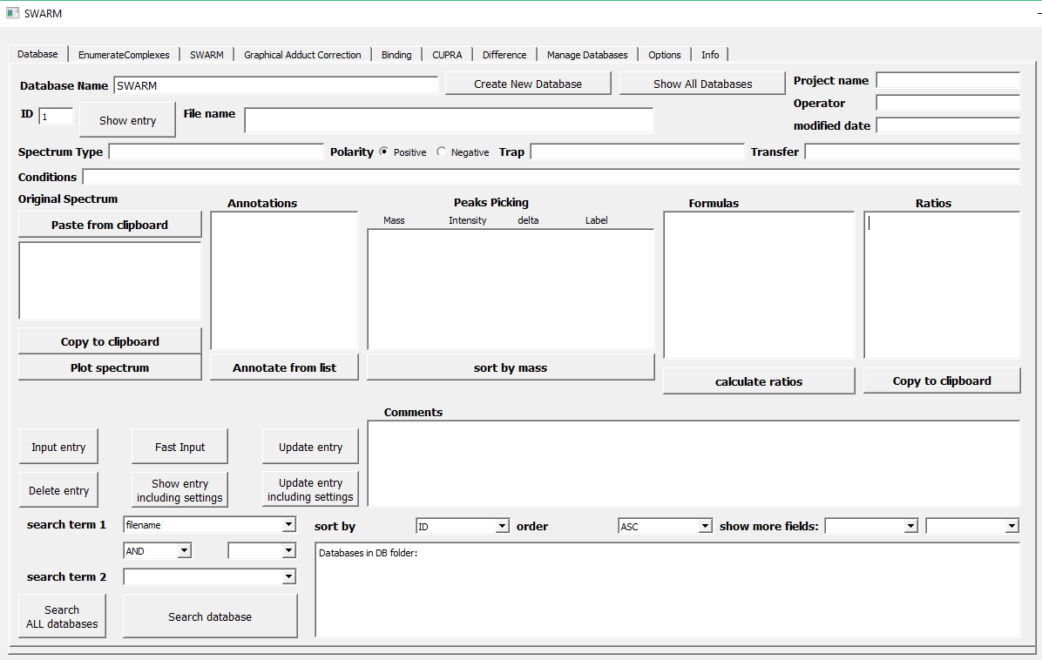
Install SWARM on WINDOWS
Install Python if you don’t have it yet. Preferable installation is Anaconda;
Extract SWARM.zip file in your working directory;
Connect to Internet. Double click and run the SWARM_setup.bat file. Wait until all required modules are downloaded from pip depository and installed;
If successful run SWARM by double clicking on SWARM_RUN.bat
Wait to load (it may take a while to load all modules)
You should see the user interface as shown below.
Important: Generally, when filling forms in this program avoid using special characters like @,#,$.
Also avoid using space, replace it with underscore.

Slide 4
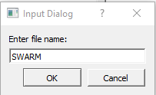


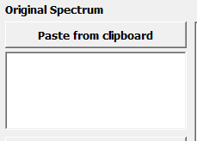
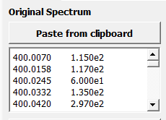

Create and maintain database
Give your database a name
2. Input file name. Each entry must have unique file name
3. Copy spectrum as a list (2 columns: m/z and intensity) and paste in this window:
4. Input the entry in database

Slide 5


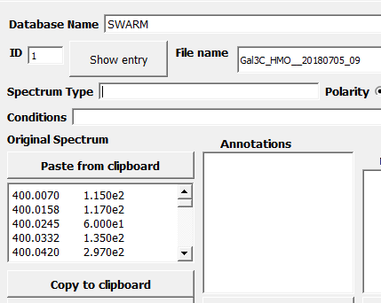
5. Your entry now has a unique ID number in the database
Check if everything works fine. Close SWARM. Open it again. Type Database name and ID number in the corresponding fields and press <Show entry>
7. You should see file name and the spectrum appear in their fields

Slide 6
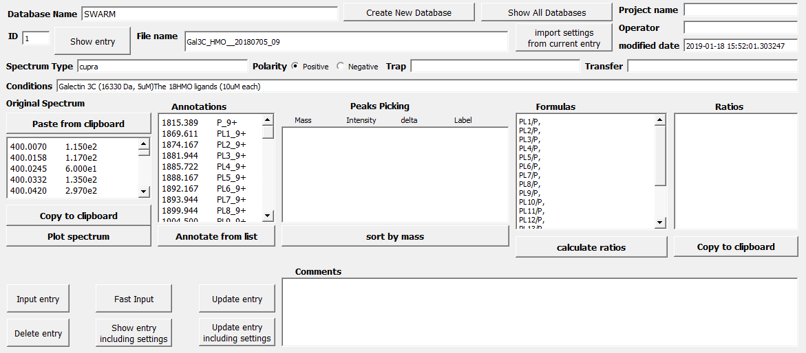
8. Fill other fields you wish to be stored in this entry and press <Update entry>
9. Continue to populate your database with new spectra

Slide 7

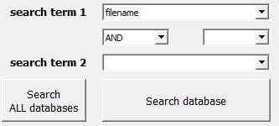
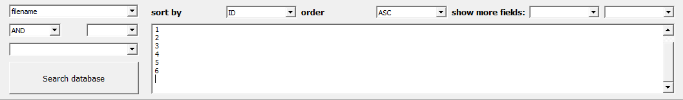
Find an entry and load it into work space
You can use almost any field as a search term.
For example, if you have several entries that contain similar file name type a common portion of the file name into “file name” field, choose “filename” in drop-down menu and press <Search database>
3. You will see a list of entries that contain the search term in their file name

Slide 8
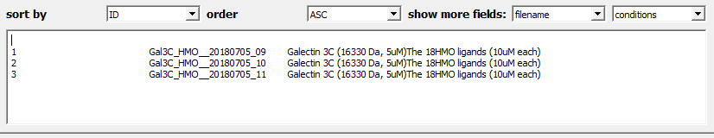
4. Choose “show more fields” in 2 dropdown menus and run <Search database> again
NOTE: When <Search database> is performed the result also appears in “Info” tab for better view and browsing. The list of found entries is also copied in “Manage Databases” tab in IDs field.
5. Try some other field as a search term

Slide 9
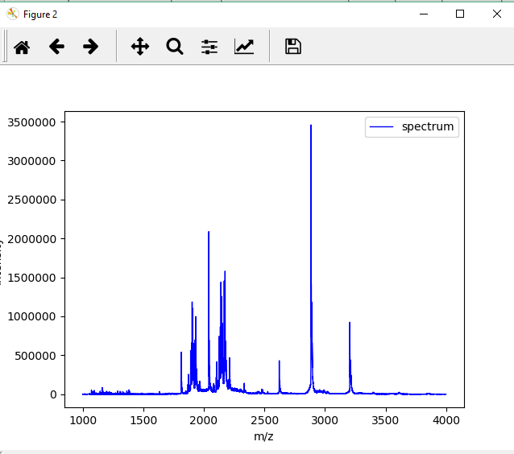
Plot spectrum
1. Load some entry and press <Plot spectrum>
This is a matplotlib plot.
Play with it to lean how to zoom, change axis ranges, save the figure in different formats

Slide 10
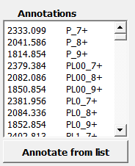
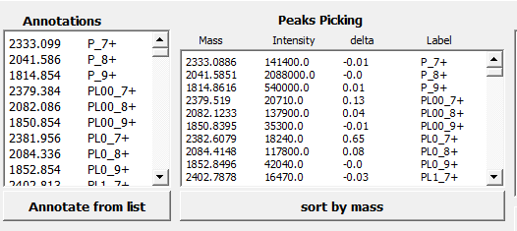

Annotate spectrum
1. Make a list of peaks you are interested in your spectrum in the following format
Format is important!
The list must contain 2 columns:
the first is the m/z of interesting peak,
the second is label, which contain a name (e.g. P or PL) followed by underscore followed by charge state number followed by sign of the charge
2. When done click <Annotate from list>. The list of found peaks will appear in window “Peaks Picking”
3. Now UPDATE the entry before loosing your hard work!

Slide 11
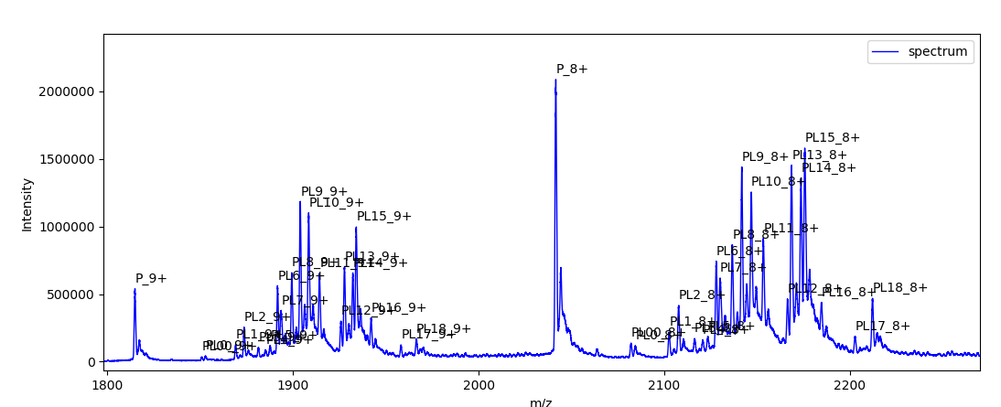
4. Press <Plot spectrum> to see the annotated spectrum
NOTE: The picture is not stored in the database because rendering is so fast!

Slide 12
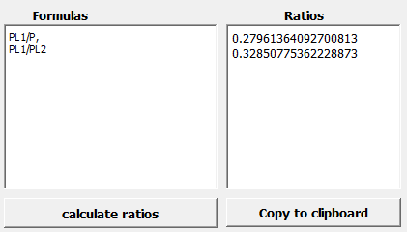
Calculate relationships between different molecular species
Window “Peaks Picking” contains the list of peak found in the spectrum with the corresponding intensities and difference from predicted m/z (user defined annotations).
In window “Formulas” we can define relationships between molecular species we wish to evaluate.
For example, we may have protein receptor (designated as P), and it’s two complexes with ligands L1 and L2 (PL1 and PL2). We can calculate ratios between PL1 and P, or PL1 and PL2 by entering formulas PL1/P, PL1/PL2 in the “Formulas” window and clicking <calculate ratios>.
In the result, intensities for all charge states of each molecular species will be combined.
The result appears in window “Ratios”
Important: formulas must be separated by comma

Slide 13





Other commands in tab [Database]
Databases are stored in folder “DB”. Push button <Show All Databases> prints the list of your databases in search window.
Search will be performed not only in current database but in all databases found in “DB” folder.
Performs sequence of commands <Paste from clipboard>, <Annotate from list>, <calculate ratios>
Updates entry indicated in ID box and includes all current settings in most fields and checkboxes in entire SWARM program
Loads entry indicated in ID box and includes all settings for most fields and checkboxes in entire SWARM program

Slide 14
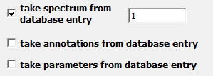
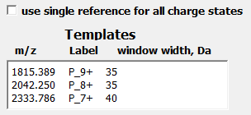
Running SWARM
Click on tab SWARM
SWARM can accept spectrum from window “Original spectrum” or take it directly from database entry. This is controlled by checking checkbox
Similarly, SWARM can accept annotations from window “Peaks Annotations” or take it directly from database entry.
Checking checkbox “take parameters from database entry” overrides all settings and replaces them with those stored in the indicated entry.
2. Setup the “Templates”
Note: if checkbox “use single template for all charge states” is checked only first line in the list of templates will be used and applied to all charge states

Slide 15
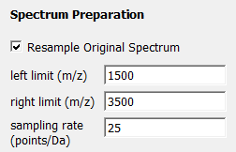

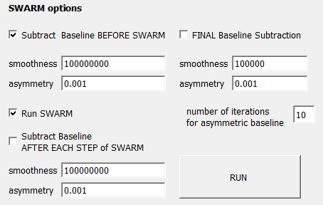
3. Set up parameters for spectrum.
Putting limits to the spectrum range and choosing sampling rate lower than original may speedup the processing time.
Window parameter in Savitzky-Golay filter must be an odd number. The higher value the more smoothing effect.
This panel gives you full control of ALS baseline: should it be applied before, after and/or after each template subtractions. Checkbox “Run SWARM” indicates if template subtraction should be performed or not.
4. Press <RUN> button.

Slide 16
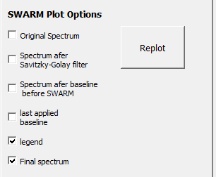
Tip: To save time, run SWARM several times with “run SWARM” box UNCHECKED in order to find the best parameters for ALS procedure.
Tip: Subtraction of template shift a little the position of some peaks. Since SWARM looks for top of the peak as indicated in annotations it can fail at some point when this top shifted more than the value of “accuracy” parameter. In such case, determine the new position of the top and edit m/z value for this peak in annotations
5. Plot options.
Checkboxes here indicate what will be shown in Figure.
If box “last applied baseline” is checked a ALS baseline curve will appear in the plot.

Slide 17
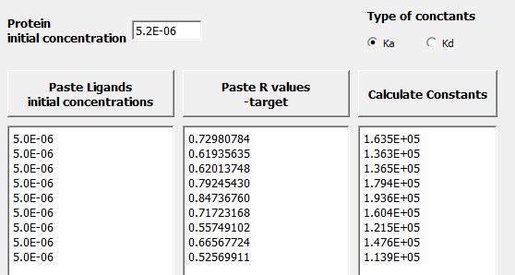
Calculate affinities
Two tabs are devoted to calculation of affinities [Binding] and [CUPRA]. Although [CUPRA] can be used for any situation [Binding] is conceptually simple special case and hence are presented separately.
1. Click on tab [Binding]
This method deals with situation when one protein receptor in the presence of several ligands exists in equilibrium with several complexes, PL₁, PL₂,…PL_{n}.
Total concentration of protein is given in the corresponding box and initial concentrations of the ligands are given in the first column.
From ESI MS spectrum we obtain ratios PL₁/P, PL₂/P,…PL_{n}/P and paste them in the second column.
2. Check desirable radio button (Ka or Kd).
Press <Calculate Constants> button to get the list of affinities.

Slide 18
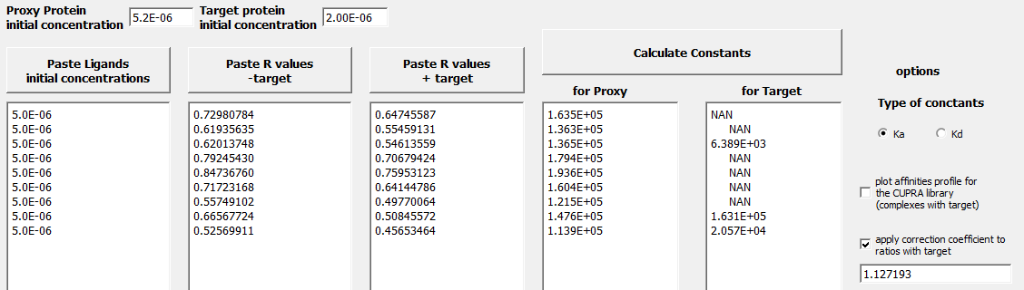
Calculate affinities by CUPRA
1. Click on tab [CUPRA]
This method deals with a situation when each member of the ligand library can bind to the proxy protein and potentially can also interact with the target protein. Although we are primarily interested in interactions with the target, in the spectrum, we can only observe complexes with the proxy. In order to sense the effect of the target we need to compare R values (R with respect to proxy of course) in 2 spectra: with and without added target.
2. Fill the form with the experimental conditions and found R values
3. Check desirable radio button (Ka or Kd).
Press <Calculate Constants> button to get the list of affinities.

Slide 19
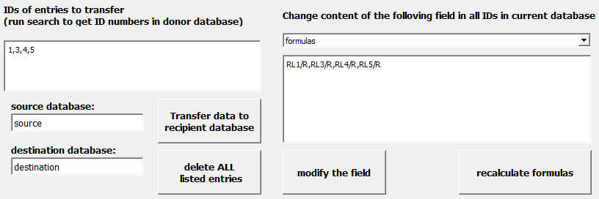
Manage databases
1. Click on tab [Manage Databases]
This tab helps to transfer data from one database to another, change content for more than one entry in the database, and automate SWARM by applying it to a list of entries.
2. Fill the form with source and destination databases names. Create the list of IDs either manually or using search in tab [Database]
3. From drop-down menu choose field that should be modified and in the window below type the value(s)
4. Push button <modify the field> and wait till complete.
5. If the field you modified was “Formulas” then you may want to recalculate ratios by pressing button <recalculate formulas> and wait till complete. The result will be saved in the database. This may take a while depending on complexity of task.

Slide 20




Listed entries can be deleted, transferred to another database or compiled into report of ratios as csv file.
6. Push button <AUTOSWARM> and process all the listed entries with SWARM with current settings. The result will be stored in new entries with a suffix (e.g. _SWARM) added to filename.

Slide 21
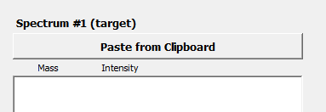
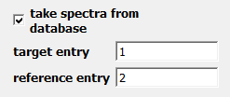
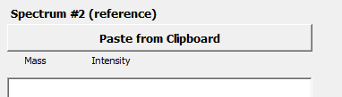
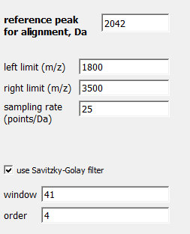
Create difference spectrum
If you wish to subtract one spectrum from another use [Difference] tab.
1. Fill the form. Spectra can be pastes in the corresponding fields
or taken directly from the database.
ref peak must be present in both spectra
3. Push button <Plot difference spectrum> to plot.
The resulting spectrum appears in the corresponding window and can be copied.

Slide 22
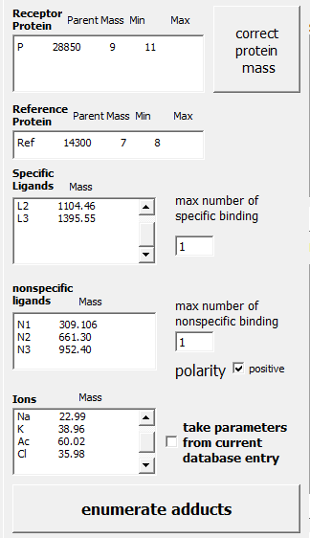
Enumerate complexes
Tab [EnumerateComplexes] contains a tool for easy creating lists of annotations.
Mass of receptor protein with range of charge states
ref peak used for correction for nonspecific complexes (with range of charge states)
List of masses for specific ligands
List of masses for nonspecific ligands that can form adducts
List of masses for ions that can form adducts
1. Fill the form. Press button <enumerate adducts>

Slide 23
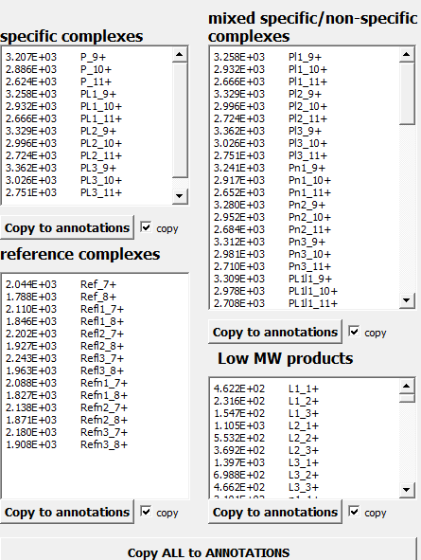
results
Specific complexes
Specific unit in complexes is shown in capital.
Nonspecific unit is shown in low case.
adducts
By default 3 charge state are shown for small molecular ions

Slide 24


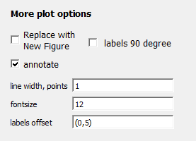
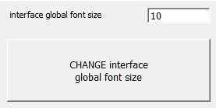
Miscellaneous options
1. Tab [Options]
Turns off popup dialog when operating database entries (Enter, Update etc.)
When looking for peaks listed in annotations the peak will be detected within m/z±”Mass accuracy” range
Check replace box to replace previous matplotlib plot with the new one.
Check annotate box to have annotations appear in the figure
Change font size in user interface. Close and open SWARM for the new settings to take effect.

Slide 25
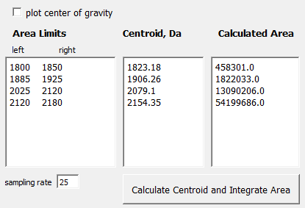
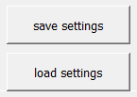
This tool calculates centroid and integral intensity for areas in the spectrum
Check this box to see centroid and the area in the plotted spectrum.
List of the ranges to evaluate
Setting can be saved in the entry, to which they apply. Additionally, these options permit saving/loading settings into/from a file.

