Slide 1

Parallel
multichannel
multikernel
convolution

Slide 2




The Team

Slide 3
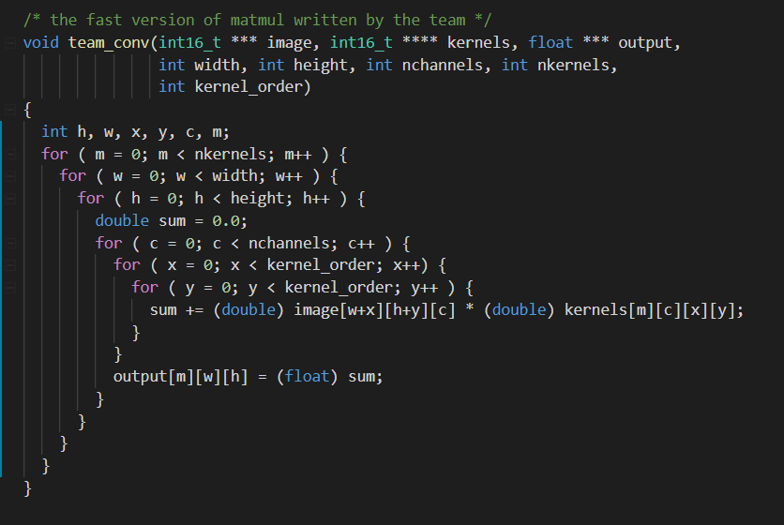
Original Function as provided

Slide 4
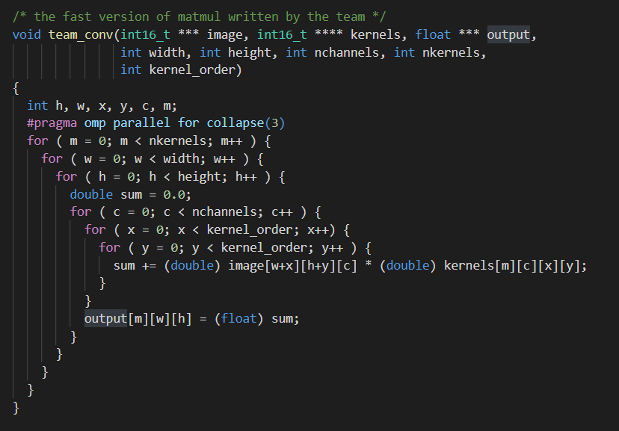
Adding in a parallelization on three for loops

Slide 5
Step 1: Parallelize by threading to #pragma omp parallel for collapse(3)
Width | Height | Kernel_Order | Number_Of_Channels | Kernel_Number |  | No Improvement | Parallelized collapse(1) |  | Parallelized collapse(2) |  | Parallelized collapse(3)
16 | 16 | 5 | 1024 | 128 |  | 2864872 | 164775 | 17 | 162546 | 16 | 163035 | 15
32 | 32 | 3 | 512 | 256 |  | 4137490 | 242200 | 17 | 254254 | 14 | 249677 | 14
64 | 64 | 1 | 256 | 64 |  | 442745 | 28149 | 15 | 29390 | 12 | 28495 | 12
128 | 128 | 7 | 128 | 128 |  | 32516436 | 1774827 | 18 | 1574541 | 20 | 1582756 | 20
256 | 256 | 5 | 64 | 64 |  | 19271368 | 1003890 | 19 | 1019410 | 18 | 971688 | 19
512 | 512 | 7 | 32 | 32 |  | 32403120 | 2352950 | 13 | 1585599 | 20 | 1618731 | 20
image_width: 16..512
image height: 16..512
kernel order: 1, 3, 5, or 7
number of channels: 32..2048 (always powers of 2)
number of kernels: 32..2048 (always powers of 2)
Run this on Stoker. Time results as follows: (in microseconds)

Slide 6
Step 2: Try to Parallelize by threading to #pragma omp parallel for collapse(6) This didn’t work…. We had to add in some complicated math to reorder stuff Well, actually it did work, to a degree for really large inputs
image_width: 16..512
image height: 16..512
kernel order: 1, 3, 5, or 7
number of channels: 32..2048 (always powers of 2)
number of kernels: 32..2048 (always powers of 2)
Run this on Stoker. Time results as follows: (in microseconds)

Slide 7
Step 3: Try to Vectorize using _m128d Again, this didn’t work…. Well, again, it did, to a degree for really large numbers, but for smaller ones, on average there was a 1.2 – 2x speedup.
image_width: 16..512
image height: 16..512
kernel order: 1, 3, 5, or 7
number of channels: 32..2048 (always powers of 2)
number of kernels: 32..2048 (always powers of 2)
Run this on Stoker. Time results as follows: (in microseconds)

Slide 8
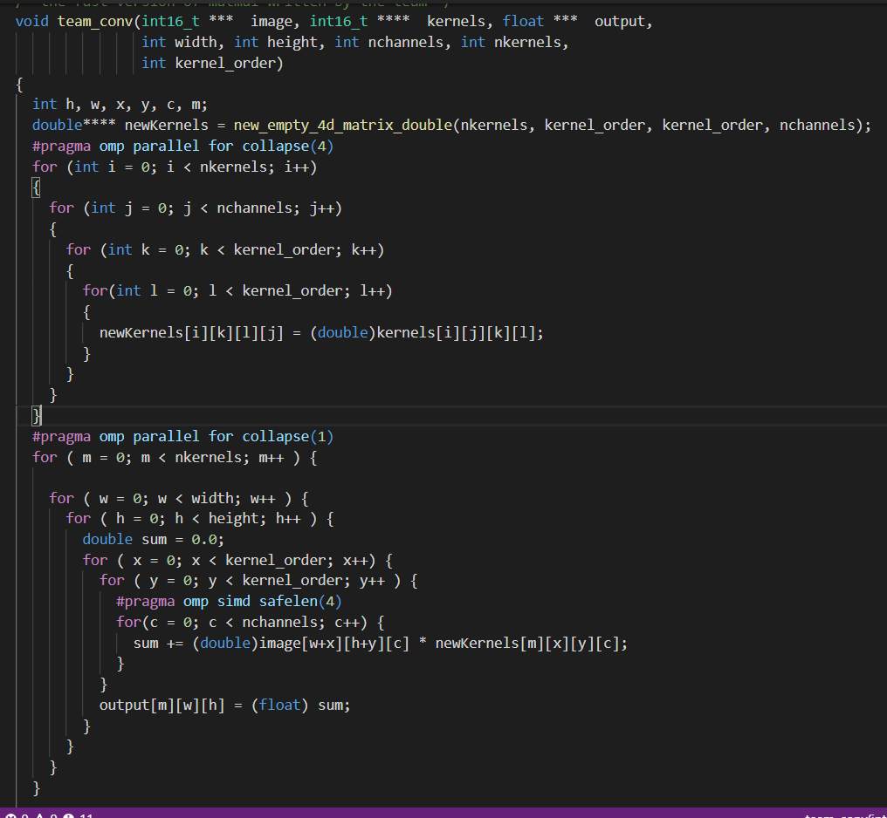
Adding in a Vectorization (as from the notes)

Slide 9
Step 4: Add in some real vectorization (we referred to the notes(Lecture 7) for this!)
Width | Height | Kernel_Order | Number_Of_Channels | Kernel_Number |  | No Improvement | Parallelized collapse(3) |  | Vectorization collapse(3) |  | Vectorization collapse(1)
16 | 16 | 5 | 1024 | 128 |  | 2864872 | 163035 | 15 | 110574 | 29 | 106550 | 26
32 | 32 | 3 | 512 | 256 |  | 4137490 | 249677 | 14 | 146560 | 29 | 146553 | 25
64 | 64 | 1 | 256 | 64 |  | 442745 | 28495 | 12 | 8816 | 44 | 9284 | 41
128 | 128 | 7 | 128 | 128 |  | 1383479 | 1605436 | 20 | 1086641 | 30 | 1083797 | 29
256 | 256 | 5 | 64 | 64 |  | 884024 | 987276 | 17 | 709312 | 26 | 661981 | 28
512 | 512 | 7 | 32 | 32 |  | 2156709 | 1424520 | 22 | 1045832 | 30 | 1186200 | 27
image_width: 16..512
image height: 16..512
kernel order: 1, 3, 5, or 7
number of channels: 32..2048 (always powers of 2)
number of kernels: 32..2048 (always powers of 2)
Run this on Stoker. Time results as follows: (in microseconds)

Slide 10
Live Demo

