Slide 1
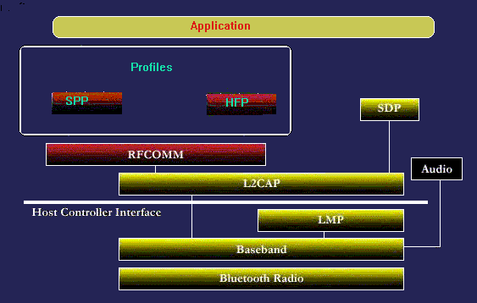
Bluetooth stack layout.

Slide 2
Bluetooth Basic.
Bluetooth transceiver device
Radio-frequency (RF) technology utilizing the unlicensed 2.5GHz Industrial-Scientific-Medical (ISM) band (frequency hopping between 2.402GHz and 2.480GHz )
Possible range for devices under transmitter Power Class 1,2,3 are ~100m, ~10m, ~10cm respectively
Receiver Signal Strength Indicator (RSSI) is a measure of strength of received signal.

Slide 3
Baseband
Base band
The Bluetooth baseband provides transmission channels for both data and voice and is capable of supporting one asynchronous data link and up to three synchronous voice links (or one link supporting both). Synchronous connection-oriented (SCO) links are typically used for voice transmission. These are point-to-point symmetric connections that reserve time slots in order to guarantee timely transmission. The slave device is always allowed to respond during the time-slot immediately following a SCO transmission from the master. A master can support up to three SCO links to a single or multiple slaves, but a single slave can support only two SCO links to different masters. SCO packets are never retransmitted.
The SCO link is established by the master sending a SCO setup message via the LM protocol.

Slide 4
Baseband cont..
Asynchronous connectionless (ACL) links are typically used for data transmission. Transmissions on these links are established on a per-slot basis (in slots not reserved for SCO links). ACL links support point-to-multipoint transfers of asynchronous data. After an ACL transmission from the master, only the addressed slave device may respond during the next time-slot, or if no device is addressed, the packet is considered a broadcast message. Most ACL links include packet retransmission to assure data integrity.
Between a master and a slave only a single ACL link can exist.

Slide 5

Baseband Cont..
Base band continues
PACKETS
ACCESS CODE: Each packet starts with an access code. If a packet header follows, the access code is 72 bits long, otherwise the access code is 68 bits long. This access code is used for synchronization, DC offset compensation and identification. The access code identifies all packets exchanged on the channel of the piconet: all packets sent in the same piconet are preceded by the same channel access code. In the receiver of the Bluetooth unit, a sliding correlator correlates against the access code and triggers when a threshold is exceeded. This trigger signal is used to determine the receive timing. The access code is also used in paging and inquiry procedures. In this case, the access code itself is used as a signaling message and neither a header nor a payload is present. The access code consists of a preamble, a sync word, and possibly a trailer,

Slide 6
Link Manager
Link Manager
The baseband state machine is controlled largely by the link manager. This firmware-generally provided with the link control hardware-handles link setup, security, and control. Its capabilities include authentication and security services, quality of service monitoring, and baseband state control. The link manager controls paging, changing slave modes, and handling required changes in master/slave roles. It also supervises the link and controls handling of multi-slot packets.
Link Manager messages have higher priority than user data.

Slide 7
Link Manager cont..
Link managers communicate with each other using the Link Management Protocol (LMP), which uses the underlying baseband services. LMP packets, which are sent in the ACL payload, are differentiated from logical link control and adaptation protocol (L2CAP) packets by a bit in the ACL header. They are always sent as single-slot packets and are a higher priority than L2CAP packets. This helps ensure the integrity of the link under a high traffic demand.
Link manger takes care of Link key and saves Linkey after pairing for upcoming session to avoid connection procedure.

Slide 8
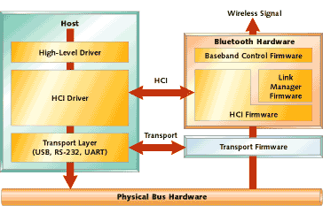
HCI

Slide 9
Protocols and Profiles
Explain
L2CAP
SDP
RFCOMM
HFP
A2DP - AVDTP AVRCP - AVCTP
PBAP - OBEX
MAP - OBEX
CTN - OBEX
SIMAP

Slide 10
LMP
Link Manager Protocol
Is implemented on controller
Manages link between two devices. Power management, Link establishment, query device ablity.

Slide 11
L2CAP
L2CAP – Is the logical link Control Adaptation protocol.
Its main functionalities are
Quality of service
Protocol multiplexing
Segmentation and reassembling.

