Slide 1

Database Project:Biobank and Biospecimen Management System
by Ahmed Rami
221000202

Slide 2
methodology
1.Conceptual design
I worked out the entity list and relationships on paper first: which entities are strong vs. weak, where many-to-many relationships needed resolving through associative tables. This became the ER diagram and, the table structure.
2.physical design
The conceptual model was mapped to a relational schema using standard mapping rules, then written as MySQL DDL.
4.Documentation
The report was written last, every code block in it is copied from the .sql files to report.doc
3.Implementation and population
Tables, then test data, then views/triggers/procedures, then query examples.

Slide 3
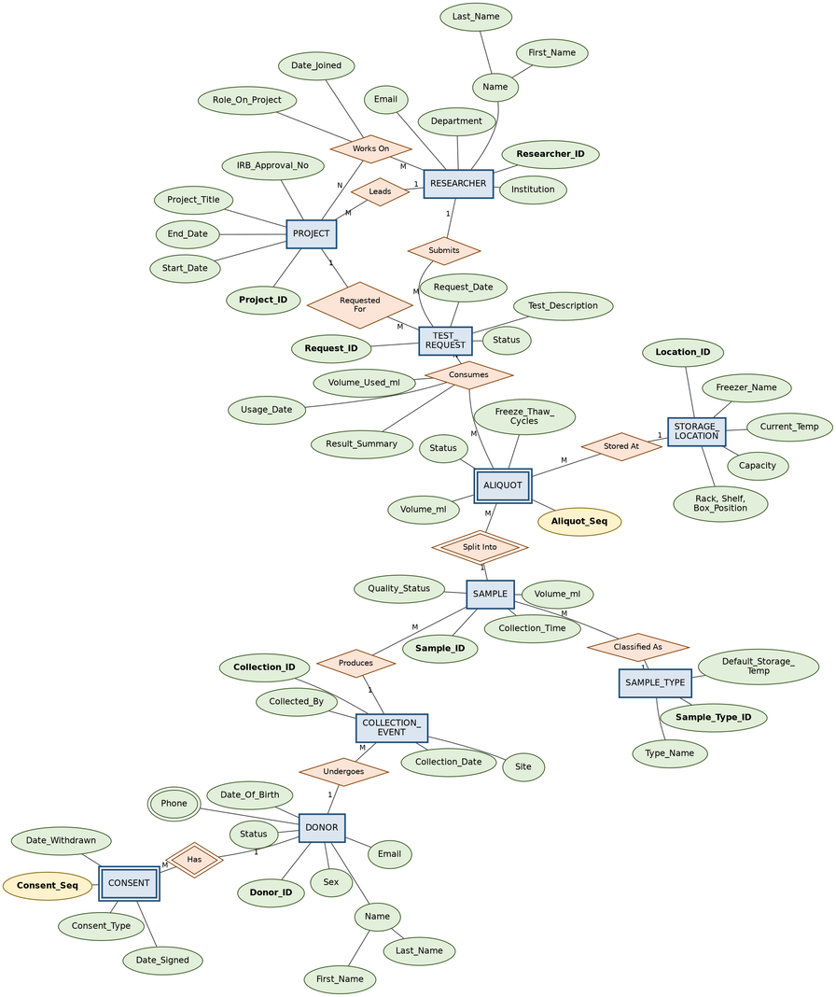
Database Design
13 tables, split into three categories:
9 strong/lookup entities: DONOR, COLLECTION_EVENT, SAMPLE, SAMPLE_TYPE, STORAGE_LOCATION, RESEARCHER, PROJECT, TEST_REQUEST, STORAGE_TEMP_LOG
2 weak entities: CONSENT (owned by DONOR) and ALIQUOT (owned by SAMPLE) each has a composite primary key (owner's key + a partial key like Consent_Seq), because a consent record or an aliquot has no independent identity outside its parent.
2 associative tables resolving many-to-many relationships: PROJECT_RESEARCHER (researchers ↔ projects, since a project has a team and a researcher works on multiple projects) and SAMPLE_USAGE (aliquots ↔ test requests, since one aliquot can be partially used by several requests and one request can consume several aliquots).

Slide 4
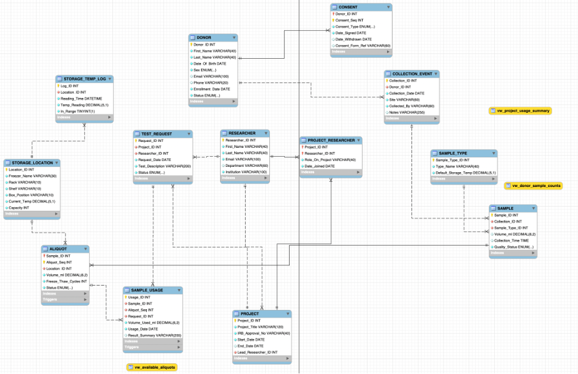
Key design decisions:
SAMPLE_TYPE and STORAGE_LOCATION were factored out as separate lookup entities rather than embedded, specifically to satisfy 3NF attributes like Default_Storage_Temp depend on the type, not the individual sample, so keeping them inline would have created transitive dependencies and duplicated data.
Every foreign key got an explicit ON DELETE/ON UPDATE action: CASCADE for owned/dependent data (deleting a donor removes their consents), RESTRICT for shared reference data (you can't delete a sample type still in use).
Business/system rules that couldn't be expressed as simple constraints were pushed into triggers rather than left to application code e.g., "an aliquot's total volume can never exceed its parent sample's volume" is enforced by a BEFORE INSERT trigger, not just documented as a rule.

Slide 5
Implementation
create_tables.sql DDL: all 13 tables in dependency order, with PRIMARY KEY, FOREIGN KEY, CHECK, and UNIQUE constraints, plus supporting indexes on frequently-joined foreign key columns.
load_data.sql DML: realistic test data, 10+ rows per main table.
views.sql 3 views joining across the schema for common reporting needs (available inventory, project usage summary, donor sample counts).
triggers_procedures.sql 2 triggers (volume-check on insert, auto-depletion on usage), 1 stored procedure (sp_register_test_request, wrapping two inserts in one transaction with an OUT parameter), 1 function (a reusable consent-status check).
queries.sql 17 queries covering retrieval, joins, aggregation, correlated and non-correlated subqueries, and INSERT/UPDATE/DELETE.

Slide 6
thank you

