Slide 1
1. Perform calculation on sales from 1 previous , current and 2 next value
2. Perform calculation on sales from 3 previous , current and 2 next value

Slide 2
3. For the following relation schema:
Table 1 : employee(employee-name, street, city)
Table 2 : works(employee-name, company-name, salary)
Table 3 : company(company-name, city)
Table 4 : manages(employee-name, manager-name)
Give an expression in SQL for each of the following queries:
a) Find the names, street address, and cities of residence for all employees who work for 'First Bank Corporation' and earn more than $10,000.

Slide 3
b) Find the names of all employees in the database who live in the same cities as the companies for which they work
c) Find the names of all employees in the database who live in the same cities and on the same streets as do their managers.

Slide 4
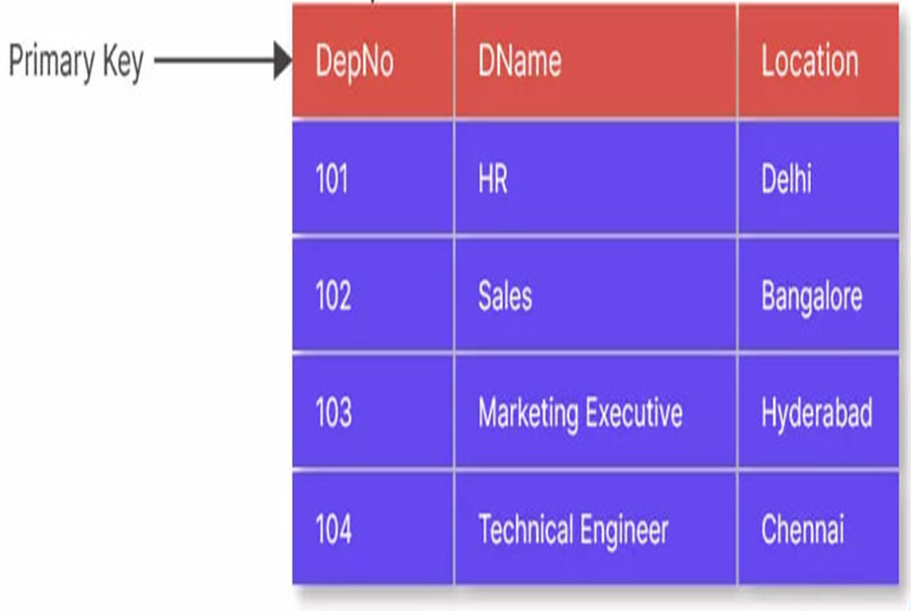
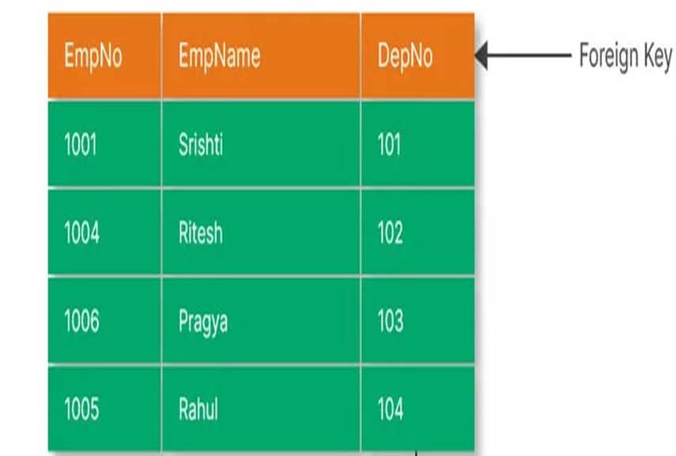
4 Create foreign key on
Department
Employee

Slide 5
5 Create foreign key on student id in Library
Student:
Library:
student_id | student_name | student_branch | student_emailid
100 | Riya | CSE | riya@xyz.com
101 | Aman | CSE | aman@xyz.com
102 | Deepak | Mech | deepak@xyz.com
103 | Barkha | IT | barkha@xyz.com
book_id | student_id | number_of_books_borrowed
200 | 100 | 9
201 | 101 | 15
202 | 102 | 7
203 | 103 | 0

Slide 6
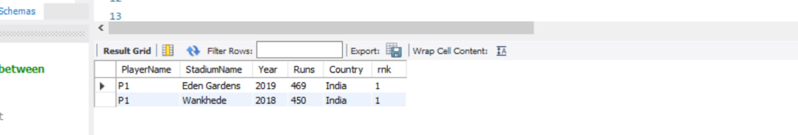
6. Get the output using table partition_by_ground_yr_ind_orde

Slide 7
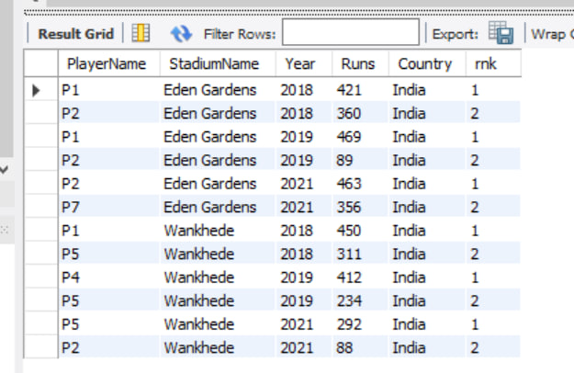
7. Get the output using table partition by ground wise rank

