Slide 1
UART
ELEC 418
Advanced Digital Systems
Dr. Ron Hayne
Images Courtesy of Thomson Engineering

Slide 2
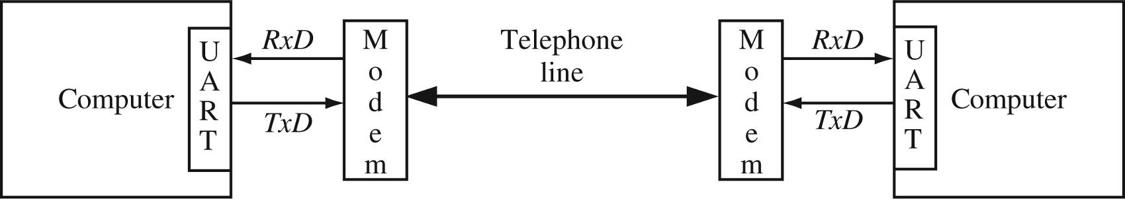
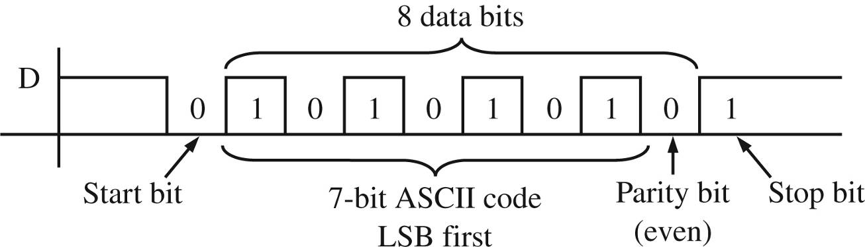
UART
Universal Asynchronous Receiver Transmitter
  Serial Data Transmission

Slide 3
68HC11 Microcontroller
UART Registers
  RSR Receive Shift Register
  RDR Receive Data Register
  TDR Transmit Data Register
  TSR Transmit Shift Register
  SCCR Serial Communications Control Register
  SCSR Serial Communications Status Register
UART Flags
  TDRE Transmit Data Register Empty
  RDRF Receive Data Register Full

Slide 4
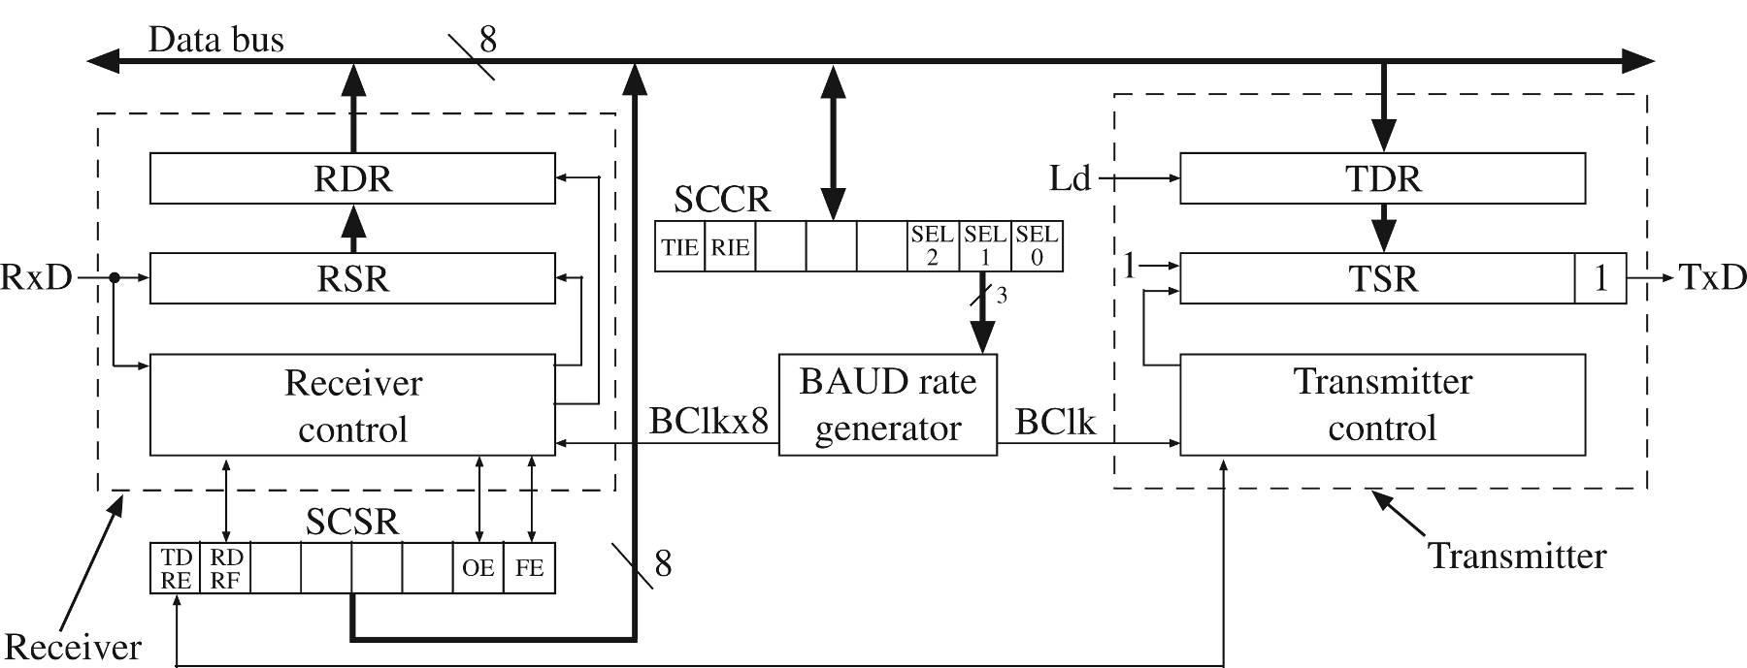
UART Block Diagram

Slide 5
Transmitter Operation
Microcontroller waits until TDRE = '1'
  Loads data into TDR
  Clears TDRE
UART transfers data from TDR to TSR
  Sets TDRE
UART outputs start bit ('0') then shifts TSR right eight times followed by a stop bit ('1')

Slide 6
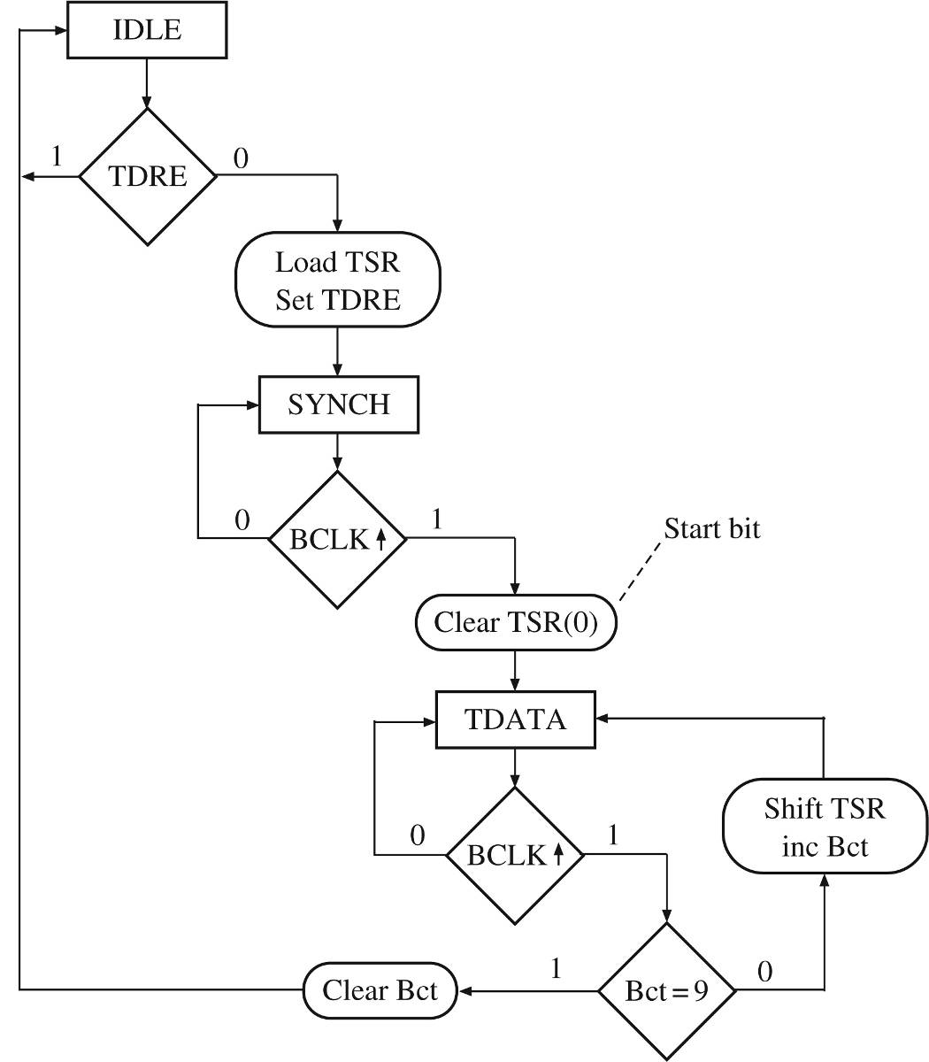
Transmitter SM Chart

Slide 7
Transmitter VHDL Model
library IEEE;
use IEEE.std_logic_1164.all;
use IEEE.numeric_std.all;
entity UART_Transmitter is
port(Bclk, sysclk, rst_b, TDRE, loadTDR: in std_logic;
DBUS: in unsigned(7 downto 0);
setTDRE, TxD: out std_logic);
end UART_Transmitter;

Slide 8
Transmitter VHDL Model
architecture xmit of UART_Transmitter is
type stateType is (IDLE, SYNCH, TDATA);
signal state, nextstate: stateType;
signal TSR: unsigned(8 downto 0);
signal TDR: unsigned(7 downto 0);
signal Bct: integer range 0 to 9;
signal inc, clr, loadTSR, shftTSR, start: std_logic;
signal Bclk_rising, Bclk_Dlayed: std_logic;
begin
TxD <= TSR(0);
setTDRE <= loadTSR;
Bclk_rising <= Bclk and (not Bclk_Dlayed);

Slide 9
Transmitter VHDL Model
Xmit_Control: process(state, TDRE, Bct, Bclk_rising)
begin
inc <= '0'; clr <= '0'; loadTSR <= '0';
shftTSR <= '0'; start <= '0';
case state is
when IDLE =>
if (TDRE = '0') then
loadTSR <= '1'; nextstate <= SYNCH;
else
nextstate <= IDLE;
end if;

Slide 10
Transmitter VHDL Model
when SYNCH =>
if (Bclk_rising = '1') then
start <= '1'; nextstate <= TDATA;
else nextstate <= SYNCH;
end if;
when TDATA =>
if (Bclk_rising = '0') then
nextstate <= TDATA;
elsif (Bct /= 9) then
shftTSR <= '1'; inc <= '1';
nextstate <= TDATA;
else clr <= '1'; nextstate <= IDLE;
end if;
end case;
end process;

Slide 11
Transmitter VHDL Model
Xmit_update: process(sysclk, rst_b)
begin
if (rst_b = '0') then
TSR <= "111111111"; state <= IDLE;
Bct <= 0; Bclk_Dlayed <= '0';
elsif (sysclk'event and sysclk = '1') then
state <= nextstate;
if (clr = '1') then Bct <= 0;
elsif (inc = '1') then
Bct <= Bct + 1;
end if;

Slide 12
Transmitter VHDL Model
if (loadTDR = '1') then
TDR <= DBUS;
end if;
if (loadTSR = '1') then
TSR <= TDR & '1';
end if;
if (start = '1') then
TSR(0) <= '0';
end if;
if (shftTSR = '1') then
TSR <= '1' & TSR(8 downto 1);
end if;
Bclk_Dlayed <= Bclk;
end if;
end process; end xmit;

Slide 13
Receiver Operation
UART waits for start bit
  Shifts bits into RSR
When all data bits and stop bit are received
  RSR loaded into RDR
  Set RDRF
Microcontroller waits until RDRF is set
  Read RDR
  Clear RDRF

Slide 14
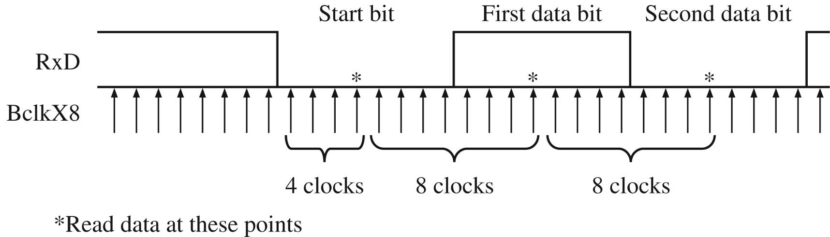
Sampling RxD

Slide 15
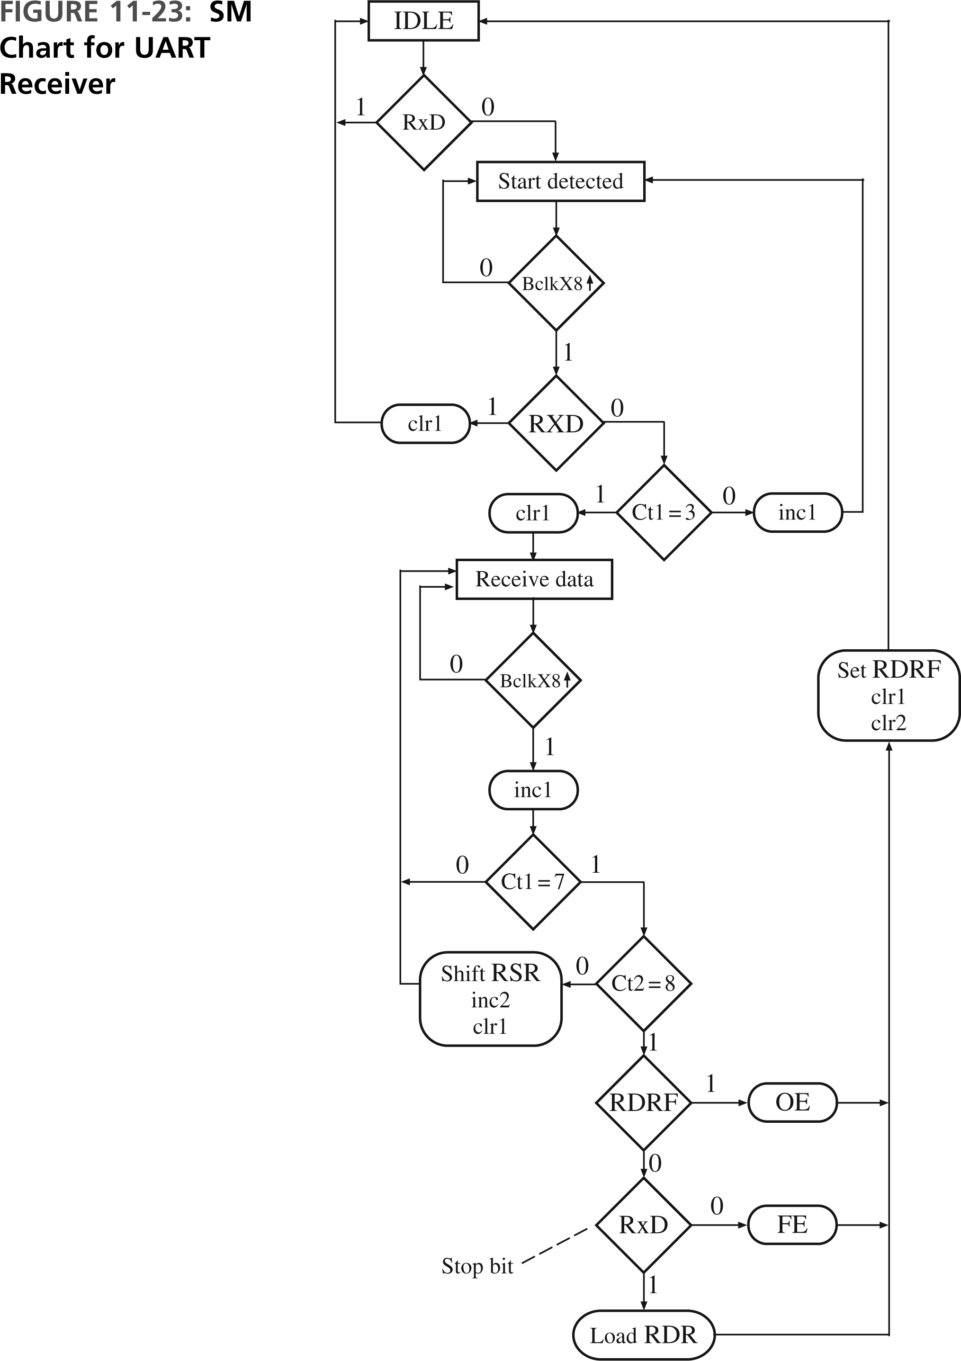
Receiver SM Chart

Slide 16
Receiver VHDL Model
library IEEE;
use IEEE.std_logic_1164.all;
use IEEE.numeric_std.all;
entity UART_Receiver is
port(RxD, BclkX8, sysclk, rst_b, RDRF: in std_logic;
RDR: out unsigned(7 downto 0);
setRDRF, setOE, setFE: out std_logic);
end UART_Receiver;

Slide 17
Receiver VHDL Model
architecture rcvr of UART_Receiver is
type stateType is (IDLE, START_DETECTED, RECV_DATA);
signal state, nextstate: stateType;
signal RSR: unsigned(7 downto 0);
signal ct1 : integer range 0 to 7;
signal ct2 : integer range 0 to 8;
signal inc1, inc2, clr1, clr2, shftRSR, loadRDR: std_logic;
signal BclkX8_Dlayed, BclkX8_rising: std_logic;
begin
BclkX8_rising <= BclkX8 and (not BclkX8_Dlayed);

Slide 18
Receiver VHDL Model
Rcvr_Control: process(state, RxD, RDRF, ct1, ct2,
BclkX8_rising)
begin
inc1 <= '0'; inc2 <= '0'; clr1 <= '0';
clr2 <= '0'; shftRSR <= '0'; loadRDR <= '0';
setRDRF <= '0'; setOE <= '0'; setFE <= '0';
case state is
when IDLE =>
if (RxD = '0') then
nextstate <= START_DETECTED;
else
nextstate <= IDLE;
end if;

Slide 19
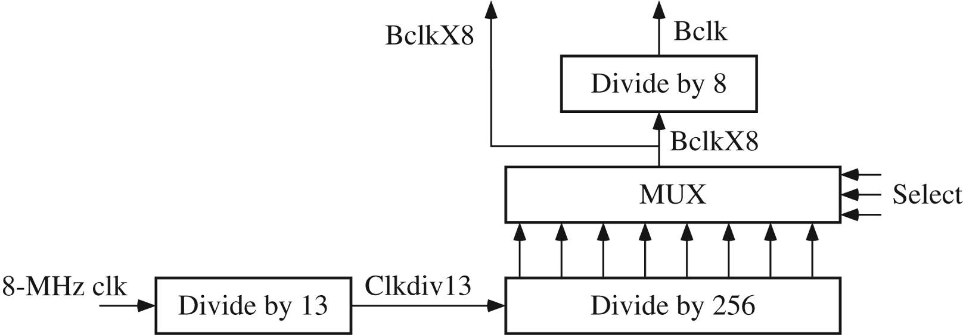
Baud Rate Generator
Select Bits | BAUD Rate
000 | 38,462
001 | 19,231
010 | 9615
011 | 4808
100 | 2404
101 | 1202
110 | 601
111 | 300.5

Slide 20
VHDL Model
entity clk_divider is
port(Sysclk, rst_b: in std_logic;
Sel: in unsigned(2 downto 0);
BclkX8: buffer std_logic;
Bclk: out std_logic);
end clk_divider;
architecture baudgen of clk_divider is
signal ctr1: unsigned(3 downto 0) := "0000";
-- divide by 13 counter
signal ctr2: unsigned(7 downto 0) := "00000000";
-- div by 256 ctr
signal ctr3: unsigned(2 downto 0) := "000";
-- divide by 8 counter
signal Clkdiv13: std_logic;

Slide 21
VHDL Model
begin
process(Sysclk) -- first divide system clock by 13
begin
if (Sysclk'event and Sysclk = '1') then
if (ctr1 = "1100") then ctr1 <= "0000";
else ctr1 <= ctr1 + 1;
end if;
end if;
end process;
Clkdiv13 <= ctr1(3);

Slide 22
VHDL Model
process(Clkdiv13) -- ctr2 is an 8-bit counter
begin
if (Clkdiv13'event and Clkdiv13 = '1') then
ctr2 <= ctr2 + 1;
end if;
end process;
BclkX8 <= ctr2(to_integer(sel)); -- MUX
process(BclkX8)
begin
if (BclkX8'event and BclkX8 = '1') then
ctr3 <= ctr3 + 1;
end if;
end process;
Bclk <= ctr3(2);
end baudgen;

Slide 23
Complete UART
entity UART is
port(SCI_sel, R_W, clk, rst_b, RxD: in std_logic;
ADDR2: in unsigned(1 downto 0);
DBUS: inout unsigned(7 downto 0);
SCI_IRQ, TxD, RDRF_out, Bclk_out, TDRE_out:
out std_logic);
end UART;
architecture uart1 of UART is
component UART_Receiver
port(RxD, BclkX8, sysclk, rst_b, RDRF: in std_logic;
RDR: out unsigned(7 downto 0);
setRDRF, setOE, setFE: out std_logic);
end component;

Slide 24
Complete UART
component UART_Transmitter
port(Bclk, sysclk, rst_b, TDRE, loadTDR:
in std_logic;
DBUS: in unsigned(7 downto 0);
setTDRE, TxD: out std_logic);
end component;
component clk_divider
port(Sysclk, rst_b: in std_logic;
Sel: in unsigned(2 downto 0);
BclkX8: buffer std_logic; Bclk: out std_logic);
end component;

Slide 25
Complete UART
signal RDR, SCSR, SCCR: unsigned(7 downto 0);
signal TDRE, RDRF, OE, FE, TIE, RIE: std_logic;
signal BaudSel: unsigned(2 downto 0);
signal setTDRE, setRDRF, setOE, setFE, loadTDR,
loadSCCR: std_logic;
signal clrRDRF, Bclk, BclkX8, SCI_Read, SCI_Write:
std_logic;
begin
RCVR: UART_Receiver port map(RxD, BclkX8, clk,
rst_b, RDRF, RDR, setRDRF, setOE, setFE);
XMIT: UART_Transmitter port map(Bclk, clk, rst_b,
TDRE, loadTDR,DBUS, setTDRE, TxD);
CLKDIV: clk_divider port map(clk, rst_b, BaudSel,
BclkX8, Bclk);

Slide 26
Microcontroller Interface
Memory-Mapped I/O
ADDR2 | R_W | Action
00 | 0 | DBUS ← RDR
00 | 1 | TDR ← DBUS
01 | 0 | DBUS ← SCSR
01 | 1 | DBUS ← hi-Z
1- | 0 | DBUS ← SCCR
1- | 1 | SCCR ← DBUS

Slide 27
UART Test Bench
entity UART_test is
end UART_test;
architecture test1 of UART_test is
component UART
port(SCI_sel, R_W, clk, rst_b, RxD: in std_logic;
ADDR2: in unsigned(1 downto 0);
DBUS: inout unsigned(7 downto 0);
SCI_IRQ, TxD, RDRF_out, Bclk_out, TDRE_out:
out std_logic);
end component;
signal SCI_sel, R_W, clk, rst_b, RxD, SCI_IRQ, TxD, RDRF, Bclk, TDRE: std_logic := '0';
signal ADDR2: unsigned(1 downto 0);
signal DBUS: unsigned(7 downto 0);

Slide 28
UART Test Bench
begin
uart1: UART port map (SCI_sel, R_W, clk, rst_b, RxD,
ADDR2, DBUS, SCI_IRQ, TxD, RDRF, Bclk, TDRE);
clk <= not clk after 50 ns;
process
begin
wait for 120 ns;
rst_b <= '1';
SCI_sel <= '1';
DBUS <= "10000000";
ADDR2 <= "10";
R_W <= '1';
wait for 100 ns;

Slide 29
UART Test Bench
DBUS <= "01101001";
ADDR2 <= "00";
wait for 100 ns;
R_W <= '0';
wait until TDRE = '1';
DBUS <= "00111100";
R_W <= '1';
wait for 100 ns;
R_W <= '0';
wait until TDRE = '1';
DBUS <= "10101010";
R_W <= '1';
wait for 100 ns;
R_W <= '0';
wait;
end process;
end test1;

Slide 30
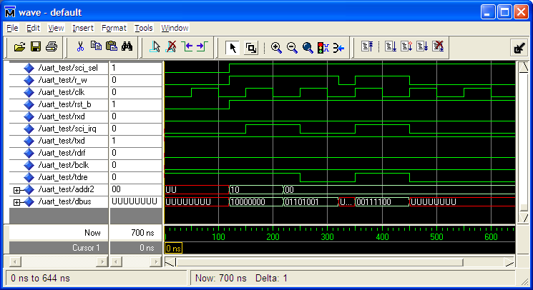
ModelSim Simulation

Slide 31
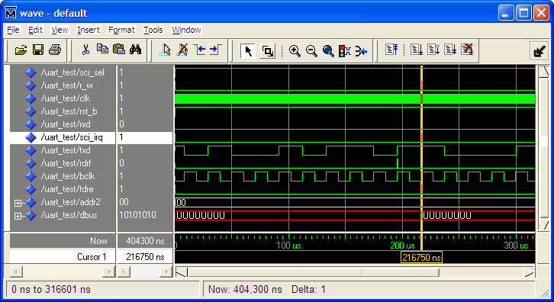
ModelSim Simulation

Slide 32
Loop-Back Test
RxD <= TxD;
process
begin
wait for 120 ns;
report "Begin Testing";
rst_b <= '1';
SCI_sel <= '1';
-- Set SCCR
DBUS <= "10000000";
ADDR2 <= "10";
R_W <= '1';
wait for 100 ns;
-- Load TDR
DBUS <= "01101001";
ADDR2 <= "00";
wait for 100 ns;
DBUS <= "ZZZZZZZZ";
R_W <= '0';
wait until RDRF = '1';
assert DBUS = "01101001"
report "Test Failed";
report "Testing Complete";
wait;

Slide 33
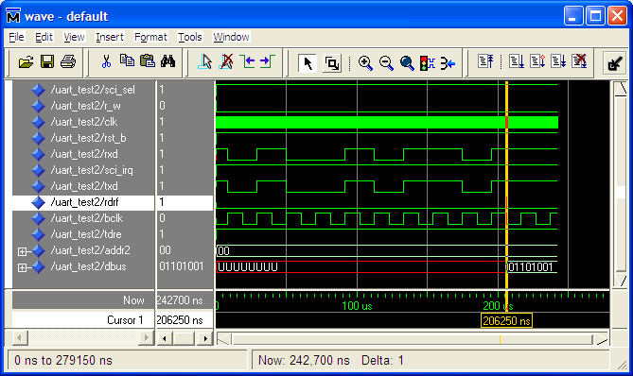
Loop-Back Test

Slide 34
Summary
Universal Asynchronous Receiver Transmitter
  Transmitter
  Receiver
  Baud Rate Generator
  VHDL Models
  ModelSim Simulation

