Slide 1
Universal Asynchronous Receiver/Transmitter (UART)

Slide 2
UART (Universal Asynchronous Receiver/Transmitter)
Most UARTS are full duplex – they have separate pins and electronic hardware for the transmitter and receiver that allows serial output and serial input to take place simultaneously.
Based around shift registers and a clock signal.
UART clock determines baud rate
UART frames the data bits with
  a start bit to provide synchronisation to the receiver
  one or more (usually one) stop bits to signal end of data
Most UARTs can also optionally generate parity bits on transmission and parity checking on reception to provide simple error detection.
UARTs often have receive and transmit buffers(FIFO's) as well as the serial shift registers
7-<number>

Slide 3
UART - Transmitter
Transmitter (Tx) - converts data from parallel to serial format
  inserts start and stop bits
  calculates and inserts parity bit if required
  output bit rate is determined by the UART clock
Status information
Parallel data
Serial output
UART Clock from
baud rate generator
7-<number>

Slide 4
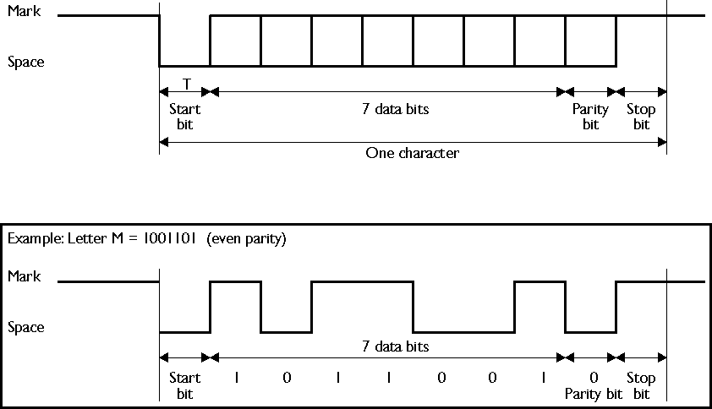
Asynchronous serial transmission
1
0
Serial transmission is little endian (least significant bit first)
7-<number>

Slide 5
UART - The Receiver
  synchronises with transmitter using the falling edge of the start bit.
  samples the input data line at a clock rate that is normally a multiple of baud rate, typically 16 times the baud rate.
  reads each bit in middle of bit period (many modern UARTs use a majority decision of the several samples to determine the bit value)
  removes the start and stop bits, optional calculates and checks the parity bit. Presents the received data value in parallel form.
Status information
Serial input
Parallel data
UART Clock from
baud rate generator
7-<number>

Slide 6
Asynchronous serial reception
Idle
Start bit
etc.
waiting for start bit
1
First data bit
Start detected
0
7-<number>

Slide 7
UARTs
Usually used on simple systems
Typically point to point communications
Various different formats and protocols
Normally 8-bit data format with one start and one stop bit
Standards: E.g. RS232
  defines connector type, pin assignments, voltage levels, max bit rate, cable length etc.
  Min. 3 pins – TxD, RxD, Ground
  Other pins for data flow control.
Some common RS232 baud rates - 300,1200,9600,19200
Handshaking
  None
  Hardware - RTS, CTS, etc - simple logic levels
  Software - Xon/Xoff protocol
7-<number>

Slide 8
The LPC23xx UARTs
UART1 is identical to UART0/2/3, but with the addition of a modem interface.
16 byte Receive and Transmit FIFOs.
Register locations conform to ‘550 industry standard.
Receiver FIFO trigger points at 1, 4, 8, and 14 bytes.
Built-in baud rate generator.
Standard modem interface signals included (CTS, DCD, DTS, DTR, RI, RTS).
Either software or hardware flow control can be implemented.
7-<number>

Slide 9
UART Registers
Control registers
Transmit
Receive
FIFO control
Status
Interrupt
Interrupt enable
Format control
Baud rate control
7-<number>

Slide 10
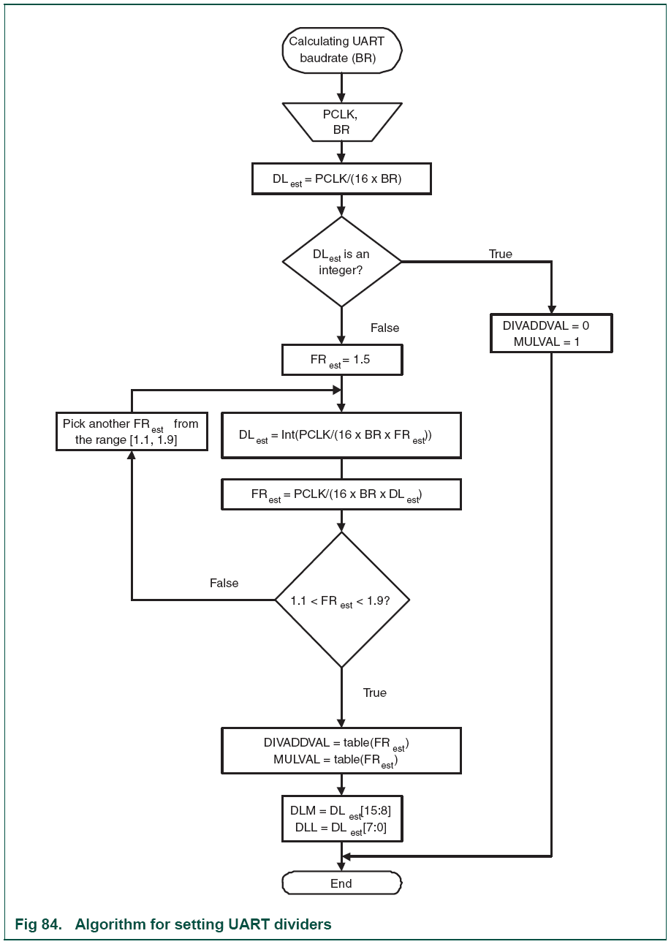

Baud Rate generator
7-<number>

Slide 11
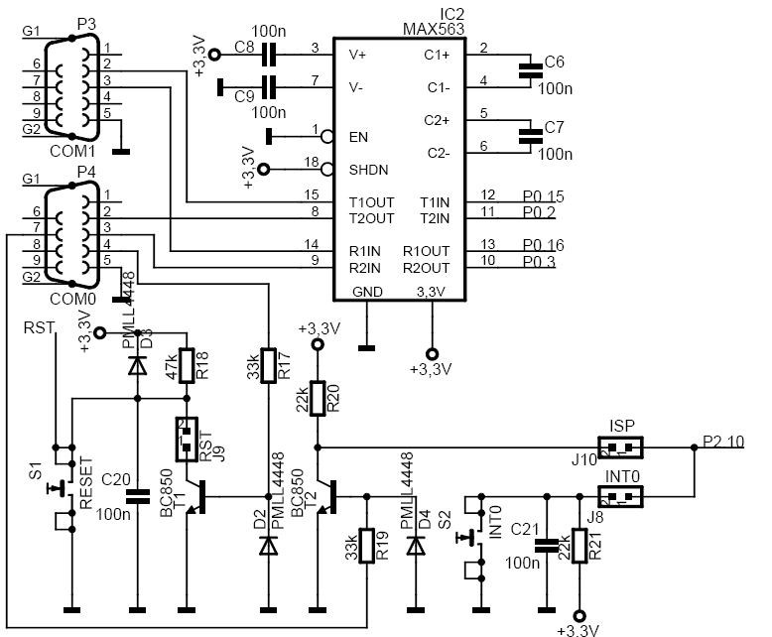
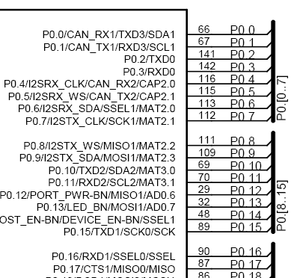
MCB2300 Board schematic
RS232 driver/receiver
9-pin D connectors
LPC2368 microcontrollerport pins
7-<number>

Slide 12
The MCB2300 and Keil C compiler
The C standard I/O functions can be set up to use the UARTs
Using the serial.c and retarget.c source files the standard output functions such as printf() can be directed to use UART 1 for output. Standard input is currently not set up but could be.
To use the standard serial output
  declare extern void init_serial (void);
  call init_serial(); at the start of your program
  all standard output will now go to UART 1
None standard input int getkey(); is also available
  waits for single byte input and returns ASCII value
7-<number>

Slide 13
Serial configuration
#define UART1 /* Use UART 0 for printf */
/* If UART 0 is used for printf */
#ifdef UART0
#define UxFDR U0FDR
#define UxLCR U0LCR
#define UxDLL U0DLL
#define UxDLM U0DLM
#define UxLSR U0LSR
#define UxTHR U0THR
#define UxRBR U0RBR
/* If UART 1 is used for printf */
#elif defined(UART1)
#define UxFDR U1FDR
#define UxLCR U1LCR
#define UxDLL U1DLL
#define UxDLM U1DLM
#define UxLSR U1LSR
#define UxTHR U1THR
#define UxRBR U1RBR
#endif
7-<number>

Slide 14
UART initialisation
/* Initialize Serial Interface */
void init_serial (void) {
#ifdef UART0
PINSEL0 |= 0x00000050; /* Enable TxD0 and RxD0 */
#elif defined (UART1)
PINSEL0 |= 0x40000000; /* Enable TxD1 */
PINSEL1 |= 0x00000001; /* Enable RxD1 */
#endif
UxFDR = 0; /* Fractional divider not used */
UxLCR = 0x83; /* 8 bits, no Parity, 1 Stop bit */
UxDLL = 78; /* 9600 Baud Rate @ 12.0 MHZ PCLK */
UxDLM = 0; /* High divisor latch = 0 */
UxLCR = 0x03; /* DLAB = 0 */
}
7-<number>

Slide 15
Low level serial I/O
/* Implementation of putchar (also used by printf function to output data) */
int sendchar (int ch) { /* Write character to Serial Port */
while (!(UxLSR & 0x20));
return (UxTHR = ch);
}
int getkey (void) { /* Read character from Serial Port */
while (!(UxLSR & 0x01));
return (UxRBR);
}
7-<number>

