Slide 1
Universal Serial Bus (USB)
EE 446 Embedded Architecture

Slide 2
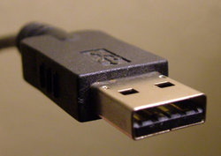
Universal Serial Bus
A representative peripheral interface
Universal Serial Bus (USB) provides a serial bus standard for connecting devices, usually to a computer, but it also is in use on other devices such as set-top boxes, game consoles and PDAs. (wikipedia.org)

Slide 3
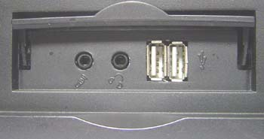
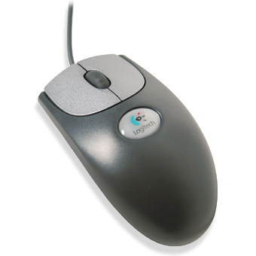
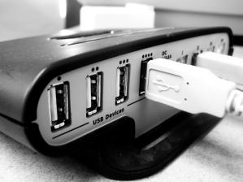
What USB Can Do
USB is a likely solution any time you want to use a computer to communicate with devices outside the computer.
The interface is suitable for one-of-kind and small-scale designs as well as mass-produced, standard peripheral types.
Device, male connector
Computer, female connector
Hub

Slide 4
Comparison
Interface | Format | Number of Devices (maximum) | Length (maximum, feet) | Speed (maximum, bits/sec.) | Typical Use
USB | asynchronous serial | 127 | 16 (or up to 96 ft. with 5 hubs) | 1.5M, 12M, 480M | Mouse, keyboard, disk drive, modem, audio
RS-232 (EIA/TIA-232) | asynchronous serial | 2 | 50-100 | 20k (115k with some hardware) | Modem, mouse, instrumentation
Parallel Printer Port | parallel | 2 (8 with daisy-chain support) | 10–30 | 8M | Printers, scanners, disk drives
IEEE-1394 (FireWire) | serial | 64 | 15 | 400M (increasing to 3.2G with IEEE-1394b | Video, mass storage

Slide 5
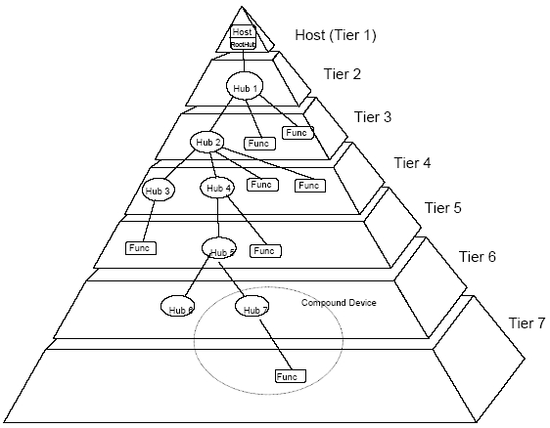
7 Level
Notes:
Up to 127 devices connected.

Slide 6
Benefits for Users
Ease of Use Ease of use was a major design goal for USB, and the result is an interface that’s a pleasure to use for many reasons:
One interface for many devices. USB is versatile enough to be usable with many kinds of peripherals. Instead of having a different connector type and supporting hardware for each peripheral, one interface serves many.
Automatic configuration. When a user connects a USB peripheral to a computer, its OS automatically detects the peripheral and loads the appropriate software driver.
Hot pluggable We can connect and disconnect a peripheral whenever you want, whether or not the system and peripheral are powered, without damaging the PC or peripheral. The operating system detects when a device is attached and readies it for use.
No power supply required (sometimes). A peripheral that requires up to 500 milliamperes can draw all of its power from the bus instead of having its own supply..

Slide 7

USB
USB 1.0 specification introduced in 1994
USB 2.0 specification finalized in 2001
Became popular due to cost/benefit advantage
Eg. IEEE 1394 – high bandwidth, high cost
Three generations of USB
USB 1.0
USB 2.0
USB 3.0 and WUSB
Notes:
IEEE 1394 – high bandwidth, high cost – This refers to accommodating low cost/ low performance peripherals (mouse, keyboard)

Slide 8
USB 2.0
A big step in USB’s evolution was version 2.0
support for much faster transfers.
a 40-times increase was found to be feasible, for a bus speed of 480 Megabits per second.
How to use it
USB 2.0 is backwards compatible with USB 1.1.
Version 2.0 peripherals can use the same connectors and cables as 1.x peripherals.
To use the new, higher speed, peripherals must connect to 2.0-compliant hosts and hubs. 2.0 hosts and hubs can also communicate with 1.x peripherals.
A 2.0-compliant hub with a slower peripheral attached will translate as needed between the peripheral’s speed and high speed.
This increases the hub’s complexity but makes good use of the bus time without requiring different hubs for different speeds.

Slide 9
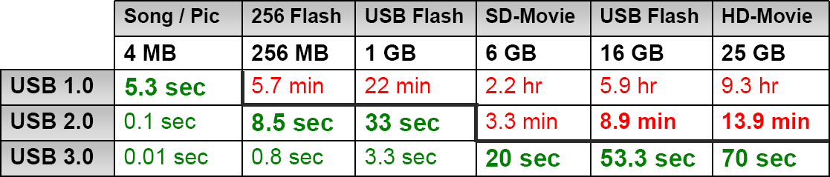
USB 3.0 Overview
Also referred to as SuperSpeed USB
Speeds 10x faster than 2.0 (5 Gbps in controlled test environment)
Transfer of 25 GB file in approx 70 seconds (see chart)
Extensible – Designed to scale > 25Gbps
Optimized power efficiency
No device polling (asynchronous notifications)
Lower active and idle power requirements
Backward compatible with USB 2.0
USB 2.0 device will work with USB 3.0 host
USB 3.0 device will work with USB 2.0 host

Slide 10
USB 3.0
"SuperSpeed" bus provides a fourth transfer mode at 5.0 Gbit/s
Communication is full-duplex during SuperSpeed; (in the modes supported previously, by 1.x and 2.0, communication is half-duplex, with direction controlled by the host.)

Slide 11
USB versus IEEE-1394
IEEE-1394 is best suited for video and other links where speed is essential or a host PC isn’t available.
USB is best suited for typical peripherals such as keyboards, printers, scanners, and disk drives as well as low- to moderate-speed, cost-sensitive applications. For many devices, either interface would work.
With USB, a single host controls communications with many peripherals.
IEEE-1394 uses a peer-to-peer model, where peripherals can communicate with each other directly.
A single communication can also be directed to multiple receivers.
IEEE-1394’s 400 Megabits per second is more than 30 times faster than USB 1.x’s 12 Megabits per second.
As USB is getting faster with version 2.0, IEEE-1394 is getting faster with the proposed IEEE-1394.b.

Slide 12
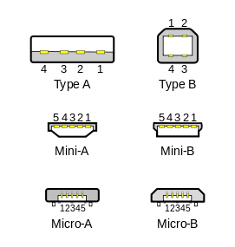
Physical Appearances
Type A connectors on host devices that supply power
Type B connectors on target devices that receive power.

Slide 13
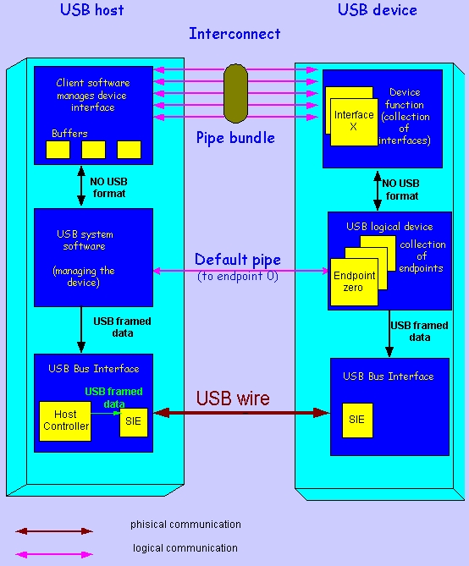
Communication Flow
Notes:
Application Layer (top layer)
Host end：Client Software (device driver)
= >Manages the appropriate interface by
transferring data from its buffers to the
endpoint with the appropriate interface
Device end：Function
= >Composed of interfaces and controls the
functionality of the device
USB Logical device
Compose of a collection of independent endpoints
Each endpoint has an unique Endpoint Number and is unidirectional(except endpoint zero and has two type--In/Out)
Default pipe is associated with endpoint zero
USB System Software
Compose of The Host Controller Driver and The USB Driver
Responsible for
=>Bandwidth allocation
=>bus power management
Two of above are in order to enable devices to access the bus
SIE：Serial Interface Engine
It is part of both the host’s and the device’s physical layer
=>Serialization and Deserialization
=>Encoding and Decoding
=>Generate(for out) and Verify(for in) CRC
=>Detect PID

Slide 14
The Physical Layer

Slide 15
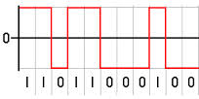
Signaling On The Bus
The USB cable is 4 wire cable
Signal on the bus is done by signaling over two wires ( D₊ and D_ )
Data encoding and decoding is done using NRZI ( Non Return to Zero Inverted )
a 0 bit is transmitted by toggling the data lines
a 1 bit is transmitted by leaving the data lines as-is.

Slide 16
SIE
SIE：Serial Interface Engine
It is part of both the host’s and the device’s physical layer
=>Serialization and De-serialization
=>Encoding and Decoding
=>Generate(for out) and Verify(for in) CRC
=>Detect PID

Slide 17
HC
HC：Host Controller
=>It is an additional hardware to ensure that everything which is transmitted on the bus is correct
=>It serves both the USB and the host and has the same functionality in every USB system

Slide 18
The Protocol Engine Layer

Slide 19
Responsible for the translating the data between the application layer and the USB transactions protocol .
Two Roles
=>USB System Software (in the USB host)
=>USB Logical Device (in the USB device)

Slide 20
The USB System SW
Compose of The Host Controller Driver and The USB Driver
Responsible for
=>Bandwidth allocation
=>bus power management
Two of above are in order to enable devices to access the bus

Slide 21
The USB Logical Device
Compose of a collection of independent endpoints
Each endpoint has an unique Endpoint Number and is unidirectional(except endpoint zero and has two type--In/Out)
Default pipe is associated with endpoint zero

Slide 22
The Application Layer

Slide 23
Host end：Client Software
= >Manages the appropriate interface by
transferring data from its buffers to the
endpoint with the appropriate interface
Device end：Function
= >Composed of interfaces and controls the
functionality of the device

Slide 24
Pipes
The logic communication between the client
software on the host and the function on the
device is done through pipes
It is a association between a specific
endpoint on the device and the appropriate
software in the host

Slide 25
Pipes (continued)
An endpoint is the source or destination of the data that transmitted on the USB cable
An endpoint of a pipe is addressable with a tuple (device_address, endpoint_number)
Two direction
=>OUT：
data flows from the host to the device
=>IN：
data flows from the device to the host

Slide 26
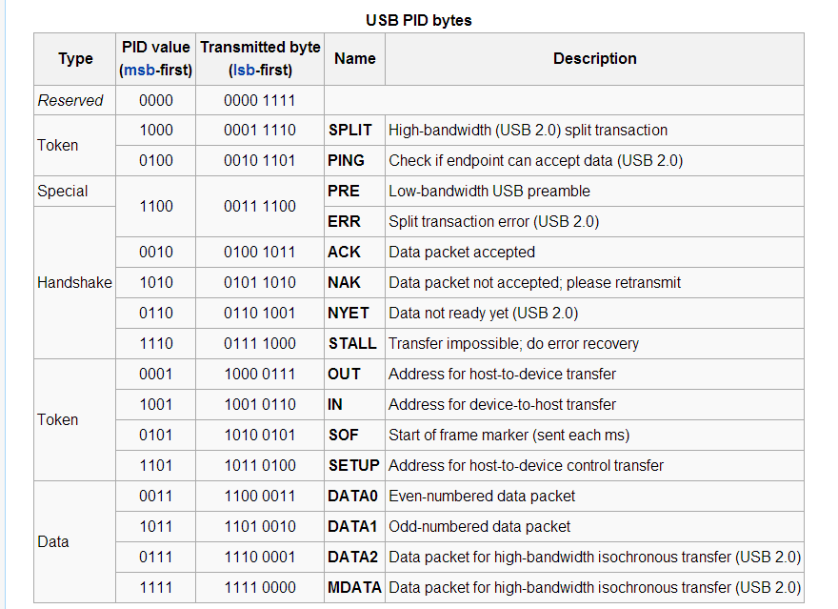
USB Packet Types
Notes:
Token Packet -> Control
Data Packet-> Data transfer
Handshake Packet-> Response to Data packet

Slide 27
Four Types of Data Transfers (Pipes)
Message Pipe
Control transfers Control transfers are bidirectional transfers used by the USB system software mainly to query, configure, and issue certain generic commands to USB devices. Control transfers typically take place between the host computer and the USB device's endpoint 0, but your control transfers might use other endpoints.
Stream Pipe
Interrupt transfers are used when a peripheral wants to be “polled” by the host periodically to see if it has data to send to the host. Keyboards, mice, and joysticks are examples of devices that typically use interrupt transfers.
Bulk transfers are used to move data between the host system and the peripheral when data integrity is more critical than data latency, and they also include error checking and retries if errors are detected. Printers, scanners, and storage devices are examples of devices that depend primarily on bulk transfers.
Isochronous transfers are used for moving “real-time” data. In these transfers, the streaming of the data is more critical than the accuracy of the data. There is no error-checking or retries associated with isochronous transfers. Web-cams, speakers and microphones are examples of devices that utilize isochronous transfers.
Notes:
In telecommunication, an isochronous signal is a signal in which the time interval separating any two significant instants is equal to the unit interval or a multiple of the unit interval. Variations in the time intervals are constrained within specified limits.
A Universal Serial Bus (USB) device can support isochronous endpoints to transfer time-dependent data at a steady rate, such as with audio/video streaming. To transfer data, the client driver issues a request to read or write data to an isochronous endpoint. As a result, the host controller initiates an isochronous transfer that sends or receives data by polling the device at regular intervals.

Slide 28
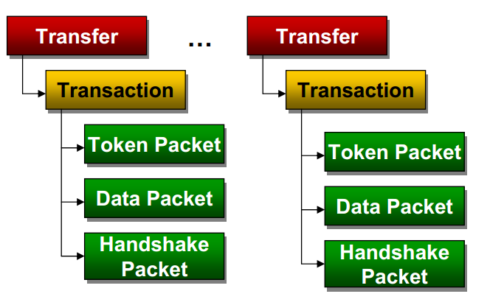
Notes:
The transfer is the process of making a communications request with an endpoint.
Transfers determine aspects of the communications flow such as:
➢ Data format imposed by the USB
➢ Direction of communication flow
➢ Packet size constraints
➢ Bus access constraints
➢ Latency constraints
➢ Required data sequences
➢ Error Handling
A transfer has one or more
transactions which then has one,
two or three packets

Slide 29
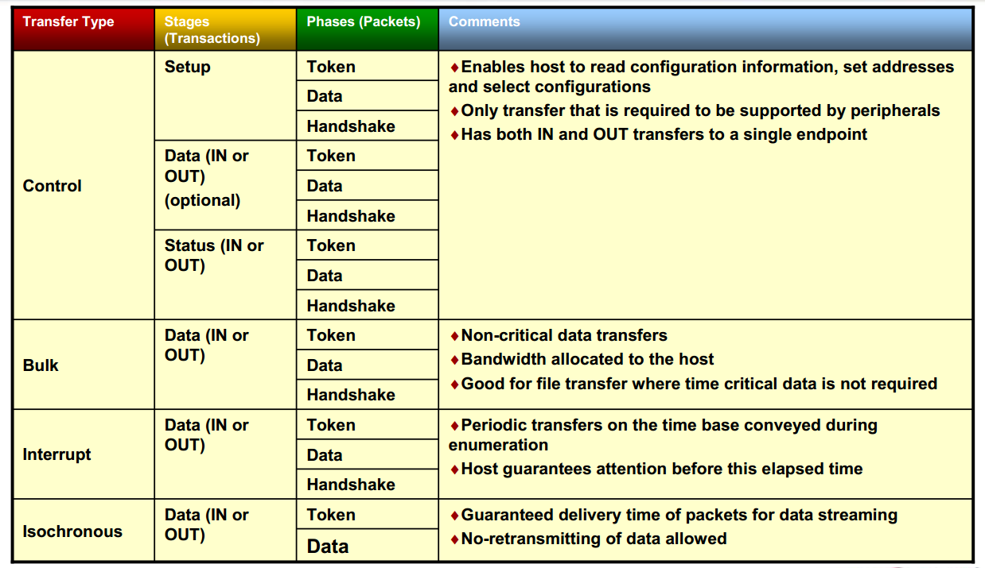

Slide 30
USB On-The-Go (OTG)
Released in December 2006.
USB On-The-Go makes it possible for two USB devices to communicate with each other without requiring a separate USB host.
In practice, one of the USB devices acts as a host (device roles change) for the other device.
For example:
A usb flash drive (peripheral) served by a printer (host);
A keyboard (peripheral) connected to a mobile phone (host)

Slide 31
USB OTG supported by Micro-AB
An OTG product must have a single Micro-AB receptacle and no other USB receptacles.
When attached to a PC, (host)
• an OTG device requires a cable which has a USB Standard-A plug on one end
• and a Micro-B plug on the other end. (Peripheral)

Slide 32
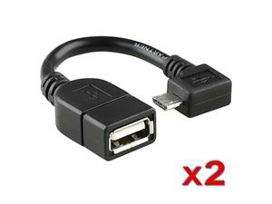
In order to attach a peripheral to an OTG device (now it serves as a host)
the peripheral either needs to have a cable ending in a Micro-A plug which is inserted into the OTG device's Micro-AB (same physical appearance as Micro-A receptacle) with receptacle
or the OTG device itself needs an adapter cable which has a Micro-A plug on one end and a Standard-A receptacle on the other. The adapter cable enables any standard USB peripheral to be attached to an OTG device. (see below)

Slide 33
In order to attach two OTG devices together requires either a cable with a Micro-B plug at one end and a Micro-A plug at the other or can be achieved using a combination of the PC cable and adapter cable.

Slide 34
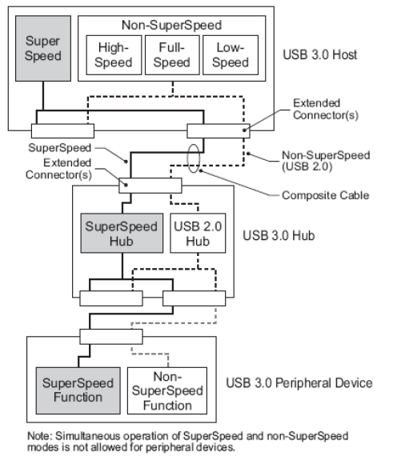
USB 3.0 Bus Architecture
Operates concurrently with USB 2.0 (Dual bus architecture)
Mechanically and electrically backward/forward compatible
Devices configured at fastest signaling rate
Hubs contain additional ports
Speed and power efficiency
Non polling reduces power consumption
Additional data lines included to increase speed
Efficiency of bandwidth – simultaneous communication between host and device
Dedicated in and out lines allow communication between host and device
Notes:
USB 2.0 uses half duplex method for communication. One line controlling IN and OUT.

Slide 35

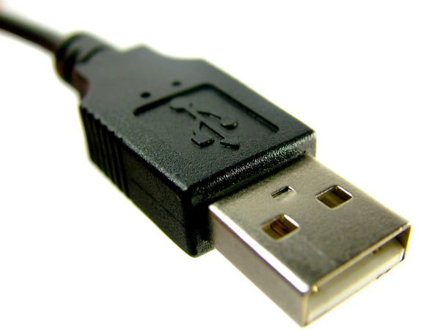
www.studymafia.org
Seminar
On
Universal Serial Bus
Submitted To: Submitted By:
www.studymafia.org www.studymafia.org

Slide 36
Content
History and Evolution
Why We Need USB？
Architectural Overview
USB communication flow
Protocol Layer
Conclusion
References

Slide 37
Key Word
Down：From host to device
Up：From device to host
Example
Down stream：data flow from host to device
Up stream： data flow from device to host

Slide 38
History
USB—Universal Serial Bus
Invented and standardized by a group of computer and peripherals manufactures in 1995
Compete with IEEE1394

Slide 39
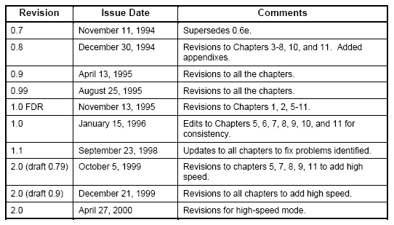
Evolution

Slide 40
Why We Need USB？
Connection of the PC to the telephone：
=>In order to transmit data
Ease-of-use：
=>Saupport plug and play
Port expansion：
=>Up to 127 devices
=>Can add lots of device to a XX

Slide 41
Characteristic (2)
The logical topology of the USB is a star structure
It is similar to computer network
The USB uses a polling protocol
Up to 7 level

Slide 42
USB Can Do
Combines low speed and high speed bus activity , USB enables shared access for both speed
Automatic configuring of devices and a serial bus which is simplified and easy to plug into
Attach / detach easily without restarting system

Slide 43
Architectural Overview
Host：only one
=>The smartest element in the USB system
=>Responsible to the complexity of the
protocol to make devices design simple
and low cost
=>Control the media access（no one can
access the bus unless it get an approval required from the host )

Slide 44
USB System Member (2)
Hub：one or more
=>Like the hubs used for computer network
=>Enables many devices to connect to a single USB port

Slide 45
USB System Member (3)
Device：one or more
=>Everything in the USB system , which is
not a host , is a device ( include hubs)
=>A device may provides one or more USB
functions
=>Has an unique address at the end of the
enumeration process

Slide 46
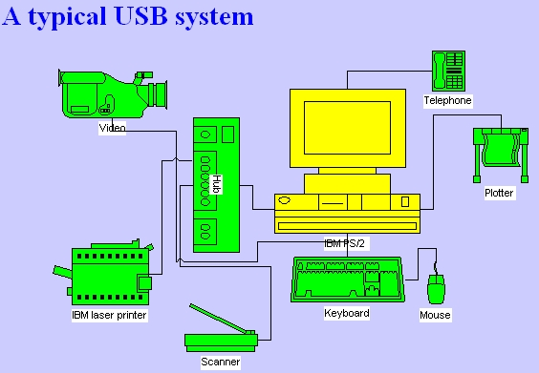
Typical Application

Slide 47
Communication Flow

Slide 48
Pipes (1)
The logic communication between the client
software on the host and the function on the
device is done through pipes
It is a association between a specific
endpoint on the device and the appropriate
software in the host

Slide 49
Pipes (2)
An endpoint is the source or destination of the data that transmitted on the USB cable
Two direction
=>OUT：
data flows from the host to the device
=>IN：
data flows from the device to the host

Slide 50
Signaling On The Bus
The USB cable is 4 wire cable
Signal on the bus is done by signaling over tow wires ( D₊ and D_ )
=>1： D_ low , D₊ high
=>0： D_ high , D₊ low
Data encoding and decoding is done using NRZI ( Non Return to Zero Inverted )

Slide 51
SIE
SIE：Serial Interface Engine
It is part of both the host’s and the device’s physical layer
=>Serialization and Deserialization
=>Encoding and Decoding
=>Generate(for out) and Verify(for in) CRC
=>Detect PID

Slide 52
HC
HC：Host Controller
=>It is an additional hardware to ensure that everything which is transmitted on the bus is correct
=>It serves both the USB and the host and has the same functionality in ever USB system

Slide 53
This Layer Handles
Responsible for the translating the data between the application layer and the USB transactions protocol .
Two Role
=>USB System Software (in the USB host)
=>USB Logical Device (in the USB device)

Slide 54
The USB System SW
Compose of The Host Controller Driver and The USB Driver
Responsible for
=>Bandwidth allocation
=>bus power management
Two of above are in order to enable devices to access the bus

Slide 55
The USB Logical Device
Compose of a collection of independent endpoints
Each endpoint has an unique Endpoint Number and is unidirectional(except endpoint zero and has two type--In/Out)
Default pipe is associated with endpoint zero

Slide 56
The Application Layer
Host end：Client Software
= >Manages the appropriate interface by
transferring data from its buffers to the
endpoint with the appropriate interface
Device end：Function
= >Composed of interfaces and controls the
functionality of the device

Slide 57
Protocol Layer
USB transactions are done through packets include three phases
=>Token phase：host initiates token
indicating the future transfer type
=>Data phase：actual data transmitted
=>Handshake phase：indicate the success or failure of the transaction

Slide 58
Transfer Types (1)
Control Transfer
=>Used to configure a device (enumeration)
=>Compose of three phases (setup,data,status)
Isochronous Transfer
=>Used for multimedia devices
=>It is guarantee the required bandwidth
=>No handshake phase

Slide 59
Transfer Types (2)
Bulk Transfer
=>Used for large burst data
=>Guarantee of delivery , no guarantee of
bandwidth or minimum latency
Interrupt Transfer
=>If there is a pending interrupt , the function
will send details to host after host poll it

Slide 60


Packet (1)
PID：Packet Identifier Field
Address Field
=>So , there are up to 127 devices in USB

Slide 61
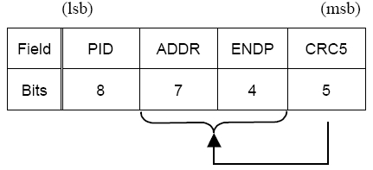
Packet (2)
Token Packet
=>ADDR & ENDP define an unique endpoint

Slide 62
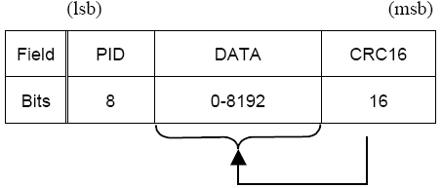
Packet (3)
Data Packet

Slide 63
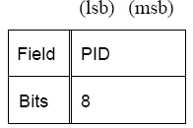
Packet (4)
Handshake Packet
=>Such as ACK 、NAK 、STALL…etc.

Slide 64
Conclusion
USB is powerful and easy to use
The complex host make the device easy to design

Slide 65
Reference
www.google.com
www.wikipedia.com
www.studymafia.org

Slide 66
Thanks

