Slide 1
DEPARTMENT OF COMPUTER SCIENCE AND ENGINEERING
Advance Computer Architecture
VI Sem CSE
UNIT-1,2
Seema Sharma
Assistant Professor-II
CSE

Slide 2
Computer Architecture
The architecture of a computer is the interface between the machine and the software.
Computer architecture is a specification detailing how a set of software and hardware technology standards interact to form a computer system or platform. In short, computer architecture refers to how a computer system is designed and what technologies it is compatible with.
Deals with the functional behavior of a computer system as viewed by programmer (like the size of a data type – 32 bits to an integer).
Logical aspects of system implementation as seen by the programmer.
E.g., instruction sets, instruction formats, data types, addressing modes.

Slide 3
Deals with structural relationships that are not visible to the programmer(like clock frequency or the size of the physical memory).
All physical aspects of computer systems, E.g. circuit design, control signals, memory types.
Design better programs, including system software such as compilers, operating systems, and device drivers.
Optimize program behavior.
Evaluate computer system performance. Understand time, space, and price tradeoffs
Critical interface between hardware and software
Standardizes instructions, machine language bit patterns, etc.

Slide 4


What is Computer Architecture?
Coordination of many levels of abstraction Under a rapidly changing set of forces Design, Measurement, and Evaluation
Application
Software
Operating System
Com
piler
Firmware
Instruction Set
Architecture
Instr. Set Proc.
I/O system
Datapath & Control
Control
Mem
ALU
I Reg
Digital Design _{I2}
Hardware
I1
O2
O1
Circuit Design
Vdd
O1
Bottom Up view
I1
Physical Design
Vdd
O1
2
I1

Slide 5




What You Will Learn In This Course
A Typical Computing Scenario
You will Learn:
How to design processor to run programs
Processor
Execution
Processor
Processor
locaa?cdheed
The memory hierarchy to supply instructions and data to the processor as quickly as possible
Computer Bus
Memory Array
?
The input and output of a computer system
H
D Con
troller
Hard Drive
HD Controller
HD Controller
Hard Drive
In-depth understanding of trade-offs at hardware- software boundary
Disp
lay Co
ntroller
Display Controller
Power Supply
Keyb
oard C
ontroller
Keyboard Controller
Prin
ter Co
ntroller
Experience with the design process of a complex (hardware) design
Network Controller
3

Slide 6
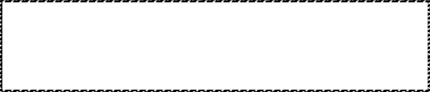
Layer of Representations
Program:
temp = v[k]; v[k] = v[k+1]; v[k+1] = temp;
High Level Language Program
Top down
Compiler
view
Assembly Program:
Assembly Language
Program
lw $15, | 0($2)
lw $16, | 4($2)
sw $16, | 0($2)
sw $15, | 4($2)
Assembler
Object machine code
Linker
Machine Language Program:
Executable machine code
Loader
0000 | 1001 | 1100 | 0110 | 1010 | 1111 | 0101 | 1000
1010 | 1111 | 0101 | 1000 | 0000 | 1001 | 1100 | 0110
1100 | 0110 | 1010 | 1111 | 0101 | 1000 | 0000 | 1001
0101 | 1000 | 0000 | 1001 | 1100 | 0110 | 1010 | 1111
Machine Language Program in Memory
Instruction
Set
Architecture
Machine Interpretation
Control Signal Specification
ALUOP[0:3] ⬅ InstReg[9:11] & MASK
4
Courtesy D. Patterson

Slide 7

Computer Architecture (Our Perspective)
Computer Architecture =
Instruction Set Architecture + Machine Organization
Instruction Set Architecture: the attributes of a [computing] system as seen by the programmer, i.e. the conceptual structure and functional behavior
Instruction Set
Instruction Formats
Data Types & Data Structures: Encodings & Representations
Modes of Addressing and Accessing Data Items and Instructions
Organization of Programmable Storage
Exceptional Conditions
7

Slide 8
Computer Architecture
Machine Organization: organization of the data flows and controls, the logic design, and the physical implementation.
Capabilities & Performance Characteristics of Principal Functional Unit (e.g., ALU)
Ways in which these components are interconnected
Information flows between components
Logic and means by which such information flow is controlled.
Choreography of Functional Units to realize the ISA
Register Transfer Level (RTL) Description
8

Slide 9
Advantage and Disadvantage
Advantage: Different implementations of the same architecture
Disadvantage: sometimes prevents using new innovations

Slide 10
Computer Architecture
Forces on Computer Architecture
Technology
Programming Languages
Applications
Computer Architecture
Operating Systems
History
10

Slide 11
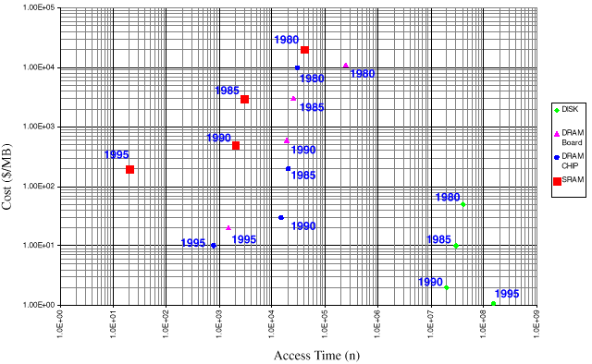
Memory Technology
DRAM capacity: DRAM speed: DRAM Cost/bit: Disk capacity:
about 60% per year (2x every 18 months) about 10% per year
about 25% per year about 60% per year
Prepared
by: Engr. Alzien S. Malonzo ⁹

Slide 12

How Technology Impacts Computer Architecture
Higher level of integration enables more complex architectures. Examples:
On-chip memory
Super scaler processors
Higher level of integration enables more application specific architectures (e.g., a variety of microcontrollers )
Larger logic capacity and higher performance allow more freedom in architecture trade-offs. Computer architects can focus more on what should be done rather than worrying about physical constraints
Lower cost generates a wider market. Profitability and
competition stimulates architecture innovations

Slide 13




Measurement and Evaluation
Architecture is an iterative process
-- searching the space of possible designs
Design
-- at all levels of computer systems
Analysis
Creativity
Cost / Performance Analysis
Good Ideas
Mediocre Ideas
Bad Ideas

Slide 14

Performance Analysis
Basic Performance Equation:
₌ Instructions
Cycles
Instructions
Seconds
Cycles
CPU time = ^{Seconds}
(execution time)
Program
Program
 | Instruction Count | Cycle Per Instruction* | Clock Rate
Program | X
Compiler | X | (X)
Instruction Set | X | X
Organization |  | X | X
Technology |  |  | X
*Note: Different instructions may take different number of clock cycles. Cycle Per
Instruction (CPI) is only an average and can be affected by application.

Slide 15
BRIEF HISTORY OF COMPUTER ARCHITECTURE
First Generation (1945-1958) Features
Vacuum tubes
¨ Machine code, Assembly language
¨ Computers contained a central processor that was
unique to that machine
¨ Different types of supported instructions, few machines could be considered "general purpose"
¨ Use of drum memory or magnetic core memory, programs and data are loaded using paper tape or punch cards
¨ 2 Kb memory, 10 KIPS

Slide 16
BRIEF HISTORY OF COMPUTER ARCHITECTURE
Two types of models for a computing machine:
¨ Harvard architecture - physically separate storage and signal pathways for instructions and data. (The term originated from the Harvard Mark I, relay-based computer, which stored instructions on punched tape and
data in relay latches.)
¨ Von Neumann architecture - a single storage structure to hold both the set of instructions and the data. Such machines are also known as stored-program computers.

Slide 17
BRIEF HISTORY OF COMPUTER ARCHITECTURE
Von Neumann bottleneck - the bandwidth, or the data transfer rate, between the CPU and memory is very small in comparison with the amount of memory.
NB: Modern high performance CPU chip designs incorporate aspects of both architectures. On chip cache memory is divided into an instruction cache and a data cache. Harvard architecture is used as the CPU accesses the cache and von Neumann architecture is used for off chip memory access.

Slide 18
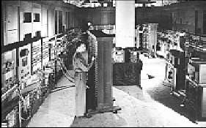
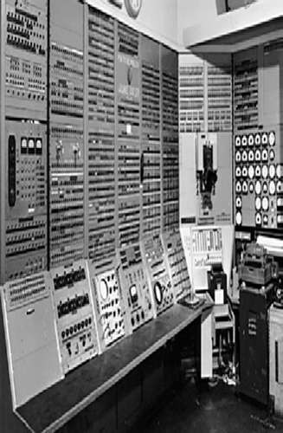
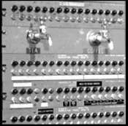
BRIEF HISTORY OF COMPUTER ARCHITECTURE
1943-46, ENIAC
1949, Whirlwind computer by Jay Forrester (MIT)

Slide 19
BRIEF HISTORY OF COMPUTER ARCHITECTURE
Second Generation (1958-1964)Features
¨ Transistors – small, low-power, low-cost, more reliable than vacuumtubes,
¨ Magnetic core memory
¨ Two's complement, floating point arithmetic
¨ Reduced the computational time from milliseconds to microseconds
¨ High level languages
¨ First operating Systems: handled one program at a time

Slide 20
BRIEF HISTORY OF COMPUTER ARCHITECTURE
1959 - IBM´s 7000 series mainframes were the company´s first transistorized computers.
IBM 7090 is the most powerful data processing system at that time. The fullytransistorized system has computing speeds six times faster than those of its vacuum-tube predecessor, the IBM 709. Although the IBM 7090 is a general purpose data processing system, it is designed with special attention to the needs of
the design of missiles, jet engines, nuclear reactors and supersonic aircraft.

Slide 21
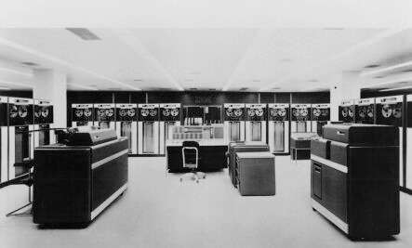
BRIEF HISTORY OF COMPUTER ARCHITECTURE
IBM 7090 Basic Cycle Time: 2.18 μSecs

Slide 22
BRIEF HISTORY OF COMPUTER ARCHITECTURE
Third Generation (1964-1974) Features
¨ Introduction of integrated circuits combining thousands of transistor son a single chip
¨ Semiconductor memory
¨ Timesharing, graphics, structured programming
¨ 2 Mb memory, 5 MIPS
¨ Use of cache memory
¨ IBM’s System 360 - the first family of computers making a clear distinction between architecture and implementation

Slide 23
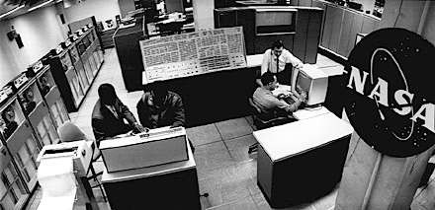
BRIEF HISTORY OF COMPUTER ARCHITECTURE
The IBM System/360 Model 91 was introduced in 1966 as the fastest, most powerful computer then in use. It was specifically designed to handle high-speed data processing for scientific applications such as space exploration, theoretical astronomy, subatomic physics and global weather forecasting.

Slide 24
BRIEF HISTORY OF COMPUTER ARCHITECTURE
Fourth Generation (1974-present) Features
¨ Introduction of Very Large-Scale Integration (VLSI)/Ultra Large Scale Integration (ULSI) - combines millions of transistors
¨ Single-chip processor and the single-board computer emerged
¨ Smallest in size because of the high component density
¨ Creation of the Personal Computer (PC)
¨ Wide spread use of data communications
¨ Object-Oriented programming: Objects & operations on objects
¨ Artificial intelligence: Functions & logic predicates

Slide 25
BRIEF HISTORY OF COMPUTER ARCHITECTURE
1971 - The 4004 was the world's first universal microprocessor,invented by Federico Faggin, Ted Hoff, and Stan Mazor.
With just over 2,300 MOS transistors in an area of only 3 by 4 millimeters had as much power as the ENIAC.

Slide 26
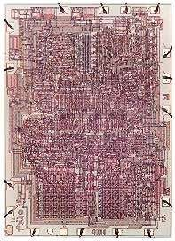
BRIEF HISTORY OF COMPUTER ARCHITECTURE
4-bit CPU
1K data memory and 4K program memory clock rate: 740kHz
Just a few years later, the word size of the 4004 was doubled to form the 8008.

Slide 27
BRIEF HISTORY OF COMPUTER ARCHITECTURE
1974 – 1977 the first personal computers – introduced on the market as kits (major assembly required).
¨ Scelbi (SCientific, ELectronic and BIological) and designed by the Scelbi Computer Consulting
Company, based on Intel's 8008 microprocessor, with 1K of programmable memory, Scelbi sold for $565 and came, with an additional 15K of memory available for
$2760.
¨ Mark-8 (also Intel 8008 based) designed by Jonathan Titus.

Slide 28
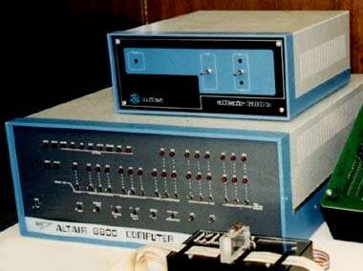
BRIEF HISTORY OF COMPUTER ARCHITECTURE
Altair (based on the the new Intel 8080 microprocessor), built by MITS (Micro Instrumentation Telemetry Systems). The computer kit contained an 8080 CPU, a 256 Byte RAM card, and a new Altair
Bus design for the price of $400.

Slide 29
BRIEF HISTORY OF COMPUTER ARCHITECTURE
1976 - Steve Wozniak and Steve Jobs released the Apple I computer and started Apple Computers. The Apple I was the first single circuit board computer. It came with a video interface, 8k of RAM and a keyboard. The system incorporated some economical components, including the 6502 processor (only $25 dollars - designed by Rockwell and produced by MOS Technologies) and dynamic RAM.
1977 - Apple II computer model was released, also based on the 6502 processor, but it had color graphics (a first for a personal computer), and used an audio cassette drive for storage. Its original configuration came with 4 kb of RAM, but a year later this was increased to 48 kb of RAM and the cassette drive was replaced by a floppy disk drive.

Slide 30
BRIEF HISTORY OF COMPUTER ARCHITECTURE
1977 - Commodore PET (Personal Electronic Transactor) was designed by Chuck Peddle, ran also on the 6502 chip, but at half the price of the Apple II. It included 4 kb of RAM, monochrome graphics and an audio cassette drive for data storage.
1981 - IBM released their new computer IBM PC which ran on a 4.77 MHz Intel 8088 microprocessor and equipped with 16 kilobytes of memory, expandable to 256k. The PC came with one or two 160k floppy disk drives and an optional color monitor.

Slide 31
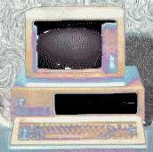
BRIEF HISTORY OF COMPUTER ARCHITECTURE
first one built from off the shelf parts (called open architecture) and marketed by outside distributors

Slide 32
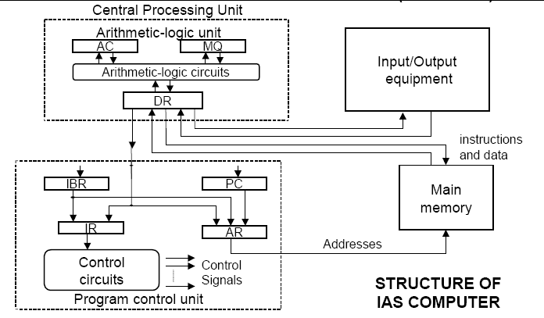
BRIEF HISTORY OF COMPUTER ARCHITECTURE
First Generation (1945-1958)

Slide 33
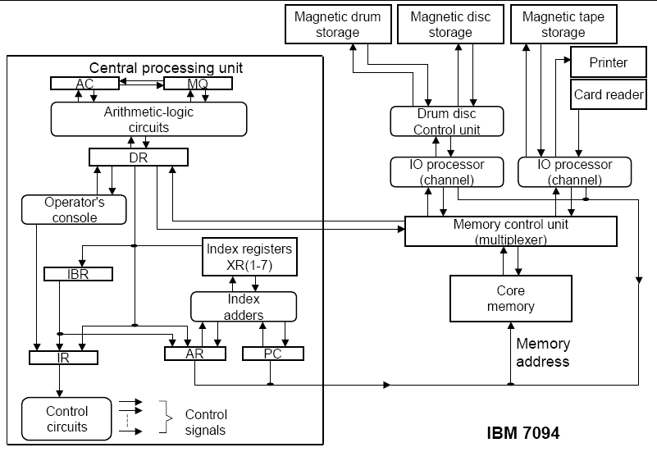
BRIEF HISTORY OF COMPUTER ARCHITECTURE
Second Generation (1958-1964)

Slide 34
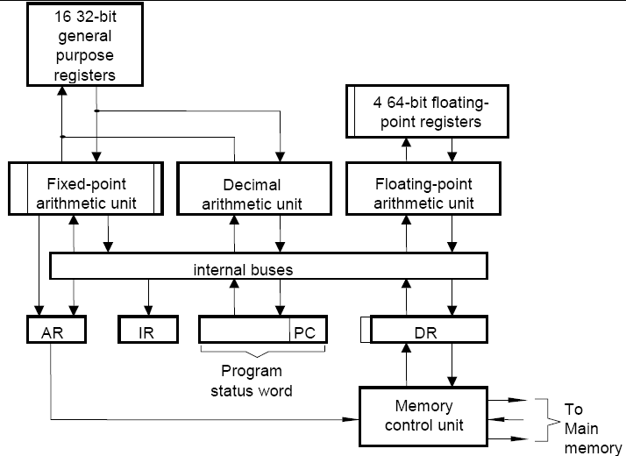
BRIEF HISTORY OF COMPUTER ARCHITECTURE
Third Generation (1964-1974)

Slide 35
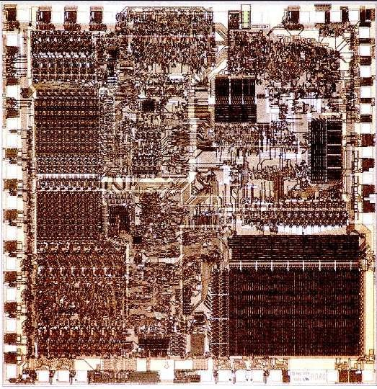
BRIEF HISTORY OF COMPUTER ARCHITECTURE
1974-present
Intel 8080
¨ 8-bit Data
¨ 16-bit Address
¨ 6 μm NMOS
¨ 6K Transistors
¨ 2 MHz
¨ 1974

Slide 36
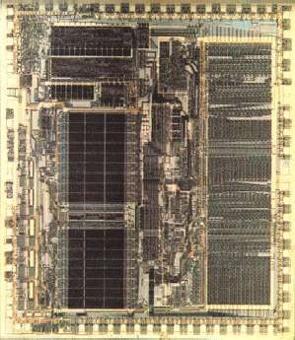
BRIEF HISTORY OF COMPUTER ARCHITECTURE
Motorola 68000
¨ 32 bit architecture internally, but 16 bit data bus
¨ 16 32-bit registers, 8 data and 8 address registers
¨ 2 stage pipeline
¨ no vertual memory support
¨ 68020 was fully 32 bit externally
¨ 1979

Slide 37
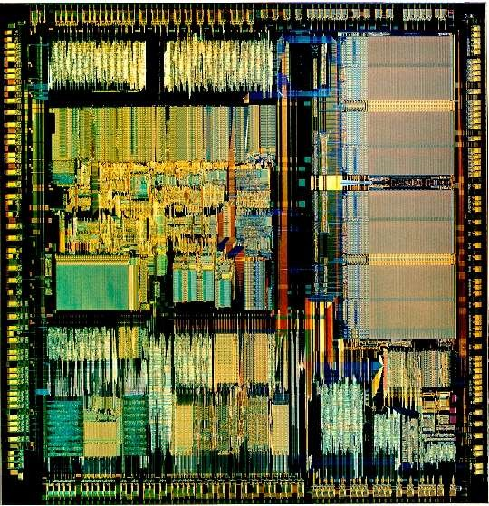
BRIEF HISTORY OF COMPUTER ARCHITECTURE
Intel386 CPU
¨ 32-bit Data
¨ improved addressing
¨ security modes (kernal, system services, application services, applications)
¨ 1985

Slide 38
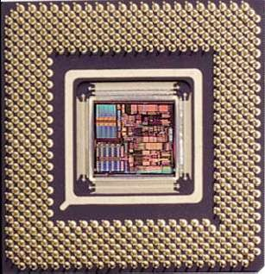
BRIEF HISTORY OF COMPUTER ARCHITECTURE
1974-present Alpha 21264
¨ 64-bit Address/Data
¨ Superscalar
¨ Out-of-Order Execution
¨ 256 TLB entries
¨ 128KB Cache
¨ Adaptive Branch Prediction
¨ 0.35 μm CMOS Process
¨ 15.2M Transistors
¨ 600 MHz

Slide 39
Examples
Examples Intel
(versions)
Introduced in
(8086, 80386, Pentium, ...)
1978
1985
1986
1986
1987
1992
1993
IBM Power (Power 2, 3, 4, 5) HP PA-RISC (v1.1, v2.0)
MIPS
Sun Sparc
(MIPS I, II, III, IV, V) (v8, v9)
Digital Alpha(v1, v3)
PowerPC (601, 604, …)

Slide 40
Chapter 2 Unit -2 Instruction Set Principles

Slide 41
Computer Architecture’s Changing Definition
1950s to 1960s: Computer Architecture Course = Computer Arithmetic
1970s to mid 1980s: Computer Architecture Course = Instruction Set Design, especially ISA appropriate for compilers
1990s: Computer Architecture Course = Design of CPU, memory system, I/O system, Multiprocessors

Slide 42
Instruction Set Architecture (ISA)
software
instruction set
hardware

Slide 43
Instruction Set Architecture (ISA)
Application (iTunes)
Operating
software
instruction set
hardware
Compiler
System
Assembler
(Mac OS X)
Processor Memory
I/O system
Datapath & Control
Digital Design Circuit Design Transistors

Slide 44
Instruction Set Architecture
Instruction set architecture is the structure of a computer that a machine language programmer must understand to write a correct (timing independent) program for that machine.
The instruction set architecture is also the machine description that a hardware designer must understand to design a correct implementation of the computer.

Slide 45
Interface Design
A good interface:
Lasts through many implementations (portability, compatibility)
Is used in many different ways (generality)
Provides convenient functionality to higher levels
Permits an efficient implementation at lower levels
use
imp 1
time
Interface
use
imp 2
use
imp 3

Slide 46
Evolution of Instruction Sets
Single Accumulator (EDSAC 1950)
Accumulator + Index Registers
(Manchester Mark I, IBM 700 series 1953)
Separation of Programming Model
from Implementation
High-level Language Based
Concept of a Family
(B5000 1963)
(IBM 360 1964)
General Purpose Register Machines
Complex Instruction Sets
Load/Store Architecture
(Vax, Intel 432 1977-80)
(CDC 6600, Cray 1 1963-76)
RISC
(Mips,Sparc,HP-PA,IBM RS6000,PowerPC . . .1987)
LIW/”EPIC”?
(IA-64. . .1999)

Slide 47
Evolution of Instruction Sets
Major advances in computer architecture are typically associated with landmark instruction set designs
Ex: Stack vs GPR (System 360)
Design decisions must take into account:
technology
machine organization
programming languages
compiler technology
operating systems
And they in turn influence these

Slide 48
What Are the Components of an ISA?
Sometimes known as The Programmer’s Model of the machine
Storage cells
General and special purpose registers in the CPU
Many general purpose cells of same size in memory
Storage associated with I/O devices
The machine instruction set
The instruction set is the entire repertoire of machine operations
Makes use of storage cells, formats, and results of the fetch/execute cycle
i.e., register transfers

Slide 49
What Are the Components of an ISA?
The instruction format
Size and meaning of fields within the instruction
The nature of the fetch-execute cycle
Things that are done before the operation code is known

Slide 50
What Must an Instruction Specify?(I)
Data Flow
Which operation to perform add r0, r1, r3
Ans: Op code: add, load, branch, etc.
Where to find the operands: add r0, r1, r3
In CPU registers, memory cells, I/O locations, or part of instruction
Place to store result add r0, r1, r3
Again CPU register or memory cell

Slide 51
What Must an Instruction Specify?(II)
Location of next instruction add r0, r1, r3 br endloop
Almost always memory cell pointed to by program counter—PC
Sometimes there is no operand, or no result, or no next instruction. Can you think of examples?

Slide 52
Instructions Can Be Divided into 3 Classes (I)
Data movement instructions
Move data from a memory location or register to another memory location or register without changing its form
Load—source is memory and destination is register
Store—source is register and destination is memory
Arithmetic and logic (ALU) instructions
Change the form of one or more operands to produce a result stored in another location
Add, Sub, Shift, etc.
Branch instructions (control flow instructions)
Alter the normal flow of control from executing the next instruction in sequence
Br Loc, Brz Loc2,—unconditional or conditional branches

Slide 53
Classifying ISAs
Accumulator (before 1960):
1 address add A acc <− acc + mem[A]
Stack (1960s to 1970s):
0 address add tos <− tos + next
Memory-Memory (1970s to 1980s):
2 address add A, B mem[A] <− mem[A] + mem[B]
3 address add A, B, C mem[A] <− mem[B] + mem[C]
Register-Memory (1970s to present):
2 address add R1, A R1 <− R1 + mem[A]
load R1, A R1 <_ mem[A]
Register-Register (Load/Store) (1960s to present):
3 address add R1, R2, R3 R1 <− R2 + R3
load R1, R2 R1 <− mem[R2]
store R1, R2 mem[R1] <− R2

Slide 54
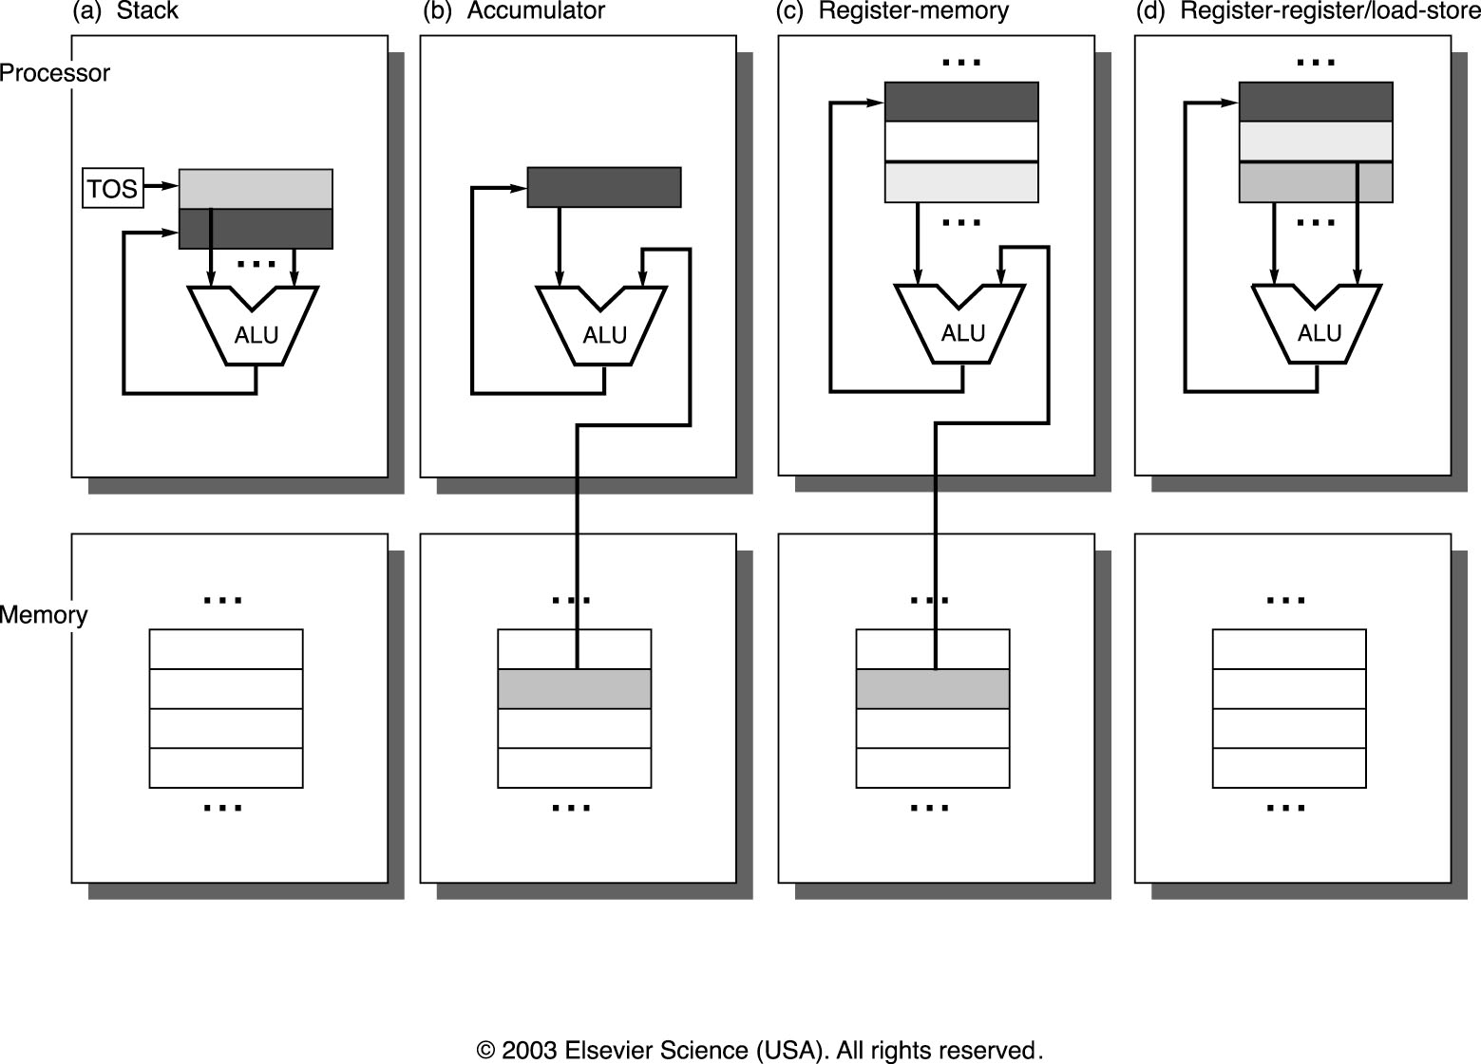
Classifying ISAs

Slide 55
Stack Architectures
Instruction set:
add, sub, mult, div, . . .
push A, pop A
Example: A*B - (A+C*B)
push A
push B
mul
push A
push C
push B
mul
add
sub
A
B
A*B
A
C
B
B*C
A+B*C
result
A
A*B
A
C
A
A*B
A*B
A
A*B
A*B

Slide 56
Stacks: Pros and Cons
Pros
Good code density (implicit operand addressing→ top of stack)
Low hardware requirements
Easy to write a simpler compiler for stack architectures
Cons
Stack becomes the bottleneck
Little ability for parallelism or pipelining
Data is not always at the top of stack when need, so additional instructions like TOP and SWAP are needed
Difficult to write an optimizing compiler for stack architectures

Slide 57
Accumulator Architectures
Instruction set:
add A, sub A, mult A, div A, . . .
load A, store A
Example: A*B - (A+C*B)
load B
mul C
add A
store D
load A
mul B
sub D
B
B*C
A+B*C
A+B*C
A
A*B
result

Slide 58
Accumulators: Pros and Cons
Pros
Very low hardware requirements
Easy to design and understand
Cons
Accumulator becomes the bottleneck
Little ability for parallelism or pipelining
High memory traffic

Slide 59
Memory-Memory Architectures
Instruction set:
(3 operands) add A, B, C sub A, B, C mul A, B, C
Example: A*B - (A+C*B)
3 operands
mul D, A, B
mul E, C, B
add E, A, E
sub E, D, E

Slide 60
Memory-Memory: Pros and Cons
Pros
Requires fewer instructions (especially if 3 operands)
Easy to write compilers for (especially if 3 operands)
Cons
Very high memory traffic (especially if 3 operands)
Variable number of clocks per instruction (especially if 2 operands)
With two operands, more data movements are required

Slide 61
Register-Memory Architectures
Instruction set:
add R1, A sub R1, A mul R1, B
load R1, A store R1, A
Example: A*B - (A+C*B)
load R1, A
mul R1, B /* A*B */
store R1, D
load R2, C
mul R2, B /* C*B */
add R2, A /* A + CB */
sub R2, D /* AB - (A + C*B) */

Slide 62
Memory-Register: Pros and Cons
Pros
Some data can be accessed without loading first
Instruction format easy to encode
Good code density
Cons
Operands are not equivalent (poor orthogonality)
Variable number of clocks per instruction
May limit number of registers

Slide 63
Load-Store Architectures
Instruction set:
add R1, R2, R3 sub R1, R2, R3 mul R1, R2, R3
load R1, R4 store R1, R4
Example: A*B - (A+C*B)
load R1, &A
load R2, &B
load R3, &C
load R4, R1
load R5, R2
load R6, R3
mul R7, R6, R5 /* C*B */
add R8, R7, R4 /* A + C*B */
mul R9, R4, R5 /* A*B */
sub R10, R9, R8 /* A*B - (A+C*B) */

Slide 64
Load-Store: Pros and Cons
Pros
Simple, fixed length instruction encoding
Instructions take similar number of cycles
Relatively easy to pipeline
Cons
Higher instruction count
Not all instructions need three operands
Dependent on good compiler

Slide 65
Registers: Advantages and Disadvantages
Advantages
Faster than cache (no addressing mode or tags)
Deterministic (no misses)
Can replicate (multiple read ports)
Short identifier (typically 3 to 8 bits)
Reduce memory traffic
Disadvantages
Need to save and restore on procedure calls and context switch
Can’t take the address of a register (for pointers)
Fixed size (can’t store strings or structures efficiently)
Compiler must manage

Slide 66
General Register Machine and Instruction Formats
C
P
U
I
n
s
t
r
u
c
t
i
o
n
f
o
r
m
a
t
R
s
e
g
i
s
t
e
r
M
s
e
m
o
r
y
l
o
a
d
R
8
,
O
p
1
(
R
8
ฌ
O
p
1
l
)
o
a
d
R
O
8
p
1
A
d
d
r
:
O
p
1
l
o
a
d
R
8
O
p
1
A
d
d
r
R
6
R
4
a
d
d
R
2
,
R
4
,
R
6
(
R
2
ฌ
R
4
+
R
6
)
a
d
d
R
2
R
4
R
R
6
2
P
r
o
g
r
a
N
m
e
x
t
i
c
o
u
n
t
e
r

Slide 67
General Register Machine and Instruction Formats
It is the most common choice in today’s general-purpose computers
Which register is specified by small “address” (3 to 6 bits for 8 to 64 registers)
Load and store have one long & one short address: One and half addresses
Arithmetic instruction has 3 “half” addresses

Slide 68
Real Machines Are Not So Simple
Most real machines have a mixture of 3, 2, 1, 0, and 1- address instructions
A distinction can be made on whether arithmetic instructions use data from memory
If ALU instructions only use registers for operands and result, machine type is load-store
Only load and store instructions reference memory
Other machines have a mix of register-memory and memory-memory instructions

Slide 69
Alignment Issues
If the architecture does not restrict memory accesses to be aligned then
Software is simple
Hardware must detect misalignment and make 2 memory accesses
Expensive detection logic is required
All references can be made slower
Sometimes unrestricted alignment is required for backwards compatibility
If the architecture restricts memory accesses to be aligned then
Software must guarantee alignment
Hardware detects misalignment access and traps
No extra time is spent when data is aligned
Since we want to make the common case fast, having restricted alignment is often a better choice, unless compatibility is an issue

Slide 70
Types of Addressing Modes (VAX)
memory
1. Register direct Ri
2. Immediate (literal) #n
3. Displacement M[Ri + #n]
4. Register indirect M[Ri]
5. Indexed M[Ri + Rj]
6. Direct (absolute) M[#n]
7. Memory Indirect M[M[Ri] ]
8. Autoincrement M[Ri++]
9. Autodecrement M[Ri - -]
10. Scaled M[Ri + Rj*d + #n]
reg. file

Slide 71
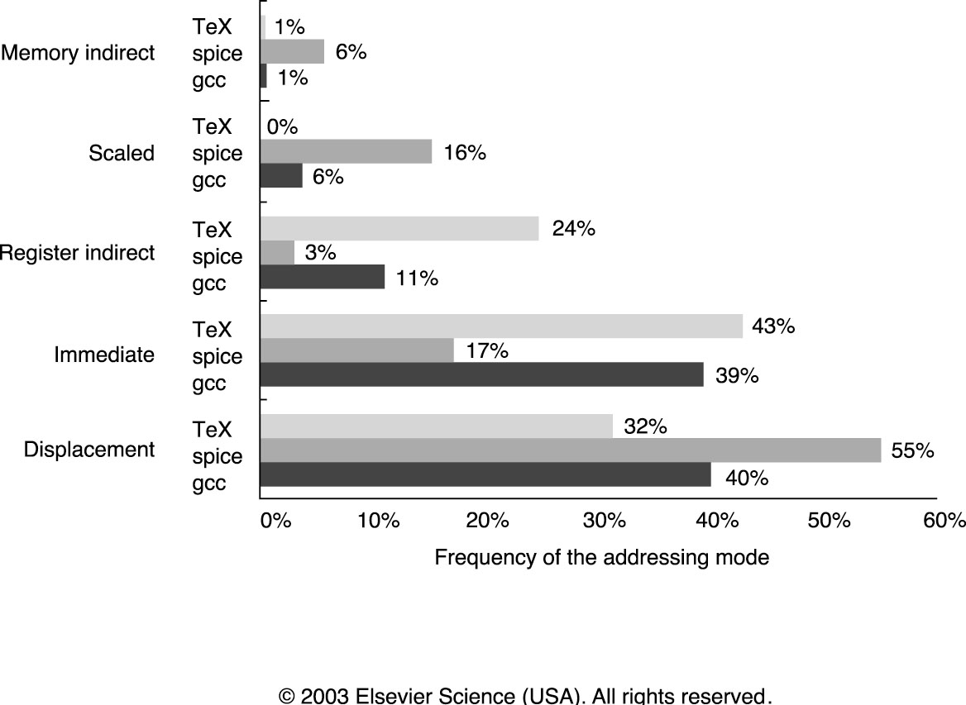
Summary of Use of Addressing Modes

Slide 72
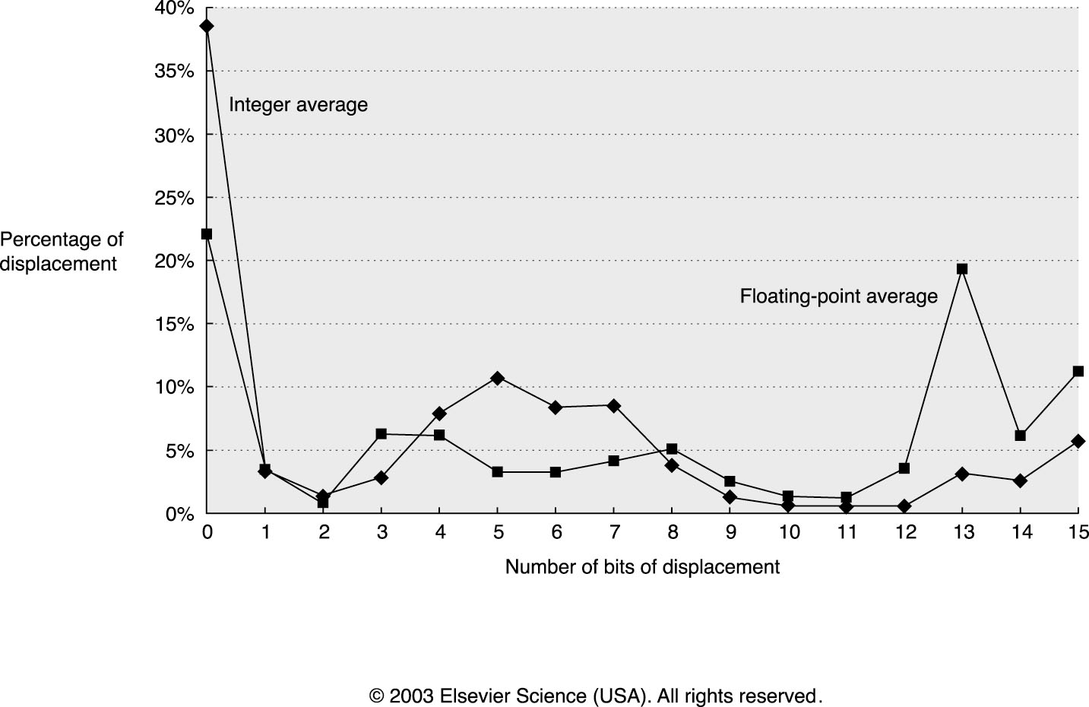
Distribution of Displacement Values

Slide 73
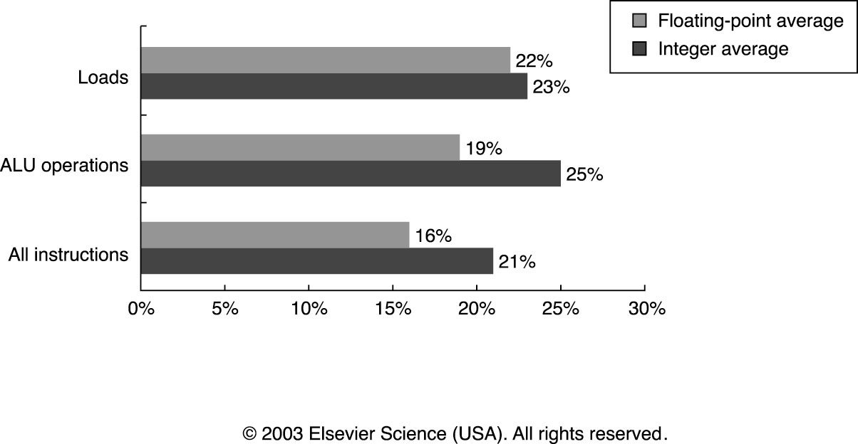
Frequency of Immediate Operands

Slide 74
Types of Operations
Arithmetic and Logic: AND, ADD
Data Transfer: MOVE, LOAD, STORE
Control BRANCH, JUMP, CALL
System OS CALL, VM
Floating Point ADDF, MULF, DIVF
Decimal ADDD, CONVERT
String MOVE, COMPARE
Graphics (DE)COMPRESS

Slide 75
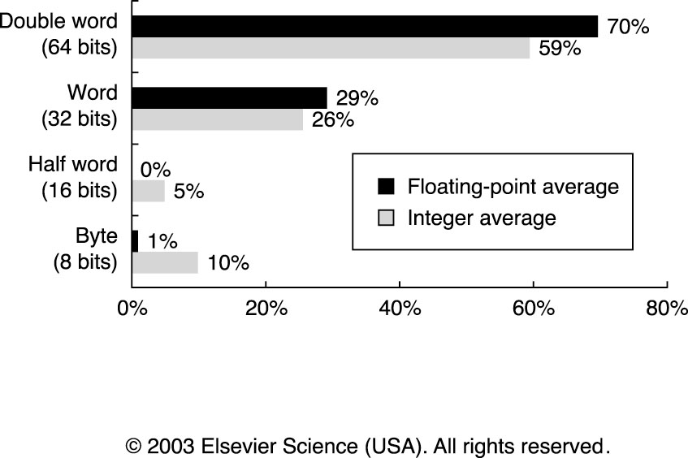
Distribution of Data Accesses by Size

Slide 76
80x86 Instruction Frequency (SPECint92, Fig. 2.16)

Slide 77
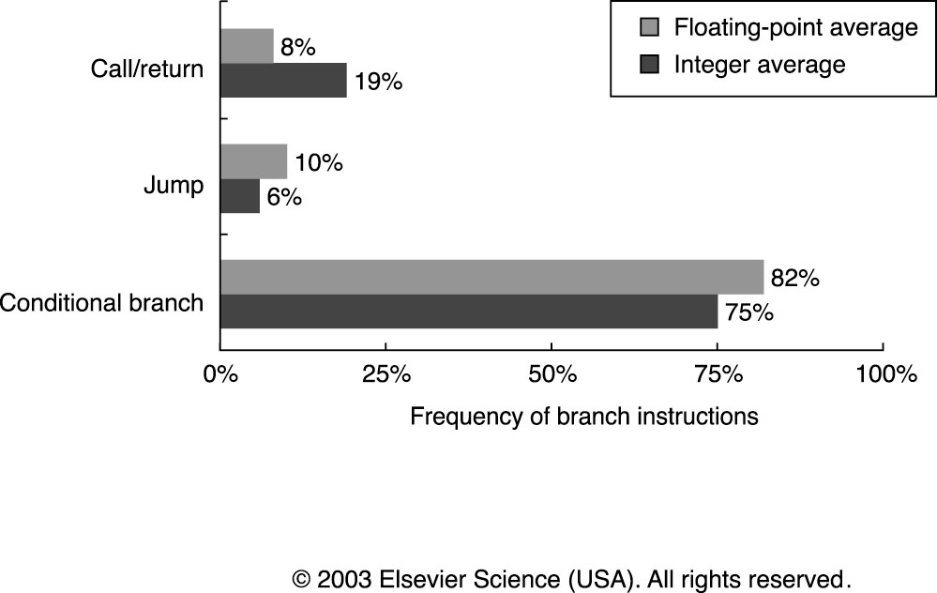
Relative Frequency of Control Instructions

Slide 78
Control instructions (contd.)
Addressing modes
PC-relative addressing (independent of program load & displacements are close by)
Requires displacement (how many bits?)
Determined via empirical study. [8-16 works!]
For procedure returns/indirect jumps/kernel traps, target may not be known at compile time.
Jump based on contents of register
Useful for switch/(virtual) functions/function ptrs/dynamically linked libraries etc.

Slide 79
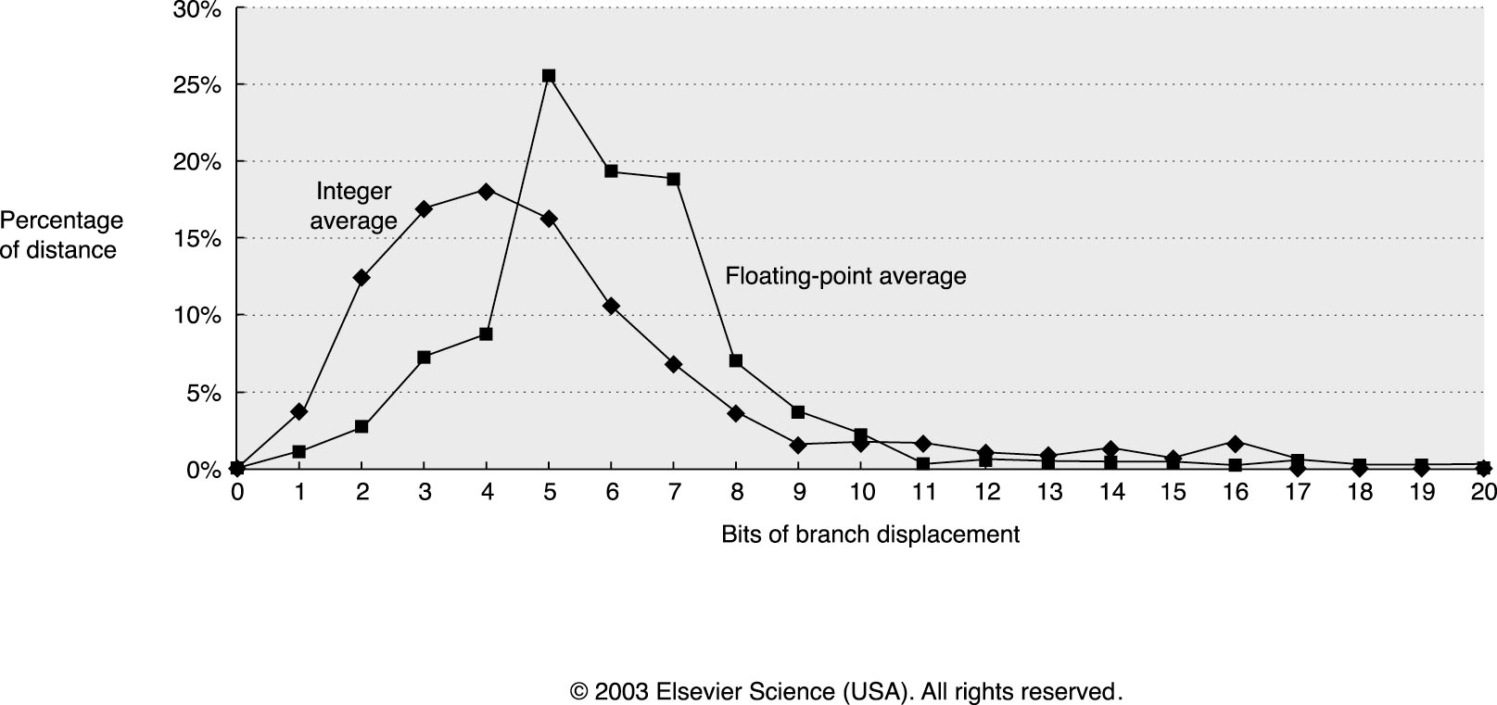
Branch Distances (in terms of number of instructions)

Slide 80
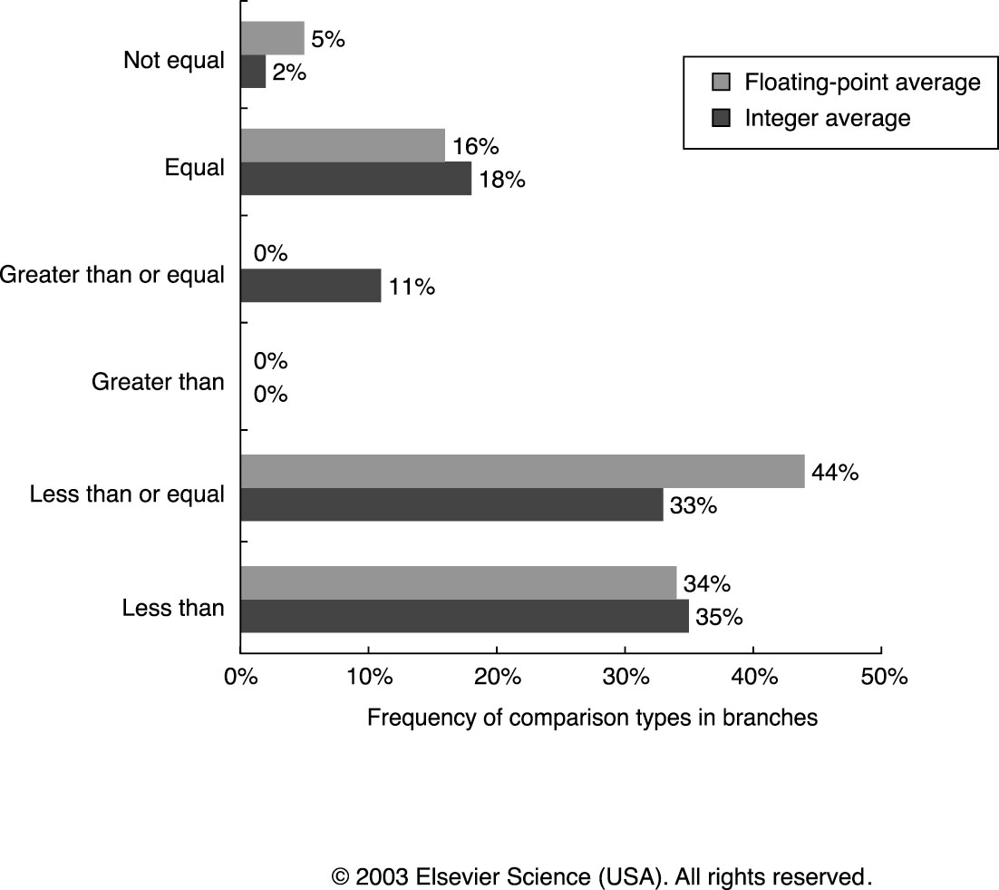
Frequency of Different Types of Compares in Conditional Branches

Slide 81
Encoding an Instruction set
a desire to have as many registers and addressing mode as possible
the impact of size of register and addressing mode fields on the average instruction size and hence on the average program size
a desire to have instruction encode into lengths that will be easy to handle in the implementation

Slide 82
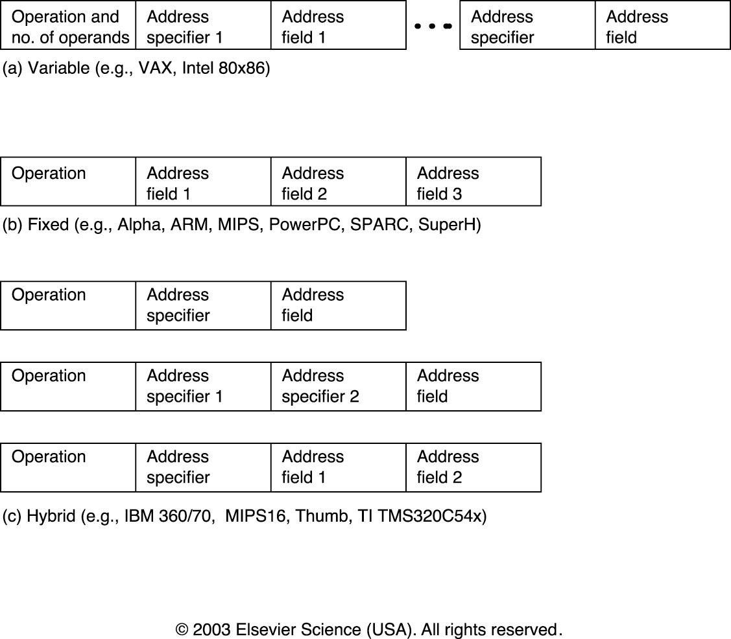
Three choice for encoding the instruction set

Slide 83
Compilers and ISA
Compiler Goals
All correct programs compile correctly
Most compiled programs execute quickly
Most programs compile quickly
Achieve small code size
Provide debugging support
Multiple Source Compilers
Same compiler can compiler different languages
Multiple Target Compilers
Same compiler can generate code for different machines

Slide 84
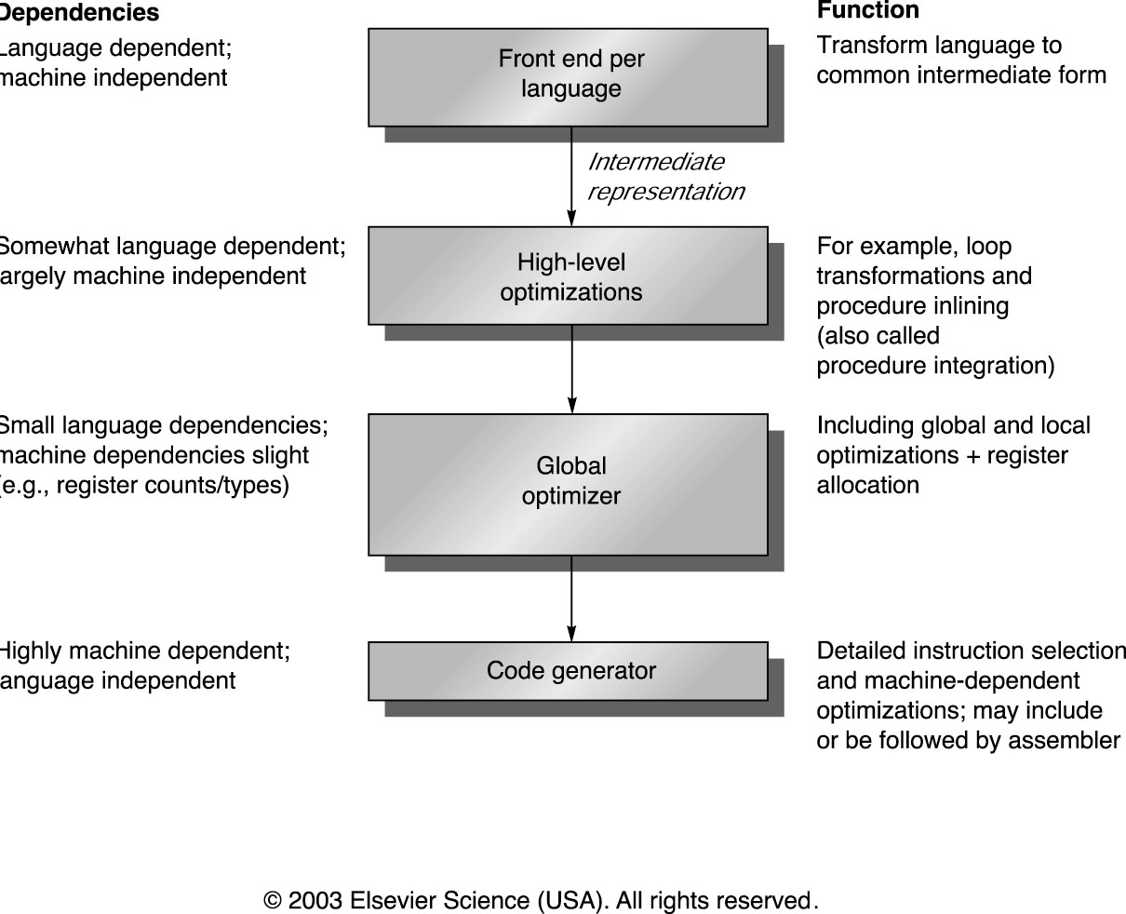
Compilers Phases

Slide 85
Compiler Based Register Optimization
Assume small number of registers (16-32)
Optimizing use is up to compiler
HLL programs have no explicit references to registers
usually – is this always true?
Assign symbolic or virtual register to each candidate variable
Map (unlimited) symbolic registers to real registers
Symbolic registers that do not overlap can share real registers
If you run out of real registers some variables use memory

Slide 86
Allocation of Variables
Stack
used to allocate local variables
grown and shrunk on procedure calls and returns
register allocation works best for stack-allocated objects
Global data area
used to allocate global variables and constants
many of these objects are arrays or large data structures
impossible to allocate to registers if they are aliased
Heap
used to allocate dynamic objects
heap objects are accessed with pointers
never allocated to registers

Slide 87
Designing ISA to Improve Compilation
Provide enough general purpose registers to ease register allocation ( more than 16).
Provide regular instruction sets by keeping the operations, data types, and addressing modes orthogonal.
Provide primitive constructs rather than trying to map to a high-level language.
Simplify trade-off among alternatives.
Allow compilers to help make the common case fast.

Slide 88
ISA Metrics
Orthogonality
No special registers, few special cases, all operand modes available with any data type or instruction type
Completeness
Support for a wide range of operations and target applications
Regularity
No overloading for the meanings of instruction fields
Streamlined Design
Resource needs easily determined. Simplify tradeoffs.
Ease of compilation (programming?), Ease of implementation, Scalability

Slide 89
Quick Review of Design Space of ISA
Five Primary Dimensions
Number of explicit operands ( 0, 1, 2, 3 )
Operand Storage Where besides memory?
Effective Address How is memory location specified?
Type & Size of Operands byte, int, float, vector, . . .
How is it specified?
Operations add, sub, mul, . . .
How is it specifed?
Other Aspects
Successor How is it specified?
Conditions How are they determined?
Encodings Fixed or variable? Wide?
Parallelism

Slide 90
ISA Metrics
Aesthetics:
Orthogonality
No special registers, few special cases, all operand modes available with any data type or instruction type
Completeness
Support for a wide range of operations and target applications
Regularity
No overloading for the meanings of instruction fields
Streamlined
Resource needs easily determined
Ease of compilation (programming?)
Ease of implementation
Scalability

Slide 91
MIPS data types
Bytes
characters
Half-words
Short ints, OS related data-structures
Words
Single FP, Integers
Doublewords
Double FP, Long Integers (in some implementations)

Slide 92
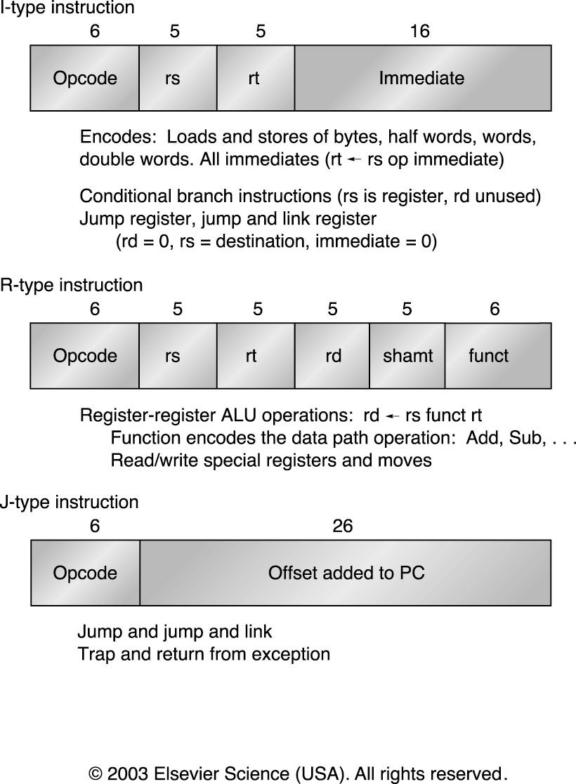
Instruction Layout for MIPS

Slide 93
MIPS (32 bit instructions)
1. Register-Register
31
26
25
21
20
16
15
11
10
6
5
0
Op
Rs1
Rs2
Rd
Opx
2a. Register-Immediate
31
26
25
21
20
16
15
0
Op
Rs1
Rd
Immediate
2b. Branch (displacement)
31
26
25
21
20
16
15
0
Op
Rs1
Rs2/Opx
Displacement
3. Jump / Call
31
26
25
0
Op
target

Slide 94
MIPS (addressing modes)
Register direct
Displacement
Immediate
Byte addressable & 64 bit address
R0 ← always contains value 0
Displacement = 0→ register indirect
R0 + Displacement=0 → absolute addressing

Slide 95
Types of Operations
Loads and Stores
ALU operations
Floating point operations
Branches and Jumps (control-related)

