Slide 1
DEPARTMENT OF COMPUTER SCIENCE AND ENGINEERING
Advance Computer Architecture
VI Sem CSE
UNIT-3,4
Seema Sharma
Assistant Professor-II
CSE

Slide 2

UNIT - 3

Slide 3
Arithmetic & Logic Unit (ALU)
Part of the computer that actually performs arithmetic and logical operations on data
All of the other elements of the computer system are there mainly to bring data into the ALU for it to process and then to take the results back out
Based on the use of simple digital logic devices that can store binary digits and perform simple Boolean logic operations
Notes:
The ALU is that part of the computer that actually performs arithmetic and logical
operations on data. All of the other elements of the computer system—control unit,
registers, memory, I/O—are there mainly to bring data into the ALU for it to process
and then to take the results back out. We have, in a sense, reached the core or
essence of a computer when we consider the ALU.
An ALU and, indeed, all electronic components in the computer are based on
the use of simple digital logic devices that can store binary digits and perform simple
Boolean logic operations.

Slide 4
Arithmetic & Logic Unit
Does the calculations
Everything else in the computer is there to service this unit
Handles integers
May handle floating point (real) numbers
May be separate FPU (maths co-processor)
May be on chip separate FPU (486DX +)

Slide 5
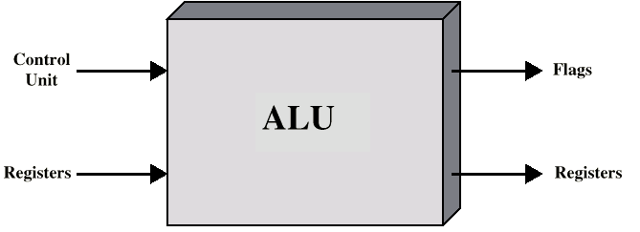
ALU Inputs and Outputs

Slide 6
Integer Representation
Only have 0 & 1 to represent everything
Positive numbers stored in binary
e.g. 41=00101001
No minus sign
No period
Sign-Magnitude
Two’s compliment

Slide 7
Sign-Magnitude
Left most bit is sign bit
0 means positive
1 means negative
+18 = 00010010
-18 = 10010010
Problems
Need to consider both sign and magnitude in arithmetic
Two representations of zero (+0 and -0)

Slide 8
Two’s Compliment
+3 = 00000011
+2 = 00000010
+1 = 00000001
+0 = 00000000
-1 = 11111111
-2 = 11111110
-3 = 11111101

Slide 9
Benefits
One representation of zero
Arithmetic works easily (see later)
Negating is fairly easy
3 = 00000011
Boolean complement gives 11111100
Add 1 to LSB 11111101

Slide 10
Negation Special Case 1
0 = 00000000
Bitwise not 11111111
Add 1 to LSB +1
Result 1 00000000
Overflow is ignored, so:
- 0 = 0 √

Slide 11
Negation Special Case 2
-128 = 10000000
bitwise not 01111111
Add 1 to LSB +1
Result 10000000
So:
-(-128) = -128 X
Monitor MSB (sign bit)
It should change during negation

Slide 12
Range of Numbers
8 bit 2s compliment
+127 = 01111111 = 2⁷ -1
-128 = 10000000 = -2⁷
16 bit 2s compliment
+32767 = 011111111 11111111 = 2¹⁵ - 1
-32768 = 100000000 00000000 = -2¹⁵

Slide 13
Conversion Between Lengths
Positive number pack with leading zeros
+18 = 00010010
+18 = 00000000 00010010
Negative numbers pack with leading ones
-18 = 10010010
-18 = 11111111 10010010
i.e. pack with MSB (sign bit)

Slide 14
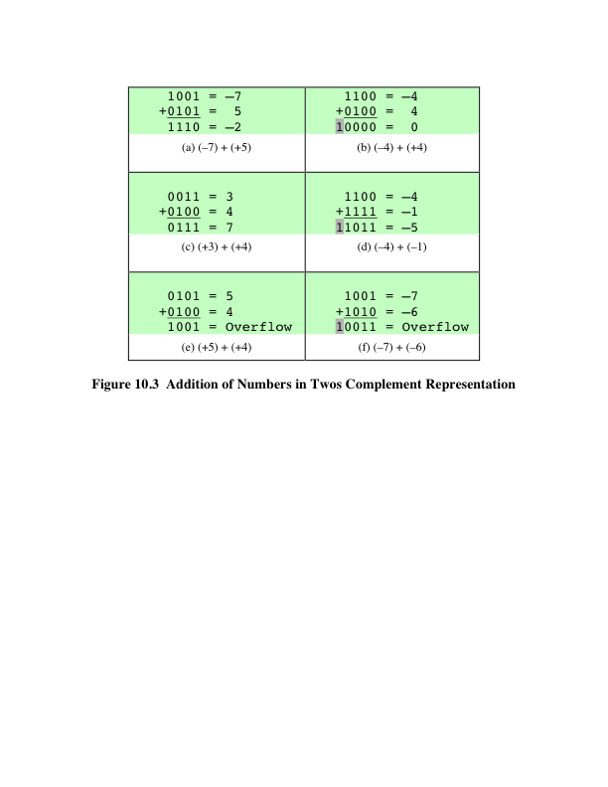
Addition
Notes:
Addition in twos complement is illustrated in Figure 10.3. Addition proceeds as if
the two numbers were unsigned integers. The first four examples illustrate successful
operations. If the result of the operation is positive, we get a positive number
in twos complement form, which is the same as in unsigned-integer form. If the
result of the operation is negative, we get a negative number in twos complement
form. Note that, in some instances, there is a carry bit beyond the end of the word
(indicated by shading), which is ignored.

Slide 15
OVERFLOW RULE:
If two numbers are added, and they are both positive or both negative, then overflow occurs if and only if the result has the opposite sign.
Notes:
On any addition, the result may be larger than can be held in the word size
being used. This condition is called overflow. When overflow occurs, the ALU must
signal this fact so that no attempt is made to use the result.
Figures 10.3e and f show examples of overflow. Note that overflow can occur
whether or not there is a carry.

Slide 16
SUBTRACTION RULE:
To subtract one number (subtrahend) from another (minuend), take the twos complement (negation) of the subtrahend and add it
to the minuend.
Notes:
Subtraction rule.

Slide 17
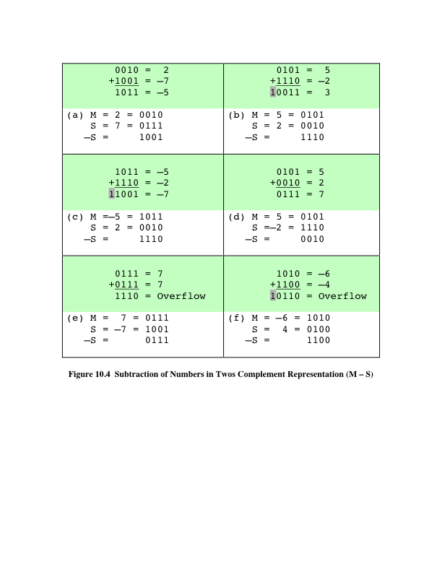
Subtraction
Notes:
Thus, subtraction is achieved using addition, as illustrated in Figure 10.4. The
last two examples demonstrate that the overflow rule still applies.

Slide 18
Addition and Subtraction
Normal binary addition
Monitor sign bit for overflow
Take twos compliment of substahend and add to minuend
i.e. a - b = a + (-b)
So we only need addition and complement circuits

Slide 19
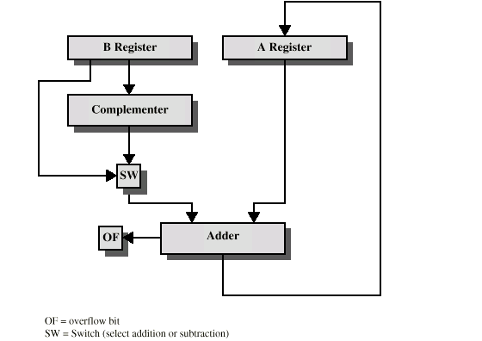
Hardware for Addition and Subtraction

Slide 20
Multiplication
Complex
Work out partial product for each digit
Take care with place value (column)
Add partial products

Slide 21
Multiplication Example
1011 Multiplicand (11 dec)
x 1101 Multiplier (13 dec)
1011 Partial products
0000 Note: if multiplier bit is 1 copy
1011 multiplicand (place value)
1011 otherwise zero
10001111 Product (143 dec)
Note: need double length result

Slide 22
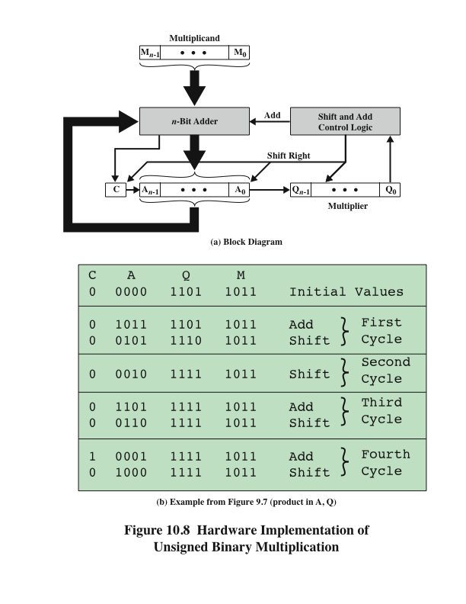
Hardware Implementation of Unsigned Binary Multiplication
Notes:
Figure 10.8a shows a possible implementation employing these measures. The
multiplier and multiplicand are loaded into two registers (Q and M). A third register,
the A register, is also needed and is initially set to 0. There is also a 1-bit C register,
initialized to 0, which holds a potential carry bit resulting from addition.

Slide 23
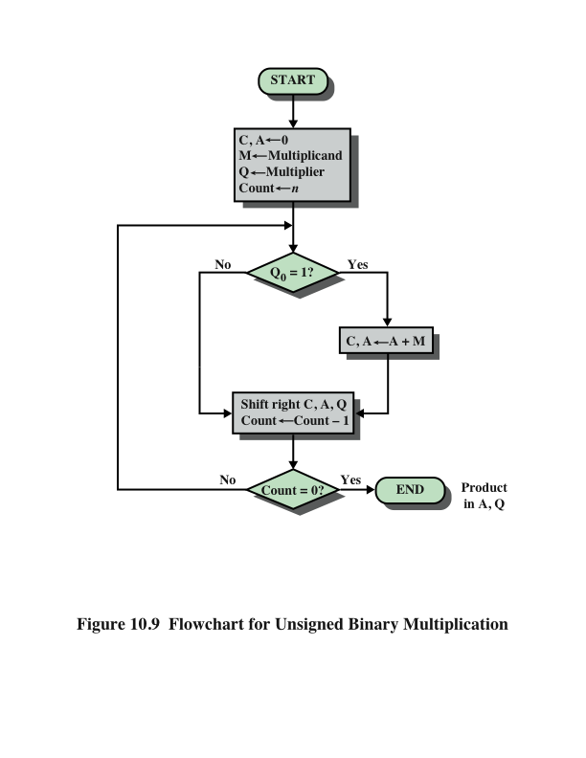
Flowchart for Unsigned Binary Multiplication
Notes:
The operation of the multiplier is as follows. Control logic reads the bits of the
multiplier one at a time. If Q₀ is 1, then the multiplicand is added to the A register
and the result is stored in the A register, with the C bit used for overflow. Then all
of the bits of the C, A, and Q registers are shifted to the right one bit, so that the C
bit goes into A_{n-1}, A₀ goes into Q_{n-1} and Q₀ is lost. If Q₀ is 0, then no addition is
performed, just the shift. This process is repeated for each bit of the original multiplier.
The resulting 2n-bit product is contained in the A and Q registers. A flowchart
of the operation is shown in Figure 10.9, and an example is given in Figure 10.8b.
Note that on the second cycle, when the multiplier bit is 0, there is no add operation.

Slide 24
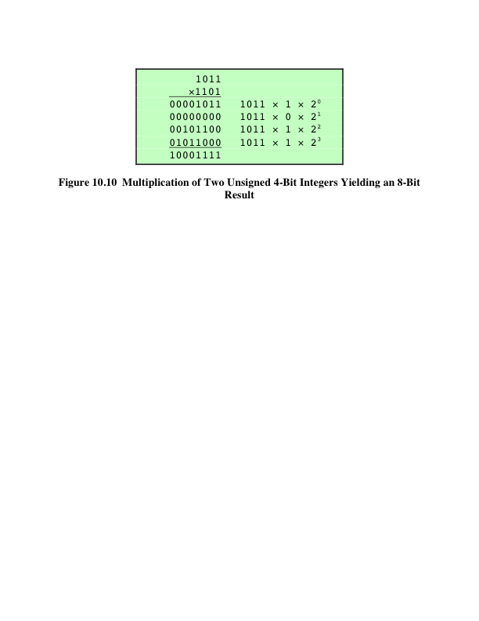
Twos Complement Multiplication
Notes:
Figure 10.10 recasts Figure 10.7 to make the generation of partial products by multiplication explicit.
The only difference in Figure 10.10 is that it recognizes that the partial products
should be viewed as 2n-bit numbers generated from the n-bit multiplicand.

Slide 25
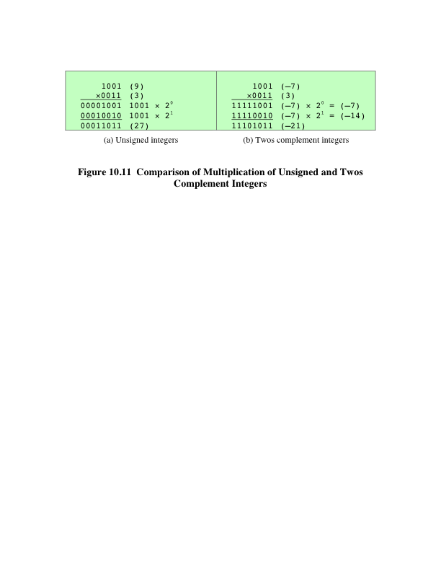
Comparison
Notes:
Now we can demonstrate that straightforward multiplication will not work if
the multiplicand is negative. The problem is that each contribution of the negative
multiplicand as a partial product must be a negative number on a 2n-bit field; the sign
bits of the partial products must line up. This is demonstrated in Figure 10.11, which
shows that multiplication of 1001 by 0011. If these are treated as unsigned integers,
the multiplication of 9 * 3 = 27 proceeds simply. However, if 1001 is interpreted
as the twos complement value -7, then each partial product must be a negative
twos complement number of 2n (8) bits, as shown in Figure 10.11b. Note that this is
accomplished by padding out each partial product to the left with binary 1s.

Slide 26
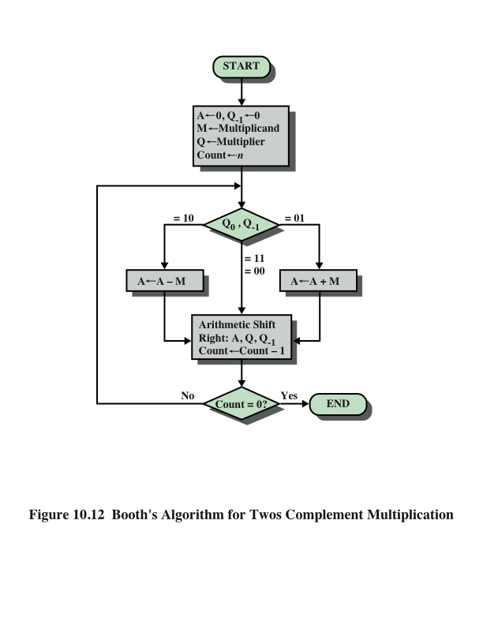
Notes:
Booth’s algorithm is depicted in Figure 10.12 and can be described as follows.
As before, the multiplier and multiplicand are placed in the Q and M registers,
respectively. There is also a 1-bit register placed logically to the right of the least
significant bit (Q₀) of the Q register and designated Q₋₁ its use is explained shortly.
The results of the multiplication will appear in the A and Q registers. A and Q₋₁
are initialized to 0. As before, control logic scans the bits of the multiplier one at a
time. Now, as each bit is examined, the bit to its right is also examined. If the two
bits are the same (1–1 or 0–0), then all of the bits of the A, Q, and Q₋₁ registers are
shifted to the right 1 bit. If the two bits differ, then the multiplicand is added to or
subtracted from the A register, depending on whether the two bits are 0–1 or 1–0.
Following the addition or subtraction, the right shift occurs. In either case, the right
shift is such that the leftmost bit of A, namely, A_{n-1}not only is shifted into A_{n-2},
but also remains in A_{n-1}. This is required to preserve the sign of the number in A
and Q. It is known as an arithmetic shift, because it preserves the sign bit.

Slide 27
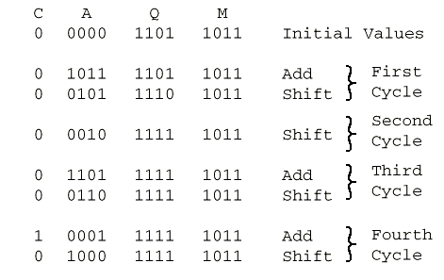
Execution of Example

Slide 28
Multiplying Negative Numbers
This does not work!
Solution 1
Convert to positive if required
Multiply as above
If signs were different, negate answer
Solution 2
Booth’s algorithm

Slide 29
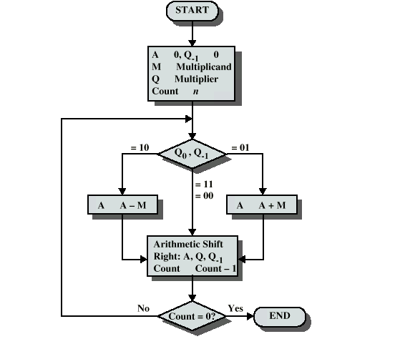
Booth’s Algorithm

Slide 30
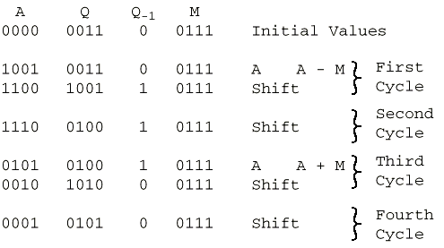
Example of Booth’s Algorithm

Slide 31
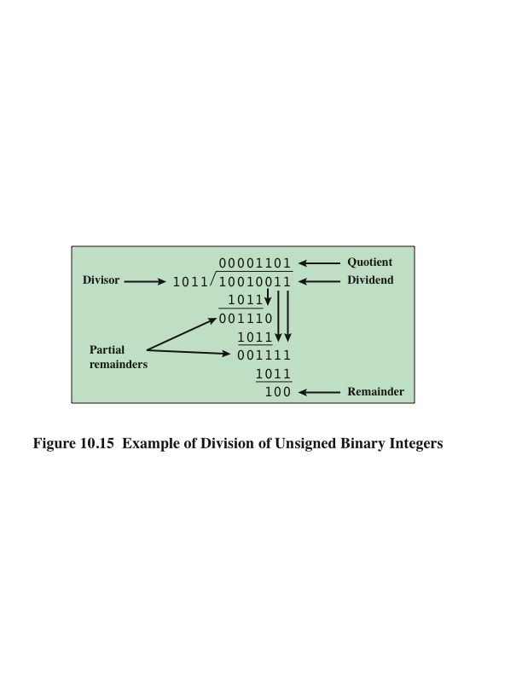
Division
Notes:
Division is somewhat more complex than multiplication but is based on the same
general principles. As before, the basis for the algorithm is the paper-and-pencil
approach, and the operation involves repetitive shifting and addition or subtraction.
Figure 10.15 shows an example of the long division of unsigned binary integers.
It is instructive to describe the process in detail. First, the bits of the dividend
are examined from left to right, until the set of bits examined represents a number
greater than or equal to the divisor; this is referred to as the divisor being able to
divide the number. Until this event occurs, 0s are placed in the quotient from left
to right. When the event occurs, a 1 is placed in the quotient and the divisor is subtracted
from the partial dividend. The result is referred to as a partial remainder.
From this point on, the division follows a cyclic pattern. At each cycle, additional
bits from the dividend are appended to the partial remainder until the result is
greater than or equal to the divisor. As before, the divisor is subtracted from this
number to produce a new partial remainder. The process continues until all the bits
of the dividend are exhausted.

Slide 32
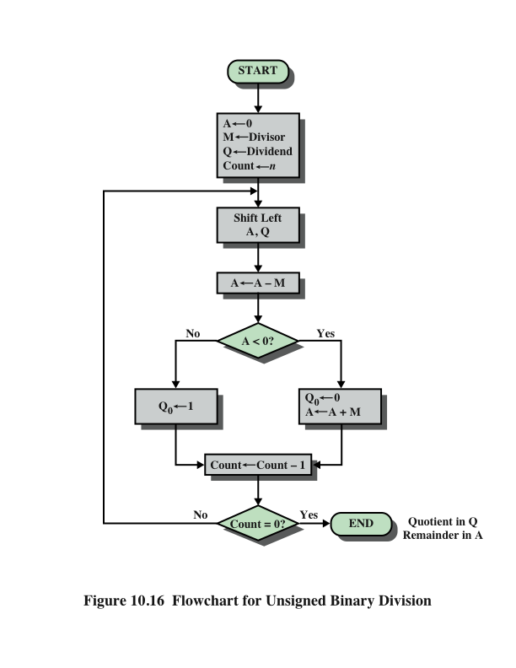
Flowchart for Unsigned Binary Division
Notes:
Figure 10.16 shows a machine algorithm that corresponds to the long division
process.

Slide 33
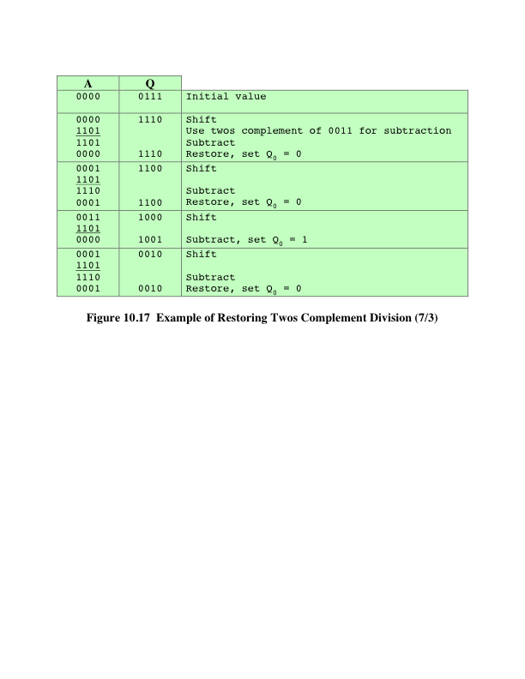
Example of Restoring Twos Complement Division
Notes:
Example of restoring twos complement division.

Slide 34
Division of Unsigned Binary Integers
00001101
Quotient
Divisor
1011
10010011
Dividend
1011
001110
Partial
Remainders
1011
001111
1011
Remainder
100

Slide 35
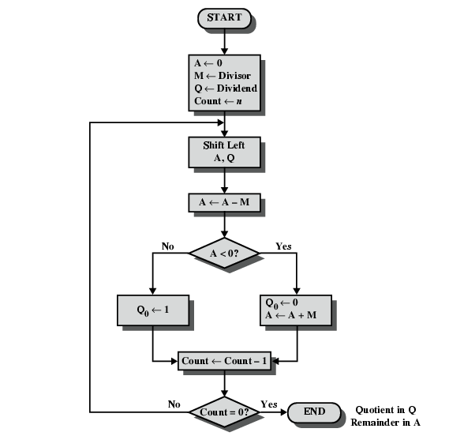
Flowchart for Unsigned Binary Division

Slide 36
Real Numbers
Numbers with fractions
Could be done in pure binary
1001.1010 = 2³ + 2⁰ +2⁻¹ + 2⁻³ =9.625
Where is the binary point?
Fixed?
Very limited
Moving?
How do you show where it is?

Slide 37
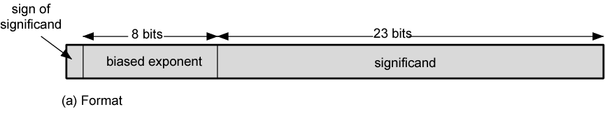
Floating Point
+/- .significand x 2^{exponent}
Misnomer
Point is actually fixed between sign bit and body of mantissa
Exponent indicates place value (point position)
Misnomer:เรียกชื่อผิด, ใช้ชื่อผิด

Slide 38
Floating-Point Representation
Principles
With a fixed-point notation it is possible to represent a range of positive and negative integers centered on or near 0
By assuming a fixed binary or radix point, this format allows the representation of numbers with a fractional component as well
Limitations:
Very large numbers cannot be represented nor can very small fractions
The fractional part of the quotient in a division of two large numbers could be lost
Notes:
With a fixed-point notation (e.g., twos complement) it is possible to represent a
range of positive and negative integers centered on or near 0. By assuming a fixed
binary or radix point, this format allows the representation of numbers with a fractional
component as well.
This approach has limitations. Very large numbers cannot be represented, nor
can very small fractions. Furthermore, the fractional part of the quotient in a division
of two large numbers could be lost.

Slide 39
Floating-Point
Significand
The final portion of the word
Any floating-point number can be expressed in many ways
Normal number
The most significant digit of the significand is nonzero
The following are equivalent, where the significand is expressed in binary form:
0.110 * 2⁵
110 * 2²
0.0110 * 2⁶
Notes:
Table 10.2 shows the biased representation for 4-bit integers. Note that when
the bits of a biased representation are treated as unsigned integers, the relative magnitudes
of the numbers do not change. For example, in both biased and unsigned
representations, the largest number is 1111 and the smallest number is 0000. This is
not true of sign-magnitude or twos complement representation. An advantage of
biased representation is that nonnegative floating-point numbers can be treated as
integers for comparison purposes.
The final portion of the word (23 bits in this case) is the significand.
Any floating-point number can be expressed in many ways.
To simplify operations on floating-point numbers, it is typically required that they
be normalized. A normal number is one in which the most significant digit of the
significand is nonzero. For base 2 representation, a normal number is therefore one
in which the most significant bit of the significand is one.

Slide 40
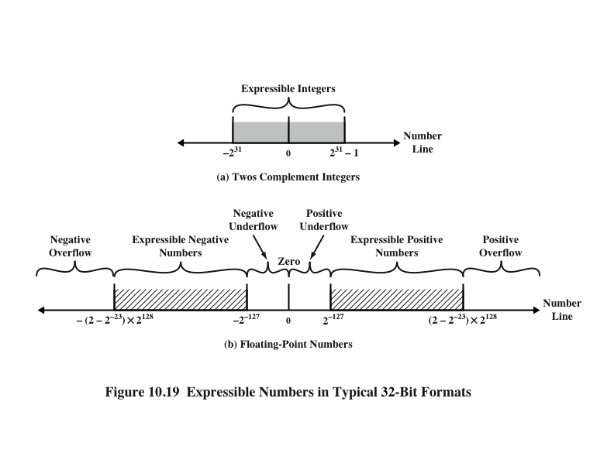
Expressible Numbers
Notes:
Figure 10.19 indicates the range of numbers that can be represented
in a 32-bit word. Using twos complement integer representation, all of the
integers from -2³¹ to 2³¹ - 1 can be represented, for a total of 2³² different numbers.
With the example floating-point format of Figure 10.18, the following ranges
of numbers are possible:
• Negative numbers between -(2 - 2⁻²³) * 2¹²⁸ and -2⁻¹²⁷
• Positive numbers between 2⁻¹²⁷ and (2 - 2⁻²³) * 2¹²⁸
Five regions on the number line are not included in these ranges:
• Negative numbers less than -(2 - 2⁻²³) * 2¹²⁸, called negative overflow
• Negative numbers greater than 2⁻¹²⁷, called negative underflow
• Zero
• Positive numbers less than 2⁻¹²⁷, called positive underflow
• Positive numbers greater than (2 - 2⁻²³) * 2¹²⁸, called positive overflow
The representation as presented will not accommodate a value of 0.
However, as we shall see, actual floating-point representations include a special
bit pattern to designate zero. Overflow occurs when an arithmetic operation
results in an absolute value greater than can be expressed with an exponent of 128
(e.g., 2¹²⁰ * 2¹⁰⁰ = 2²²⁰). Underflow occurs when the fractional magnitude is too
small (e.g., 2⁻¹²⁰ * 2⁻¹⁰⁰ = 2⁻²²⁰). Underflow is a less serious problem because
the result can generally be satisfactorily approximated by 0.
It is important to note that we are not representing more individual values
with floating-point notation. The maximum number of different values that can be
represented with 32 bits is still 2³². What we have done is to spread those numbers
out in two ranges, one positive and one negative. In practice, most floating-point
numbers that one would wish to represent are represented only approximately.
However, for moderate sized integers, the representation is exact.

Slide 41
IEEE Standard 754
Most important floating-point representation is defined
Standard was developed to facilitate the portability of programs from one processor to another and to encourage the development of sophisticated, numerically oriented programs
Standard has been widely adopted and is used on virtually all contemporary processors and arithmetic coprocessors
IEEE 754-2008 covers both binary and decimal floating-point representations
Notes:
The most important floating-point representation is defined in IEEE Standard 754,
adopted in 1985 and revised in 2008. This standard was developed to facilitate the
portability of programs from one processor to another and to encourage the development
of sophisticated, numerically oriented programs. The standard has been
widely adopted and is used on virtually all contemporary processors and arithmetic
coprocessors. IEEE 754-2008 covers both binary and decimal floating-point representations.
In this chapter, we deal only with binary representations.

Slide 42
IEEE 754-2008
Defines the following different types of floating-point formats:
Arithmetic format
All the mandatory operations defined by the standard are supported by the format. The format may be used to represent floating-point operands or results for the operations described in the standard.
Basic format
This format covers five floating-point representations, three binary and two decimal, whose encodings are specified by the standard, and which can be used for arithmetic. At least one of the basic formats is implemented in any conforming implementation.
Interchange format
A fully specified, fixed-length binary encoding that allows data interchange between different platforms and that can be used for storage.
Notes:
IEEE 754-2008 defines the following different types of floating-point formats:
• Arithmetic format: All the mandatory operations defined by the standard are
supported by the format. The format may be used to represent floating-point
operands or results for the operations described in the standard.
• Basic format: This format covers five floating-point representations, three
binary and two decimal, whose encodings are specified by the standard, and
which can be used for arithmetic. At least one of the basic formats is implemented
in any conforming implementation.
• Interchange format: A fully specified, fixed-length binary encoding that allows
data interchange between different platforms and that can be used for storage.

Slide 43
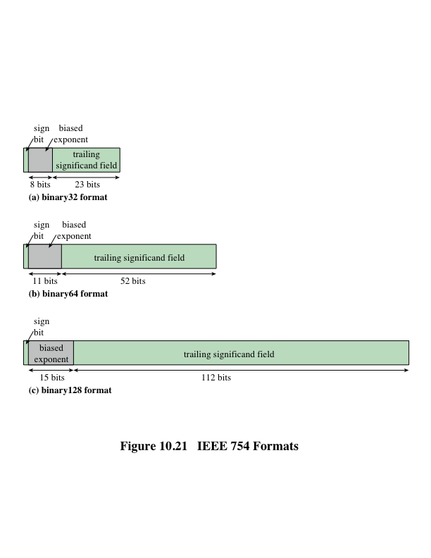
IEEE 754 Formats
Notes:
The three basic binary formats have bit lengths of 32, 64, and 128 bits, with
exponents of 8, 11, and 15 bits, respectively (Figure 10.21).

Slide 44
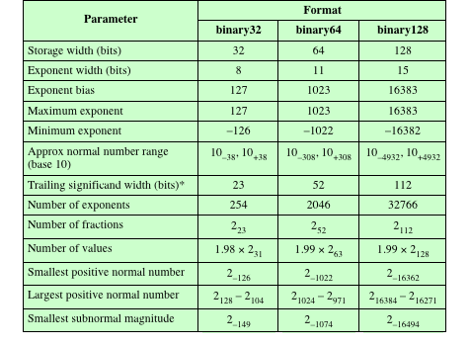
Table 10.3
IEEE 754
Format
Parameters
* not including implied bit and not including sign bit
Notes:
Table 10.3 summarizes
the characteristics of the three formats. The two basic decimal formats have bit
lengths of 64 and 128 bits. All of the basic formats are also arithmetic format types
(can be used for arithmetic operations) and interchange format types (platform
independent).

Slide 45
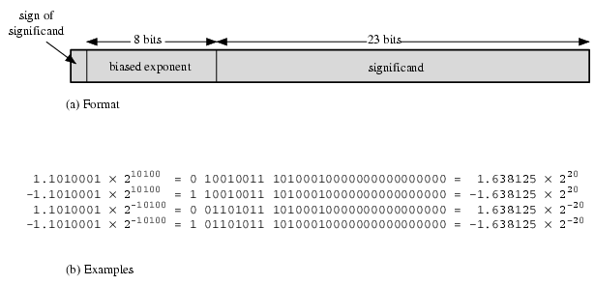
Floating Point Examples

Slide 46
Signs for Floating Point
Mantissa is stored in 2s compliment
Exponent is in excess or biased notation
e.g. Excess (bias) 128 means
8 bit exponent field
Pure value range 0-255
Subtract 128 to get correct value
Range -128 to +127

Slide 47
Normalization
FP numbers are usually normalized
i.e. exponent is adjusted so that leading bit (MSB) of mantissa is 1
Since it is always 1 there is no need to store it
(c.f. Scientific notation where numbers are normalized to give a single digit before the decimal point
e.g. 3.123 x 10³)

Slide 48
FP Ranges
For a 32 bit number
8 bit exponent
+/- 2²⁵⁶ ≈ 1.5 x 10⁷⁷
Accuracy
The effect of changing lsb of mantissa
23 bit mantissa 2⁻²³ ≈ 1.2 x 10⁻⁷
About 6 decimal places

Slide 49
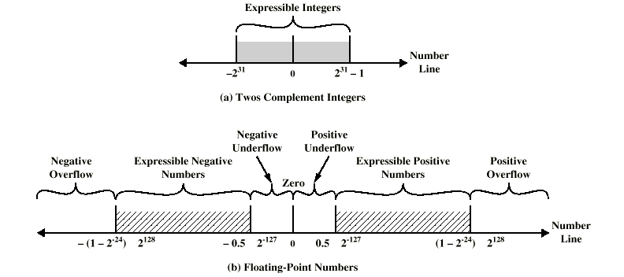
Expressible Numbers

Slide 50
IEEE 754
Standard for floating point storage
32 and 64 bit standards
8 and 11 bit exponent respectively
Extended formats (both mantissa and exponent) for intermediate results

Slide 51
The Processor: Datapath & Control
Our implementation of the MIPS is simplified
memory-reference instructions: lw, sw
arithmetic-logical instructions: add, sub, and, or, slt
control flow / branch instructions: beq, j
Generic implementation
use the program counter (PC) to supply the instruction address and fetch the instruction from memory (and update the PC)
decode the instruction (and read registers)
execute the instruction
All instructions (except j) use the ALU after reading the registers
How? memory-reference? arithmetic? control flow?
Fetch
PC = PC+4
Exec
Decode
Notes:
memory reference use ALU to compute addresses
arithmetic use the ALU to do the require arithmetic
control use the ALU to compute branch conditions.

Slide 52
Fetching Instructions
Fetching instructions involves
reading the instruction from the Instruction Memory
updating the PC to hold the address of the next instruction
Add
4
Instruction
Memory
PC
Read
Address
Instruction
PC is updated every cycle, so it does not need an explicit write control signal
Instruction Memory is read every cycle, so it doesn’t need an explicit read control signal

Slide 53
Decoding Instructions
Decoding instructions involves
sending the fetched instruction’s opcode and function field bits to the control unit
Control
Unit
Read Addr 1
Register
File
Read
Data 1
Read Addr 2
Instruction
Write Addr
Read
Data 2
Write Data
reading two values from the Register File
Register File addresses are contained in the instruction

Slide 54
Executing R Format Operations
R format operations (add, sub, slt, and, or)
perform the (op and funct) operation on values in rs and rt
store the result back into the Register File (into location rd)
31
25
20
15
10
5
0
R-type:
op
rs
rt
rd
shamt
funct
RegWrite
ALU control
Read Addr 1
Register
File
Read
Data 1
Instruction
Read Addr 2
overflow
ALU
zero
Write Addr
Read
Data 2
Write Data
The Register File is not written every cycle (e.g. sw), so we need an explicit write control signal for the Register File

Slide 55
Executing Load and Store Operations
Load and store operations involves
compute memory address by adding the base register (read from the Register File during decode) to the 16-bit signed-extended offset field in the instruction
store value (read from the Register File during decode) written to the Data Memory
load value, read from the Data Memory, written to the Register File
RegWrite
ALU control
MemWrite
overflow
Read Addr 1
zero
Register
File
Read
Data 1
Address
Instruction
Read Addr 2
Data
Memory
ALU
Read Data
Write Addr
Read
Data 2
Write Data
Write Data
Sign
Extend
MemRead
16
32

Slide 56
Creating a Single Datapath from the Parts
Assemble the datapath segments and add control lines and multiplexors as needed
Single cycle design – fetch, decode and execute each instructions in one clock cycle
no datapath resource can be used more than once per instruction, so some must be duplicated (e.g., separate Instruction Memory and Data Memory, several adders)
multiplexors needed at the input of shared elements with control lines to do the selection
write signals to control writing to the Register File and Data Memory
Cycle time is determined by length of the longest path

Slide 57
Adding the Control
Selecting the operations to perform (ALU, Register File and Memory read/write)
Controlling the flow of data (multiplexor inputs)
31
25
20
15
10
5
0
R-type:
op
rs
rt
rd
shamt
funct
31
25
20
15
0
Observations
op field always in bits 31-26
addr of registers to be read are always specified by the rs field (bits 25-21) and rt field (bits 20-16); for lw and sw rs is the base register
addr. of register to be written is in one of two places – in rt (bits 20-16) for lw; in rd (bits 15-11) for R-type instructions
offset for beq, lw, and sw always in bits 15-0
I-Type:
op
rs
rt
address offset
31
25
0
J-type:
op
target address

Slide 58
Single Cycle Disadvantages & Advantages
Uses the clock cycle inefficiently – the clock cycle must be timed to accommodate the slowest instruction
especially problematic for more complex instructions like floating point multiply
May be wasteful of area since some functional units (e.g., adders) must be duplicated since they can not be shared during a clock cycle but
Is simple and easy to understand
Cycle 1
Cycle 2
Clk
lw
sw
Waste
Notes:
In the Single Cycle implementation, the cycle time is set to accommodate the longest instruction, the Load instruction.
Since the cycle time has to be long enough for the load instruction, it is too long for the store instruction so the last part of the cycle here is wasted.

Slide 59
Multicycle Datapath Approach
Let an instruction take more than 1 clock cycle to complete
Break up instructions into steps where each step takes a cycle while trying to
balance the amount of work to be done in each step
restrict each cycle to use only one major functional unit
Not every instruction takes the same number of clock cycles
In addition to faster clock rates, multicycle allows functional units that can be used more than once per instruction as long as they are used on different clock cycles, as a result
only need one memory – but only one memory access per cycle
need only one ALU/adder – but only one ALU operation per cycle

Slide 60
Pipelining
What is Pipelining?
A way of speeding up execution of instructions Key idea:
overlap execution of multiple instructions

Slide 61
Pipelining a Digital System
Key idea: break big computation up into pieces Separate each piece with a pipeline register
1ns
200ps
200ps
200ps
200ps
200ps
Pipeline
Register

Slide 62
Pipelining a Digital System
Why do this? Because it's faster for repeated computations
Non-pipelined:
1 operation finishes
every 1ns
1ns
Pipelined:
1 operation finishes
every 200ps
200ps
200ps
200ps
200ps
200ps

Slide 63
Thank You!

