Slide 1
DEPARTMENT OF COMPUTER SCIENCE AND ENGINEERING
Advance Computer Architecture
VI Sem CSE
UNIT-4
Seema Sharma
Assistant Professor-II
CSE

Slide 2

UNIT - 4

Slide 3
Comments about pipelining
Pipelining increases throughput, but not latency
Answer available every 200ps, BUT
A single computation still takes 1ns
Limitations:
Computations must be divisible into stages of equal sizes
Pipeline registers add overhead

Slide 4
Another Example
Unpipelined
System
30ns
3ns
Comb.
Logic
R
E
G
Delay = 33ns
Throughput = 30MHz
Clock
Op1
Op2
Op3
??
Time
One operation must complete before next can begin
Operations spaced 33ns apart

Slide 5
3 Stage Pipelining
10ns
3ns
10ns
3ns
10ns
3ns
Comb.
Logic
R
E
G
Comb.
Logic
R
E
G
Comb.
Logic
R
E
G
Delay = 39ns
Throughput = 77MHz
Clock
Space operations 13ns apart
3 operations occur simultaneously
Op1
Op2
Op3
Time
Op4

Slide 6
Nonuniform Pipelining
5ns
3ns
15ns
3ns
10ns
3ns
Com.
Log.
R
E
G
Comb.
Logic
R
E
G
Comb.
Logic
R
E
G
Delay = 18 * 3 = 54 ns
Throughput = 55MHz
Clock
Throughput limited by slowest stage
Delay determined by clock period * number of stages
Must attempt to balance stages

Slide 7
Deep Pipelines
5ns
3ns
5ns
3ns
5ns
3ns
5ns
3ns
5ns
3ns
5ns
3ns
Com.
Log.
R
E
G
Com.
Log.
R
E
G
Com.
Log.
R
E
G
Com.
Log.
R
E
G
Com.
Log.
R
E
G
Com.
Log.
R
E
G
Clock
Delay = 48ns, Throughput = 128MHz
Diminishing returns as add more pipeline stages
Register delays become limiting factor
Increased latency
Small throughput gains
More hazards

Slide 8
Computer (Processor) Pipelining
It is one KEY method of achieving High-Performance in modern microprocessors
It is being used in many different designs (not just processors)
http://www.siliconstrategies.com/story/OEG20020820S0054
It is a completely hardware mechanism
A major advantage of pipelining over “parallel processing” is that it is not visible to the programmer
An instruction execution pipeline involves a number of steps, where each step completes a part of an instruction.
Each step is called a pipe stage or a pipe segment.

Slide 9
Pipelining
Multiple instructions overlapped in execution
Throughput optimization: doesn’t reduce time for individual instructions
Instr 2
Instr 1
Stage 1
Stage 2
Stage 3
Stage 4
Stage 5
Stage 6
Stage 7
Instr 7
Instr 6
Instr 5
Instr 4
Instr 3
Instr 2
Instr 1
Stage 1
Stage 2
Stage 3
Stage 4
Stage 5
Stage 6
Stage 7

Slide 10
Computer Pipelining
The stages or steps are connected one to the next to form a pipe -- instructions enter at one end and progress through the stage and exit at the other end.
Throughput of an instruction pipeline is determined by how often an instruction exists the pipeline.
The time to move an instruction one step down the line is equal to the machine cycle (Clock Rate) and is determined by the stage with the longest processing delay (slowest pipeline stage).

Slide 11
Pipelining: Design Goals
An important pipeline design consideration is to balance the length of each pipeline stage.
If all stages are perfectly balanced, then the time per instruction on a pipelined machine (assuming ideal conditions with no stalls):
Time per instruction on unpipelined machine
Number of pipe stages
Under these ideal conditions:
Speedup from pipelining equals the number of pipeline stages: n,
One instruction is completed every cycle, CPI = 1 .

Slide 12
Pipelining: Design Goals
Under these ideal conditions:
Speedup from pipelining equals the number of pipeline stages: n,
One instruction is completed every cycle, CPI = 1 .
This is an asymptote of course, but +10% is commonly achieved
Difference is due to difficulty in achieving balanced stage design
Two ways to view the performance mechanism
Reduced CPI (i.e. non-piped to piped change)
Close to 1 instruction/cycle if you’re lucky
Reduced cycle-time (i.e. increasing pipeline depth)
Work split into more stages
Simpler stages result in faster clock cycles

Slide 13
Pipeline Hazards
Hazards are caused by conflicts between instructions. Will lead to incorrect behavior if not fixed.
Three types:
Structural: two instructions use same h/w in the same cycle – resource conflicts (e.g. one memory port, unpipelined divider etc).
Data: two instructions use same data storage (register/memory) – dependent instructions.
Control: one instruction affects which instruction is next – PC modifying instruction, changes control flow of program.

Slide 14
Handling Hazards
Force stalls or bubbles in the pipeline.
Stop some younger instructions in the stage when hazard happen
Make younger instr. Wait for older ones to complete
Flush pipeline
Blow instructions out of the pipeline
Refetch new instructions later – solving control hazards
Implementation: assert clear signals on pipeline registers

Slide 15
Single Memory is a Structural Hazard
Time (clock cycles)
I
n
s
t
r.
O
r
d
e
r
Load
M
Reg
ALU
M
Reg
Instr 1
M
Reg
ALU
M
Reg
Instr 2
M
Reg
ALU
M
Reg
Instr 3
M
Reg
ALU
M
Reg
Instr 4
M
Reg
ALU
M
Reg
Can’t read same memory twice in same clock cycle

Slide 16
Structural Hazards
Example
Assume unified cache memory, i.e., instruction and data are stored in a single cache, and each cycle only one request can be processed (either instruction or data) – this cache has only one port
 | 1 | 2 | 3 | 4 | 5 | 6 | 7 | 8 | 9
Load | f | d | x | m | w
inst1 |  | f | d | x | m | w
inst2 |  |  | f | d | x | m | w
inst3 |  |  |  | f | d | x | m | w

Slide 17
Fixing Structural Hazards Using Stalls
Stall Pipeline
 | 1 | 2 | 3 | 4 | 5 | 6 | 7 | 8 | 9 | 10
Load | f | d | x | m | w
inst1 |  | f | d | x | m | w
inst2 |  |  | f | d | x | m | w
inst3 |  |  |  | - | f | d | x | m | w
inst4 |  |  |  | - | - | f | d | x | m | w
Duplicate Resource – Separate IM and DM

Slide 18
Dealing with Structural Hazards
Stall
+ simple, low cost in h/w
Decrease IPC
Replicate the resource
+ good for performance
Increase h/w and area
Used for cheap resources
Pipeline the resource
+ good for performance
Complexity, e.g. RAM
Useful for multicycle resources

Slide 19
Speed Up Equation for Pipelining
CPI_{pipelined} = Ideal CPI + Pipeline stall clock cycles per instn
Ideal CPI x Pipeline depth Clock Cycle_{unpipelined}
Speedup = -------------------------- X --------
Ideal CPI (1+ Pipeline stall CPI) Clock Cycle_{pipelined}
Pipeline depth Clock Cycle_{unpipelined}
Speedup = ------------------------ X ---------------
1 + Pipeline stall CPI Clock Cycle_{pipelined}
x

Slide 20
Example: Dual-port vs. Single-port
Machine A: Dual ported memory
Machine B: Single ported memory, but has a 1.05 times faster clock rate
Ideal CPI = 1 for both
Loads are 40% of instructions executed
SpeedUp_{A} = Pipeline Depth/(1 + 0) x (clock_{unpipe}/clock_{pipe})
= Pipeline Depth
SpeedUp_{B} = Pipeline Depth/(1 + 0.4) x (clock_{unpipe}/(clock_{unpipe} / 1.05)
= (Pipeline Depth/1.4) x 1.05 = 0.75 x Pipeline Depth
SpeedUp_{A} / SpeedUp_{B} = Pipeline Depth/(0.75 x Pipeline Depth) = 1.33
Machine A is 1.33 times faster

Slide 21
Data Hazards
Two different instructions use the same storage location
It must appear as if they executed in sequential order
add R1, R2, R3
sub R2, R4, R1
or R1, R6, R3
add R1, R2, R3
sub R2, R4, R1
or R1, R6, R3
add R1, R2, R3
sub R2, R4, R1
or R1, R6, R3
read-after-write
(RAW)
write-after-read
(WAR)
write-after-write
(WAW)
True dependence
(real)
anti dependence
(artificial)
output dependence
(artificial)
What about read-after-read dependence ?

Slide 22
Reducing RAW Hazards: Bypassing
Data available at the end of EX stage, why wait until WB stage?
Bypass (forward) data directly to input of EX
+ Reduces/avoids stalls in a big way
Large fraction of input operands are bypassed
Complex
Important: does not relieve you from having to perform WB
 | 1 | 2 | 3 | 4 | 5 | 6 | 7 | 8 | 9
add R1, R2, R3 | f | d | x | m | w
sub R2, R4, R1 |  | f | d | x | m | w
Can bypass from MEM also

Slide 23
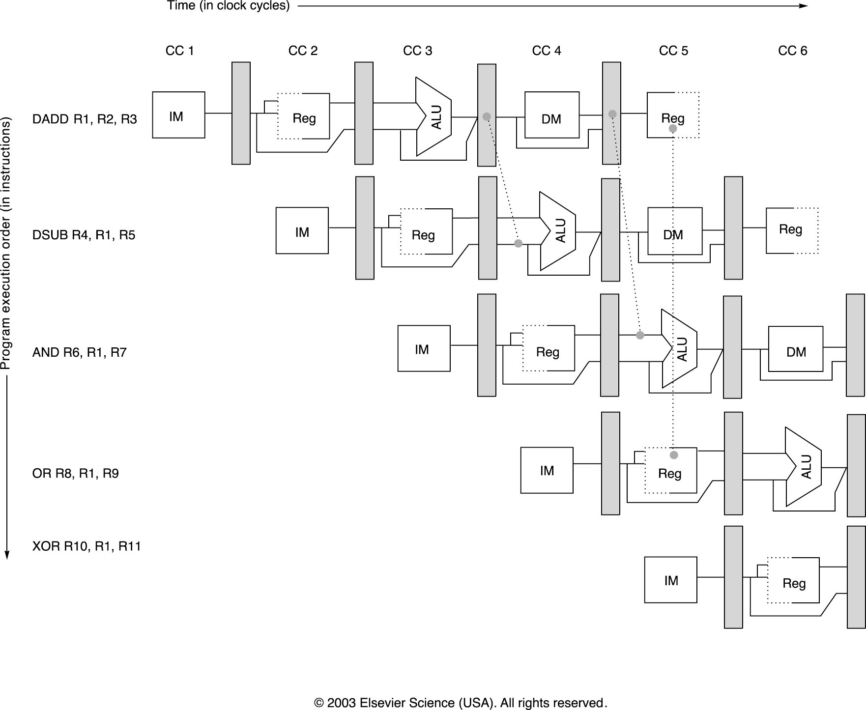
Minimizing Data Hazard Stalls by Forwarding
Notes:
Forwarding should be generalized to include passing a result directly to the functional unit that requires it.

Slide 24
But …
Even with bypassing, not all RAWs stalls can be avoided
Load to an ALU immediately after
Can be eliminated with compiler scheduling
 | 1 | 2 | 3 | 4 | 5 | 6 | 7 | 8 | 9
lw R1, 16(R3) | f | d | x | m | w
sub R2, R4, R1 |  | f | - | d | x | m | w
You can also stall before EX stage, but it is better to separate stall logic from bypassing logic

Slide 25
Compiler Scheduling
Compiler moves instructions around to reduce stalls
E.g. code sequence: a = b+c, d = e-f
before scheduling after scheduling
lw Rb, b lw Rb, b
lw Rc, c lw Rc, c
add Ra, Rb, Rc //stall lw Re, e
sw Ra, a add Ra, Rb, Rc//no stall
lw Re, e lw Rf, f
lw Rf, f sw Ra, a
sub Rd, Re, Rf //stall sub Rd, Re, Rf//no stall
sw Rd, d sw Rd, d

Slide 26
WAR: Why do they exist? (Antidependence)
Recall WAR
add R1, R2, R3
sub R2, R4, R1
or R1, R6, R3
Problem: swap means introducing false RAW hazards
Artificial: can be removed if sub used a different destination register
Can’t happen in in-order pipeline since reads happen in ID but writes happen in WB
Can happen in out-of-order reads, e.g. out-of-order execution

Slide 27
WAW (Output Depndence)
add R1, R2, R3
sub R2, R4, R1
or R1, R6, R3
Problem: scheduling would leave wrong value in R1 for the sub
Artificial: using different destination register would solve
Can’t happen in in-order pipeline in which every instruction takes same cycles since writes are in-order
Can happen in the presence of multi-cycle operations, i.e., out-of-order writes

Slide 28
RAW
WAR
EXAMPLE
WAW and
RAW
I1
I3
I5
I1. Load R1, A /R1← Memory(A)/
I2. Add R2, R1 /R2 ← (R2)+(R1)/
I3. Add R3, R4 /R3 ← (R3)+(R4)/
I4. Mul R4, R5 /R4 ← (R4)*(R5)/
I5. Comp R6 /R6 ← Not(R6)/
I6. Mul R6, R7 /R6 ← (R6)*(R7)/
Program order
I2
I4
I6
Flow
dependence
Anti-
dependence
Output
dependence,
also flow
dependence
Due to Superscalar Processing, it is possible that I4 completes before
I3 starts. Similarly the value of R6 depends on the beginning and end of I5
and I6. Unpredictable result!
A sample program and its dependence graph, where I2 and I3 share the
adder and I4 and I6 share the same multiplier. These two dependences can
be removed by duplicating the resources, or pipelined adders and multipliers.

Slide 29
Register Renaming
Rewrite the previous program as:
I1. R1b ← Memory (A)
I2. R2b ← (R2a) + (R1b)
I3. R3b ← (R3a) + (R4a)
I4. R4b ← (R4a) * (R5a)
I5. R6b ← -(R6a)
I6. R6c ← (R6b) * (R7a)
Allocate more registers and rename the registers that really do not have flow dependency. The WAR hazard between I3 and I4, and WAW hazard between I5 and I6 have been removed.
These two hazards also called Name dependencies

Slide 30
Control Hazards
Branch problem:
branches are resolved in EX stage
→ 2 cycles penalty on taken branches
Ideal CPI =1. Assuming 2 cycles for all branches and 32% branch instructions → new CPI = 1 + 0.32*2 = 1.64
Solutions:
Reduce branch penalty: change the datapath – new adder needed in ID stage.
Fill branch delay slot(s) with a useful instruction.
Fixed branch prediction.
Static branch prediction.
Dynamic branch prediction.

Slide 31
Control Hazards – branch delay slots
Reduced branch penalty:
Compute condition and target address in the ID stage: 1 cycle stall.
Target and condition computed even when instruction is not a branch.
Branch delay slot filling:
move an instruction into the slot right after the branch, hoping that its execution is necessary. Three alternatives (next slide)
Limitations: restrictions on which instructions can be rescheduled, compile time prediction of taken or untaken branches.

Slide 32
Nondelayed vs. Delayed Branch
Nondelayed Branch
Delayed Branch
or M8, M9 ,M10
add M1 ,M2,M3
add M1 ,M2,M3
sub M4, M5,M6
beq M1, M4, Exit
sub M4, M5,M6
or M8, M9 ,M10
beq M1, M4, Exit
xor M10, M1,M11
xor M10, M1,M11
Exit:
Exit:

Slide 33
Control Hazards: Branch Prediction
Idea: doing something is better than waiting around doing nothing
Guess branch target, start executing at guessed position
Execute branch, verify (check) your guess
+ minimize penalty if guess is right (to zero)
May increase penalty for wrong guesses
Heavily researched area in the last 15 years
Fixed branch prediction.
Each of these strategies must be applied to all branch instructions indiscriminately.
Predict not-taken (47% actually not taken):
continue to fetch instruction without stalling;
do not change any state (no register write);
if branch is taken turn the fetched instruction into no-op, restart fetch at target address: 1 cycle penalty.

Slide 34
Control Hazards: Branch Prediction
Predict taken (53%): more difficult, must know target before branch is decoded. no advantage in our simple 5-stage pipeline.
Static branch prediction.
Opcode-based: prediction based on opcode itself and related condition. Examples: MC 88110, PowerPC 601/603.
Displacement based prediction: if d < 0 predict taken, if d >= 0 predict not taken. Examples: Alpha 21064 (as option), PowerPC 601/603 for regular conditional branches.
Compiler-directed prediction: compiler sets or clears a predict bit in the instruction itself. Examples: AT&T 9210 Hobbit, PowerPC 601/603 (predict bit reverses opcode or displacement predictions), HP PA 8000 (as option).

Slide 35
Control Hazards: Branch Prediction
Dynamic branch prediction
Later

Slide 36
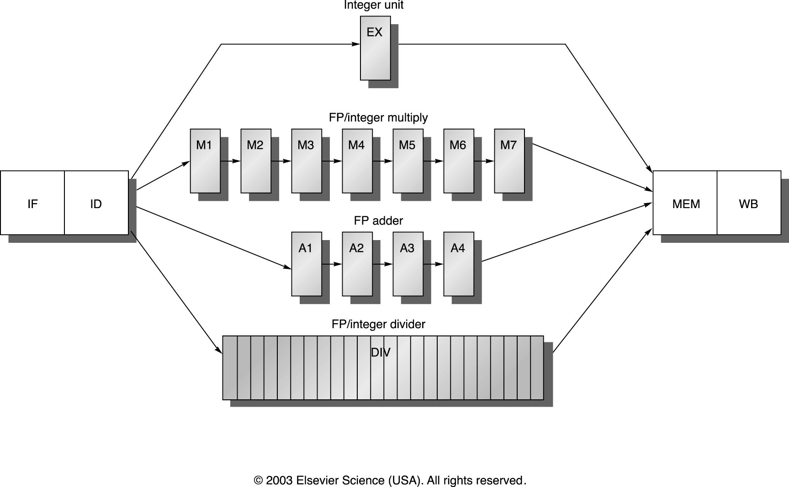
MIPS R4000 pipeline

Slide 37
MIPS FP Pipe Stages
FP Instr 1 2 3 4 5 6 7 8 …
Add, Subtract U S+A A+R R+S
Multiply U E+M M M M N N+A R
Divide U A R D²⁸ … D+A D+R, D+R, D+A, D+R, A, R
Square root U E (A+R)¹⁰⁸ … A R
Negate U S
Absolute value U S
FP compare U A R
Stages:
M First stage of multiplier
N Second stage of multiplier
R Rounding stage
S Operand shift stage
U Unpack FP numbers
A Mantissa ADD stage
D Divide pipeline stage
E Exception test stage

Slide 38
R4000 Performance
Not ideal CPI of 1:
Load stalls (1 or 2 clock cycles)
Branch stalls (2 cycles + unfilled slots)
FP result stalls: RAW data hazard (latency)
FP structural stalls: Not enough FP hardware (parallelism)
Notes:
Integer programs, major delay is branch stalls
FP its structural stalls

Slide 39
MEMORY HIERARCHY
Memory Hierarchy is to obtain the highest possible
access speed while minimizing the total cost of the memory system
Auxiliary memory
Magnetic
tapes
I/O
Main
processor
memory
Magnetic
disks
CPU
Cache
memory
Register
Cache
Main Memory
Magnetic Disk
Magnetic Tape

Slide 40
The Memory System: Memory Hierarchy
A Memory System is normally comprised of a hierarchy of memories:
Cache - very fast (1 or 2 cycle access), but small (e.g. 32 KB-64 KB)
built with SRAM on-board the processor chip
designed as two separate caches (to improve bandwidth) - one for instructions and one for data
Main Memory - larger (typically 32 MB - 256 MB) and slower (50 ns access) than cache
built with DRAM chips on separate modules/card
Virtual Memory - very large (say 2 GB - 16 GB), but also very slow (15 - 20 ms access)
built with magnetic (hard) disk
Ideally, we would like the memory system to always appear as very large and very fast!!

Slide 41
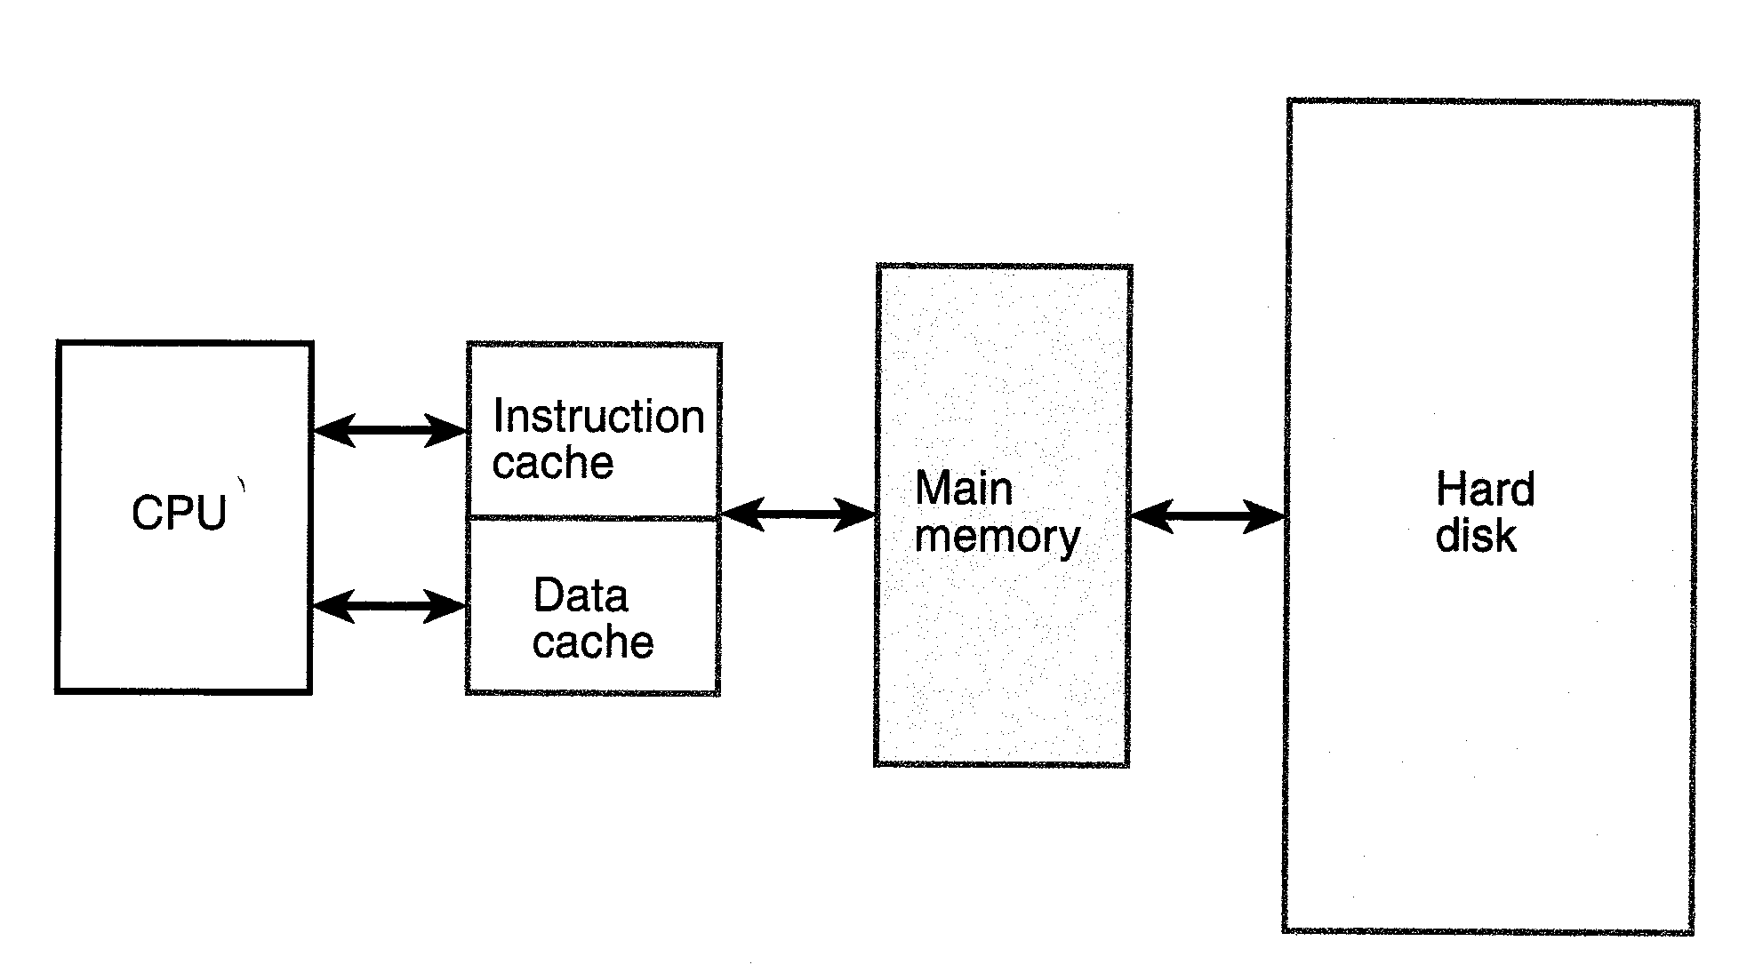

Slide 42
Memory Systems: Hierarchy
Concept of an infinite cache:
fetches by the CPU for instructions or data normally come from cache (say 95% of time)
if instructions or operands are not in cache, a "miss" occurs and CPU waits while MMU (memory management unit) goes to main memory for the missing instruction or operand
on the very rare occasion that the operand or instruction is not in main memory, the CPU must go to the hard disk to find it (while the processor either waits idle or branches)
most of the time the instructions/data are available in cache giving the appearance of a large, fast memory!
Memory addressing: 32 bit address can access 4 GB of data/instructions
Speed & Cost of 4GB DRAM Main Memory:
if all memory were only main memory (DRAM), 4 GB would cost $24,000 at $6/MB
access time would be only 50 ns, rather than the 2-3 ns obtainable with on-board cache
Memory hierarchy is essential to achieving high speed, large memory, & low cost!!!

Slide 43
Why it works: Locality of Reference
temporal locality
programs tend to contain loops (often nested loops) where an instruction and/or data are accessed many times in sequence
spacial locality
instructions and/or data that are stored in contiguous (neighboring) locations are often repeatedly accessed for reading or writing in a typical program
memory heirarchy makes use of temporal and spacial locality by transferring at one time a group of instructions/data into cache or into main memory
A group of instructions or data transferred from main memory into cache is called a line of data (say 32 bytes)
A group of instructions or data transferred from disk storage into main memory is called a page of data (say 4K bytes)

Slide 44
Virtual memory = the appearance that all 4GB addressable memory resides in main memory
Studies of the execution of computer programs have demonstrated the importance of locality of reference in designing a hierarchical memory system.
Temporal and spacial locality allow us to achieve a near infinite cache in practice for the operation of most computer programs!
thrashing = phenomenon of frequent disk accesses due to a particular program perhaps accessing a database which does not fit entirely into main memory
Solution: need a larger main memory!

Slide 45
Cache Memory Organization
Cache organization schemes:
direct mapped
fully associative
set-associative
Line: A block of data transferred into cache at a given time (4B in text illustrations)
the memory address is comprised of 5 bit tag, 3 bit index, and 2 bit byte fields
the cache stores both the data (line) as well as the main memory address (tag) of the data

Slide 46
Hit and Miss
When CPU requests data from cache, the address of requested data is compared with addresses of data in cache. If both tag and index addresses match (called a cache hit), the requested data is present in cache
data word (or byte) is transferred to CPU
If the address of requested data does not match tag plus index address of data present in cache, the cache signals the CPU that a cache miss has occurred.
Main memory transfers a new line (containing the requested data word) into the cache and also sends the requested word (or byte) along to the CPU
When a cache miss occurs and a new line of data is to be transferred in from main memory, the cache is likely already full of existing data lines so that one of them needs to be replaced with the new data line. If the line to be replaced has been changed since it was brought in from main memory, it must be written back into main memory first.

Slide 47
Direct Mapped Cache
cache address given by the index address bits
Example at left: 8 lines stored in cache with 3 index address bits
a memory line can be mapped to only one location in cache given by the index address
on a cache access, tag bits for given index are compared with the CPU address tag bits
cache hit: tag bits are identical to address tag
word is fetched from cache and sent on the bus to the CPU
cache miss: tag bits do not match address tag bits →
cache sends signal to main memory to fetch the correct line with matching tag address bits
new line of data (or instructions) is sent both to the CPU and to update the cache
direct mapping is not usually the most optimum for improving cache hit ratio due to allowing only one index address in cache at any one time

Slide 48
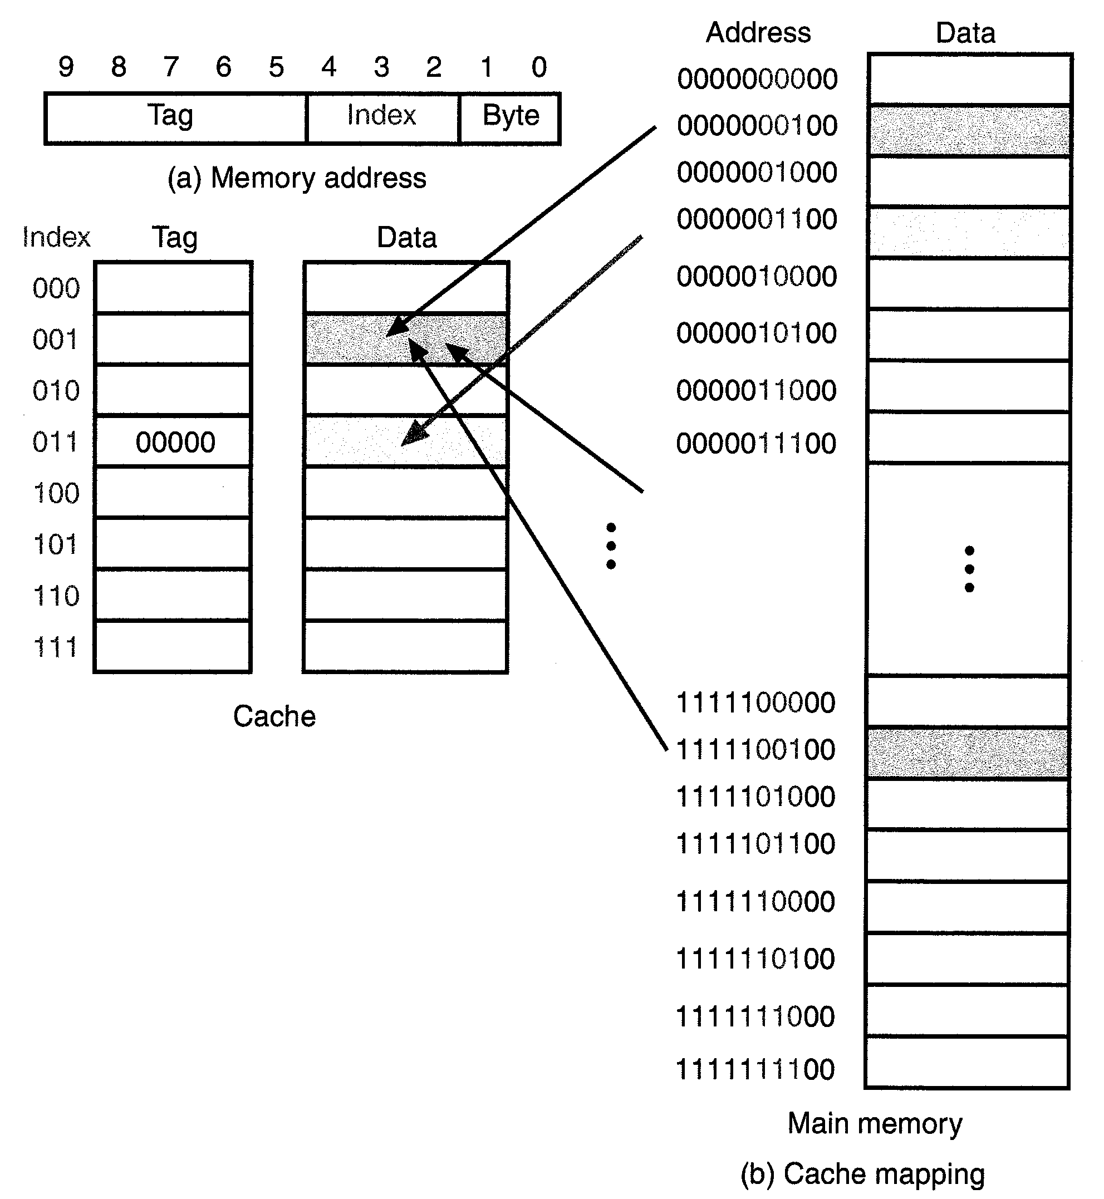

Slide 49
Fully Associative Cache Mapping
Any memory line can be placed into any location in the cache
no limitation to only store one line of data for a given index address as in the direct mapped cache
Tag address now includes the three bits that were previously labeled index address
When a request for data comes from the CPU, the entire main memory tag address must be compared with all tag addresses presently residing in the cache (next chart), to see if the requested data word is in the cache.
If not, a miss occurs and a new data line (with the requested word) is brought into the cache from main memory

Slide 50
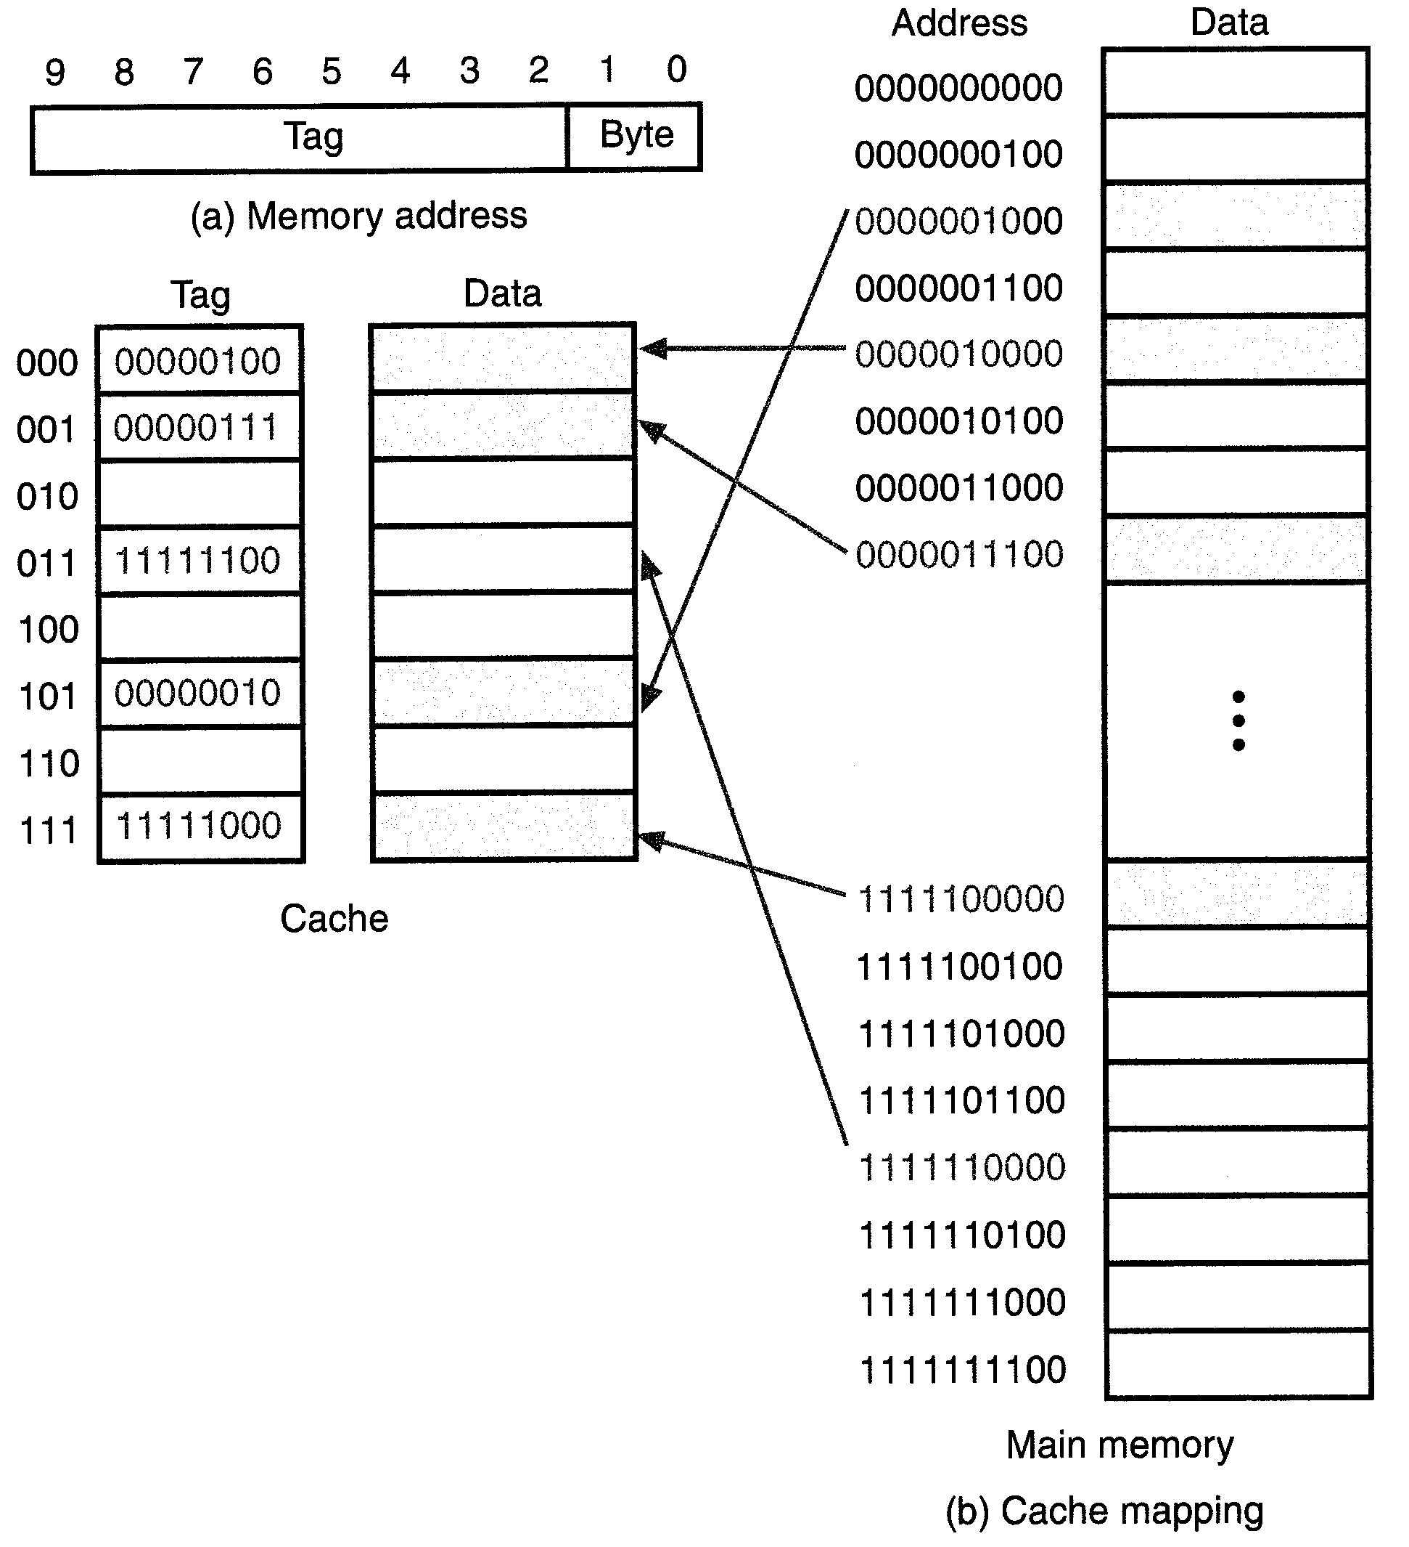

Slide 51
Two-way Set Associative Cache Mapping
A set associative cache is a compromise between direct mapped and fully associative cache approaches
Index bits again specify cache (set) address
can have two lines of data per set (2-way set associative) with two different tag addresses or four lines of data per set (4-way set associative) with four different tag addresses
Example at left: 2 index bits → 4 sets with two-way set associative organization
more realistic example: 16KB cache with 4-way set associativity, 16 bit address
line size = 16 words = 64 bytes → 256 lines in the cache
4 groups of 64 sets of 64B lines in the cache → 6 bits in index address, 6 bits for word & byte fields
with a 16 bit address, there would be 4 bits left for the tag address

Slide 52
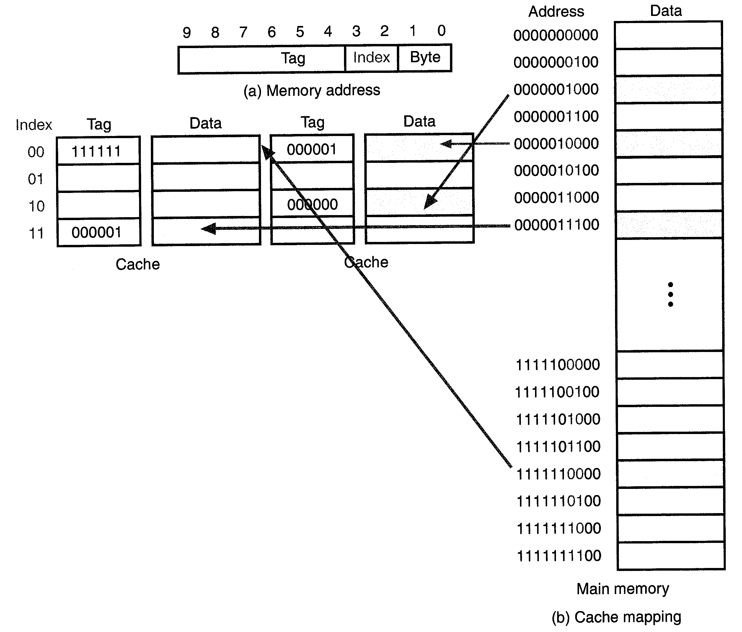

Slide 53
Set-Associative Cache Block Diagram
Cache must have logic to perform 2-way or 4-way compare of cache tag bits with CPU address tag bits
if tag bits in cache match the CPU tag address, one of the match logic outputs is “1”
the selected word is gated out to the CPU/Main Memory bus by the tri-state buffer
only one match can occur for a given tag address
a logic OR gate pulls Hit/Miss’ line high to signal to CPU a Hit is achieved
If the Tag address from CPU does not match any stored Tags, then both Match logic circuits give zero outputs, pulling the Hit/Miss’ line low to signal the CPU and main memory that a cache Miss has occurred.

Slide 54
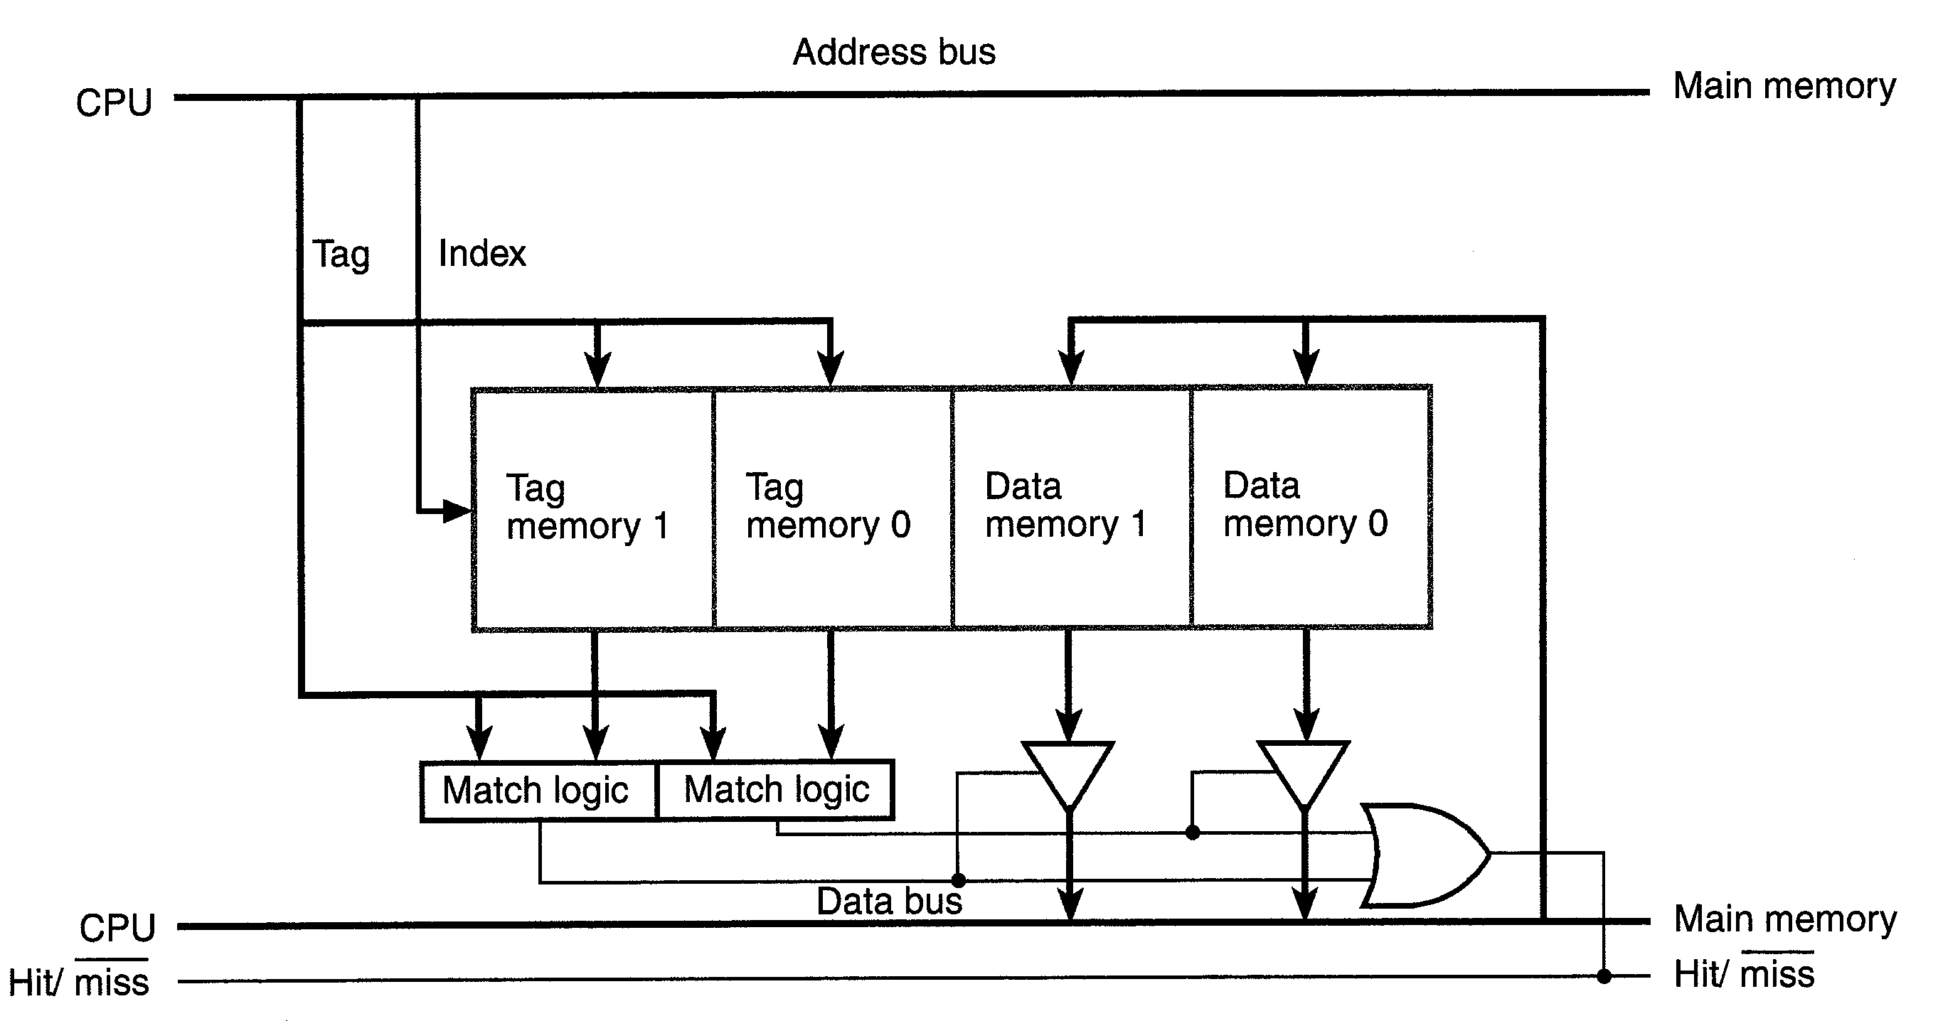

Slide 55
Set-Associative Cache with 4-word Lines
Cache lines are normally defined to contain many words
2^{n} where n is the number of bits in the Word address field
(earlier examples had assumed only one word per line for simplicity of the charts)
Example below:
a Line contains 4 Words (each Word has 4 Bytes) implying 2 address bits in the Word field
the Index address contains 2 bits implying 4 sets of lines specified by the Index address
10 bit address implies 4 bits in the Tag address field
2-way set associative organization implies that a given line of data can be in either the “left” or “right” side of the cache at the specified location given by index address bits

Slide 56
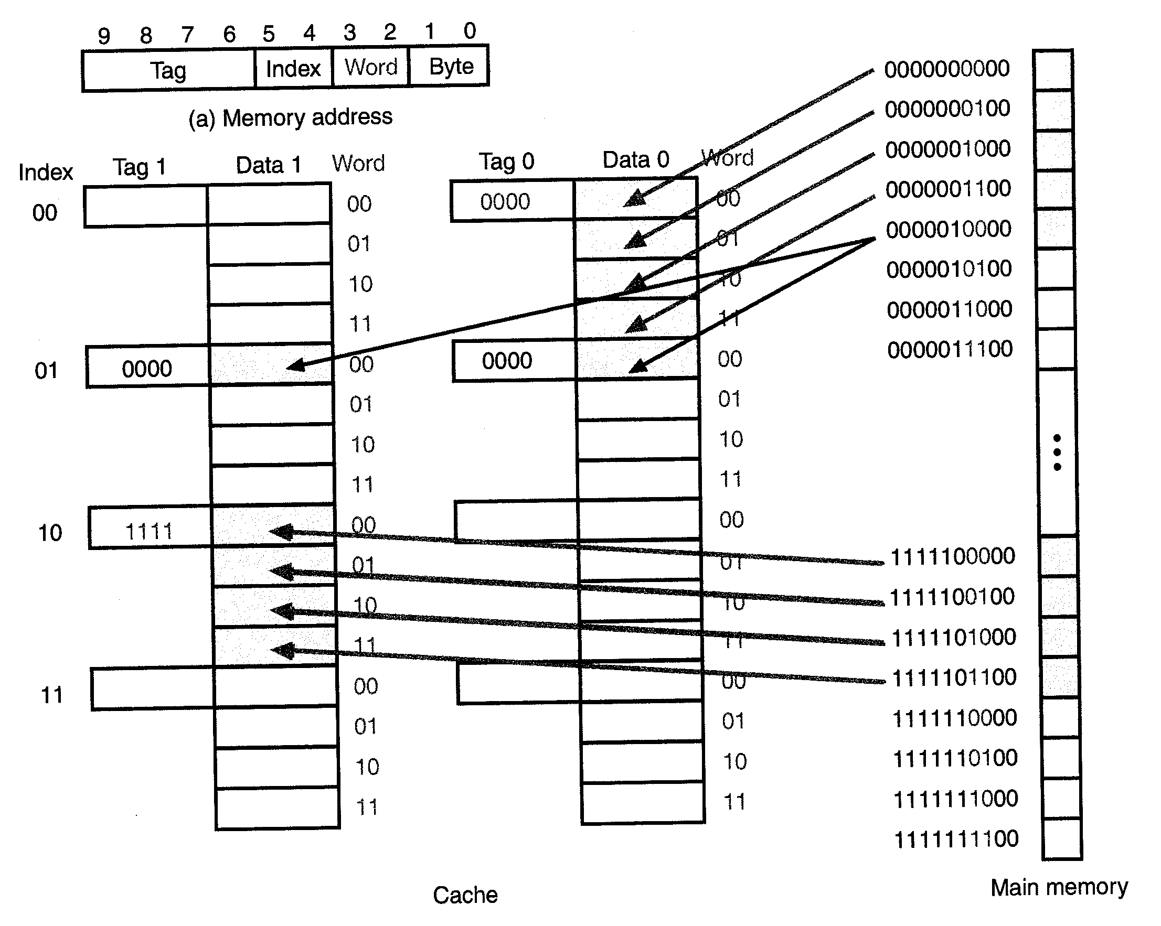

Slide 57
Cache Write/Replacement Method
Cache Replacement Algorithm:
In the event of a cache miss, assuming all lines are filled in the cache, some existing line must be replaced by the new line brought in from main memory! Which line to replace?
random replacement scheme
FIFO scheme
LRU (least recently used) algorithm
a crude approximation to the LRU approach is often used
Line size: bus between CPU and cache and between cache and memory is made as wide as possible, based on the line size
line size is a tradeoff between bandwidth to cache vs cost and performance limitations

Slide 58
Cache Write Methods:
Write-Through
the result is written to main memory (and to the cache if there is a cache hit)
write buffering sometimes used to avoid a slow down
Write-Back (also called copy-back)
CPU write only to the cache (assuming a cache hit)
if a cache miss occurs, two choices are possible
write-allocate: read the line to be written from main memory and then write to both main memory & cache
write back only to main memory
Valid bit: indicates that the associated cache line is valid
Dirty bit: indicates that a line has been written in cache (dirty in main memory)

Slide 59
256K Cache Example – Block Diagram
256KB memory with 2-way set associativity and write-through approach
32 bit memory address with byte addressing capability
line size = 16 bytes = 4 words → 2 bits each for word address and byte address
index field = 13 bits → 8192 sets
tag field = 15 bits
2-way set associativity → 16,384 line entries in cache = 64K words = 256K bytes

Slide 60
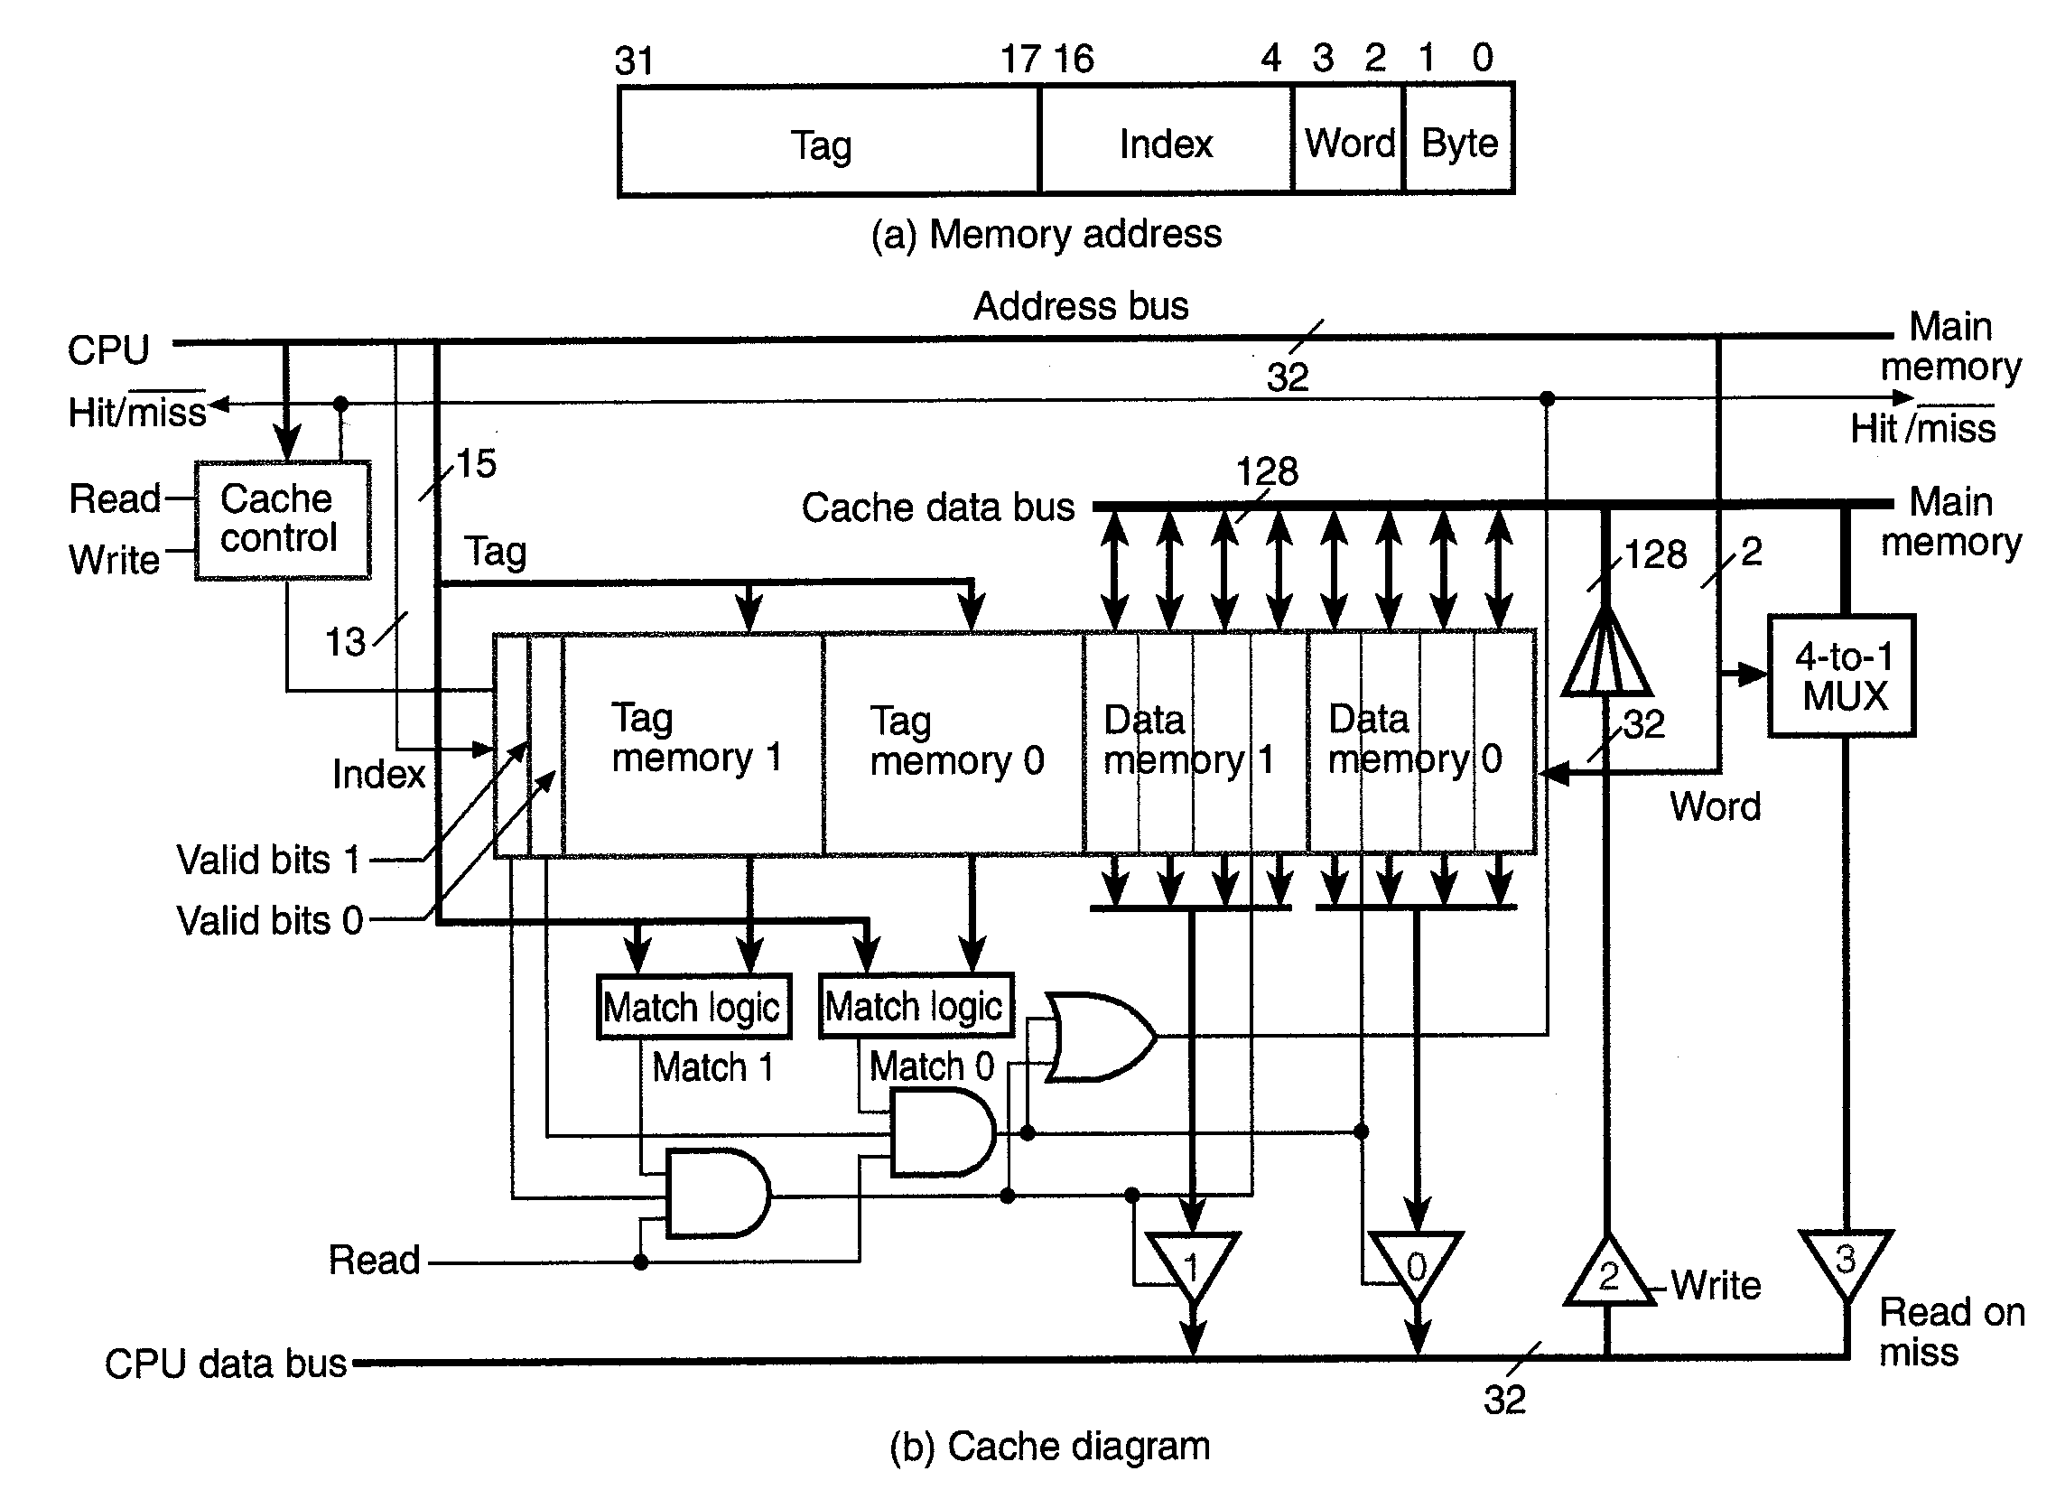

Slide 61
Additional Cache Hierarchy Design Issues
Instruction and Data L1 Caches:
two separate caches for instructions and for data increases bandwidth from CPU to memory
fetch instructions while at same time write or fetch data
two separate caches allows individual (simpler) design
instruction cache may be direct mapping while data cache may be 2-way or 4-way set associative
sometimes a single cache (unified cache) is more economical/practical

Slide 62
Multiple-Level Caches:
a second level of cache (L2) often improves "infinite cache" access time
if L1 cache miss occurs, we go to L2 for instructions/data
L2 access time (latency) may be only 2X-4X longer than L1 cache
improvement over main memory which may be 10X-20X longer latency
allows use of smaller single cycle L1 cache and larger 3-4 cycle L2 cache nearby
L2 may be on a separate chip on the back side of module, or due to recent VLSI advances with 0.18 um and 0.13 um litho capability, it may be on the same chip
example: Intel Coppermine Pentium III
example: AMD Athlon processor
example: recent IBM Power4 PPC processor has 1.5 MB of shared L2 cache on chip with 2 processors each having their own L1 caches

Slide 63
Thank You!

