Slide 1

Cost Elements of a Rapid Transit Project (Final Draft)
Stephen Bridwell, Parastoo Javadi, Prakash Krishnan, Justin Wong
W203 Lab 2 Eels
Fall 2021

Slide 2

Introduction Rapid transit systems include subways, metros, and light rails
Investing in rapid transit systems is very popular across the globe
Rapid transit system offer economic and environmental benefits to local communities
The challenge – It costs 20 times more on a per kilometer basis in New York compared to Seoul, South Korea
Rapid transit system projects are complex - project management, design, civil structures, tracks, signaling systems, maintenance facilities

Slide 3

Research Question
What are the key contributing features that impact the cost of a rapid transit project?
Understand if there are significant differences in costs due to geographic location of a project?

Slide 4
Research Design
Data Identification (dependent and independent variables)
Data wrangling (data cleansing & data mutation)
Distribution of variables and assess variable transformations
Fit linear models
Conduct model tests
Summarize models using Stargazer and compare R squared
Pick the best fitted model
Run CLM Assumptions

Slide 5
Data Identification
Integer
Cost of a Project
Location of a Project
Length of the Tracks
Duration of the Project (years)
Tunnel and Elevated Length
Number of Stations
Decimal
Decimal
Nominal
Integer
Decimal
Factors not considered: Project Management, Politics, Resources and Skill Levels

Slide 6
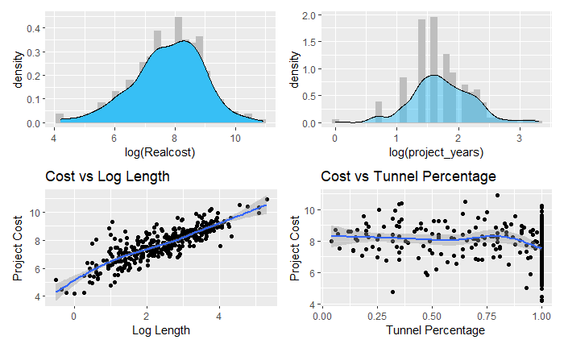
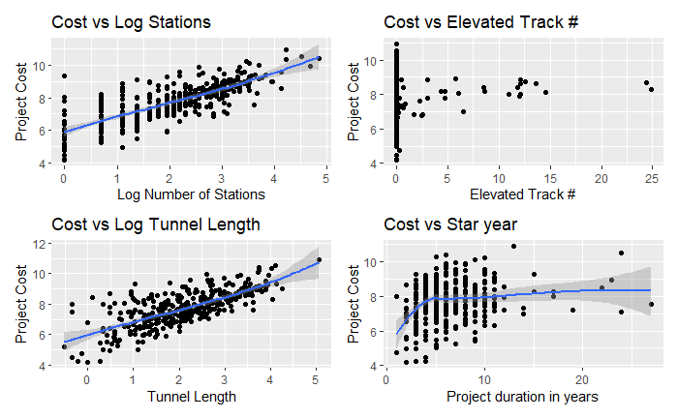
Exploratory Data Analysis
Review discrepancies in data (null values, missing values, incorrect coding, outliers)
Distribution of independent and dependent variables
Relationship of independent and dependent variables

Slide 7
Summary of Exploratory Data Analysis
 | EDA Observation | Action
1 | Tunnel percentage, elevated track length and atgrade length did not show a clear relationship to cost | These variables were not used in model building
2. | Collinearity between length of line with stations and tunnel | Length of the line was not used in the global model selected
3. | Missing or null values | Removed nearly 300 records from the analysis
4. | Non-normal distribution and non-linear distribution | Log transformation of Real Cost, Project Years, Number of Stations, Tunnel Length and Line Length

Slide 8
Regression Models
Measure the independent variables with the strongest statistical significance and highest explanation for the variation in our dependent variable (real cost) for the transit projects.
Understand the contributing features that impact real cost and understand if these features change when considering real cost for specific regions of the world
Model-1
log(Realcost) ~ log(project_years)
Model-2
log(Realcost) ~ log(Tunnel)
Model-3
log(Realcost) ~ log(Stations)
Model-4
log(Realcost) ~ log(Length)
Model-5
log(Realcost) ~ log(project_years) + log(Tunnel)
Model-6
log(Realcost) ~ log(project_years) + log(Tunnel) + log(Stations)
Model-7
log(Realcost) ~ log(project_years) + log(Tunnel) + log(Stations) + log(Length)
Global Model
Asia Model
Europe Model

Slide 9
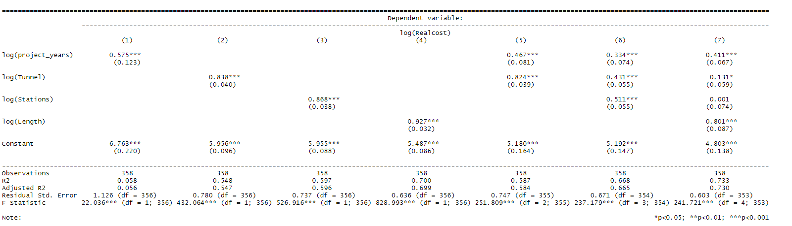
Global Model Results
Rational for Model 6 Selection-
On a global basis, number of stations, tunnel length and duration of the project have the highest statistical power to real cost
Model 6 has an excellent model fit with R2 of 0.668
Strong collinearity bias between length and project cost, length and tunnels, length and stations.
Model 6 had best statistical power of independent variables and explanation in variation of dependent variable real cost.

Slide 10
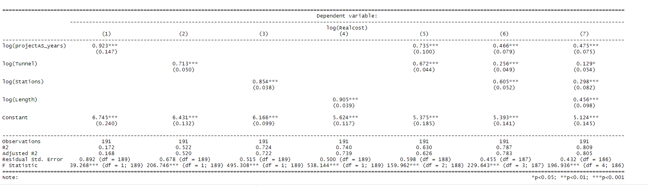
Asia Model Results
Rational for Model 7 Selection-
Model 7 is a good balance of model fit and associated terms
Best represents the description of the log of project cost by project duration, length of tracks in tunnels, number of stations and length of the line
Excellent fit of the model with a large sample size of 191
For Asia projects, duration of the project is a dominant term for cost of the project, followed by length of line and number of stations.
Tunnel length while a significant term is a not dominant factor in describing the cost of the project.

Slide 11
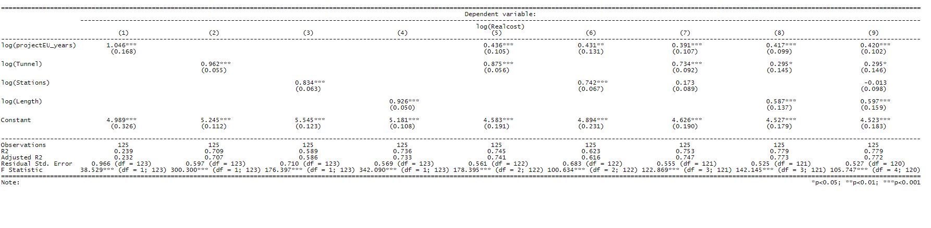
Europe Model Results
Rational for Model 5 Selection-
Model 5 was selected because addition of number of stations and length have collinearity with total tunnel length
Model 8 because we believe the strong correlation between length and cost is our concern for data leakage

Slide 12
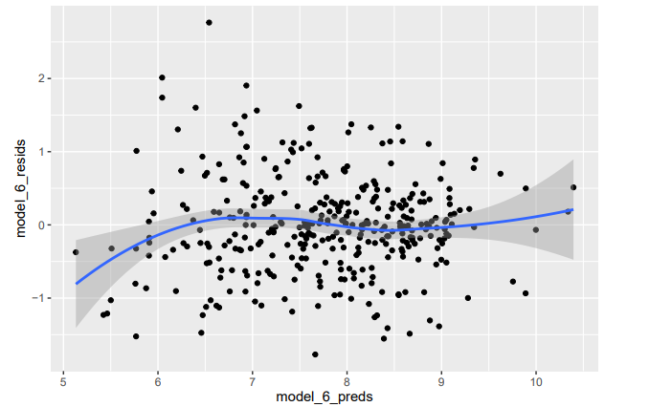
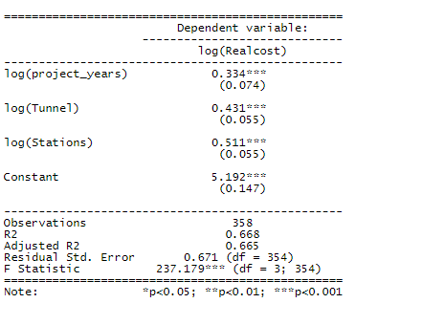
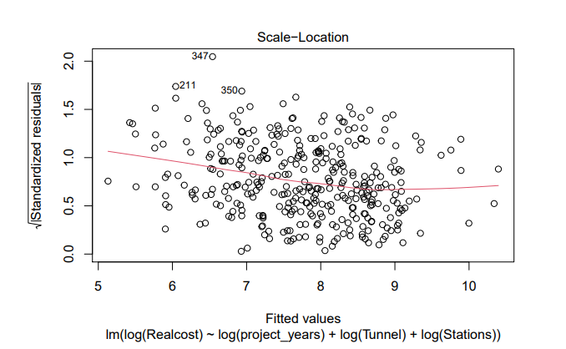
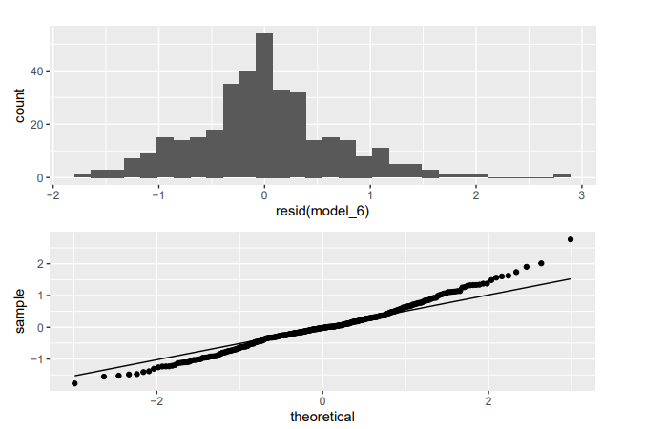
CLM Tests for Global Model
log(Realcost) ~ log(project_years) + log(Tunnel) + log(Stations)
Item | CLM Criteria | Assessment
1. | IID Sampling | Passes IID test based on dataset gathering methods. Potential clustering.
2. | Linear Conditional Expectation | From chart 1, the model shows no obvious residuals’ deviation from 0 on both side of the x-axis. This test confirms that the linear condition expectation is met in this model
3. | No perfect collinearity | From chart 2, there is no evidence of perfect collinearity with the terms. No terms are dropped from the regression model.
4. | Homoscedasticity | From chart 3, plot shows that on the left side the residuals are spreading wider, but as the model progress to the right side the residuals starts to get closer to a normal distribution and the line becomes horizontal. Despite what is stated above, because the angle is not steep, it suggests there is no major problem with homoskedasticity.
5. | Normally distributed errors | Although there is a slight deviation on both side of the Q-Q plot. The residuals distribution matches a normal distribution without any major deviations from normality.
Chart 1: Linear Conditional Expectation Test
Chart 2: Collinearity Test
Chart 3: Homoscedasticity Test
Chart 4: Normally Distributed Error Test

Slide 13
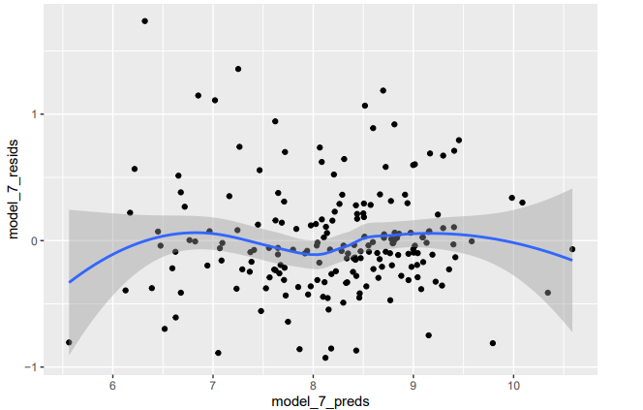
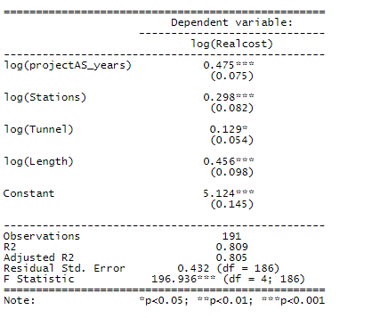
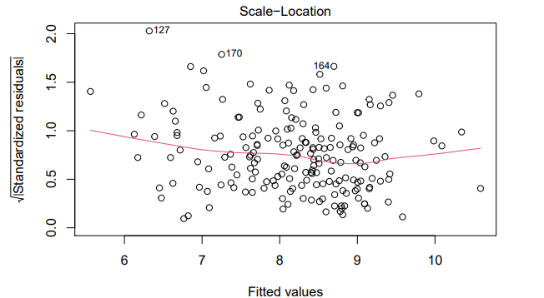
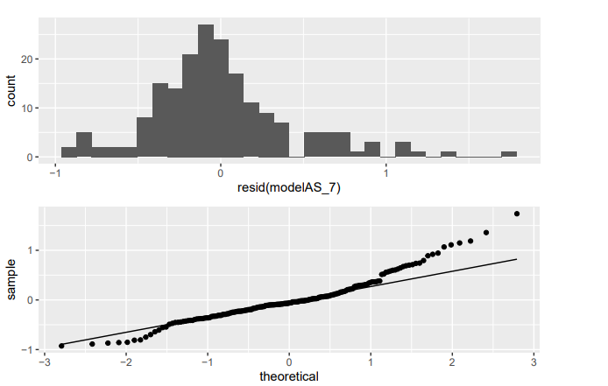
CLM Tests for Asia Model
log(Realcost) ~ log(projectAS_years) + log(Stations) + log(Tunnel) + log(Length)
Item | CLM Criteria | Assessment
1. | IID Sampling | Passes IID test based on dataset gathering methods. Potential clustering.
2. | Linear Conditional Expectation | From chart 1, the model shows no obvious residuals’ deviation from 0 on both side of the x-axis. This test confirms that the linear condition expectation is met in this model. 3
3. | No perfect collinearity | From chart 2, there is no evidence of perfect collinearity with the terms. No terms are dropped from the regression model.
4. | Homoscedasticity | From chart 3, using the scale-location plot, homoskedasticity should show up on this plot as a flat smoothing curve. The above plot shows an almost horizontal line which suggests that there is no major problem with heteroskedasticity.
5. | Normally distributed errors | From chart 4, in both plots, the residual distribution shows a strong deviation from normality on the right side of the plot. This would reject the normally distributed errors requirement of CLM; however, because of the large sample size and central limit theorem we can say the residuals are asymptotically normally distributed.
Chart 1: Linear Conditional Expectation Test
Chart 2: Collinearity Test
Chart 3: Homoscedasticity Test
Chart 4: Normally Distributed Error Test

Slide 14
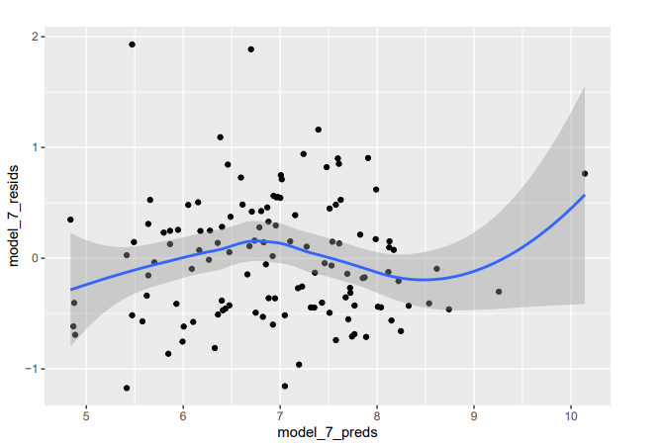
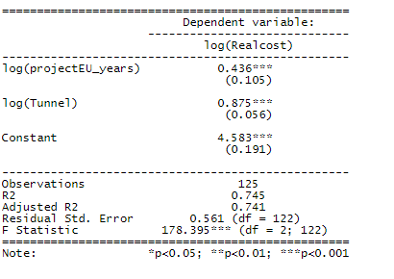
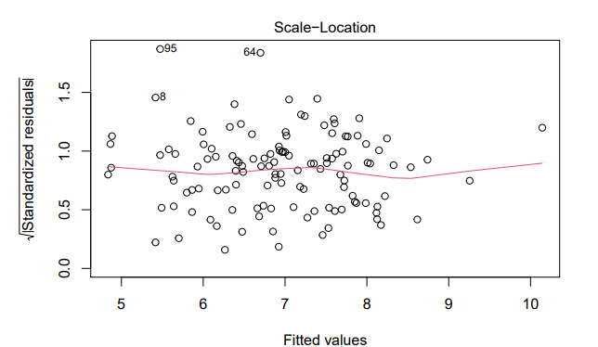
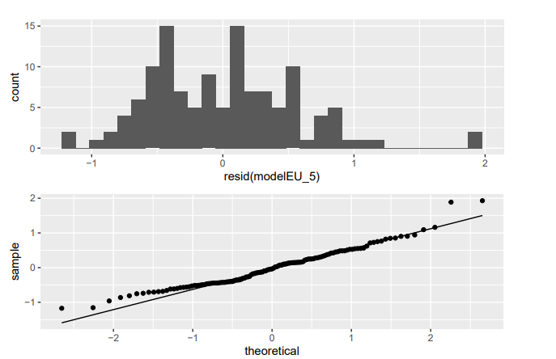
CLM Tests for Europe Model
log(Realcost) ~ log(projectEU_years) + log(Tunnel)
Item | CLM Criteria | Assessment
1. | IID Sampling | Passes IID test based on dataset gathering methods. Potential clustering.
2. | Linear Conditional Expectation | From chart 1, the model shows no obvious residuals’ deviation from 0. This test confirms that the linear condition expectation is met in this model
3. | No perfect collinearity | From chart 2, there is no evidence of perfect collinearity with the terms. No terms are dropped from the regression model.
4. | Homoscedasticity | From chart 3, using the scale-location plot, homoskedasticity should show up on this plot as a flat smoothing curve. The above plot shows an almost horizontal line which suggests that there is no major problem with heteroskedasticity.
5. | Normally distributed errors | The Q-Q plot and resisual histogram, show a normal residual distribution that meets the normally distributed errors requirement of CLM.
Chart 1: Linear Conditional Expectation Test
Chart 2: Collinearity Test
Chart 3: Homoscedasticity Test
Chart 4: Normally Distributed Error Test

Slide 15
Model Limitations
Statistical Limitations
The sample data only included all transit projects for which public information was available through a variety of sources
Large samples were available for Asia and Europe and N.America, S.America and ANZ samples were much smaller
Collinearity between length and real cost, length with stations and tunnel length
Needed transformation (log) to ensure normal distribution
Structural Limitations
In-tangible costs like quality of project management, availability of skilled resources and local politics have major bearings on project costs.
As an example in reviewing the Green Line Extension in Boston, much of the cost increases were attributed to change from a Democratic Governor to a Republican Governor, cancellation of the project and laying off critical project management personnel.
Large number of records did not have reliable data.

Slide 16
Conclusions
Global Model
Global model:
10% increase in number of stations results in 5.1% increase in real cost
10% increase in tunnel length results in 4.3% increase in real cost
10% increase in project duration results in 7.4% increase in real cost
Asia model:
10% increase in number of stations results in 8.2% increase in real cost
10% increase in tunnel length results in 5.4% increase in real cost
10% increase in project duration results in 7.5% increase in real cost
10% increase in length of kine results in 9.8% increase in cost
Europe model:
10% increase in project duration results in 10.5% increase in real cost
10% increase in tunnel length results in 5.6% increase in cost
Asia Model
Europe Model

